Slide 1
Civil Disobedience.js

Slide 2


Slide 3


Slide 4
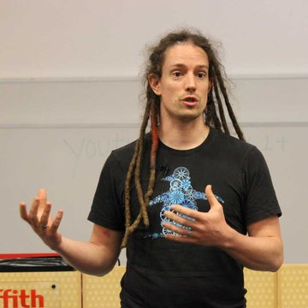

Slide 5


Slide 6


Slide 7


Slide 8
Data Retention

Slide 10


Slide 11


Slide 12


Slide 13

Creating noise-as-a-service, as an act of civil disobedience, that attacks the wholesale surveillance of Australian citizens under the data retention program.

Slide 14
https://github.com/bendechrai/squawk

Slide 15
