Slide 1
About Me
Blog - and where you can find the examples:http://bendemott.blogspot.com/
What is my job?
Lead Developer at Riders Discount in Holland, MI
Hobbies
Python, OpenGL Games, Motorcycles

Slide 2
Python: Shapely and Matplotlib
Dependencies
Shapely
RTREE (fast)
Matplotlib

Slide 3
Dependencies
Matplotlib - http://matplotlib.sourceforge.net/
Shapely - http://gispython.org/shapely/docs/1.2/
http://pypi.python.org/pypi/Shapely/1.2.4
RTREE - http://pypi.python.org/pypi/Rtree/

Slide 4
Install (Ubuntu)
Shapely
$ apt-get install python-shapely
Matplotlib
$ apt-get install python-matplotlib python-numpy
RTREE – (compile from src – package is broken)
$ sudo apt-get install libspatialindex-dev libspatialindex-1

Slide 5
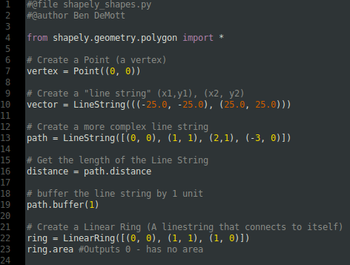
Shapely Shape-Objects

Slide 6
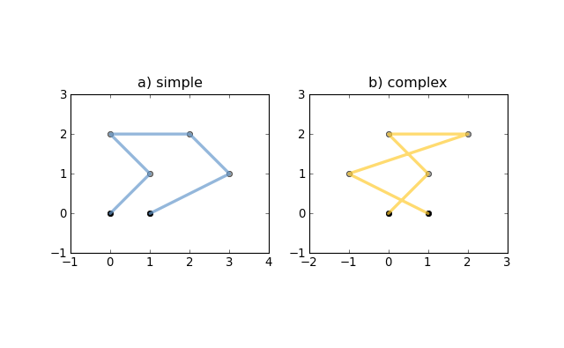
Visualizing Objects line string

Slide 7
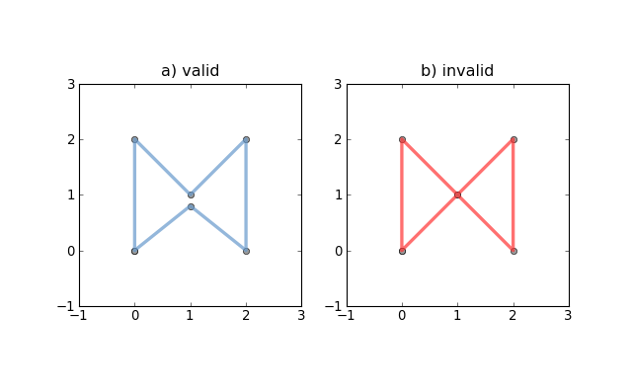
Visualizing Objects linear ring

Slide 8
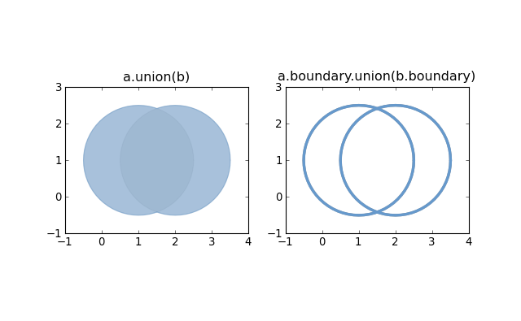
Visualizing Objects

Slide 9
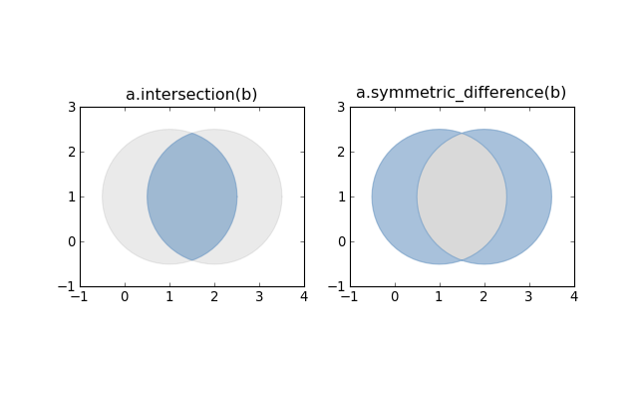
Visualizing Objects

Slide 10
Visualizing Objects

Slide 11
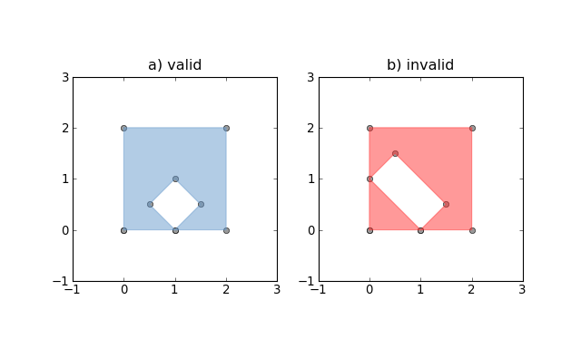
Visualizing Objects
Polgyons

Slide 12
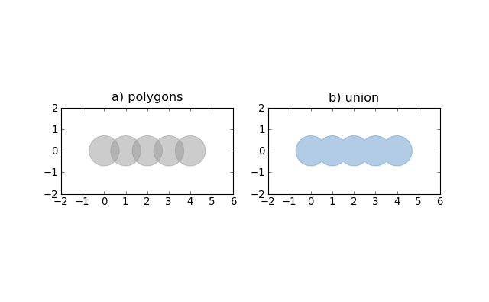
Visualizing Objects unions

Slide 13
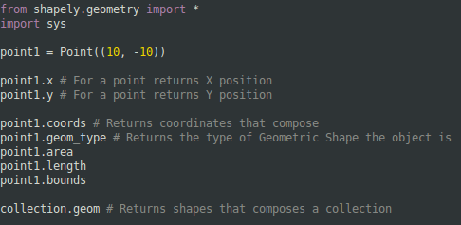
Shapely Object Properties shapely_properties.py

Slide 14
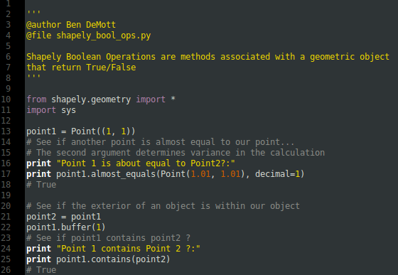
Shapely Boolean Operations

Slide 15
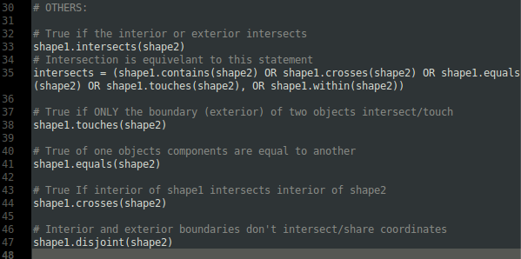
Additional Booleans

Slide 16
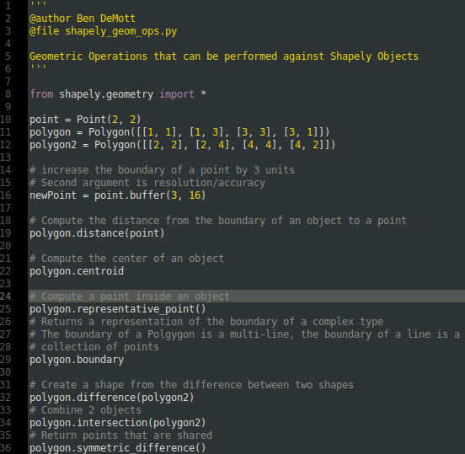
Shapely Geometric Operations

Slide 17
RTREE Introduction
RTree Searches and Stores Bounding-Boxes
Capable of 3-dimensional Indexes
All objects placed into the index are identified by a ”name”
Good for fast bounding box searches, and finding nearest neighbor

Slide 18
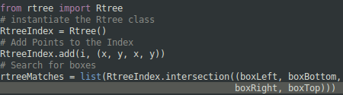

RTREE Search rtree_area_example.py

Slide 19
Matplotlib Introduction
Uses specific modules to plot various types of charts and graphs
Confusing Class Structure
You can plot just about anything you can dream up
Not very efficient, but can output real-time

Slide 20
Styles
Styles are represented by strings
'r' red line, 'g' green line, 'y' yellow line
'ro' red dots as markers, 'r.' smaller red dots, 'r+' red pluses
'r--' red dashed line, 'g^' green triangles, 'bs' blue squares
'rp' red pentagons, 'r1', 'r2', 'r3', 'r4'

Slide 21
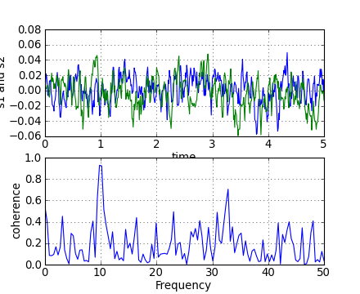
Pretty Pictures (ooo aaaa)

Slide 22
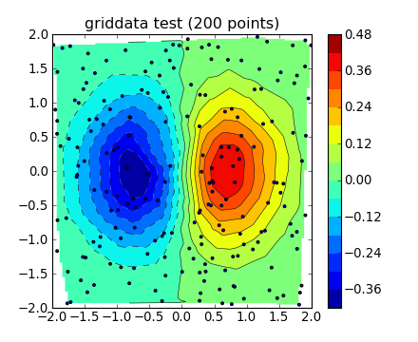
Pretty Pictures (ooo aaaa)

Slide 23
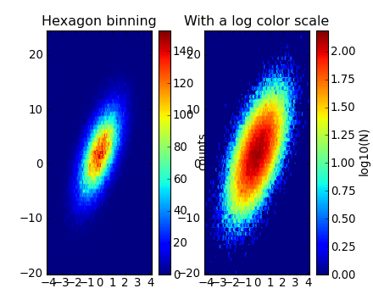
Pretty Pictures (ooo aaaa)

Slide 24
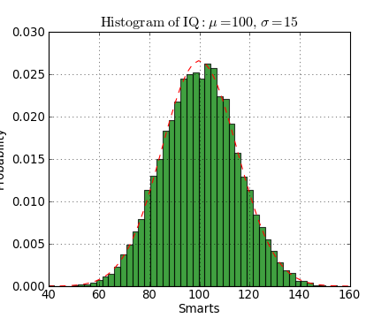
Pretty Pictures (ooo aaaa)

Slide 25
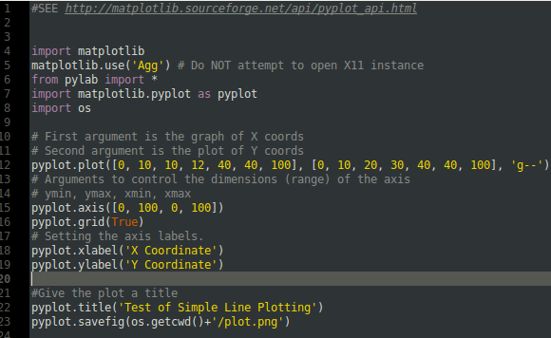
Basic Plotting Example rtree_area_example.py

Slide 26
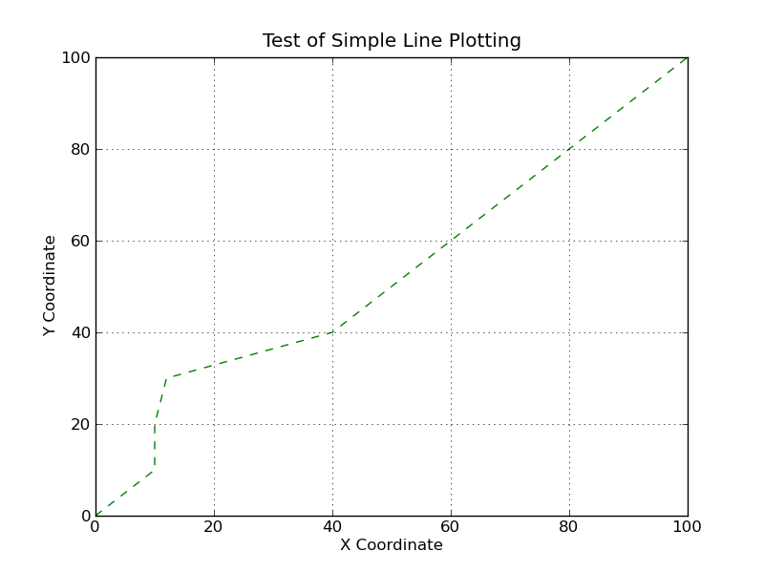
Results

Slide 27
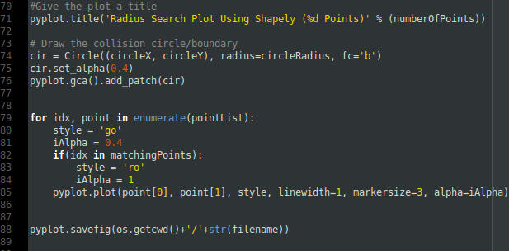
Radius Search Plot shapely_radius_plot.py

Slide 28
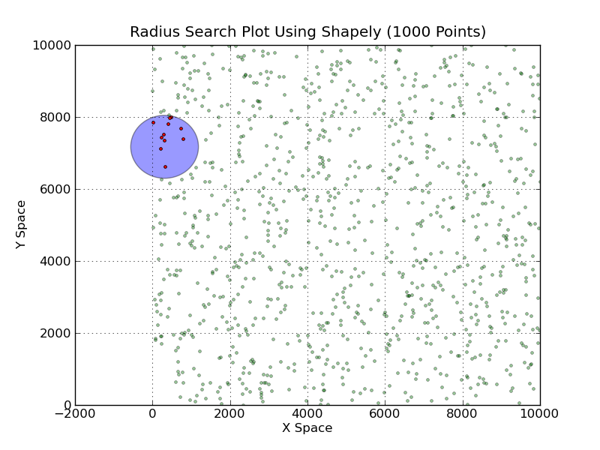
Results

Slide 29
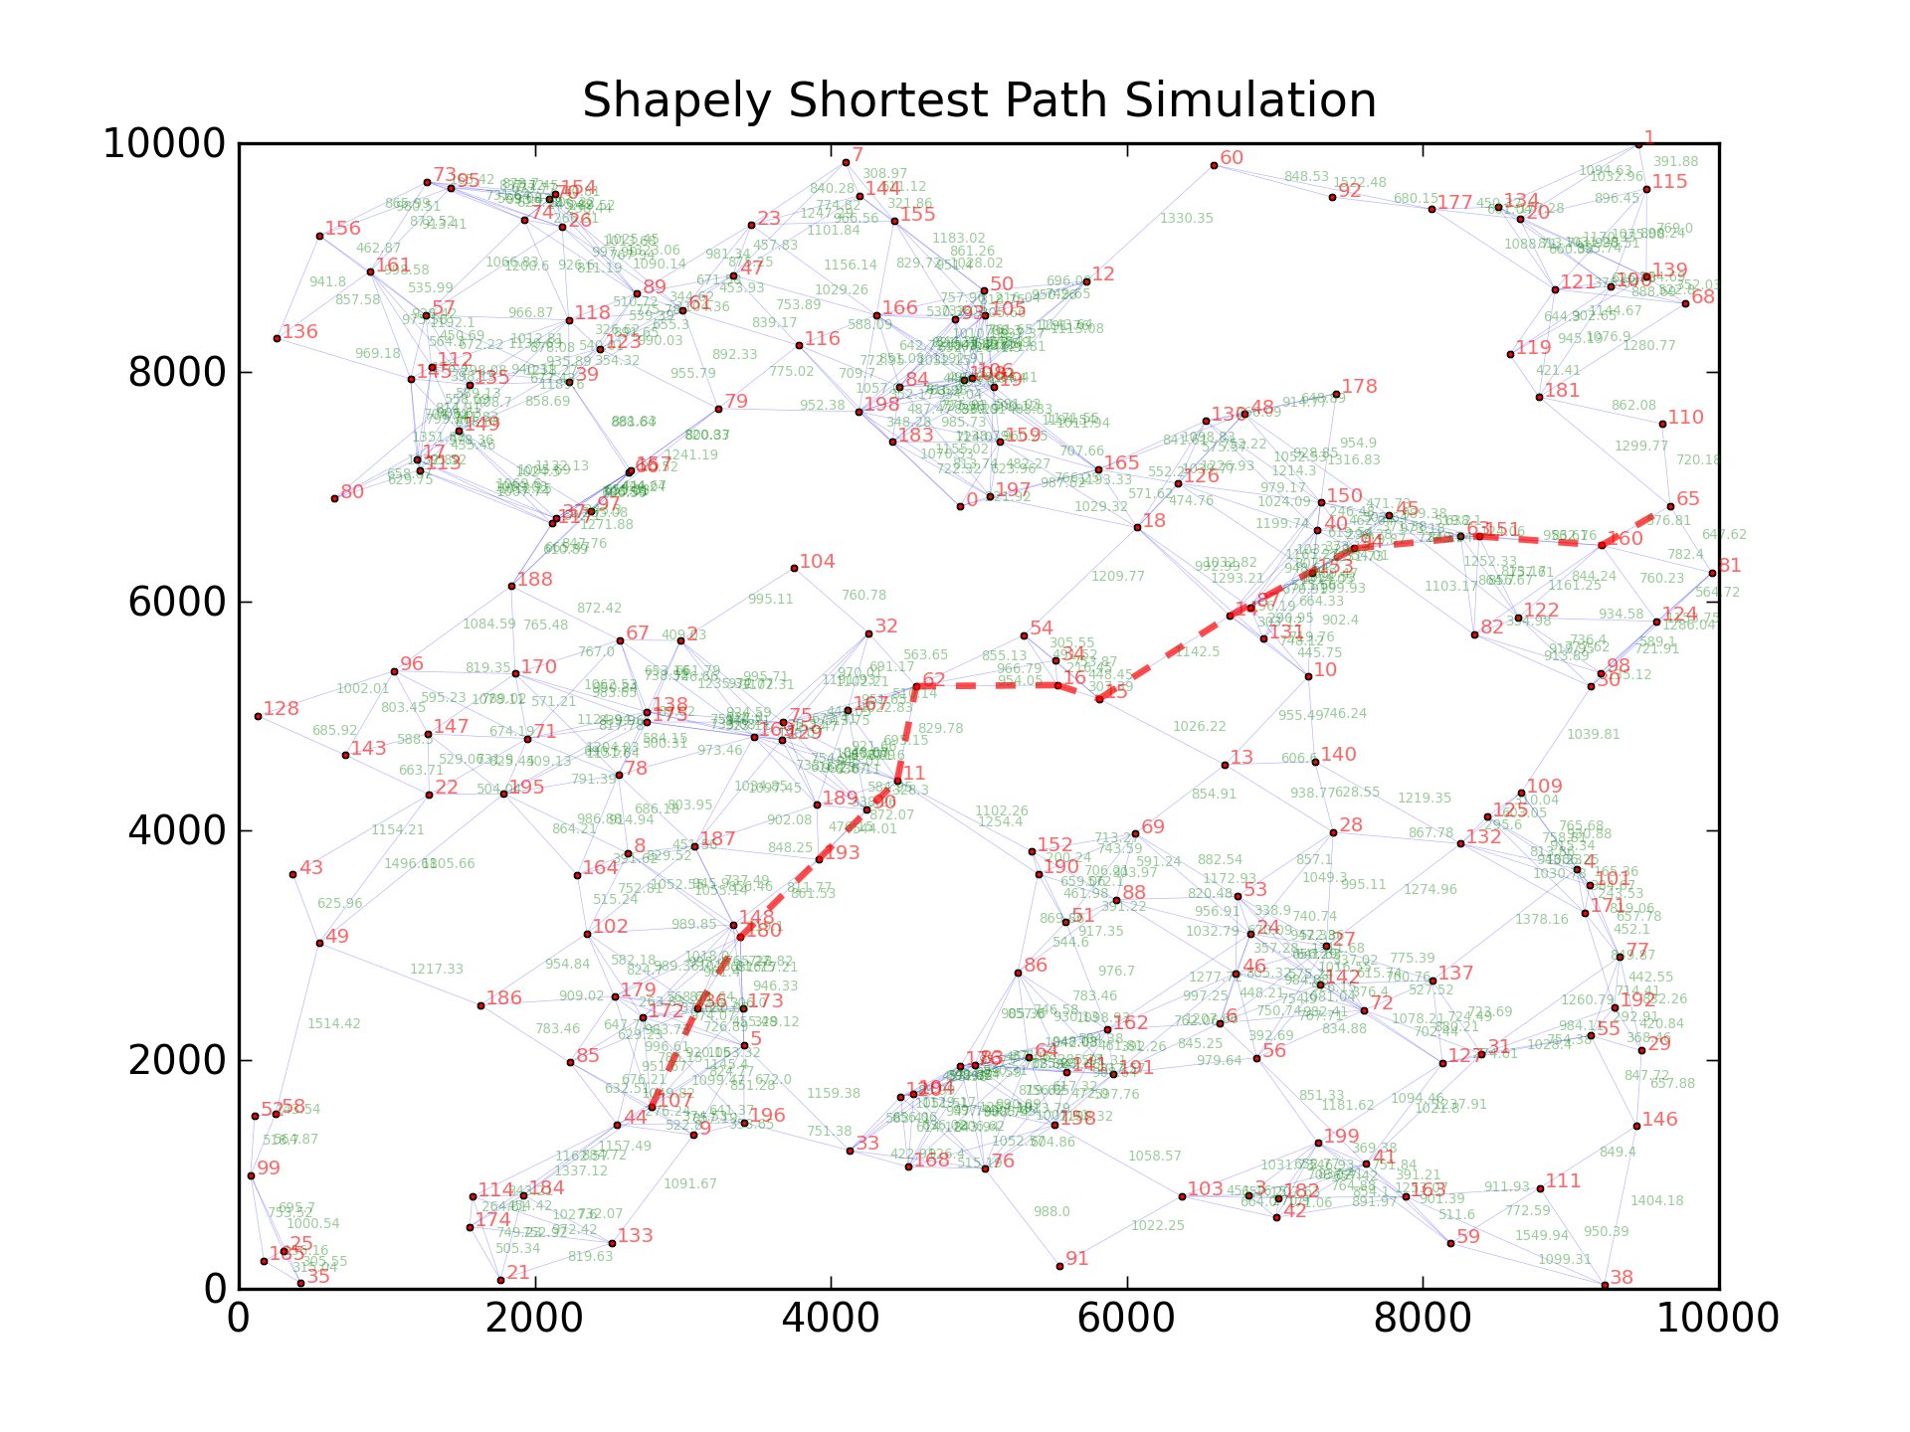
Dijkstra Plot

Slide 30
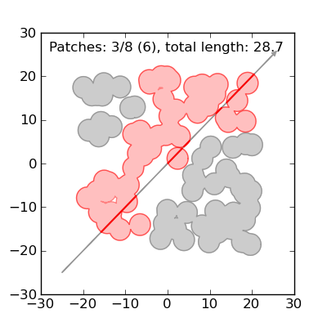
Intersection

