Slide 1


Slide 2

U Mad? Binary Analysis with the Angr Framework
Ben Denton, PhD. | DESE Research, Inc.
bdenton@dese.com | @b_denton

Slide 3

Intro
What is binary analysis?
What is angr? (An unapologetic oversimplification)
Demos!

Slide 4
What is Binary Analysis?
Software bugs have taken down spaceships¹, caused nuclear centrifuges to spin out of control ², and forced the recall of 100,000s of vehicles resulting in billions of dollars in damages ³.
How can you find these bugs when source code is unavailable?
Reverse Engineering, Vulnerability Assessment, and Binary Analysis
Process: Disassemble, Triage, Understand, Analyze, Symbolize.
¹ Ariane 5: Who Dunnit? https://ieeexplore.ieee.org/document/589224/
² Lessons from Stuxnet https://ieeexplore.ieee.org/document/5742014/
³ A Case Study of Toyota Unintended Acceleration and Software Safety https://users.ece.cmu.edu/~koopman/pubs/koopman14_toyota_ua_slides.pdf

Slide 5

What is angr?
Binary Analysis Framework developed by the University of California Santa Barbara since 2013.
Features:
iPython accessible
Powerful analyses
Versatile
Open and expandable
Architecture “independent”
Binary Loader
Intermediate Representation
Data Model Abstraction
Symbolic Execution Engine
angr

Slide 6
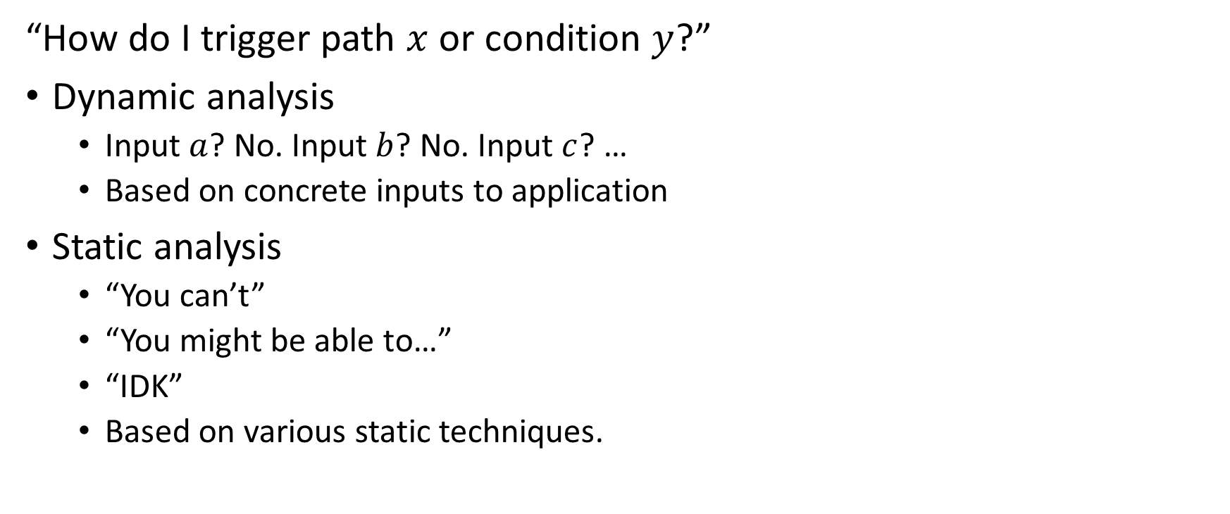
Software Analysis
“How do I trigger path $x$ or condition $y$?”
Dynamic analysis
Input $a$? No. Input $b$? No. Input $c$? …
Based on concrete inputs to application
Static analysis
“You can’t”
“You might be able to…”
“IDK”
Based on various static techniques.
???

Slide 7
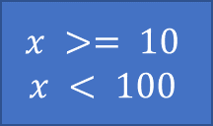
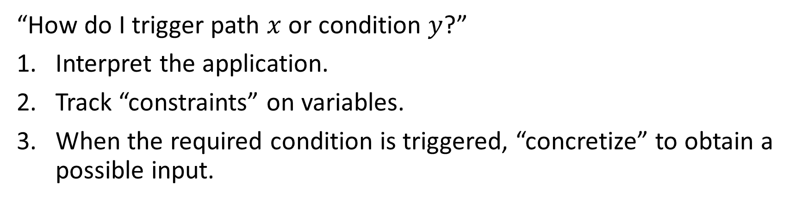
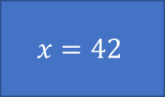
Symbolic Execution
“How do I trigger path $x$ or condition $y$?”
Interpret the application.
Track “constraints” on variables.
When the required condition is triggered, “concretize” to obtain a possible input.
Constraints
Concretize
$$x=42$$
$$x >= 10$$
$$x < 100$$

Slide 8
Symbolic Execution Example
def f (x, y):
if (x > y):
x = x + y
y = x – y
x = x – y
if (x – y > 0):
call g()
return (x, y)
This function swaps the values of x and y when x > y.
The x – y > 0 statement is always false so the call is unreachable.
Source code is here but our techniques allow for the same analysis without source code.
Notes:
Why is this important?
This capability (and others) enables advanced and automated program analysis that was not possible 10 years ago.

Slide 9
Symbolic Execution Example
def f (x, y):
if (x > y):
x = x + y
y = x – y
x = x – y
if (x – y > 0):
call g()
return (x, y)
Execute the program on symbolic values.
Notes:
Why is this important?
This capability (and others) enables advanced and automated program analysis that was not possible 10 years ago.

Slide 10
Symbolic Execution Example
x → A
y → B
def f (x, y):
if (x > y):
x = x + y
y = x – y
x = x – y
if (x – y > 0):
call g()
return (x, y)
Execute the program on symbolic values.
Symbolic state maps variables to symbolic values.
Notes:
Why is this important?
This capability (and others) enables advanced and automated program analysis that was not possible 10 years ago.

Slide 11
Symbolic Execution Example
x → A
y → B
def f (x, y):
if (x > y):
x = x + y
y = x – y
x = x – y
if (x – y > 0):
call g()
return (x, y)
Execute the program on symbolic values.
Symbolic state maps variables to symbolic values.
Path condition is a quantifier-free formula over the symbolic inputs that encodes all branch decisions take so far.
A > B
A ≤ B
Notes:
Why is this important?
This capability (and others) enables advanced and automated program analysis that was not possible 10 years ago.

Slide 12
Symbolic Execution Example
x → A
y → B
def f (x, y):
if (x > y):
x = x + y
y = x – y
x = x – y
if (x – y > 0):
call g()
return (x, y)
Execute the program on symbolic values.
Symbolic state maps variables to symbolic values.
Path condition is a quantifier-free formula over the symbolic inputs that encodes all branch decisions take so far.
All paths in the program form its execution tree, in which some paths are feasible and some are infeasible.
A > B
A ≤ B
x → A
y → B
feasible
Notes:
Why is this important?
This capability (and others) enables advanced and automated program analysis that was not possible 10 years ago.

Slide 13
Symbolic Execution Example
x → A
y → B
def f (x, y):
if (x > y):
x = x + y
y = x – y
x = x – y
if (x – y > 0):
call g()
return (x, y)
Execute the program on symbolic values.
Symbolic state maps variables to symbolic values.
Path condition is a quantifier-free formula over the symbolic inputs that encodes all branch decisions take so far.
All paths in the program form its execution tree, in which some paths are feasible and some are infeasible.
A > B
A ≤ B
x → A + B
y → B
x → A
y → B
true
feasible
x → A + B
y → A
true
x → B
y → A
Notes:
Why is this important?
This capability (and others) enables advanced and automated program analysis that was not possible 10 years ago.

Slide 14
Symbolic Execution Example
x → A
y → B
def f (x, y):
if (x > y):
x = x + y
y = x – y
x = x – y
if (x – y > 0):
call g()
return (x, y)
Execute the program on symbolic values.
Symbolic state maps variables to symbolic values.
Path condition is a quantifier-free formula over the symbolic inputs that encodes all branch decisions take so far.
All paths in the program form its execution tree, in which some paths are feasible and some are infeasible.
A > B
A ≤ B
x → A + B
y → B
x → A
y → B
true
feasible
x → A + B
y → A
true
x → B
y → A
B - A > 0
B - A ≤ 0
Notes:
Why is this important?
This capability (and others) enables advanced and automated program analysis that was not possible 10 years ago.

Slide 15
Symbolic Execution Example
x → A
y → B
def f (x, y):
if (x > y):
x = x + y
y = x – y
x = x – y
if (x – y > 0):
call g()
return (x, y)
Execute the program on symbolic values.
Symbolic state maps variables to symbolic values.
Path condition is a quantifier-free formula over the symbolic inputs that encodes all branch decisions take so far.
All paths in the program form its execution tree, in which some paths are feasible and some are infeasible.
A > B
A ≤ B
x → A + B
y → B
x → A
y → B
true
feasible
x → A + B
y → A
true
x → B
y → A
B - A > 0
B - A ≤ 0
x → B
y → A
infeasible
Notes:
Why is this important?
This capability (and others) enables advanced and automated program analysis that was not possible 10 years ago.

Slide 16
Symbolic Execution Example
x → A
y → B
def f (x, y):
if (x > y):
x = x + y
y = x – y
x = x – y
if (x – y > 0):
call g()
return (x, y)
Execute the program on symbolic values.
Symbolic state maps variables to symbolic values.
Path condition is a quantifier-free formula over the symbolic inputs that encodes all branch decisions take so far.
All paths in the program form its execution tree, in which some paths are feasible and some are infeasible.
A > B
A ≤ B
x → A + B
y → B
x → A
y → B
true
feasible
x → A + B
y → A
true
x → B
y → A
B - A > 0
B - A ≤ 0
x → B
y → A
x → B
y → A
infeasible
feasible
Notes:
Why is this important?
This capability (and others) enables advanced and automated program analysis that was not possible 10 years ago.

Slide 17
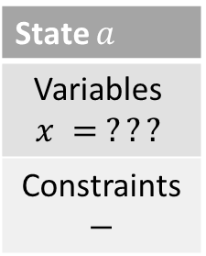
Symbolic Execution Example
x = int (input())
if x ≤ 10:
if x < 100:
print “Two!”
else:
print “Lots!”
else:
print “One!”
State $a$
Variables $$x = ???$$
Constraints $$−$$

Slide 18
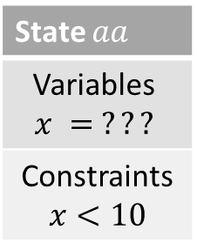
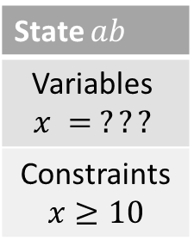
Symbolic Execution Example
x = int (input())
if x ≤ 10:
if x < 100:
print “Two!”
else:
print “Lots!”
else:
print “One!”
State $a$
Variables $$x = ???$$
Constraints $$−$$
State $aa$
Variables $$x = ???$$
Constraints $$x<10$$
State $ab$
Variables $$x = ???$$
Constraints $$x≥10$$

Slide 19
Symbolic Execution Example
State $aa$
Variables $$x = ???$$
Constraints $$x<10$$
State $ab$
Variables $$x = ???$$
Constraints $$x≥10$$
x = int (input())
if x ≤ 10:
if x < 100:
print “Two!”
else:
print “Lots!”
else:
print “One!”

Slide 20
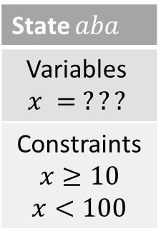
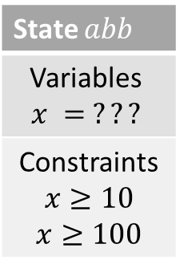
Symbolic Execution Example
State $aa$
Variables $$x = ???$$
Constraints $$x<10$$
State $ab$
Variables $$x = ???$$
Constraints $$x≥10$$
x = int (input())
if x ≤ 10:
if x < 100:
print “Two!”
else:
print “Lots!”
else:
print “One!”
State $aba$
Variables $$x = ???$$
Constraints $$x≥10$$ $$x<100$$
State $abb$
Variables $$x = ???$$
Constraints $$x≥10$$ $$x≥100$$

Slide 21
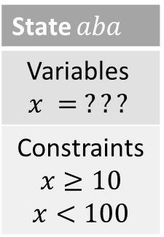
Symbolic Execution Example
x = int (input())
if x ≤ 10:
if x < 100:
print “Two!”
else:
print “Lots!”
else:
print “One!”
State $aba$
Variables $$x = ???$$
Constraints $$x≥10$$ $$x<100$$

Slide 22
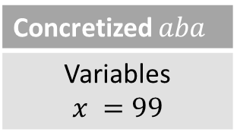
Symbolic Execution Example
x = int (input())
if x ≤ 10:
if x < 100:
print “Two!”
else:
print “Lots!”
else:
print “One!”
State $aba$
Variables $$x = ???$$
Constraints $$x≥10$$ $$x<100$$
Concretized $aba$
Variables $$x =99$$

Slide 23
Demo: crackme
Available at https://github.com/bendenton/2018_NCS

Slide 24
Demo: crackme2
Available at https://github.com/bendenton/2018_NCS

Slide 25
Demo: crackme3
Available at https://github.com/bendenton/2018_NCS

Slide 26

Questions?
bdenton@dese.com
https://github.com/bendenton/2018_NCS
https://www.linkedin.com/in/ben-denton/

