Slide 1
Vision and future directions
NWB:N technologies at the heart of the neurodata lifecycle
Preservation
Planning
Centralized and distributed data archives
Backward compatibility & standardization
Data lifecycle management strategies
Data Protocols
NWB:N-Hub extension archive
NWB:N software ecosystem & core technologies
Governance
Acquisition
Publication
Integration with data acquisition systems
Data versioning
Data publication strategies
Data archives
NWB:N
Advanced I/O strategies: streaming, compression, staging, …
In situ data pre-processing
Modeling data relationships
Interoperability
Development and integration of controlled vocabularies and ontologies
Semantic-aware & standardized visualization, analysis, and exploration
Workflow management & design
Data integration
Provenance
Automatic capture & extraction of metadata
Integration of NWB:N with workflow tools
Use & Reuse
Alternate storage backends
Analysis & Synthesis
Parallel analysis frameworks
Parallel data search, query & discovery for data-driven analytics
Quality assurance & control (QA/QC)
Data curation & standardization
Governance & protocols
Data ingestion
In situ data analysis
Integration with data archive & management systems
Foreign data fields and references
Discovery & Access
Sharing & Contributing

Slide 2
Previous Versions

Slide 3
Preservation
Planning
Centralized and distributed data archives
Backward compatibility & standardization
Data lifecycle management strategies
Data Protocols
NWB:N-Hub extension archive
NWB:N data software ecosystem & core technologies
Governance
Acquisition
Publication
Integration with data acquisition systems
Data versioning
Data publication strategies
Data archives
NWB:N
Advanced I/O strategies: data streaming, compression, staging, …
In situ data pre-processing
Modeling data relationships
Data interoperability
Development and integration of controlled vocabularies and ontologies
Semantic-aware & standardized visualization, analysis, and exploration
Workflow management & design
Data integration
Data provenance
Automatic capture & extraction of metadata
Integration of NWB:N with workflow tools
Use & Reuse
Alternate storage backends
Analysis & Synthesis
Parallel analysis frameworks
Parallel data search, query & discovery for data-driven analytics
Data quality assurance & control (QA/QC)
Data curation
Data standardization
Governance & protocols
Data ingestion
In situ data analysis
Integration with data archive & data management systems
Foreign data fields and references
Discovery & Access
Sharing & Contributing

Slide 4
Data planning
Data and lifecycle management strategies
Data protocols
Etc.
Contributing
Data curation and quality control
Governance
Data Publications
Data citation and versioning
Data archives
Data acquisition
Integration with data acquisition systems
Advanced I/O strategies (data streaming, compression, staging, in situ etc.)
In situ data analysis etc.
Data Preservation
Centralized and distributed data archives
Backward compatibility & standardization
Analysis and Synthesis
Data exploration tools
Semantic-aware data browser and visualization
Data conversion toolkit
Standardized applications for visualization and processing
Data Discovery & Access
Enabling data search, query, and discovery for data-driven analytics
Parallel data query
Alternate storage backends
Analysis workflows
Web-enabled data workflows
Integration of analysis methods and workflows with NWB:N
Data management systems
Data ingestion
Integration with data archives and lab data management
Foreign fields
Alternate storage backends
Enabling advanced, parallel data analysis
Parallel analysis framework
NWB:N Adoption, Development and Curation
Use & Reuse
Data Integration
Modeling of data relationships
Standard tools for data integration
Interoperability
Develop and maintain an accessible and sustainable open source software ecosystem for NWB:N
Enhancing NWB:N community adoption, extension and curation
NWB:N-Hub
Extension and contribution processes
Enhancing data standardization and reproducibility
Design and integrate standardized metadata models with associated controlled vocabularies and ontologies with NWB:N
Integration of provenance and data relationships
Automatic capture and extraction of metadata
Governance

Slide 5
Preservation
Planning
Centralized & distributed data archives
Data Protocols
Backward compatibility & standardization
Data lifecycle management strategies
Advanced I/O strategies (streaming, compression..)
Data versioning
Acquisition
Publication
Data archives
NWB:N
Integration with data acquisition
Data visualization, analysis, and exploration tools
In situ analysis
Parallel analysis frameworks
Use & Reuse
Analysis & Synthesis
Workflow management & design
Discovery & Access
Sharing & Contributing

Slide 6
Preservation
Planning
Publication
Acquisition
NWB:N
Use & Reuse
Analysis & Synthesis
Discovery & Access
Sharing & Contributing

Slide 7
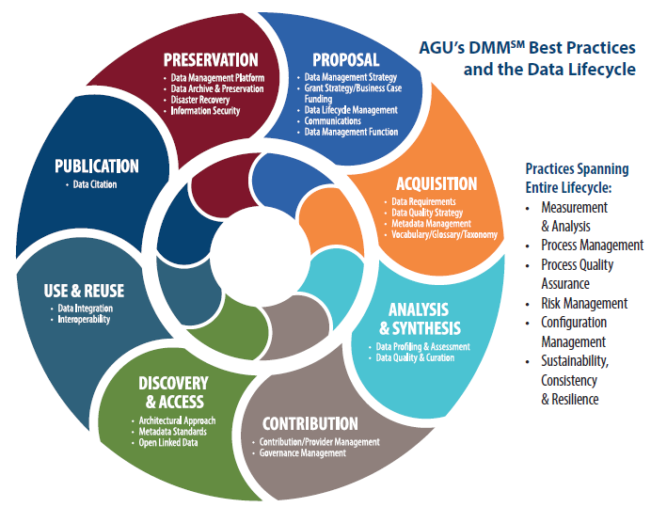
Data planning
NWB:N
Planning
Acquisition
Analysis & Synthesis
Contributing
Discovery & Access
Use & Reuse
Publication
Preservation
Data acquisition
Analysis and Synthesis
Contributing
Data Discovery & Access
Use & Reuse
Data Publications
Data Preservation
NWB:N Adoption, Development and Curation

Slide 8
Planning
Preservation
Acquisition
NWB:N
Publication
Analysis & Synthesis
Use & Reuse
Contributing
Discovery & Access

Slide 9
Planning
Preservation
Acquisition
NWB:N
Publication
Analysis & Synthesis
Use & Reuse
Contributing
Discovery & Access

