Slide 1
Airline Efficacy
A Primer for Phoenix Sky Harbor International Airport
Copper State Securities

Slide 2
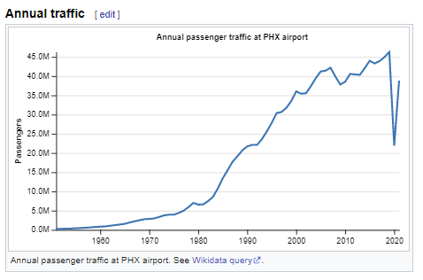
Context
In 2020, Phoenix Sky Harbor saw approximately 45 million passengers (enplaned + deplaned) through its terminals
It serves as the hub for connecting flights, changes of airline
It is the 11th busiest hub airport in the world, and is acutely vulnerable to frictions caused by delays and poor service

Slide 3
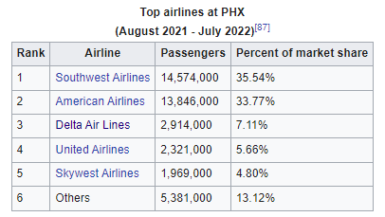
Delta & American Airlines
By market share, American Airlines and Delta Air Lines are the largest carriers at Phoenix Sky Harbor
Their success (or failure), reflects a broader success (or failure) for the airport as a whole
Sample text

Slide 4
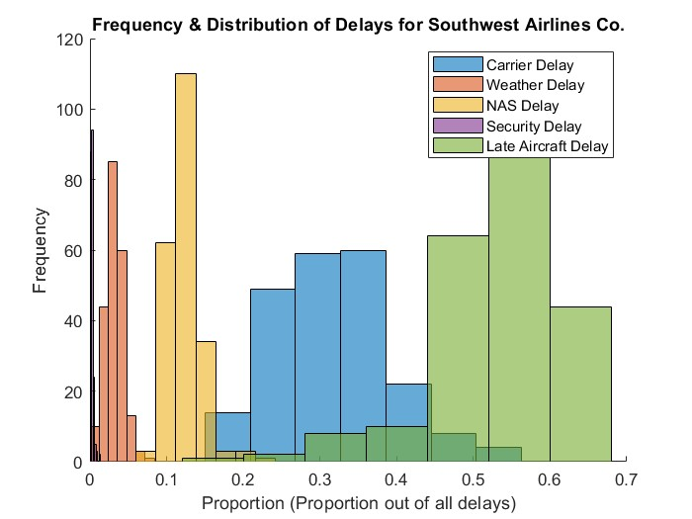
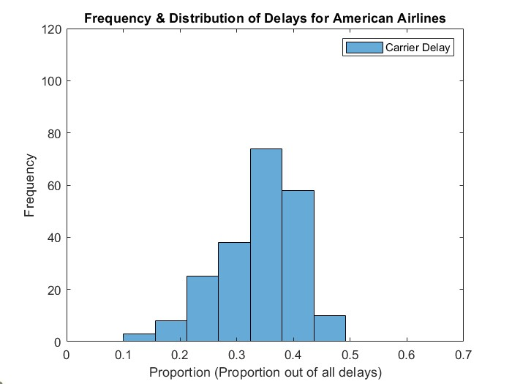
Comparison of Exploratory Data
A side-by-side look at the median/mean delays of each airline

Slide 5
Comparison of Exploratory Data II
A side-by-side look at the median/mean delays of each airline
This is where we performed more analysis to really get of sense of each airport, later we move onto ML models.
Insert Graph or Figure Here

Slide 6
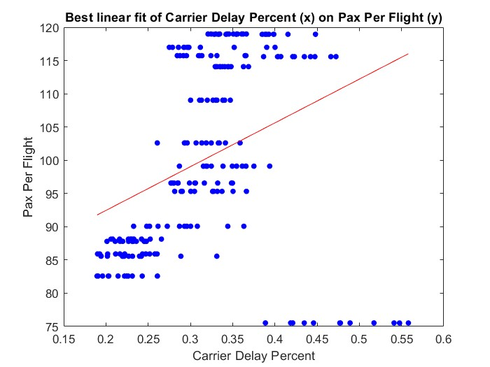
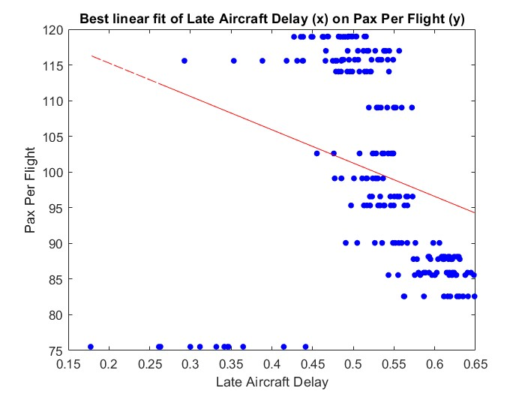
Insights from ML
A side-by-side look at the median/mean delays of each airline

Slide 7
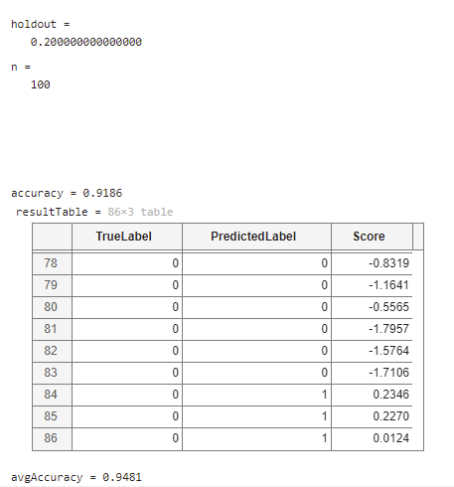
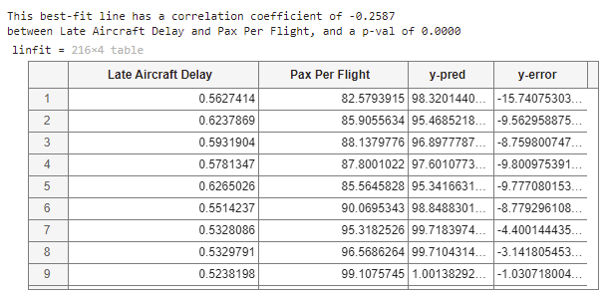
Insights from ML II
A side-by-side look at the median/mean delays of each airline
Later we moved onto ML models, here’s what we found
“Over 100 trials, the accuracy of our SVM model was ~95%. Therefore, we can accurately distinguish between Southwest Airline Co. and American Airlines.

Slide 8
Potential Losses
“Based on the assumption that passenger revenue is $x per passenger, a slope of -0.2 passengers per flight (independent variable being year, and dependent being pax_per_flight), and the # of flights in a single year being number, then…”
Loss = ($x per passenger) * (# of flights per year) * (-0.2 passengers per flight)

Slide 9
Additional Sources
These are the sources we used beyond the ones provided in the assignment brief

