Slide 1
Reverse engineering a VIC-20 expansion cartridge
Ben Dooks
ben.dooks@codethink.co.uk
ben@fluff.org
Notes:
I started off in the days of the 8 bit computer, this is a bit of a trip back to the pre PC days
Overview:
- the hardware involved
- quick overview of electrical interfaces
- some techniques on how to reverse engineer

Slide 2
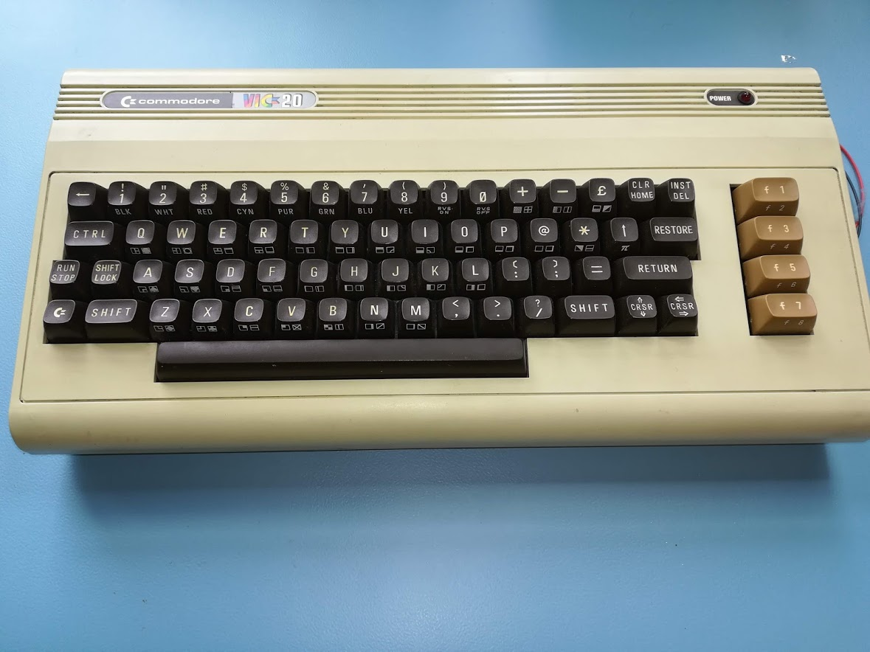
The VIC-20
Released 1980
20KiB ROM
5KiB RAM
$299 price
Notes:
That’s around $778 in current money (approx £600)
https://en.wikipedia.org/wiki/Commodore_VIC-20
5KiB of RAM leaves about 3300 bytes free for user

Slide 3
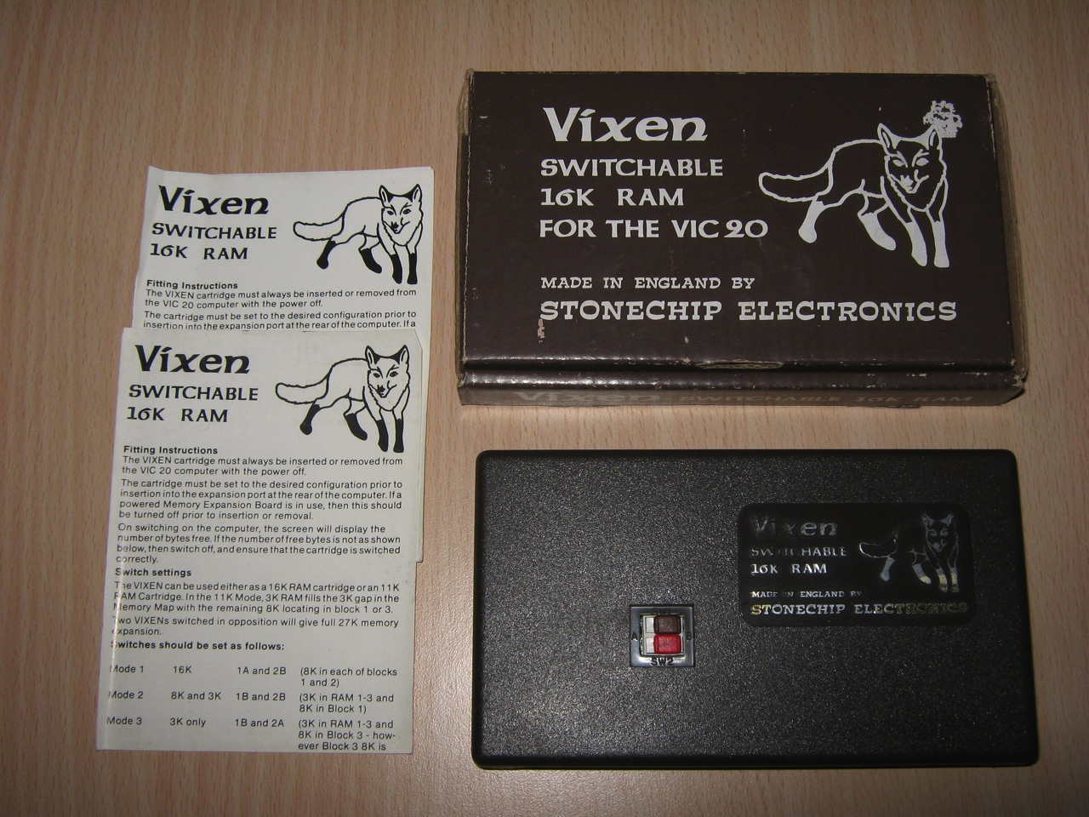
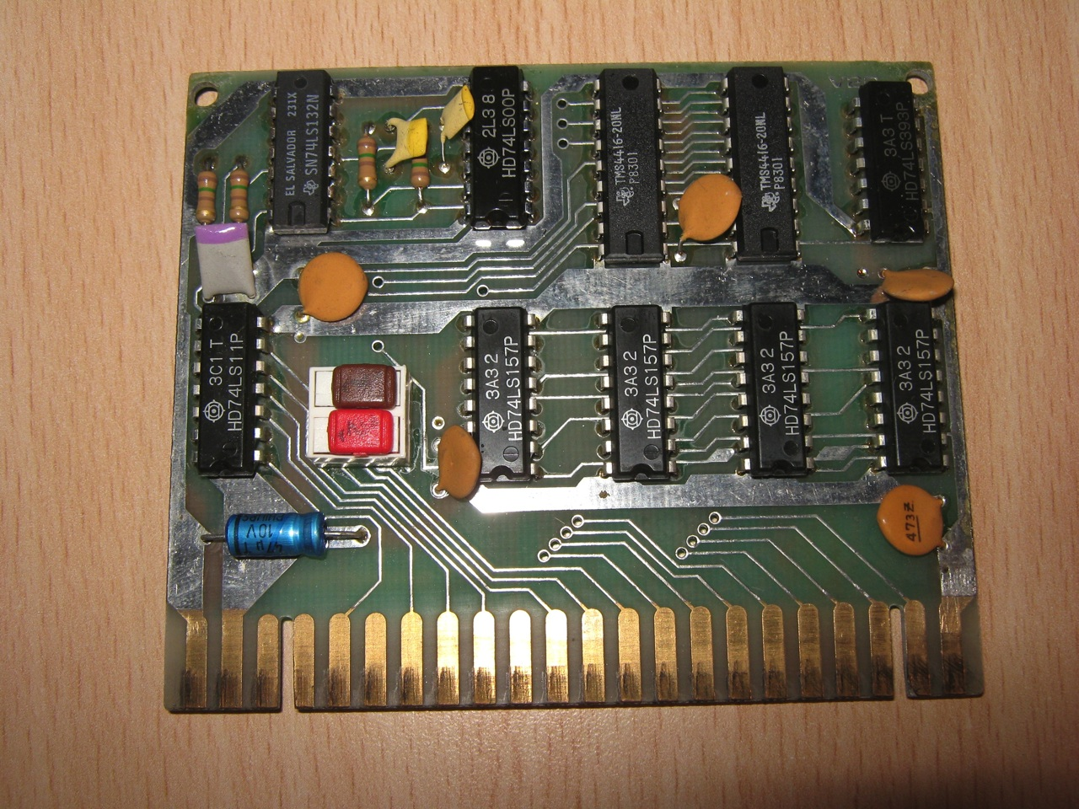
The Vixen RAM expansion
16KiB RAM expansion (8bit x 16K)
Notes:
Source :
https://www.nightfallcrew.com/18/05/2010/vixen-switchable-16k-ram-for-commodore-vic-20/
- found this device whilst browsing on line
- would have loved this as a youth
- no idea of the price of this device retailed
- does not fill the memory map (but lots more)

Slide 4
But why?
My second ever computer.
Browsing peripherals and found the Vixen RAM
  And photos of the internals
  But how did it work?
  Is there sufficient information in the pictures?
Notes:
-

Slide 5
RAM
Two main types
  Dynamic (DRAM) and Static (SRAM)
Most other expansions used static RAM
  But the vixen uses dynamic RAM
  And the circuit looks far too simple
Notes:
- Many cartridges used easier SRAM

Slide 6
Dynamic vs Static RAM
Dynamic RAM | Static RAM
Fast access time | Slower access time (250ns)
Multiplexed address bus | Simple address bus
External refresh cycle | No refresh cycle
Cheap | Expensive
Notes:
Quick table for dynamic vs static
- DRAM is much cheaper by about 8 times but requires multiplexed address and two stage address cycle.
- I think $10 per 2KiB, so for 16KiB this is a significant saving.
- DRAM also needs an external refresh needs 128 rows refreshed every 4ms

Slide 7
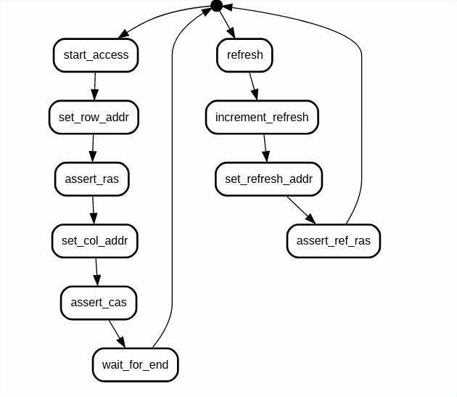
DRAM access states
Notes:
https://state-machine-cat.js.org/
Quick view of DRAM access states for normal data and for a refresh.
In a modern system this would be a simple state machine you could build in a CPLD or FPGA but would require a 8-16 multiplied clock

Slide 8
VIC-20 expansion bus
Simple extension of 6502 main bus
  8 data and 13 address bits
  Read and write
  9 pre-decoded chip selects
  CPU clock
  Soft and hard interrupt inputs
Notes:
This is a fairly simple parallel bus
Cycle time is about 1MHz (1000ns)
- note there is no way to stall memory cycles for refresh

Slide 9

6502 Bus
Notes:
Simplified diagram of 6502 memory access cycle
Address is setup before the high cycle of the clock
Data is read or written during high part of clock.
The clock cycle is around 1MHz so approx 1000ns per cycle. This we will come back to later

Slide 10
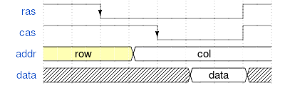

DRAM timing
Notes:
First is simple read/write single access.
Second is RAS only refresh cycle of one row

Slide 11
First thoughts
The picture tells a lot
  Components used
  Basic track info
All standard logic gates
  Datasheets available
Simple components
  Resistors, capacitors
  So no room for PLL/state machine
Notes:
- most are simple logic gates
- combinatorial logic and simple
- full list in later slide
- can sort of read some of the values from passives
- list of ICs on the next slide
- therefore no complicated state machine
- certainly no PLL here

Slide 12
Logic ICs
2x TMS4416 16K - 4bit DRAMS
1x 74LS393 – 2 x 4 bit binary counter
4x 74LS157 – 2 to 1 data mux (4 channels)
1x 74LS11 – 3 in AND gate (x3)
1x 74LS00 – 2 in NAND gate (x4)
1x 74LS132 – 2 schmitt NAND gate (x4)
Notes:
So we have about 13 usable simple logic gates and bits for data muxing

Slide 13
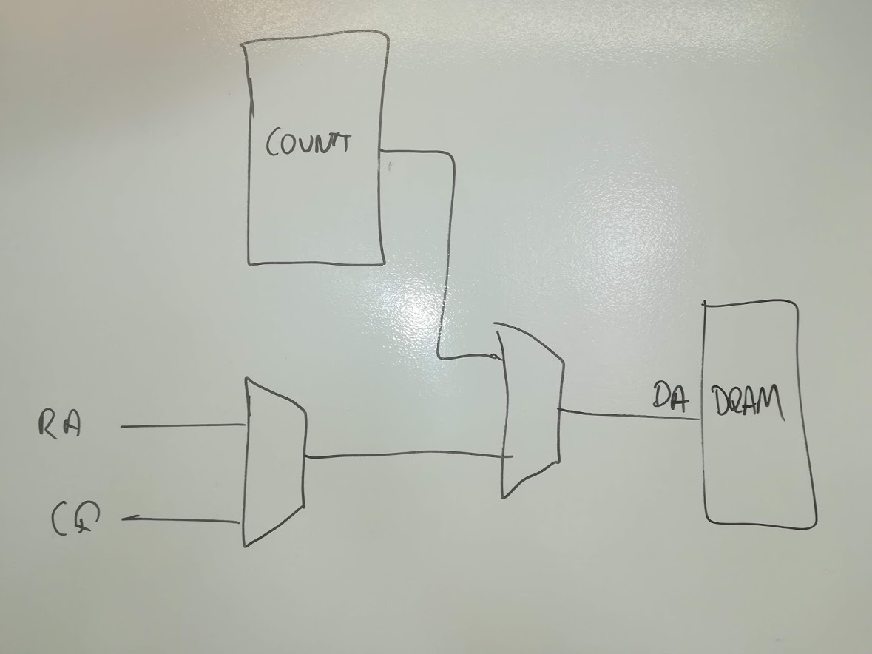
Simple start (address mux)
Notes:
The 4-by-2 muxes are a good indication they are part of the address row/column and refresh. So it is quite easy to work out the few possibilities for the address mux.
We’ll end up refreshing around 32 times more than we need to.

Slide 14
So, refresh
DRAM refresh cycle is around 400ns
  Use inactive half of cycle to refresh
  A bit more power
  Normal VIC20 draws 16W anyway
Notes:
Since the DRAM requires 400ns to refresh and we have 500ns of inactive cycle of the CPU clock we can simply refresh each cycle.
Worst case refresh current is 46mA per device, average is about 23mA.

Slide 15
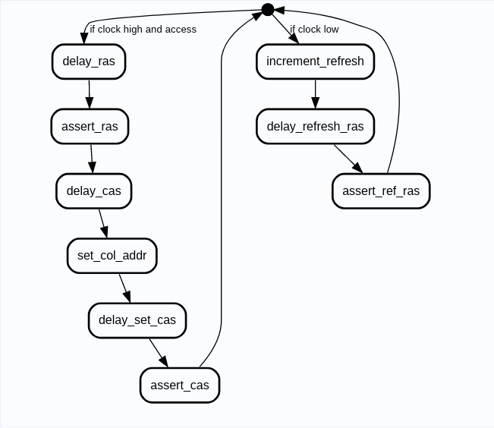
New state machine

Slide 16
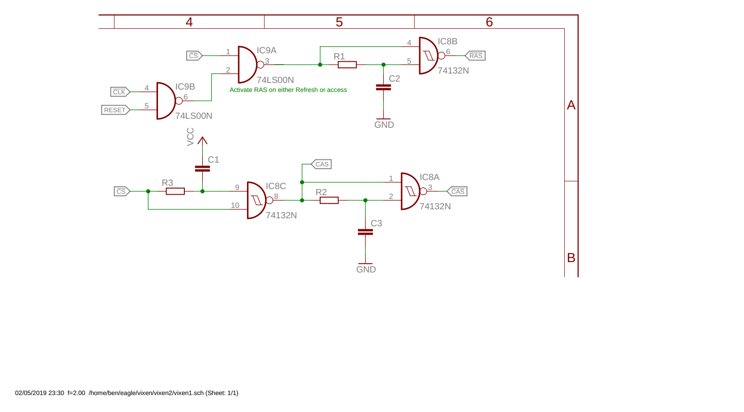
First schematic attempt
Notes:
Simple logic gate RC delays to produce RAS/CAS from the clock and the access.

Slide 17
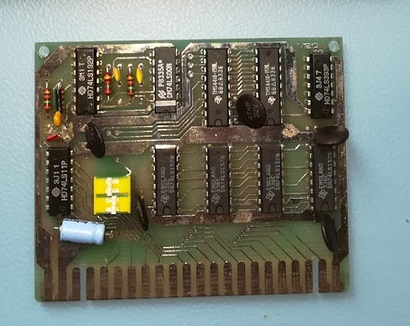
The real hardware
Track tracing
Photograph and draw
Multimeter
And sneaky cap!
Notes:
- searching find there is one on ebay
→ so bid and win
The photo shows the hardware better and there is an extra capacitor hidden in the original.

Slide 18
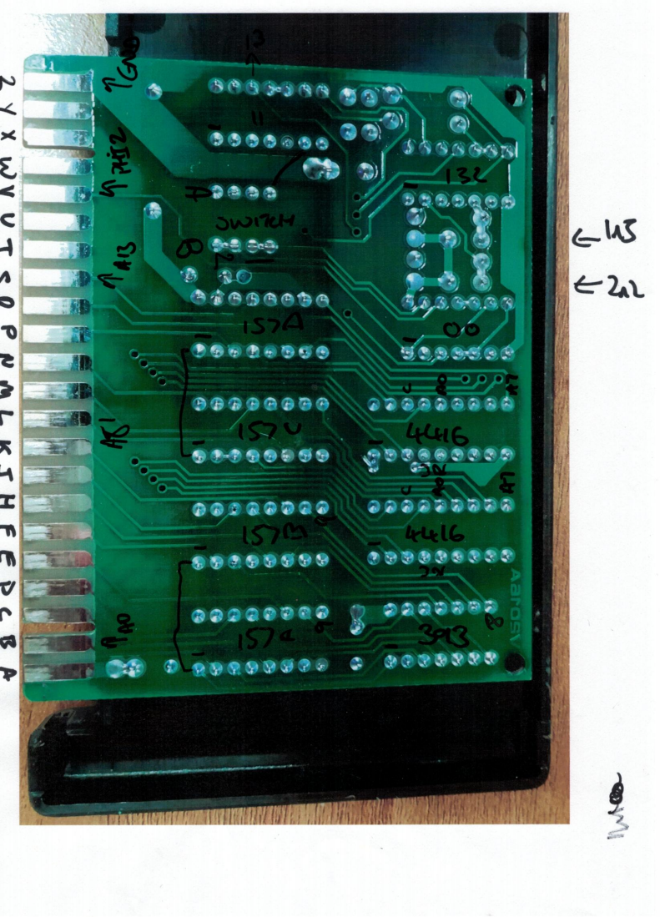
Tracing tracks
Notes:
Take photo of underside
Flip it so same way as looking down on board
Add drawings of parts
- use black marker to show components and connector details

Slide 19
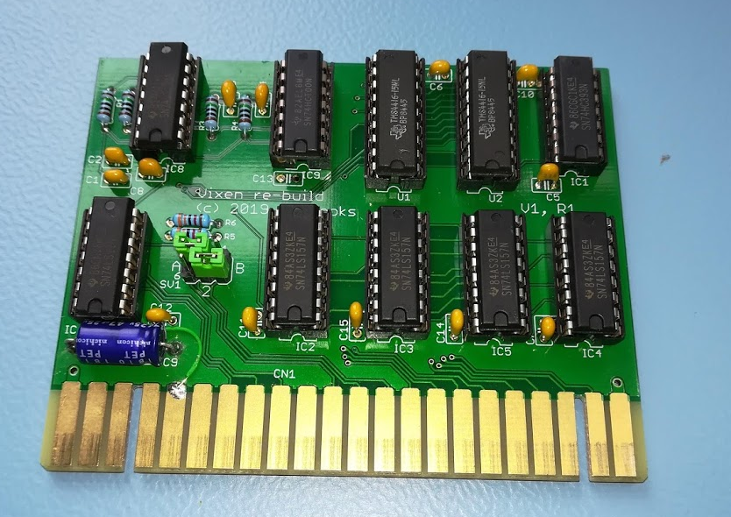
My clone board
Notes:
- spend two evenings using eagle
- sent the gerber files to JLC
- approx £30 in components
- £13 for the PCBs

Slide 20
How close was I
Almost
Refresh circuit wrong

Slide 21
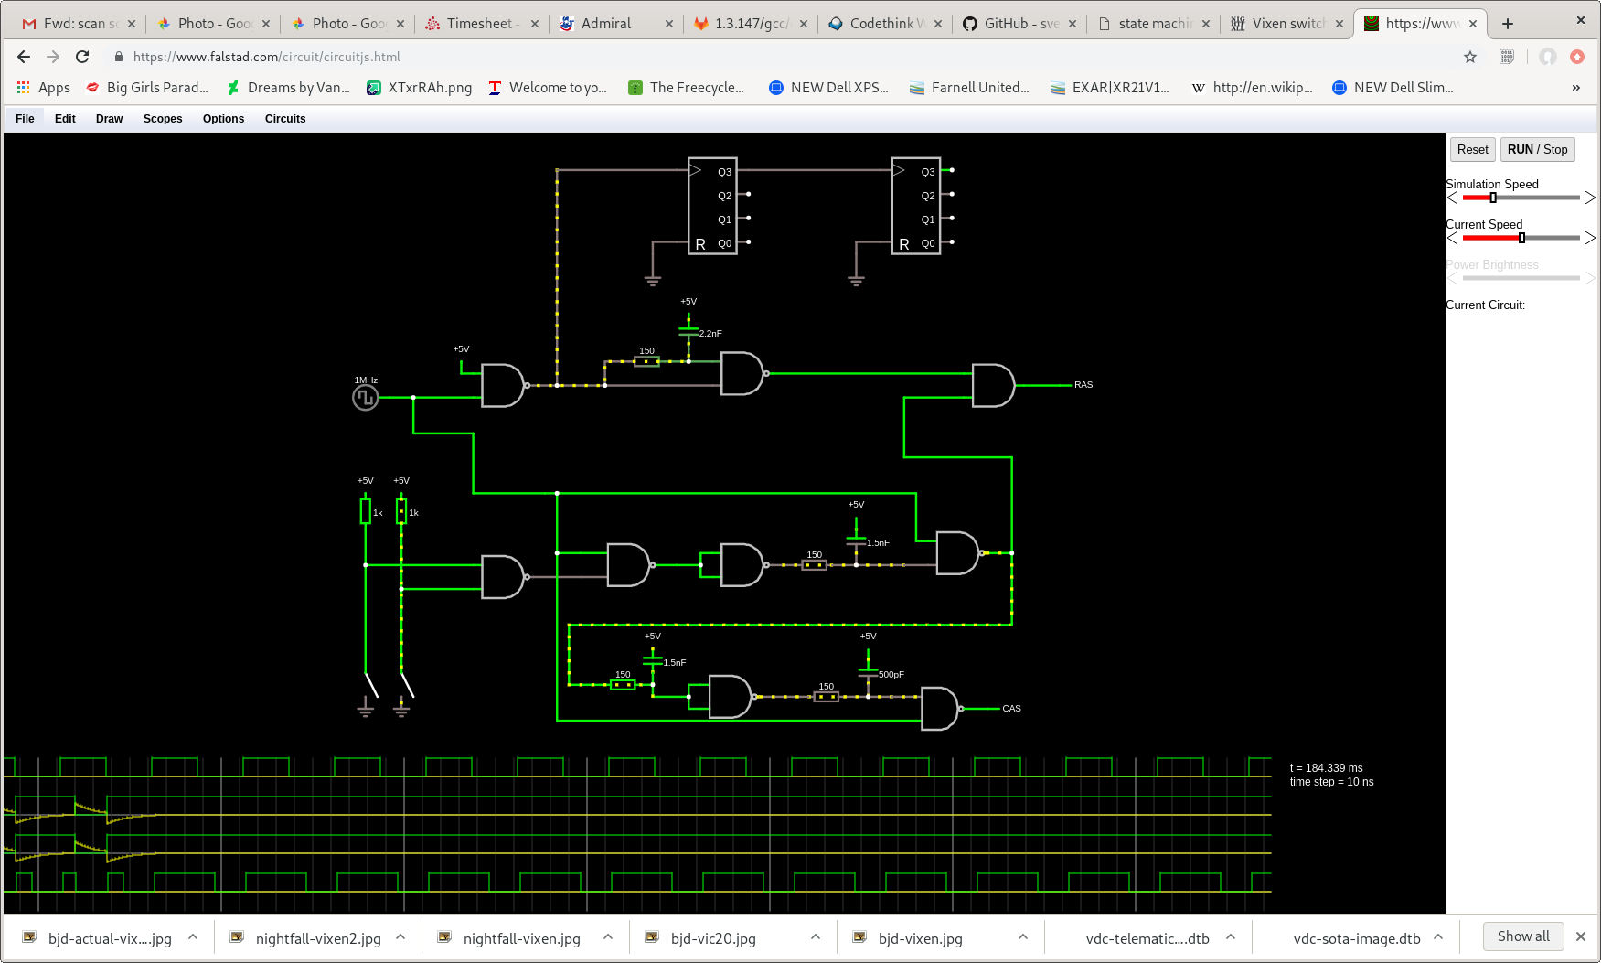
Simulation
Notes:
Should have thought of simulation sooner
(Might have saved some money)
This is circuit.js browser based simulation

Slide 22
Future
Try optimisation of design
  It is very close to optimal
Try with PLL and state machine
  Simple PLL ICs were available
  Possibly PLL + shift-register based state

Slide 23
The end?
Project files and documentation will be on:
  https://github.com/bendooks/vixen
Thank you. Any questions?
Notes:
About 10 days of work into the reverse engineering

