Slide 1
VISITOR
DESIGN PATTERN

Slide 2
Introduction
Solution
Problem
Summary
Visitor
Other examples
Side effect
When to use

Slide 3
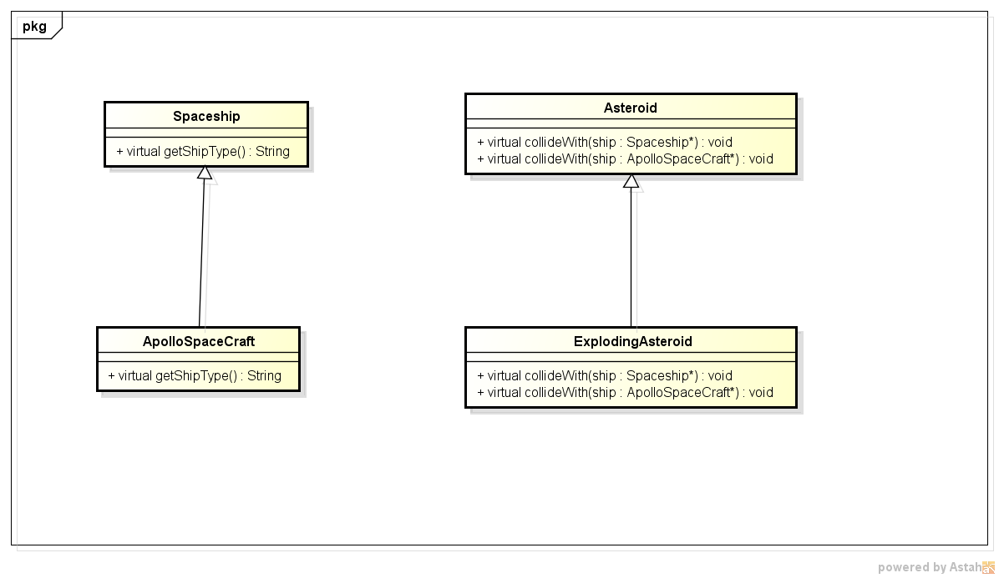
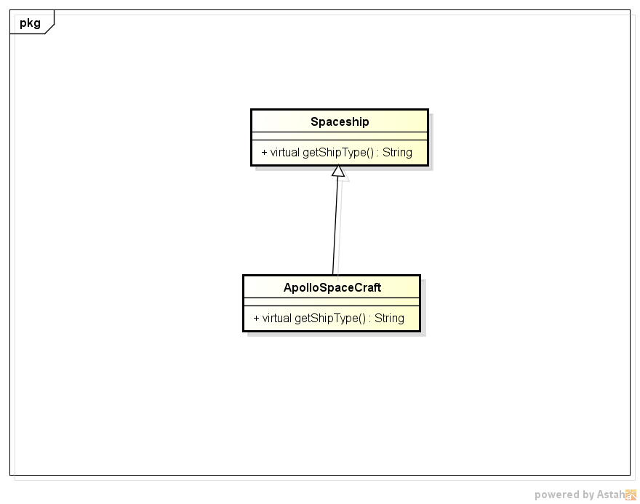
Problem:
The actual method is called on runtime based on type of the object
class Spaceship {
public:
virtual string getShipType() {
return "Spaceship";
}
};
class ApolloSpacecraft :public Spaceship {
virtual string getShipType() {
return "ApolloSpaceCraft";
}
};
class Spaceship {
public:
virtual string getShipType() {
return "Spaceship";
}
};
class ApolloSpacecraft :public Spaceship {
virtual string getShipType() {
return "ApolloSpaceCraft";
}
};
class Asteroid {
public:
virtual void collideWith(Spaceship *ship) {
cout << "Asteroid hit a Spaceship\n";
}
virtual void collideWith(ApolloSpacecraft* ship) {
cout << "Asteroid hit an ApollpSpaceCraft\n";
}
};
class ExplodingAsteroid :public Asteroid {
public:
void collideWith(Spaceship *ship) {
cout << "Exploding Asteroid hit a spaceship\n";
}
void collideWith(ApolloSpacecraft *ship) {
cout << "Exploding Asteroid hit an ApolloSpaceCraft\n";
}};
Output:
Exploding Asteroid hit a spaceship
Wrong wrong wrong. We expect Exploding asteroid hit an ApolloSpaceCraft (not a spaceship)
Output:
Spaceship
ApolloSpaceCraft
Single Dispatch
Or more common a virtual function
Double dispatch:
VISITOR
The reason is:
- C++ or other programing languages just support single dispatch. If you want to call a method based on type of two objects, we call it double dispatch we need a design pattern to sovle this one.
int main() {
Spaceship *ship = new Spaceship;
Spaceship *apollo = new ApolloSpacecraft;
cout << ship->getShipType() << endl;
cout << apollo->getShipType() << endl;
}
int main(){
Spaceship *apollo = new ApolloSpacecraft;
Asteroid *asteroid = new ExplodingAsteroid;
asteroid->collideWith(apollo);}

Slide 4
introduction
is a way of separating an algorithm from an object structure on which it operates. A practical result of this separation is the ability to add new operations to existent object structures without modifying the structures

Slide 5
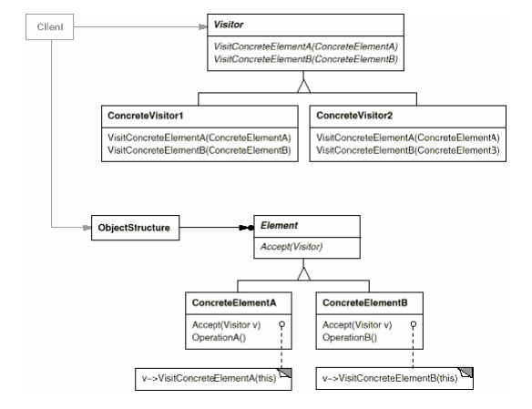

Slide 6
Introduction
Just imagine visitor is a service company. And concrete elements are houses. Each house can call service (accept method) from the company (visitor). And the company will visit your house and do the service for you. (visit concrete element method)

Slide 7
STILL CONFUSED?
LET’S BACK TO THE PROBLEM

Slide 8
SOLUTION

Slide 9
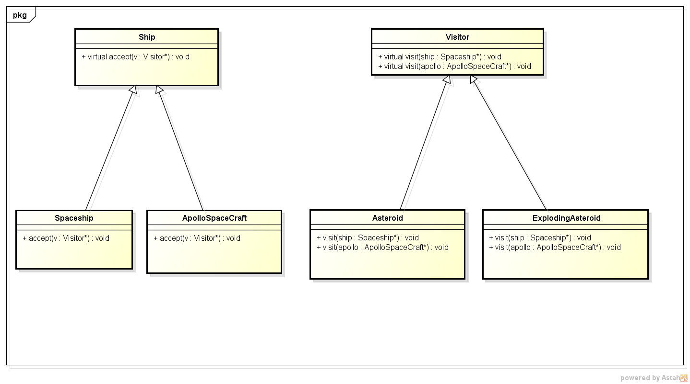

Slide 10
class Ship {
public:
virtual string getShipType() = 0;
virtual void accept(class Visitor* v) = 0;
};
class Spaceship :public Ship {
public:
virtual string getShipType() {
return "Spaceship";
}
virtual void accept(Visitor* v);
};
class ApolloSpacecraft :public Ship {
virtual string getShipType() {
return "ApolloSpaceCraft";
}
void accept(Visitor* v);
};
class Visitor {
public:
virtual void visit(Spaceship* ship) = 0;
virtual void visit(ApolloSpacecraft* apollo) = 0;
};
class Asteroid :public Visitor {
public:
void visit(Spaceship* ship) {
cout << "Asteroid hit a spaceship\n";
}
void visit(ApolloSpacecraft* apollo) {
cout << "Asteroid hit a ApolloSpaceCraft\n";
}
};
class ExplodingAsteroid :public Visitor {
public:
void visit(Spaceship* ship) {
cout << "Exploding Asteroid hit a spaceship\n";
}
void visit(ApolloSpacecraft* apollo) {
cout << "Exploding Asteroid hit an ApolloSpaceCraft\n";
}
};
int main() {
Ship *apollo = new ApolloSpacecraft;
Visitor *v=new ExplodingAsteroid;
apollo->accept(v);
return 0;
}
Output
Exploding Asteroid hit an ApolloSpaceCraft
It has solved the problem:
The method is called based on two types of the objects
1)The type of the ship
2)The type of the asteroid:
void Spaceship::accept(Visitor * v)
v->visit(this);
void ApolloSpacecraft::accept(Visitor * v)
v->visit(this);

Slide 11
When to use:
use when your object structure contains many classes that is not related (don’t share the common parent class) and you want to perform operations on those classes
Many distinct and unrelated operations you want to perform on objects of object structure and you don’t want to pollute your classes with those unrelated operation
The classes defining the object is stable, you just want add on new operations on those classes. Visitor is the best for you.
Unrelated classes use related operations
Use it when you need double dispatch
Stable classes, just add new operators
Unrelated operations, no pollution
Gather related operations,
separate unrelated ones

Slide 12
Side effect
Adding new classes to object structure is hard. You have to updated all concrete visitor classes to perform operations on those classes. It is costly.
If your classes are not stable, don’t use visitor, let the classes do by themselves
Breaking encapsulation. Some operations need to be accessed your private data member. If visitor want to access data, you have to put it on public. It breaks the rule of information hiding.

Slide 13
DIFFERENCES BETWEEN ITERATOR AND VISITOR:
Iterator traverse all elements of object structure of the same type(inherited classes)
Visitor traverse elements that don’t need belong to inherited classes
Same type traverse, Iterator
Heterogeneous structure, use Visitor

Slide 14
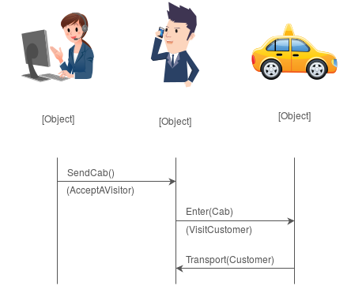
OTHER EXAMPLES
Cap company dispatcher
Customer
Taxi

Slide 15


Shopping in the supermarket
Shopping cart
(concrete elements)
Cashier
(Visitor)
Some items need to be weighted, some don’t

Slide 16
Summary
Provide services
VISITOR: A SERVICE COMPANY
CONCRETE ELEMENTS: HOUSE, STORE, SHOP THAT NEED SERVICES
Type of elements
Type of services
Double dispatch
Use it when you just need add more operations, no adding new classes of object structure.

Slide 17
references
https://en.wikipedia.org/wiki/Visitor_pattern
https://sourcemaking.com/design_patterns/visitor
https://www.codeproject.com/Articles/588882/TheplusVisitorplusPatternplusExplained
https://dzone.com/articles/design-patterns-visitor
[Erich_Gamma,_Richard_Helm,_Ralph_Johnson,_John_M: The Gang of Four Members.

Slide 18
Thank you for listening

