Slide 1

Quad Monitor

Slide 2
Quad Monitor
Concept
Hardware
Code
Demo
Problems/Improvements

Slide 3
Concept

Slide 4
Purpose
Measure the soil moisture, temperature, and humidity on the Quad
Store data for analysis
Present data on the web

Slide 5

Quad Monitor
ESP-01
WI-FI
Web
Sensors
Database
Server
%
Raspberry Pi
10.65.1.234
Temp
Moisture &
Humidity
Arduino

Slide 6
Hardware

Slide 7
Sensors
GND
DATA
VCC
Arduino
ESP-01
DHT11
Capacitive Soil
Moisture

Slide 8
Power
Bat +
Bat -
Vout
GND
Vin
GND
Battery Controller +
Boost Converter
Battery
5V Solar Panels

Slide 9
Code

Slide 10
Database
Readings
Devices
Field | Type
DeviceID | CHAR(3)
DataDate | DATE
DataTime | TIME
Reading | DECIMAL(9,6)
Field | Type
DeviceID | CHAR(3)
NodeID | VARCHAR(25)
DeviceType | VARCHAR(25)

Slide 11
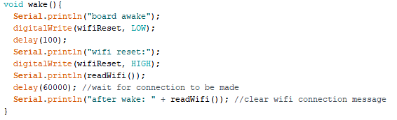
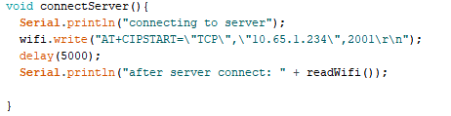
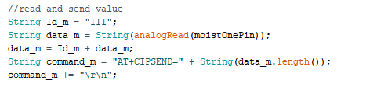
Code: Arduino
Wake up:
Connect:
Send:

Slide 12
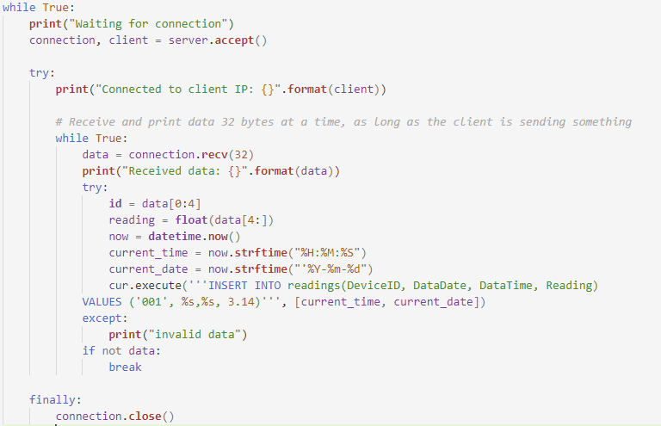
Code: Database Server

Slide 13
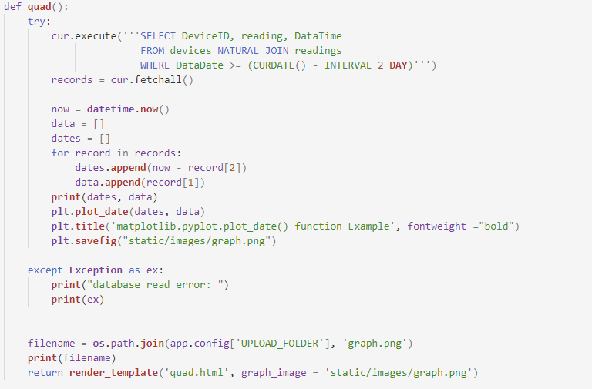
Code: Web

Slide 14
Demo

Slide 15
Improvements

Slide 16
Problems/Improvements
Solved:
Poor ESP-01 firmware documentation (unknown baud rate etc.)
Partially Solved:
Waterproofing Sensors
ESP-01 3.3v requirements
Untouched:
ESP-01 software serial unstable baud rate
Use ESP-01 without Arduino
Better UI
Battery monitoring/internal humidity

