Slide 1
INPUT
(10 x 9)
Bidirectional LSTM LAYER
Number of LSTM units = 20
DENSE LAYER
Number of units = 1
OUTPUT
(1)

Slide 2
HIP
(X, Y, Z) trajectories
(3 time series)
MAPPING
LEARNING
INPUT
Kinect Tracking Data
Bidirectional
LSTM
RNN
KNEE
(X, Y, Z) trajectories
(3 time series)
KNEE ANGLE
(1 time series)
TARGET
Vicon Data
ANKLE
(X, Y, Z) trajectories
(3 time series)

Slide 3
INPUT
Kinect Tracking Data
HIP
(X, Y, Z) trajectories
(3 time series)
KNEE
(X, Y, Z) trajectories
(3 time series)
ANKLE
(X, Y, Z) trajectories
(3 time series)
MAPPING LEARNING
Bidirectional LSTM LAYER
Number of LSTM units = 20
DENSE LAYER
Number of units = 1
TARGET
Vicon Angle
KNEE ANGLE
(1 time series)

Slide 4
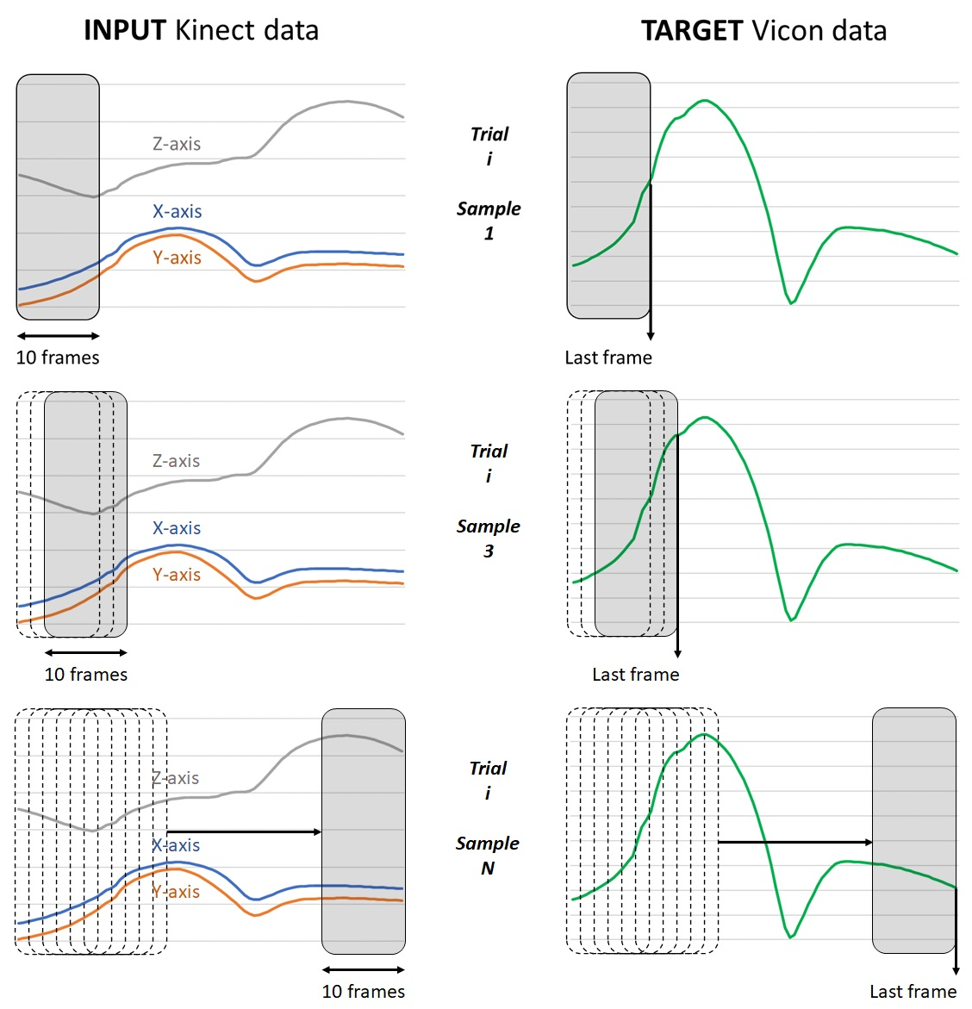

Slide 5
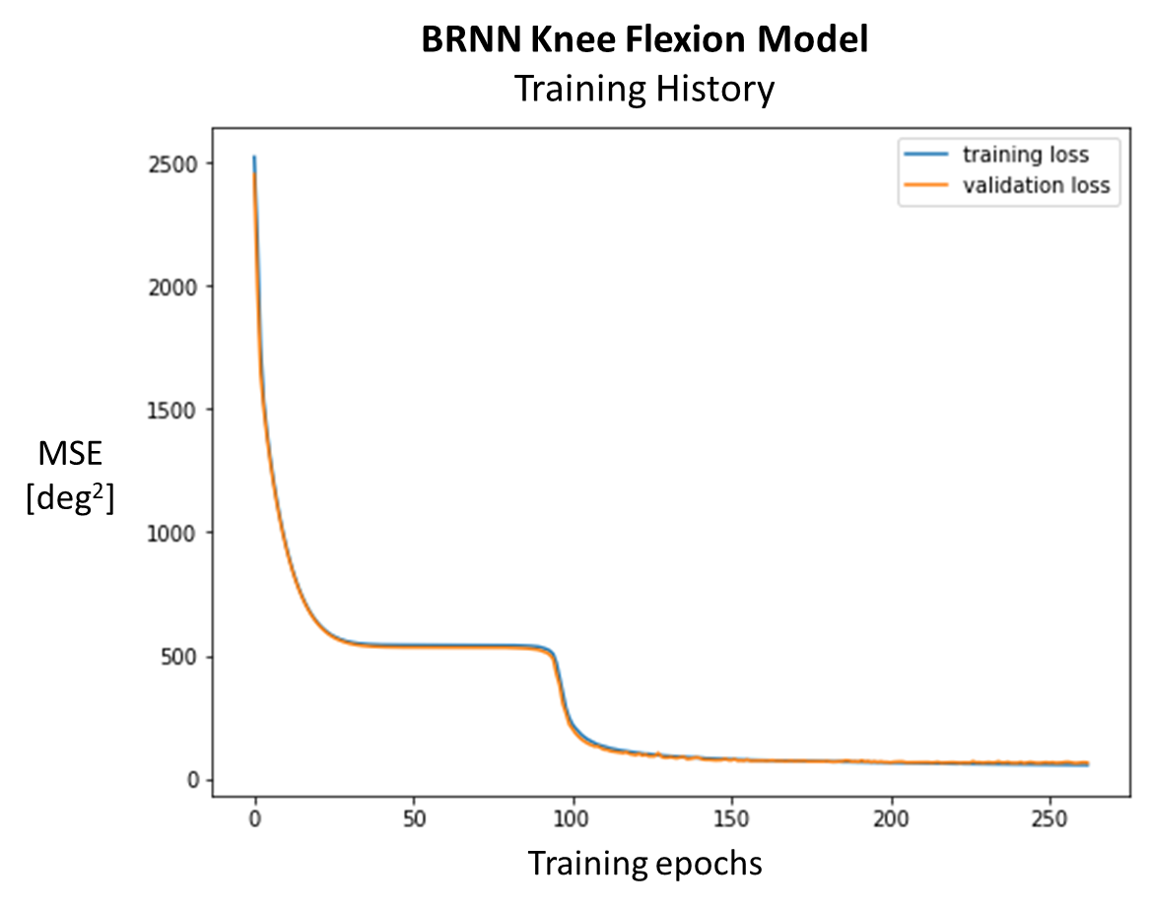
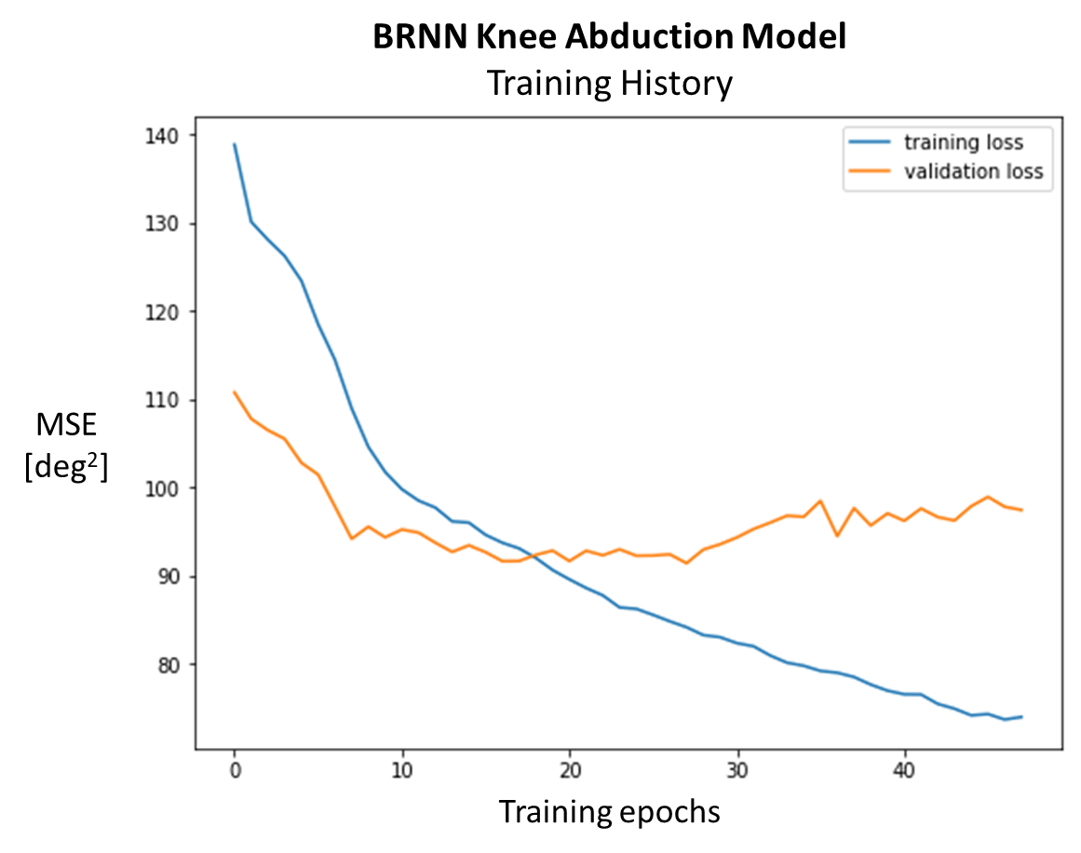

Slide 6
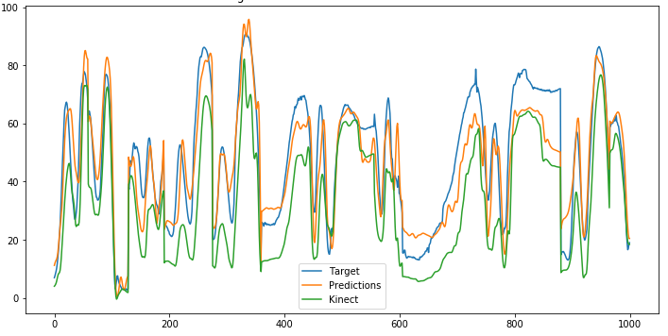
BRNN Knee Flexion Model
Target vs. Predictions vs. Kinect
Flexion angle
[deg]
Frame

Slide 7
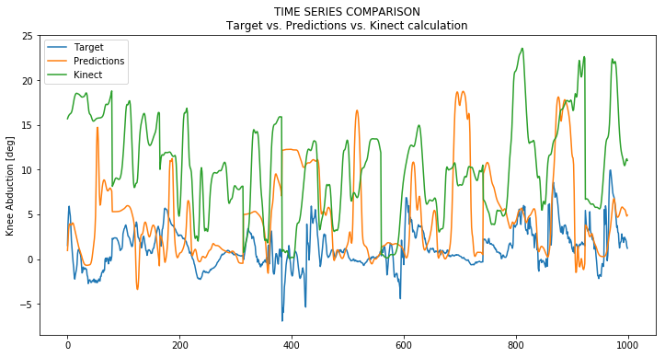
BRNN Knee Abduction Model
Target vs. Predictions vs. Kinect
Abduction angle
[deg]
Frame

Slide 8
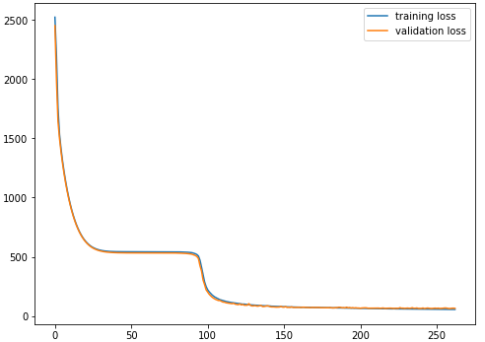
BRNN Knee Flexion Model Training History
MSE
[deg²]
Training epochs

Slide 9
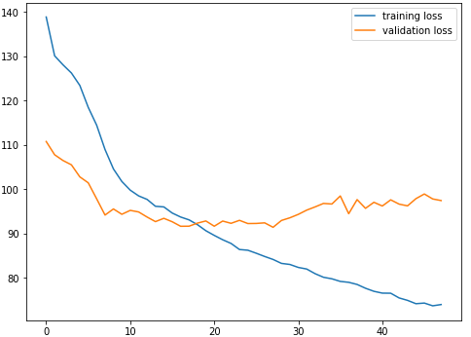
BRNN Knee Abduction Model Training History
MSE
[deg²]
Training epochs

Slide 10
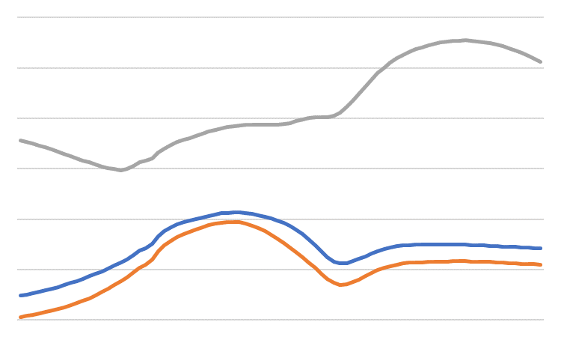
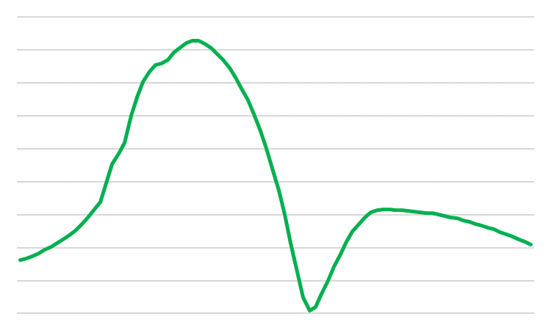
INPUT
Kinect Tracking Data
TARGET
Vicon Angle
Z-axis
Segment 1
X-axis
Y-axis
10 frames
Last frame

Slide 11
INPUT
Kinect Tracking Data
TARGET
Vicon Angle
Z-axis
Segment 3
X-axis
Y-axis
10 frames
Last frame

Slide 12
INPUT
Kinect Tracking Data
TARGET
Vicon Angle
Z-axis
Segment N
X-axis
Y-axis
10 frames
Last frame

