Slide 1
SRGAN Residual Block
Convolution
Batch Normalization
Leaky ReLU
Convolution
Batch Normalization
+
ESRGAN Residual Dense Block
Convolution
Leaky ReLU
Convolution
Leaky ReLU
Convolution
Leaky ReLU
Convolution
Leaky ReLU
Convolution
ESRGAN Residual in Residual Dense Block
Residual Dense Block
×
Residual Dense Block
×
Residual Dense Block
×
β
β
β
+
+
+
×
β
+

Slide 2
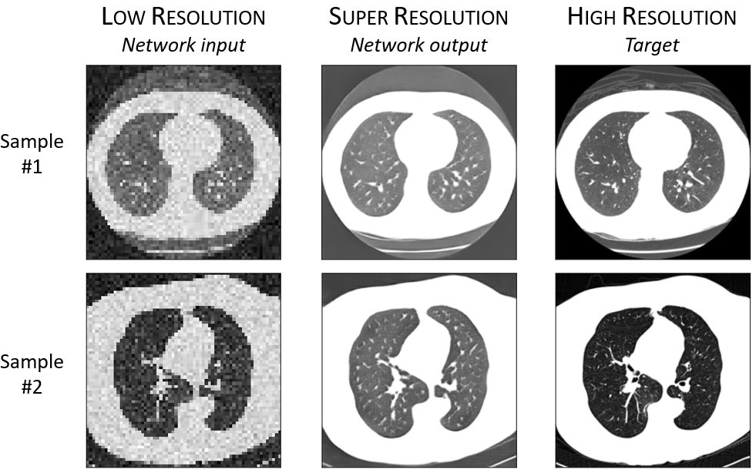
ESRGAN Generator
Residual in Residual Dense Block Network (RRDBNet)
Low Resolution input
(64x64)
Super Resolution output
(512x512)
Convolution
Residual in Residual Dense Block
x9
Residual in Residual Dense Block
Convolution
Convolution
Convolution
•
Upsampling
High Resolution target
(512x512)
Perceptual Loss
on VGG feature maps before activation

Slide 3
ESRGAN Discriminator
Relativistic average discriminator with VGG28 architecture
Convolution
Leaky ReLU
Convolution
Batch Normalization
Leaky ReLU
x6
Convolution
Batch Normalization
Leaky ReLU
Dense
Leaky ReLU
Dense
• • •
More realistic than a randomly sampled fake data?

