Slide 1
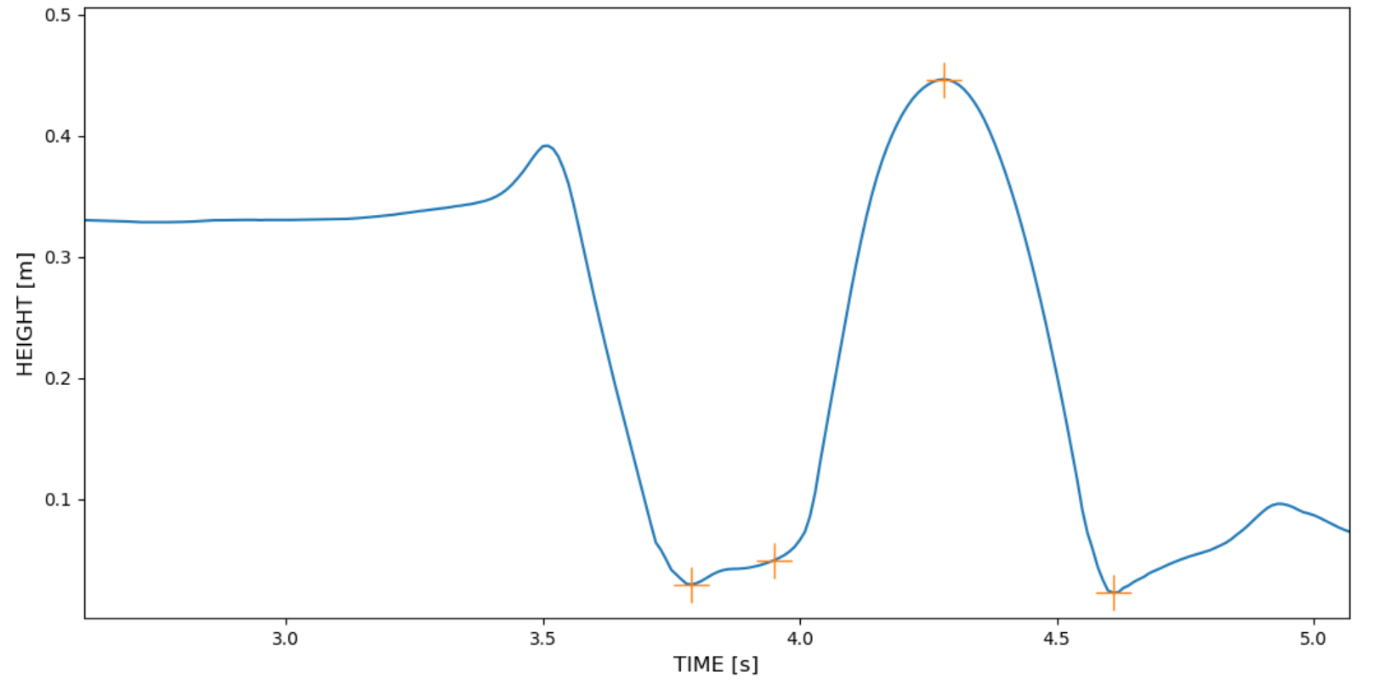
max jump
subject jump off stool
subject stands on stool
post-jump landing
primary landing
take-off

