Slide 1
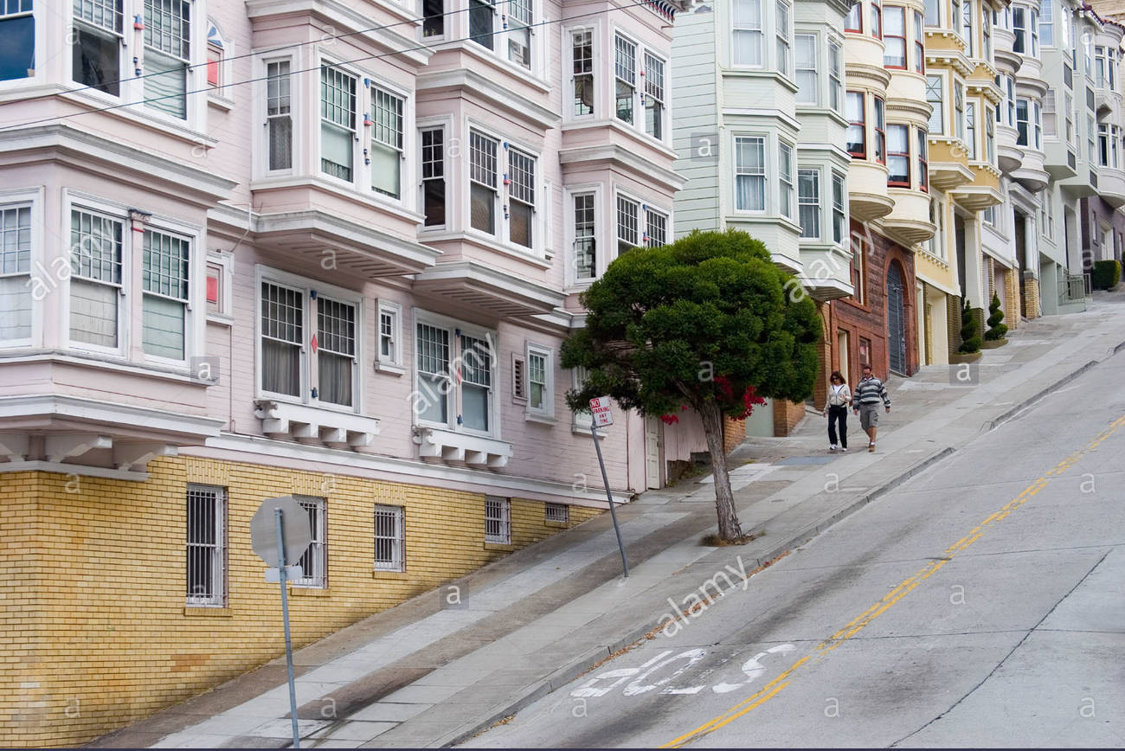
Final Project (USP4)
STEEPNESS IN SAN FRANCISCO
Benson Duong

Slide 2
Description
San Francisco is well-known for its hilly geography and steep streets.
Maps about its steepness will give insight about how to navigate it for tourists who have difficulty with steep terrain, like the elderly and handicapped people.

Slide 3
Process
All maps were re-projected as NAD_1983_StatePlane_California_III_FIPS_0403
Made a discrete steepness map
Steepness raster from Week 10 Lecture stuff
Int, Raster_to_Polygon
Categorized and Dissolved everything into 5 (multi-part) polygons for different steepness tier.

Slide 4
Steepness raster from Week 10 Lecture stuff
Topo-to-raster
Slope
Int, Raster_to_Polygon
Field calculator
Categorized and Dissolved everything into 5 (multi-part) polygons for different steepness tier.

Slide 5
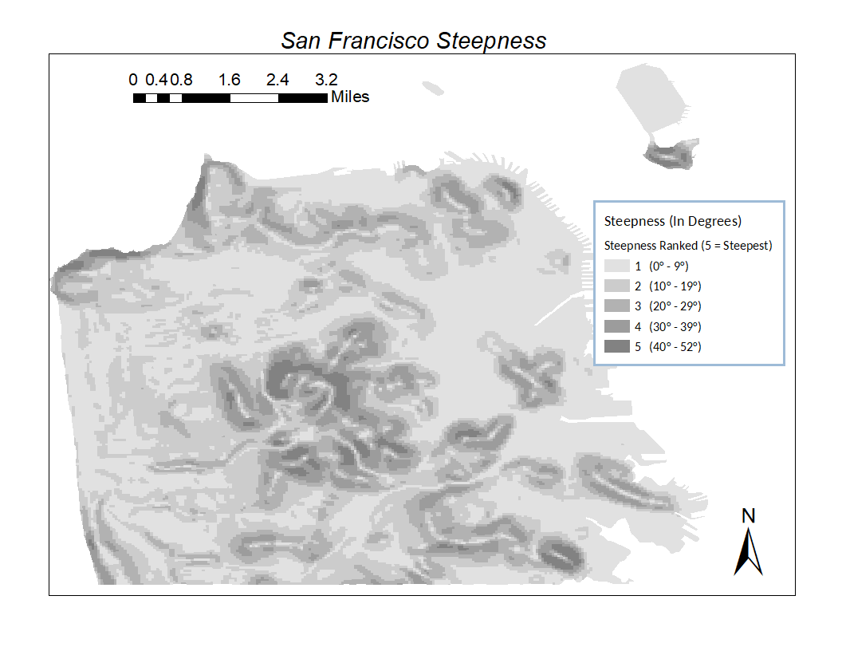

Slide 6
Secondary Maps
Made 3 maps on using this base map and another shape-files, using Spatial Join
Landmarks (Polygons)
Spatial Join = “Have Their Center In”
Sidewalks (Poly-lines)
Spatial Join = “Intersect”
Public Transit (Points and Poly-lines)
Spatial Join = “Within”

Slide 7
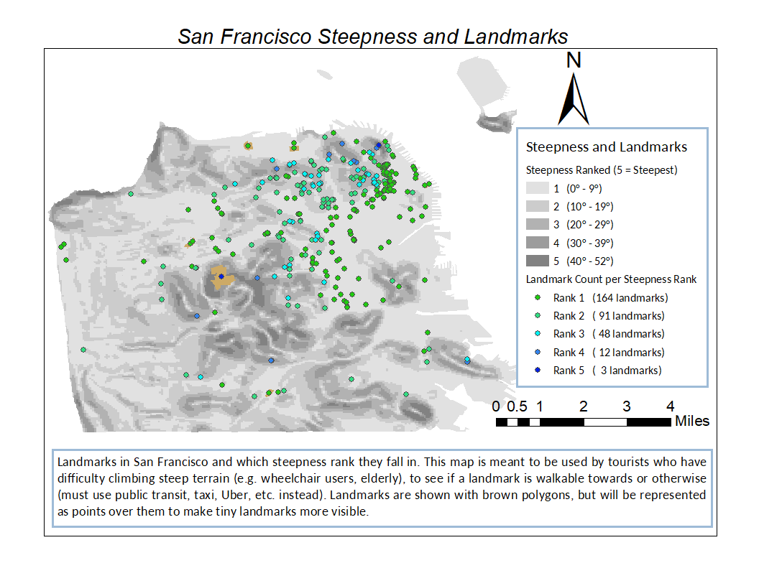

Slide 8
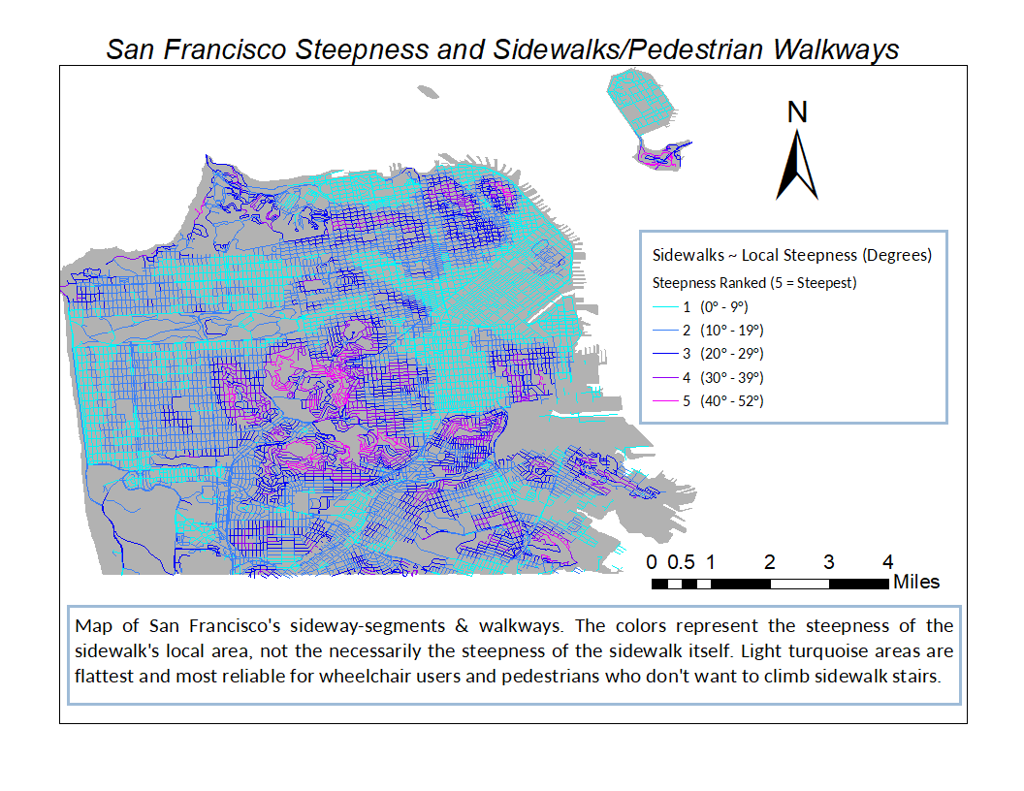

Slide 9
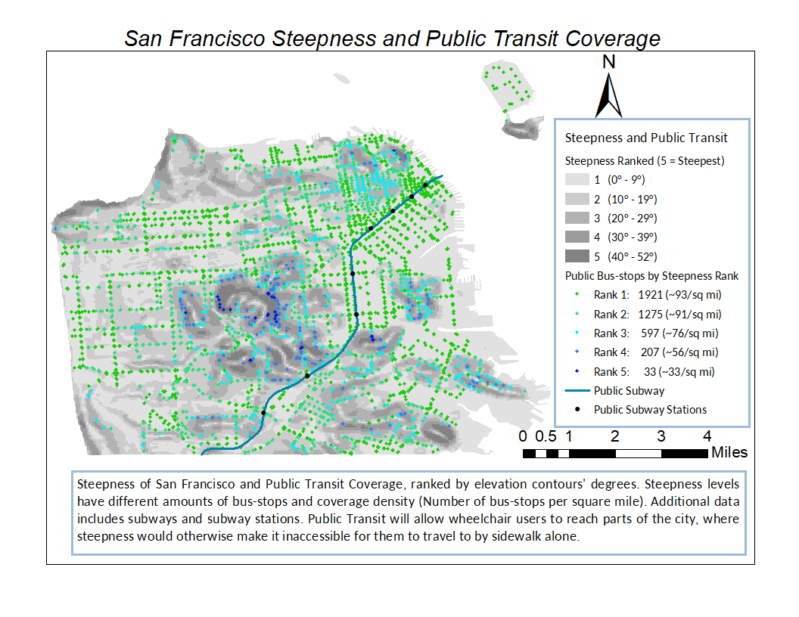

Slide 10
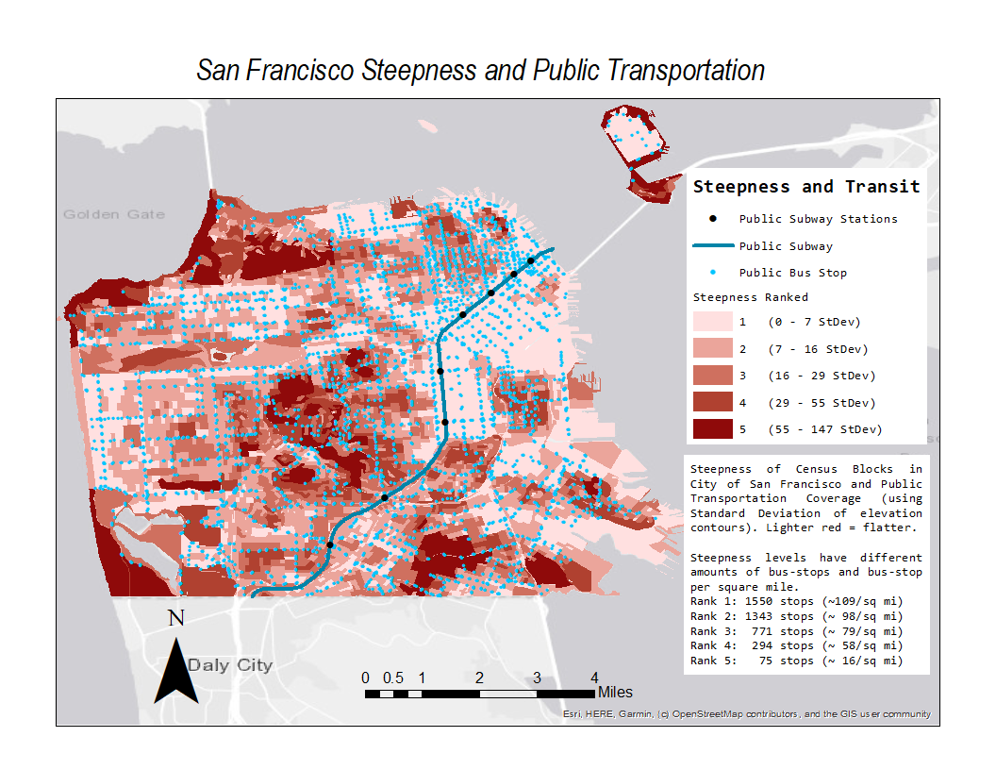
Old Version

Slide 11
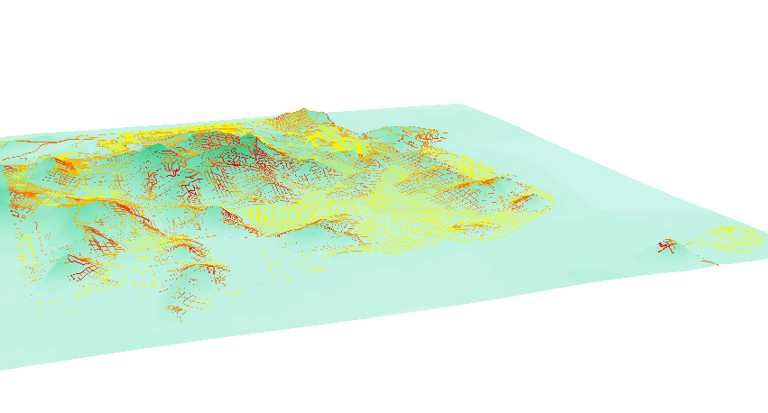
Steepness in 3D
ArcScene of sidewalk steepness.

Slide 12
Possible improvements
Less pixelated raster of the slopes
Increase the number of tiers/ranks of steepness to reduce spatial auto-correlation issues

