Slide 1

sloth pattern

Slide 2
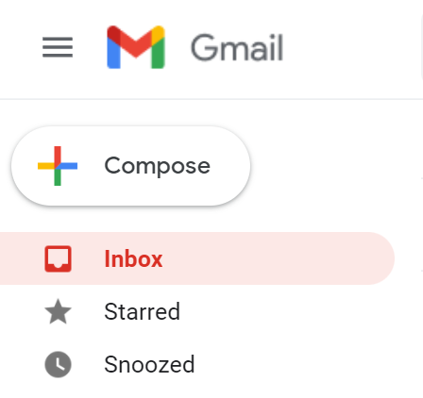

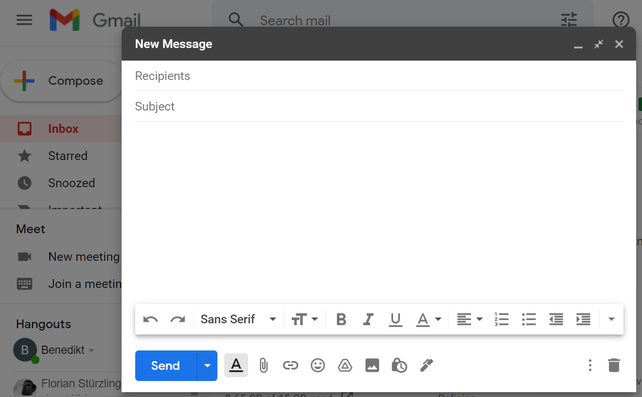

Slide 3
Goals
dialog should be independent
dialog should not end up in main bundle
no delay when clicking button

Slide 4
Code 0 main

Slide 5

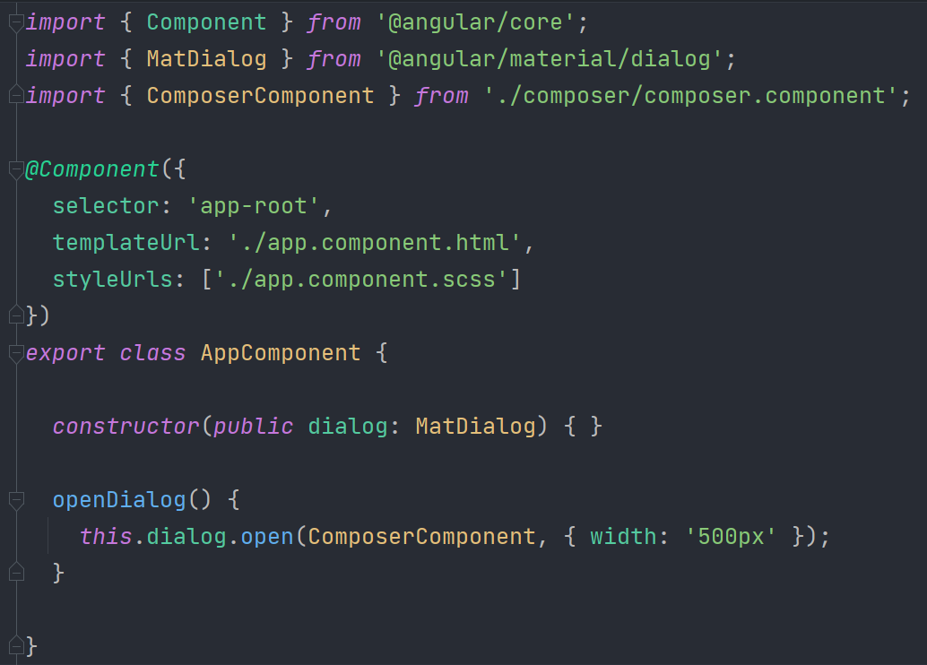


ends up in main bundle

Slide 6
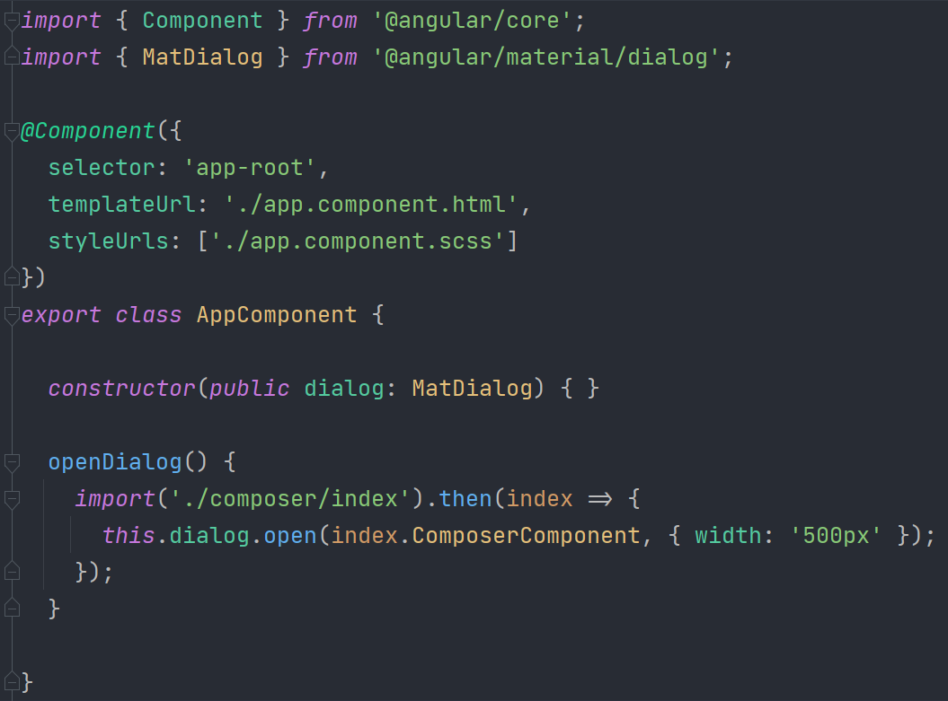
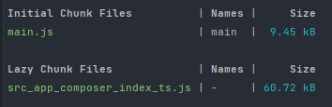
ends up in main bundle

Slide 7
Code 1,2 lazy-load name-service

Slide 8
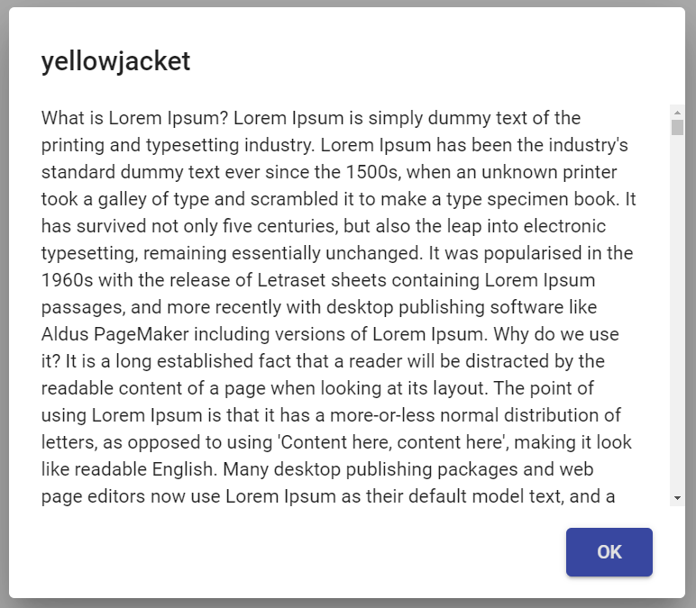

ComposerService
getName
ComposerComponent
AppComponent
needs to know internals

Slide 9
Code 3 dialog-from-service

Slide 10
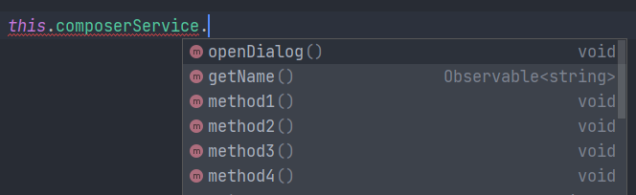
AppComponent
ComposerService
ComposerStuff
getName
openDialog
method1
method2
method3
method4

Slide 11
Code 4,5 split-services component-store

Slide 12





Goals
dialog should be independent
dialog should not end up in main bundle
no delay when clicking button

