Slide 1
COMP1008 Part II: Machine Learning
Machine learning I: Intro
Machine learning II: Supervised vs. unsupervised learning
Machine learning III: Supervised learning
Machine learning IV: ANN & extensions
Please record your attendance today at SEAtS

Slide 2
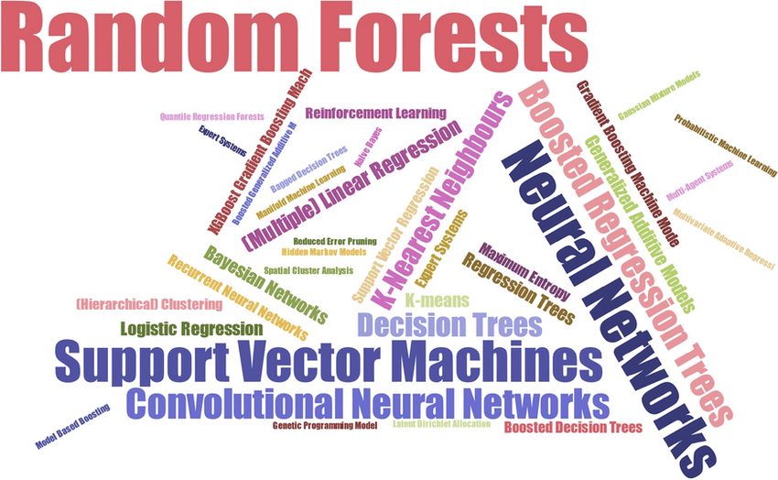
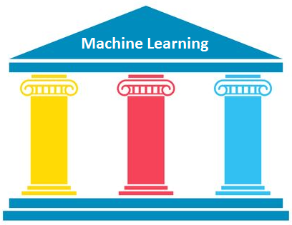
COMP1008 - Fundamentals of AI
Machine Learning - Introduction
Professor Rong Qu
rong.qu@nottingham.ac.uk
Models
Computation
Data

Slide 3
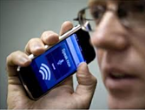
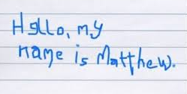
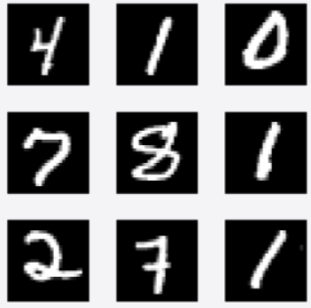

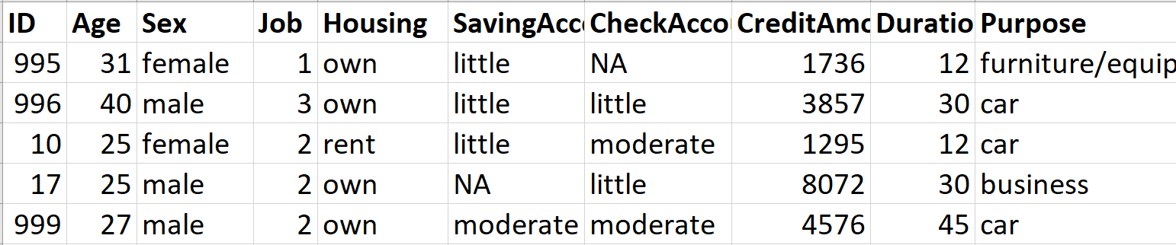
Machine Learning: Definition
A computer program is said to learn from experience E with respect to some class of tasks T and performance measure P if its performance at tasks in T, as measured by P, improves with experience E
Tom Mitchell
Let the computer programs to learn by themselves.

Slide 4
Machine Learning: To reach true AI
Top-down / Classic (deductive)
  Model all different functions and wire all these “agents” together
  Write (manually) in programming language instructions to solve the (usually specific) task
Bottom-up / Machine learning (inductive)
  Give the system a lot of data, “so it can discover by itself concepts in the world”
  Andrew Ng, Stanford University
  Analyse and understand (manually) the task
  Select the appropriate model(s)
  Training and testing
  Use the same model to (automatically) solve unseen tasks
MS Stupariu, S Cushman, AI Pleșoianu, C. Fürst, Machine learning in landscape ecological analysis: a review of recent approaches, Landscape Ecology 37(5), May 2022.
Notes:
Word cloud: data visualization

Slide 5
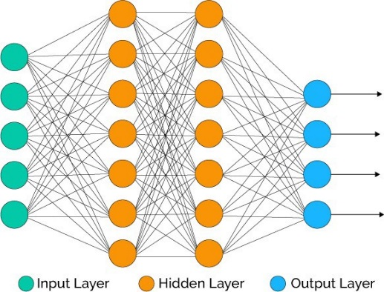
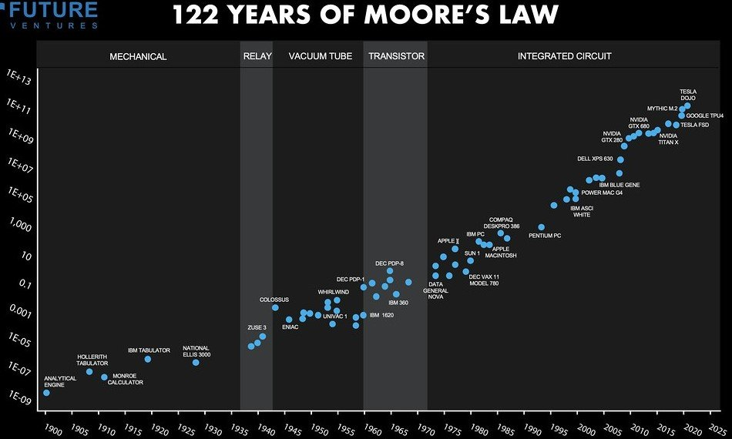
Machine Learning: Three pillars
1. Models and algorithms
  Doesn’t require knowledge engineers to find all
  functions and wire them into an “agent”
  (i.e. knowledge acquisition bottleneck / modelling)
2. Powerful and cheaper computation
  Moore’s Law(?)
Models
Computation

Slide 6
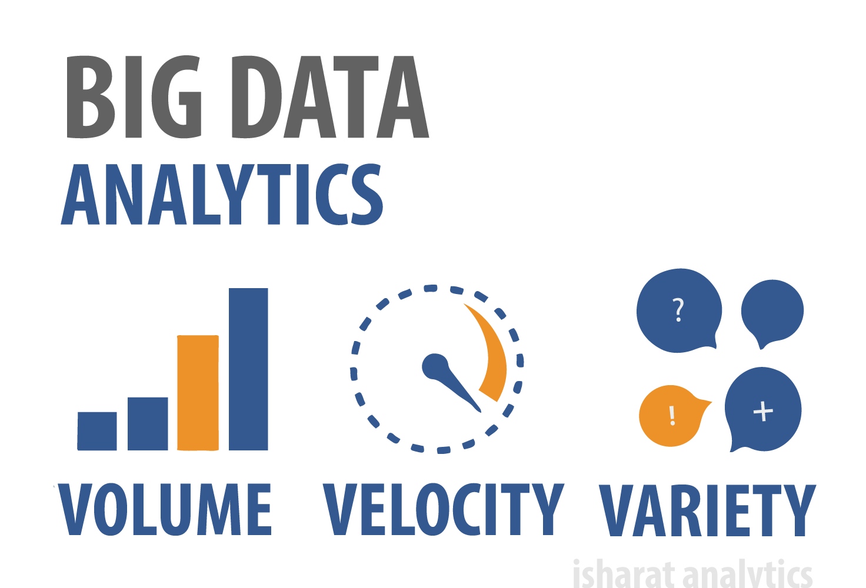
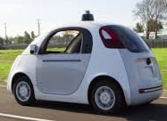


Machine Learning: Three pillars
3. Massive data warehouse
  IoT / IoE: social media; business; industries;
  devices/vehicles; things …
  Data in 2013 > all data in history
  Big data: quantity, format/dimension, speed
COMP1008 | CS Course
Machine learning | COMP4124 – Big Data Learning and Technologies
Models
Computation
Data

Slide 7
Machine Learning vs. Traditional Programs
AND
X1 | X2 | Y
1 | 1 | 1
1 | 0 | 0
0 | 1 | 0
0 | 0 | 0
Data
Computer
Output
Program
Computer
Data
Model
Output
X₁
1
Y
Tom Mitchell
X₂
1
Notes:
Human thinking! Not logic math but results driven!

Slide 8
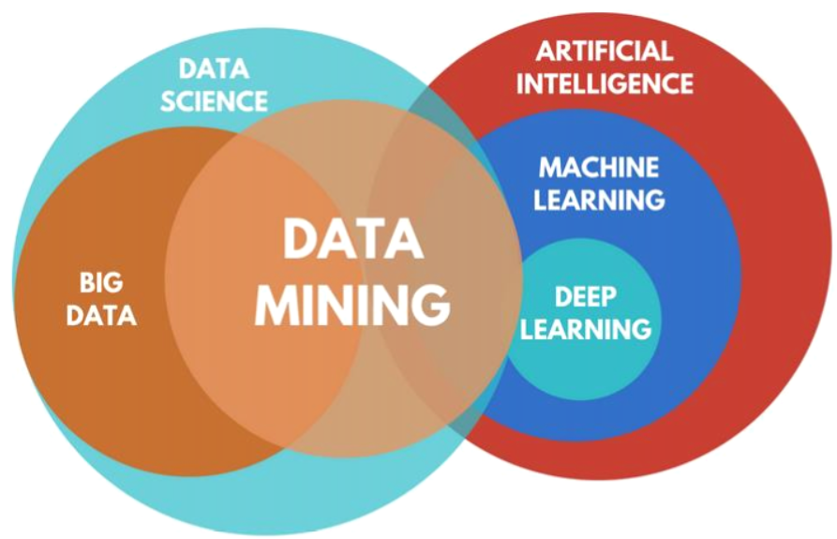
Machine Learning vs. Data Mining
Data mining: exploration and analysis of large quantities of data to discover valid, novel, useful, and ultimately understandable patterns in data.
  Valid: hold on new data with some certainty
  Novel: non-obvious to the system
  Useful: should be possible to act on the item
  Understandable: humans can interpret
  the pattern/model
Machine learning: predicts with models
Data mining: explains patterns

Slide 9
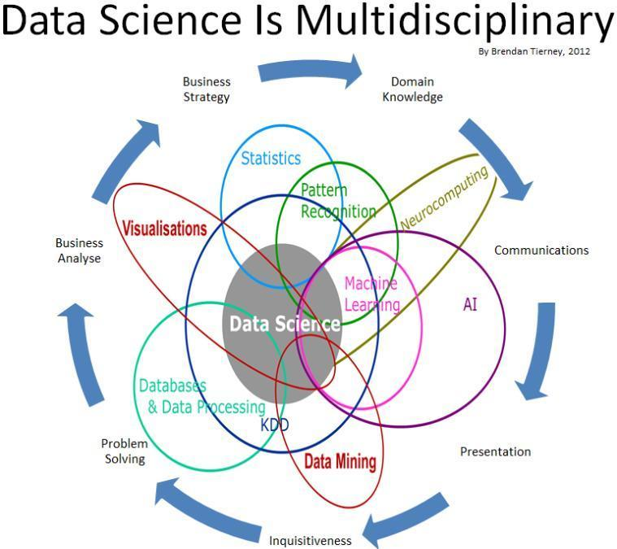
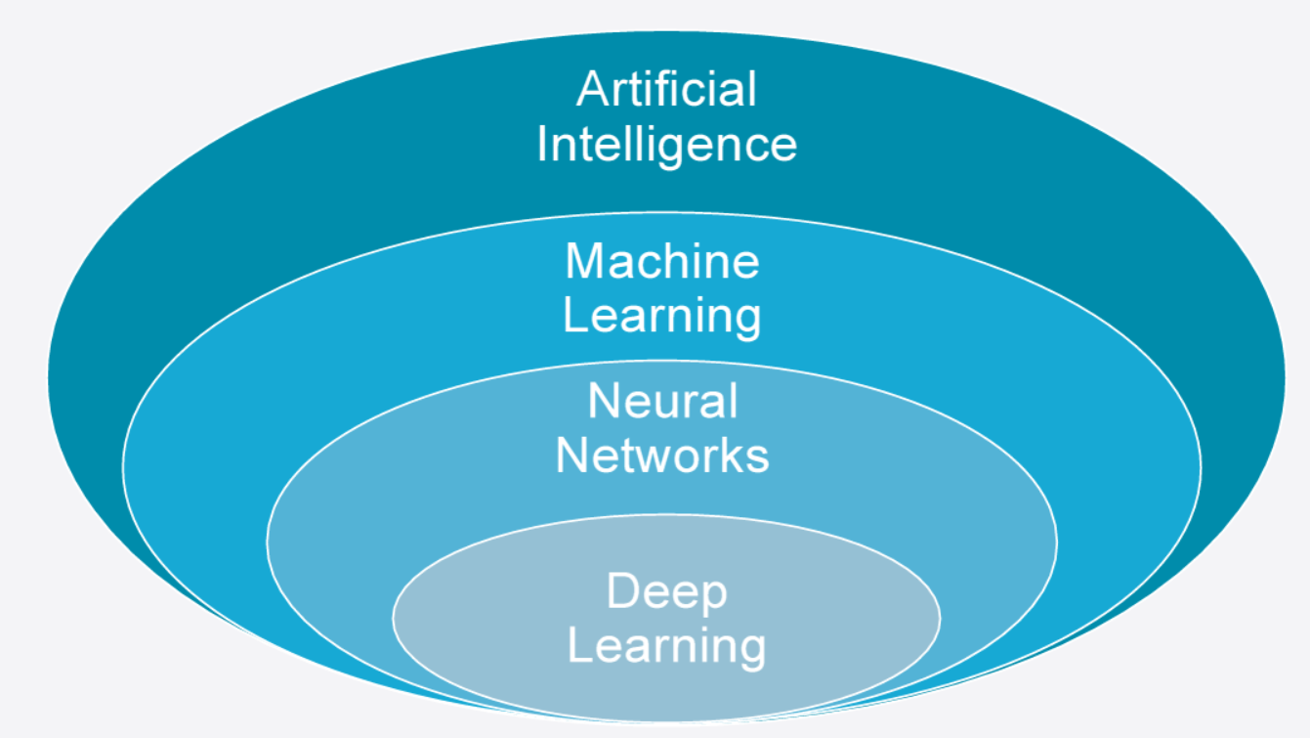
Machine Learning vs. Deep Learning vs. AI vs. Data Science

Slide 10
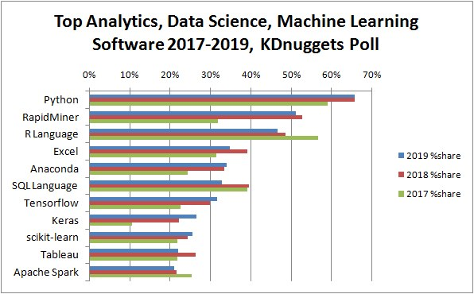
Machine Learning: Datasets & Software
UCI Machine Learning repository
KDnugget
Kaggle (also some free courses on
data science)
Python packages
  Data visualization: Matplotlib, Seaborn
  Data manipulation: NumPy, Pandas
  Machine learning: Scikit-learn
  Deep learning: TensorFlow, Keras,
  PyTorch
Computing session 0
Notes:
Coursework: DM

Slide 11
Next Week
Machine learning I: Intro
Machine learning II: Un-supervised vs. Supervised learning
Machine learning III: Supervised learning
Machine learning IV: ANN & extension
Thursday: Computing session 0
  Jupyter Notebook with Anaconda
  Python basics

