Slide 1
Computer Vision
Local Features

Slide 2
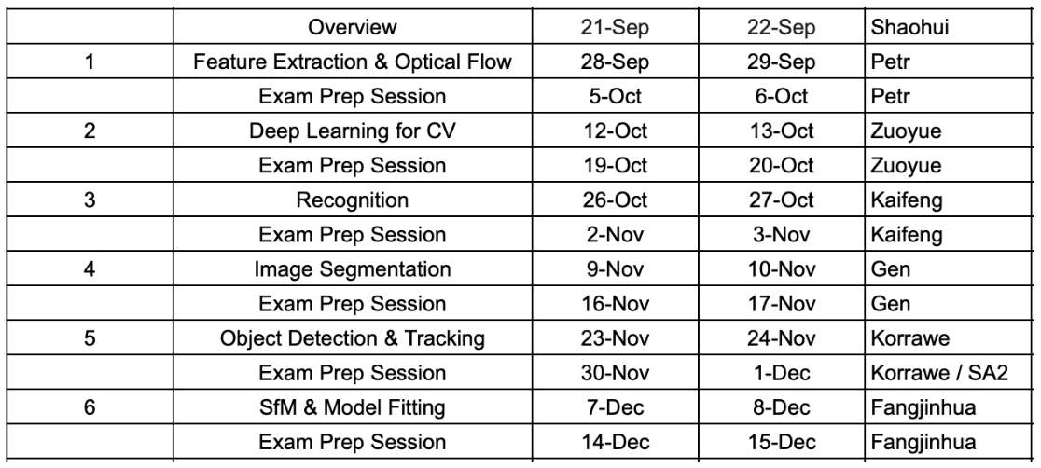
Where are we now

Slide 3
Assignment
Task 1: Harris corner detection
Task 2: Description & matching

Slide 4
Harris corner detection
Compute intensity gradients in x and y direction
Blur Images to get rid of noise
Compute Harris response
Thresholding and non-maximum suppression

Slide 5
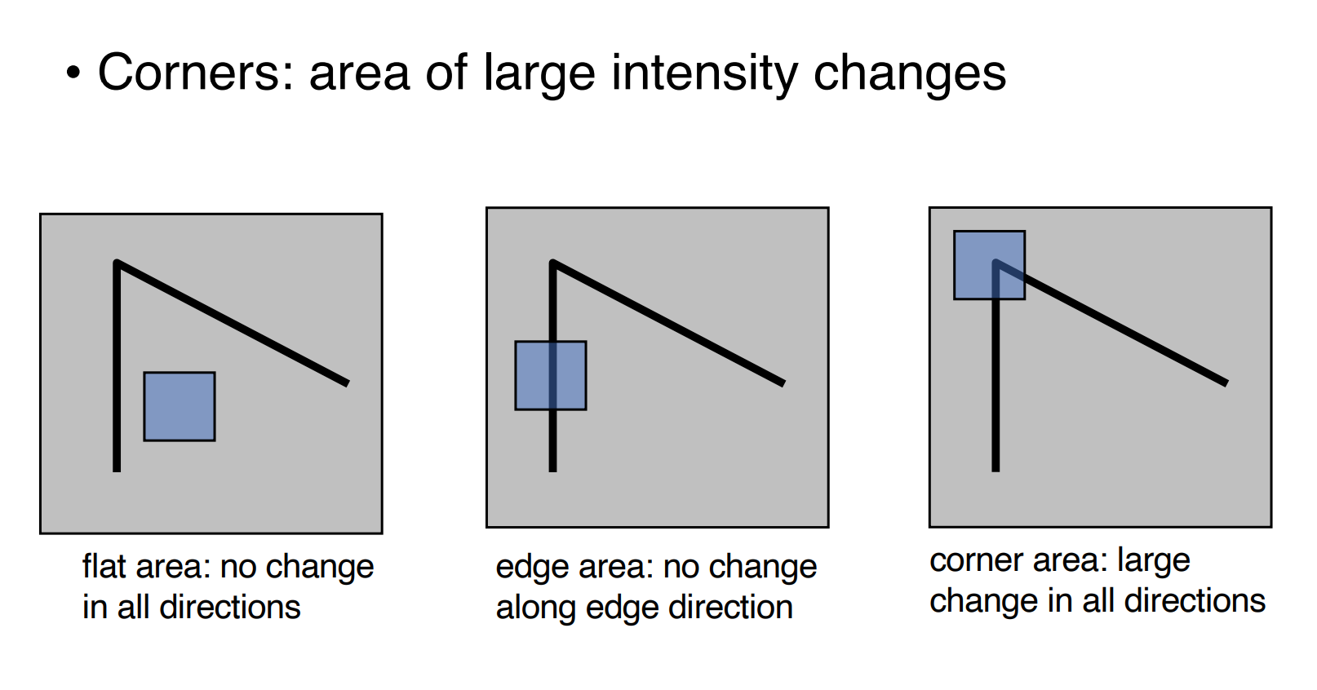
Harris corner detection

Slide 6
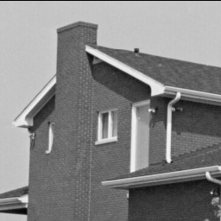
Harris corner detection

Slide 7
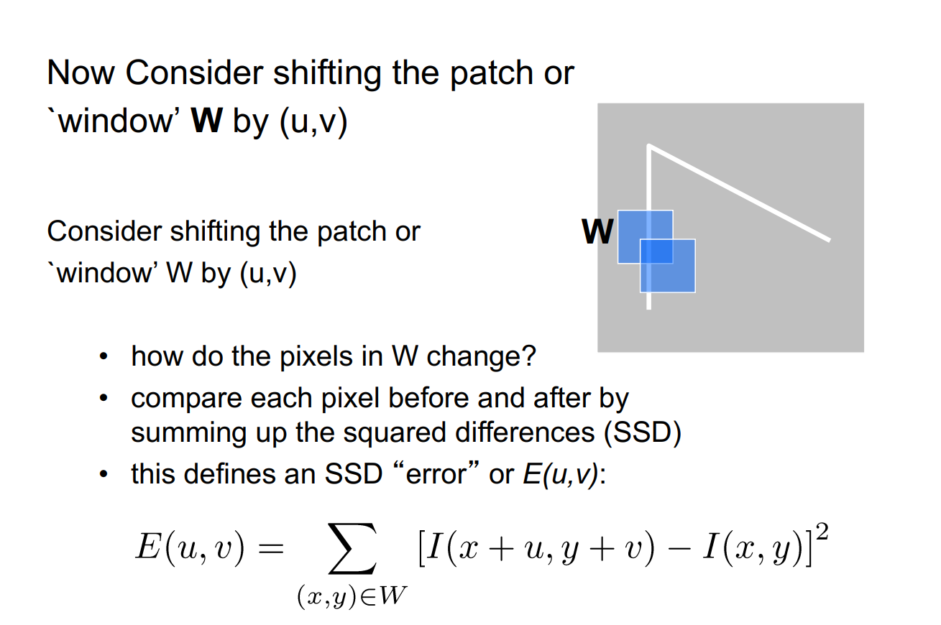
Harris corner detection

Slide 8
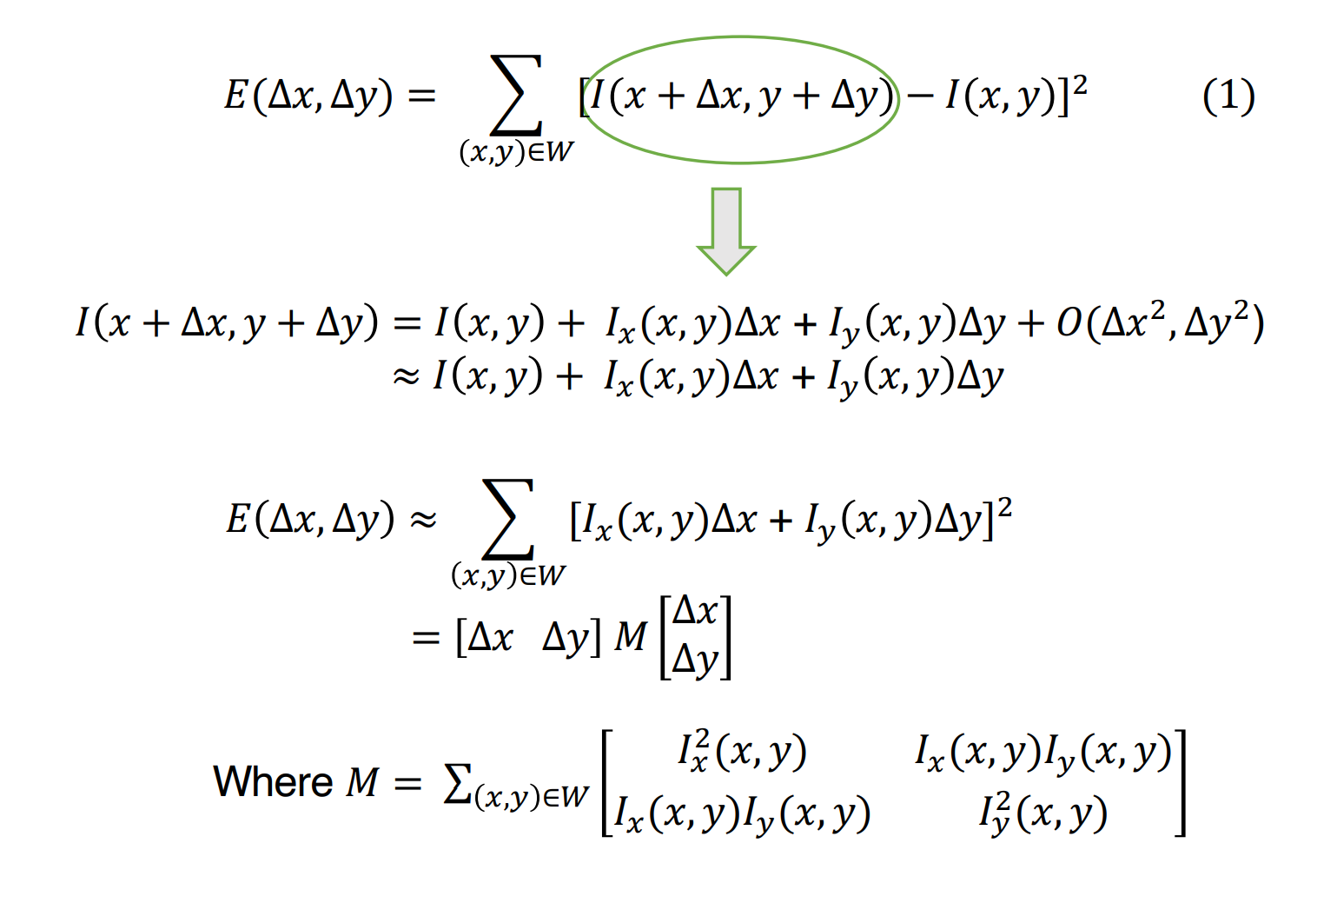
Harris corner detection

Slide 9
Harris corner detection
Taylor polynomial

Slide 10
Harris corner detection
Taylor polynomial
Negligible for small Δx, Δy.

Slide 11
Harris corner detection
Taylor polynomial

Slide 12
Harris corner detection
Taylor polynomial

Slide 13
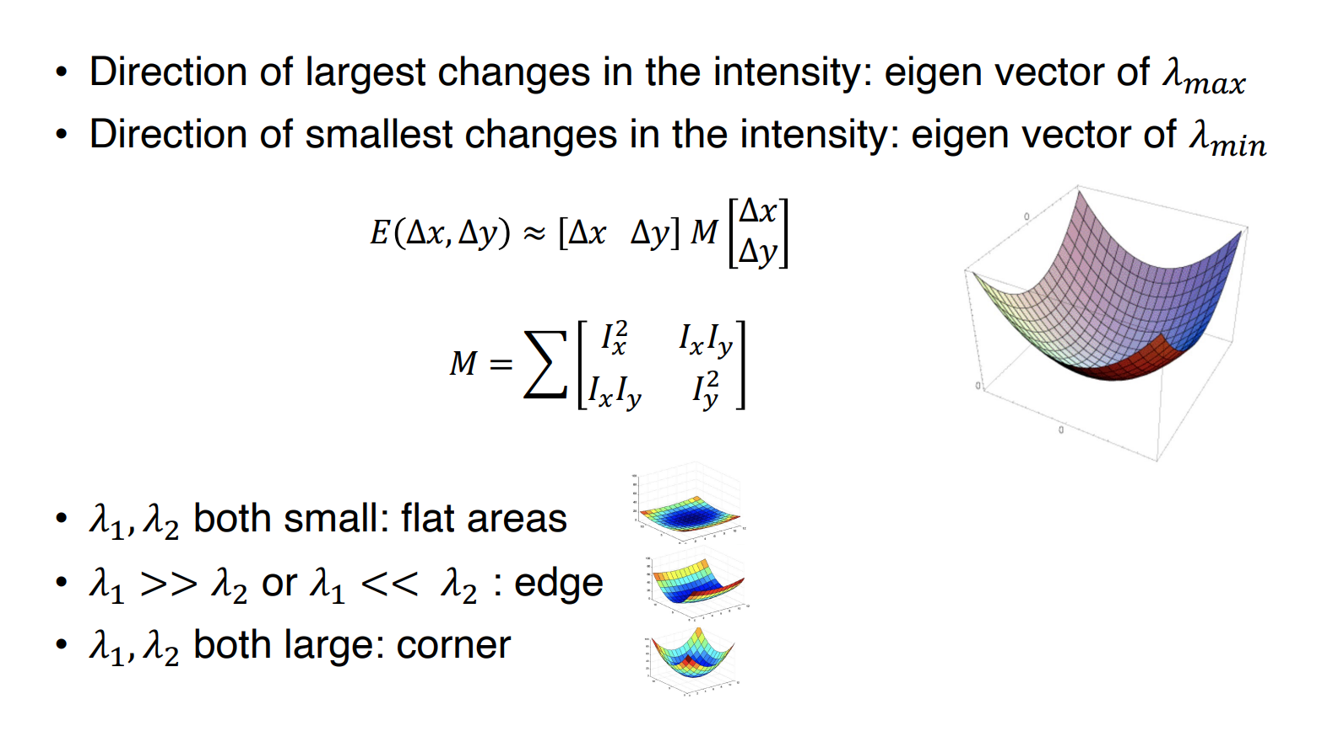
Harris corner detection

Slide 14
Harris corner detection

Slide 15
Harris corner detection
Compute intensity gradients in x and y direction
Blur gradients to get rid of noise
Compute Harris response
Thresholding and non-maximum suppression

Slide 16
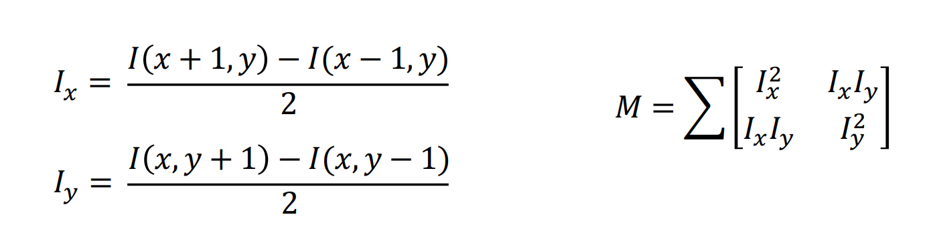
Harris corner detection
Step 1: compute image gradients
You may use scipy.signal.convolve2d

Slide 17
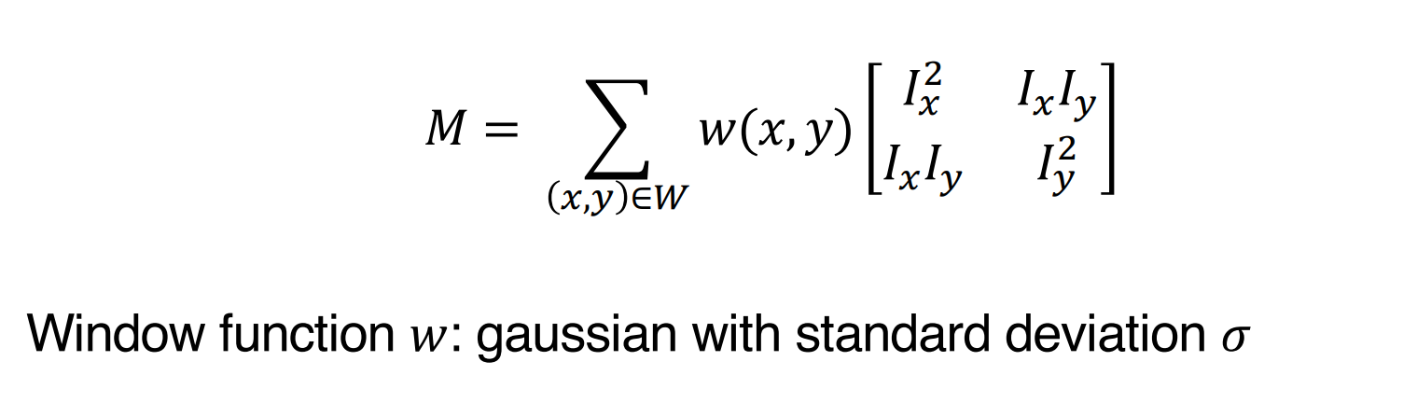
Harris corner detection
Step 2: blur the image
You may use cv2.GaussianBlur

Slide 18
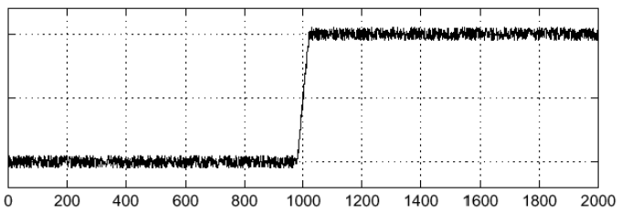
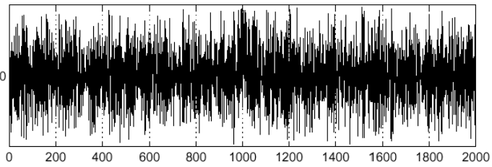
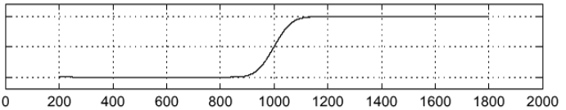
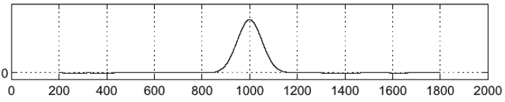
Harris corner detection
Why blur?
Intensity
Gradient
Without blur
With blur
Images taken from DZO course by Václav Hlaváč @ CTU in Prague

Slide 19
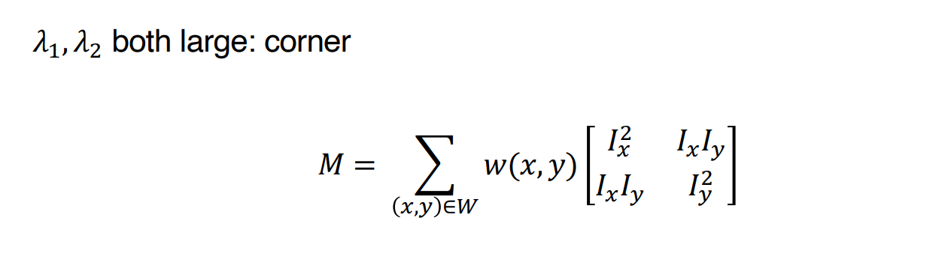
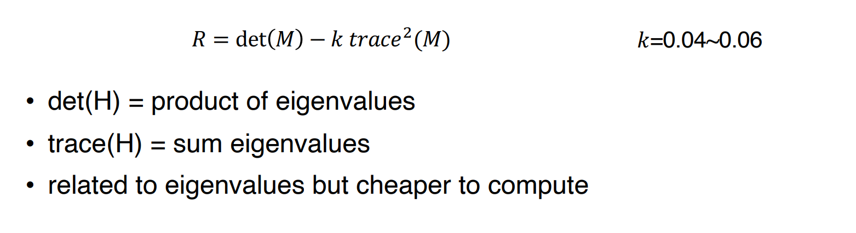
Harris corner detection
Step 3: compute Harris response

Slide 20
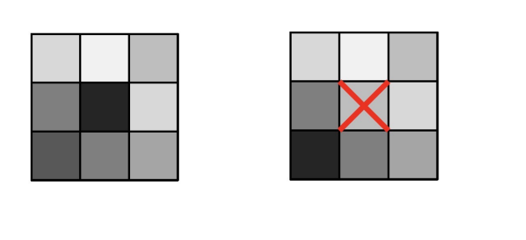
Harris corner detection
Step 4: non-maximum suppression
For every pixel above the threshold, check the surrounding pixels inside a window for the maximum response intensiy.
If the center pixel response is smaller than a pixel inside the window, remove the center pixel from the corner candidates.
You may use scipy.ndimage.maximum_filter

Slide 21

Description & Matching
Input: a pair of images
Convert to gray image -> Harris corner detection
Extract local patch descriptors
Filter out keypoints around the edges
Extract 9x9 patches around the detected keypoints as descriptor (this function is provided)

Slide 22
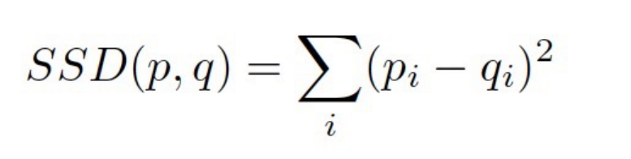
Description & Matching
Feature distances:
Make sure to avoid Python for-loop with vectorized computation.

Slide 23
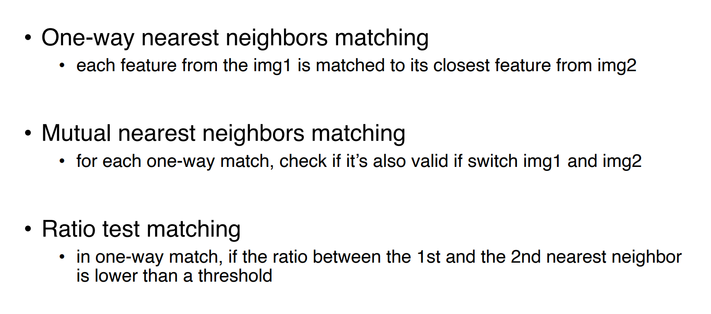
Description & Matching

Slide 24
Hand-in
Source code (please do not change the interface)
Write up a short report explaining the main steps of your implementation.
Include images showing the results and write down your comments.
By 12:00 pm on Friday 13th October, 2023 on Moodle.

