Slide 1

Modeling red fox movements Assess the potential consequences of land use changes on the movements of red foxes in the Greater Nancy Metropolis

Slide 2
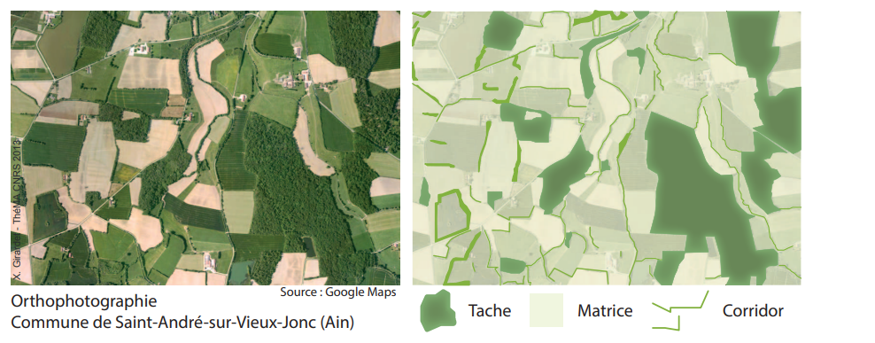
Context | What is landscape ecology ?
Landscape ecology is a sub-discipline of ecology that studies ecological processes at the landscape scale, where landscape is defined as : (1) a heterogeneous area made up of interacting ecosystems (2) a level of organization of ecological systems, superior to the ecosystem.
3 components of the landscape in landscape ecology:
Matrix : the dominant landscape ensemble that encompasses the tasks
Patch : more or less homogeneous ecosystems.
Corridors : more or less linear zones that form a network across the matrix.
Girardet, 2013

Slide 3
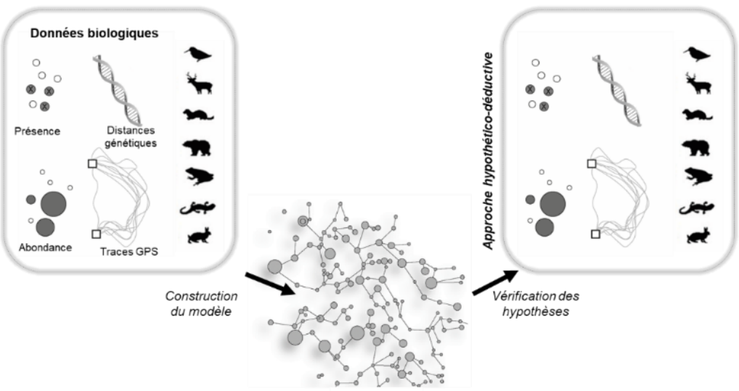

Context | Why modeling species movements ?
1
2
Decision support for development projects
Improve knowledge on functional aspects of ecosystems at landscape level
INDUCTIVE APPROACH
HYPOTHETICO-DEDUCTIVE APPROACH
Biological data
Biological data
2
1
Modeling
Approach chosen for this work
1
Construction of the model from biological data
Verification of the hypothesis with biological data
2
Notes:
Why modeling movement species ?
Little field data on species movement (cost, time)
Limitation of cartographic approaches

Slide 4
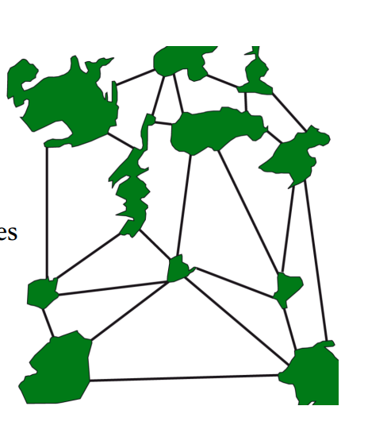
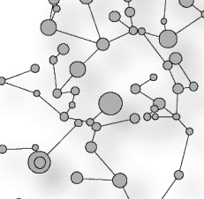
Context | What tools can be used to model species movements?
GRAPH THEORY
Generic approach that focuses on relationships between analyzed elements applied to many fields: transport, social relations, genetic links, etc.
A graph is composed of :
nodes (or vertices) linked by…
links (or edges)
LANDSCAPE GRAPHS
Landscape ecology
Softwares
Graphab
Conefor
Circuitscape
Funconn
…
Nodes = Patches
Links = Corridors

Slide 5
Context | Purpose of the current modeling
Improve knowledge on functional aspects of ecosystems at landscape level to :
Understand where the fox is most likely to live in cities to help prevent the transmission of alveolar echinococcosis
Understand how foxes and, more generally, small urban mammals may be affected by land use change induced by urbanization

Slide 6
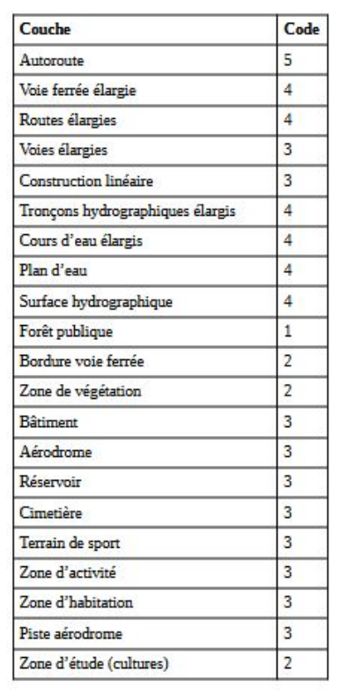
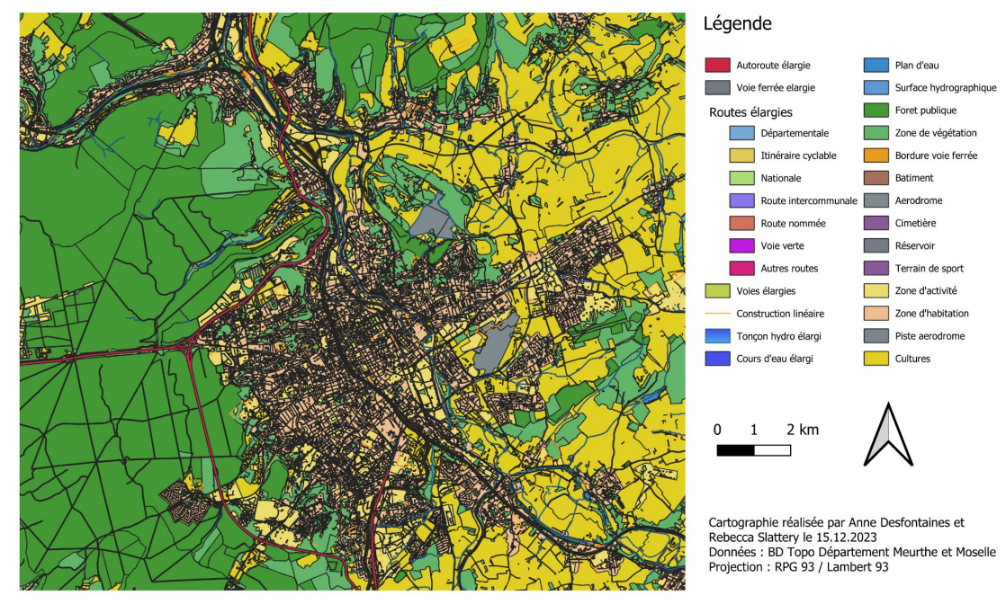
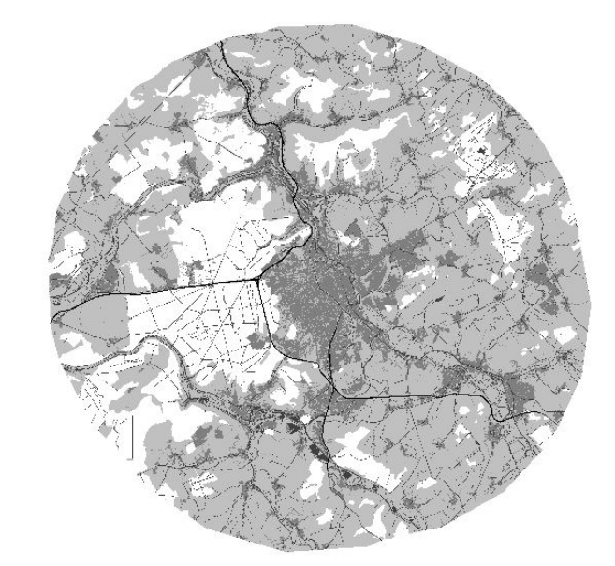
Methodology | Build a landscape map (I/II)
(2) Assigning travel costs to each type of land cover and assigning a code to each layer according to its travel cost for the species in question (the red fox) – based on literature review
2 Landscape Map (2010 & 2019)
(1) Build a land use map in the area studied (Greater Nancy Metropolis) at two different dates (2010 & 2019)

Slide 7
Methodology |Compute connectivity metrics and compare their evolution over time (I/II)
GLOBAL METRICS
LOCAL METRICS
Definition
Characterize the connectivity of an entire graph (one graph = one value).
Compare the level of connectivity of the same network before/after a development for an impact assessment: what is the loss/gain in connectivity engendered by the construction of this development?
Characterize the connectivity of a graph element (a value assigned to each node and/or link)
Compare the level of connectivity of each graph element to identify the most "important" elements (see Sheet 4, case 1).
Assess the local impact of a change in the landscape (see Sheet 4, case 2).
Interests
Metrics | Explanation
Probability of connectivity (PC) | Probability that two randomly selected individuals in the study area will come into contact, either because they are located in the same habitat patch, or because they are in two connected patches.
Equivalent connectivity (EC) | Indicates the amount of habitat that can be reached. Like the PC, it takes into account the total habitat area and the connections between habitat patches.
Metrics | Explanation
Interaction flow (IF) | Indicator of potential interactions between spot i and all other spots in the network. It takes into account the distance between spot i and the other spots, and the capacities of i and the other spots.
Betweenness Centrality (BC) | Indicates the potential flow through links and spots. It takes into account the distance between task i and the other tasks, and the capacities of i and the other tasks.
→ Compare connectivity metrics between 2010 and 2019 to see how they have evolved

Slide 8
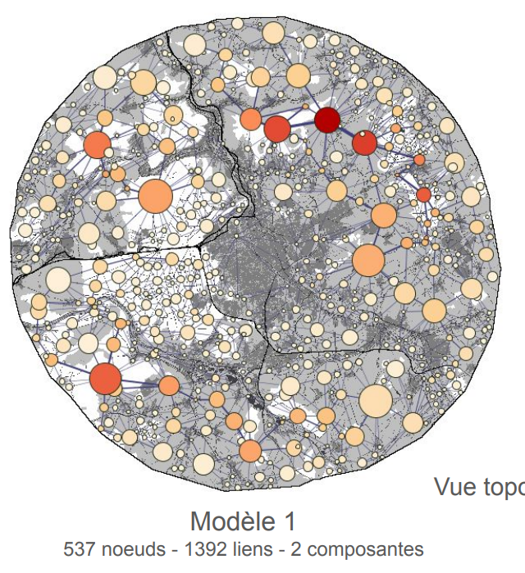
Results | What does it look like ?
Extract from previous work
Parameters of the model:
Minimal habitat size : 20 hectares
Habitats of the red fox : code 1 & 2 (forest, vegetation area, crops, railroad line edge)
Link set: planar, least-cost paths in 5 classes including intra-patch distances
Creation of a graph pruned to the maximum distance covered by the red fox (8 km, cost equivalent = 33877)
Use of BC metric (betweenness centrality metric), with p=0.05 (maximum distance)
Interpretation of the results :
In this model, we observe a discontinuity in the ecological network, divided into two components on either side of the freeway. The north-western quarter of the model is totally isolated from the rest of the network. No links cross the barrier formed by the freeway, as the cost is too high.
537 nods – 1392 links – 2 components
NB : (1) The darker the nods, the more central the patch is (2) The size of the circles is proportional to the capacity of the habitat patches.
Notes:
* betweenness centrality is a measure of centrality in a graph based on shortest paths. In graph theory and network analysis, indicators of centrality assign numbers or rankings to nodes within a graph corresponding to their network position. Applications include identifying the most influential person(s) in a social network, key infrastructure nodes in the Internet or urban networks, super-spreaders of disease, and brain networks.^{[1][2]} Centrality concepts were first developed in social network analysis, and many of the terms used to measure centrality reflect their sociological origin.^{[3]}

Slide 9


Quizz - What types of questions am I supposed to be able to answer ?
How are foxes going ?
Where do foxes like to go ?
How do you track foxes ?
What types of habitat foxes are most likely to occupy ?
How many foxes are there in Nancy ?
Which types of roads foxes are most likely to use ?
Where do foxes actually go in Nancy ?

