Slide 1
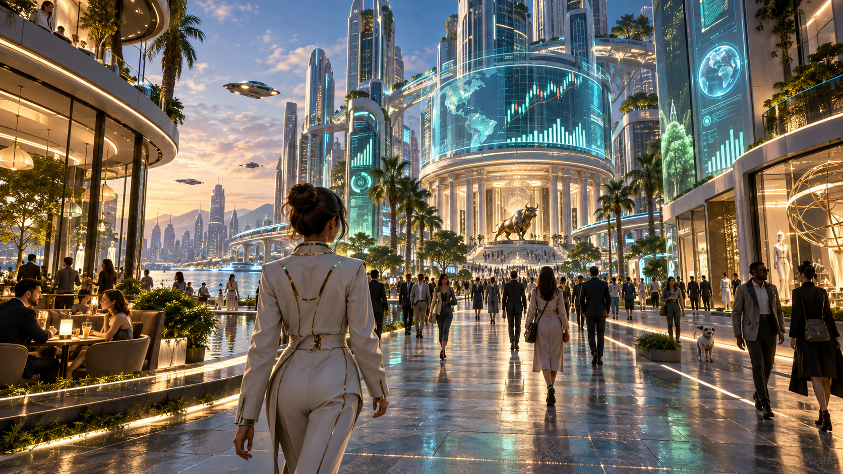
A
AMPLIWORLD
THE MARKET
BECOMES A WORLD
Trade creates wealth. The city gives wealth meaning.
Begin with $10,000. Read the world, form conviction, live with the result—and build a life the market makes possible.
FLAGSHIP PRODUCT VISION · AMPLIALPHA, INC.
Notes:
AI-generated concept art. Product vision; not a claim that every depicted feature is implemented.

Slide 2

A
AMPLIWORLD
02
A GAME THAT
STARTS WITH A TRADE
News, consumption, politics and crowd behavior enter one world state. The player chooses the asset, timing, size and leverage. The world remembers the consequence.
VIRTUAL MARKET · SERVER-EXECUTED QUOTES · 1×–5× LEVERAGE
Notes:
AI-generated concept art. All trading is virtual. Leverage is an in-game simulation only.

Slide 3
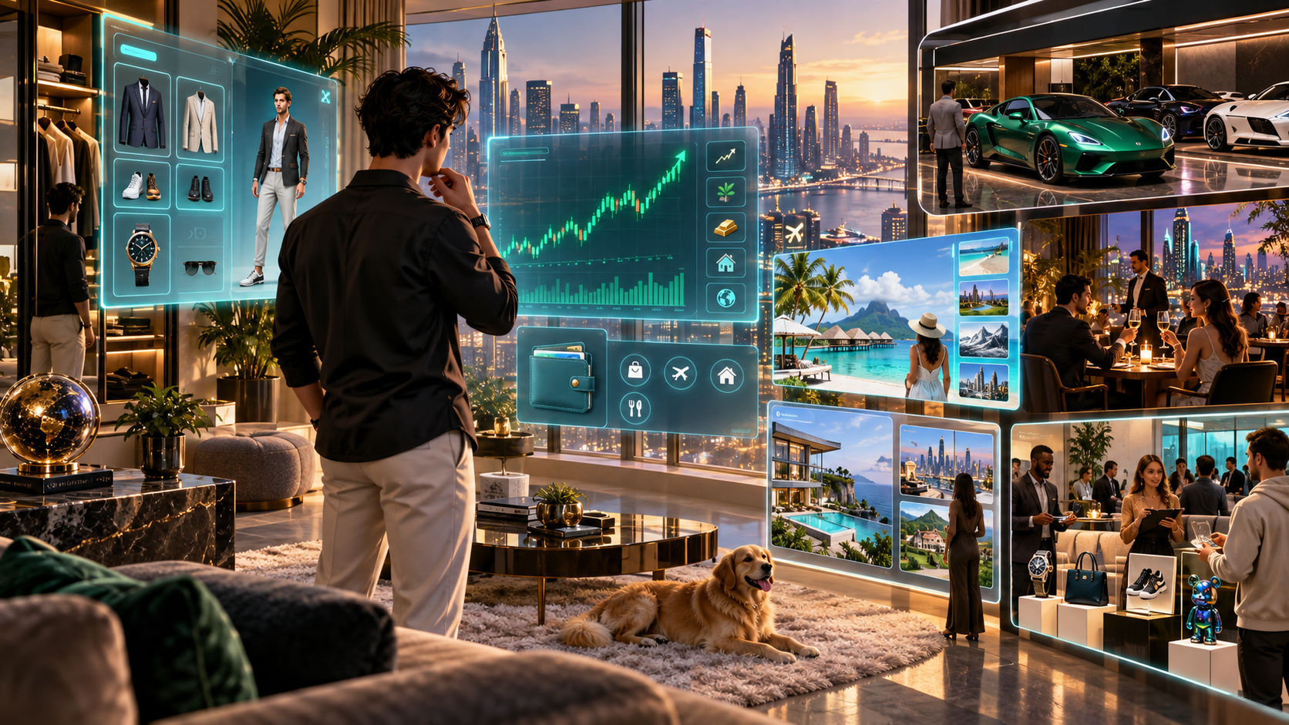
A
AMPLIWORLD
03
RETURNS BECOME
A LIFE
A portfolio is no longer only a curve. It becomes a home, a car, a journey, a wardrobe, a reputation—and permission to enter the next district.
TRADE
→
OWN
→
DISPLAY
AI CONCEPT ART
Notes:
AI-generated concept art. Lifestyle systems and marketplace are product-direction illustrations.

Slide 4
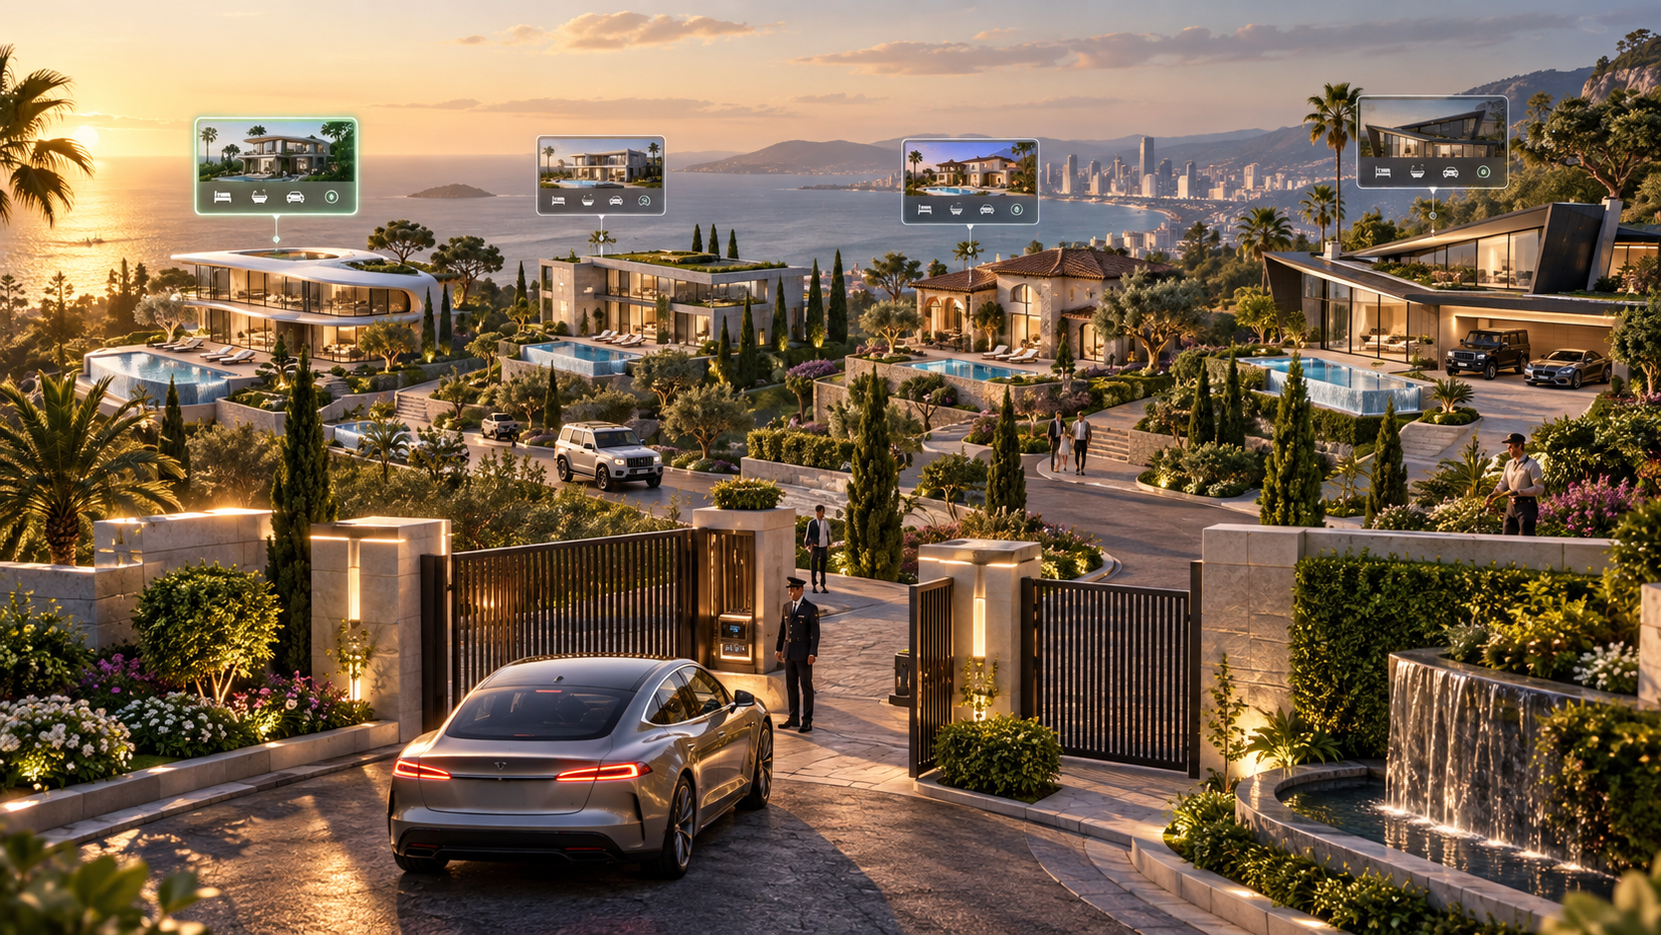
A
AMPLIWORLD
04
A CITY WITH A
REAL GAME ECONOMY
Most property is earned with virtual dollars. The rarest estate can be reached through extraordinary play—or through a cosmetic Founders edition that never improves trading power.
$1 = 100 AMPLI CREDITS
FOUNDERS EDITION · 49,900 CREDITS
NEVER SELL RETURNS, LEVERAGE OR RANK
Notes:
AI-generated concept art. Premium pricing is a hypothesis. Premium property must not grant trading power or ranking advantage.

Slide 5
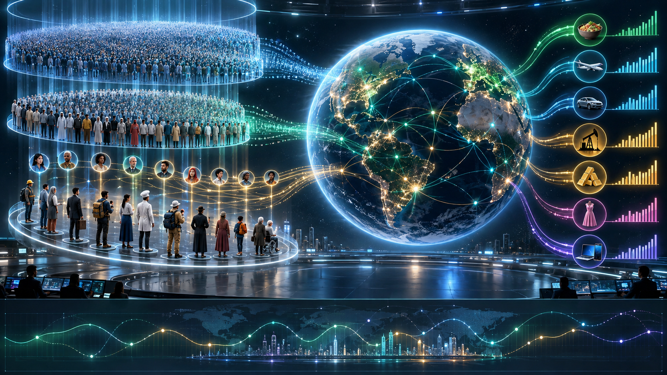
A
AMPLIWORLD
05
8.3 BILLION PEOPLE
DO NOT BELONG ON ONE SCREEN
The population frame runs behind the world. Cohorts create behavior, active agents form memory, and persistent NPCs make the simulation visible.
8.3B PERSONAS
1M WEIGHTED CORE
ACTIVE COHORTS
VISIBLE NPCs
The game creates engagement. Engagement becomes a richer market sensor.
Notes:
Research foundation includes MatrAIx Persona 8B. The proposed product uses hierarchical sampling; it does not run 8.3 billion concurrent LLMs or render 8.3 billion NPCs.

