Slide 1
TRACKING DOCS
THAT DON'T SUCK
Benedikt Buchert · Up Reply · Analytics Pioneers Summit 2026
Notes:
Hi! 30 minutes, mostly live demo. Questions any time.

Slide 2




HI, I'M BENEDIKT
tracking
martech engineering
munich
github.com/benedikt-buchert
Notes:
Tracking, martech engineering at Up Reply, based in Munich. Keep it under 20 seconds.

Slide 3






HOW DO YOU DOCUMENT YOUR TRACKING?
hands up ✋
excel
confluence
google doc
"ask dave"
"the code is
the doc"
nothing
Notes:
Ask for each one, get hands up. Expect most hands on Excel -> next slide.

Slide 4
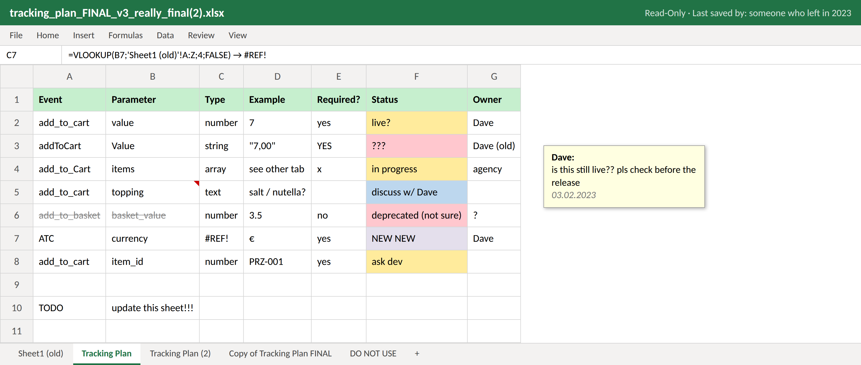
SOUND FAMILIAR?
Notes:
Let the room read it. Point at: 4 spellings of add_to_cart, value as string, #REF!, the comment from 2023, the tab called DO NOT USE.

Slide 5
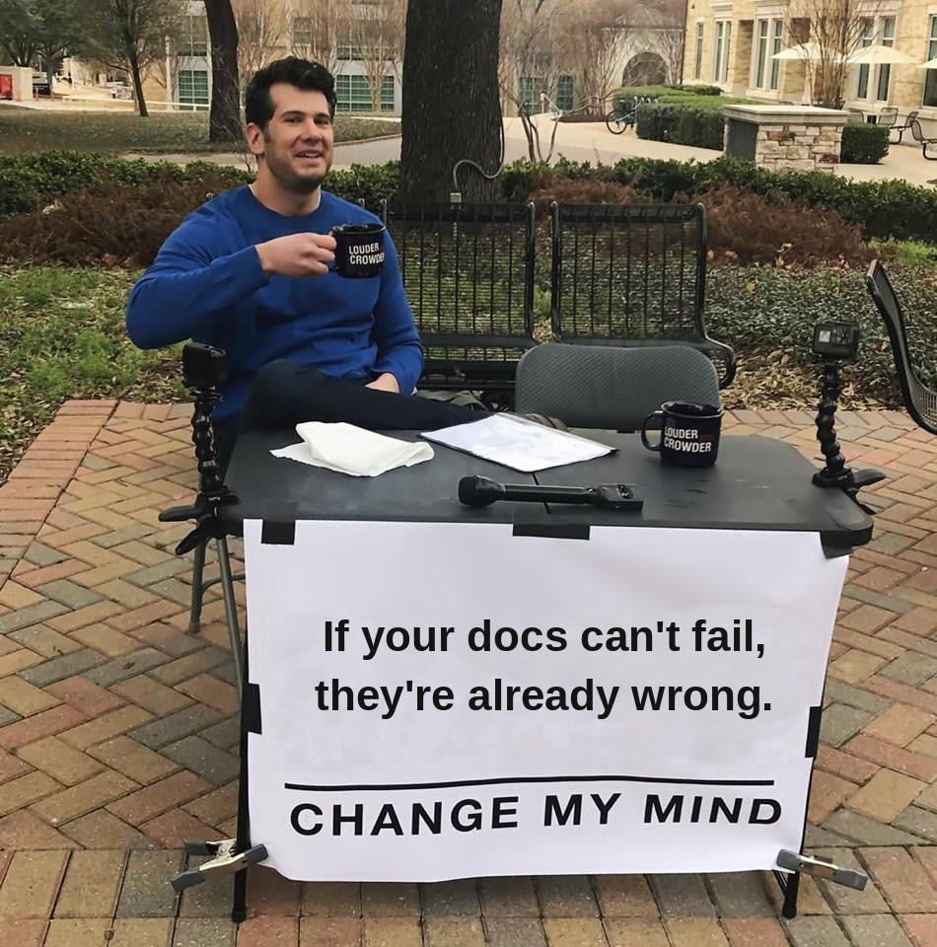
excel can't fail a test.
Notes:
Let the meme land. Then: the sheet is wrong and nothing tells you. Docs should be able to fail.

Slide 6



let's build docs that can fail.
→
→
design
docs
validate
Notes:
Switch to the demo. See README.md.

Slide 7
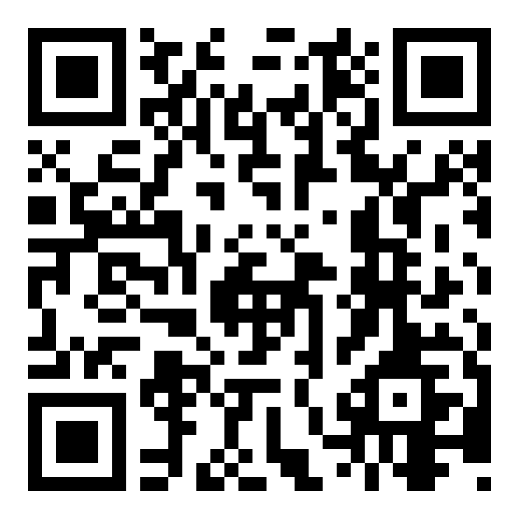
STEAL THIS
github.com/benedikt-buchert/tracking_docs
start in one line
npx create-docusaurus@3.7.0 my-docs \
https://github.com/benedikt-buchert/tracking_docs.git
live demo
tracking-docs-demo.buchert.digital
⭐ stars welcome. questions now!
Notes:
Leave this up during Q&A.

