Slide 1
CRC 1644 - Z2 Progress
Prof. Dr. Zoran Nikoloski
Student worker: Benedikt Haarscheidt

Slide 2
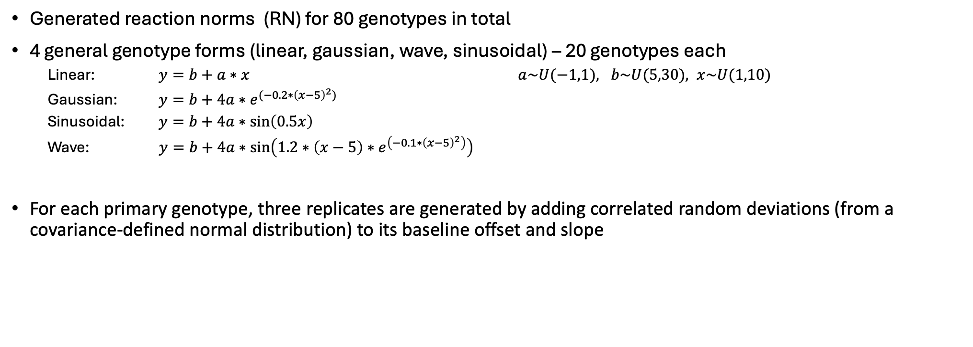
Data Synthesis
Generated reaction norms (RN) for 80 genotypes in total
4 general genotype forms (linear, gaussian, wave, sinusoidal) – 20 genotypes each
  Linear: $y=b+a∗x$ $a\sim U(−1,1), b\sim U(5,30), x\sim U(1,10)$
  Gaussian: $y=b+4a∗e^{{(−0.2∗\left(x−5\right)}^{2})}$
  Sinusoidal: $y=b+4a∗\sin\left(0.5x\right)$
  Wave: $y=b+4a∗\sin\left(1.2∗\left(x−5\right)∗e^{\left(−0.1∗{\left(x−5\right)}^{2}\right)}\right)$
For each primary genotype, three replicates are generated by adding correlated random deviations (from a covariance-defined normal distribution) to its baseline offset and slope
Notes:
https://besjournals.onlinelibrary.wiley.com/doi/10.1111/j.2041-210X.2011.00160.x

Slide 3
Data Synthesis
Four reaction-norm shapes shown as the “mother” genotype (solid lines) and three replicate curves (dashed lines) generated by sampling from a covariance structure on intercept and slope. In total 80 genotypes - 20 per form - were simulated.
Trait-value density histograms and kernel densities for each reaction norm type.

Slide 4
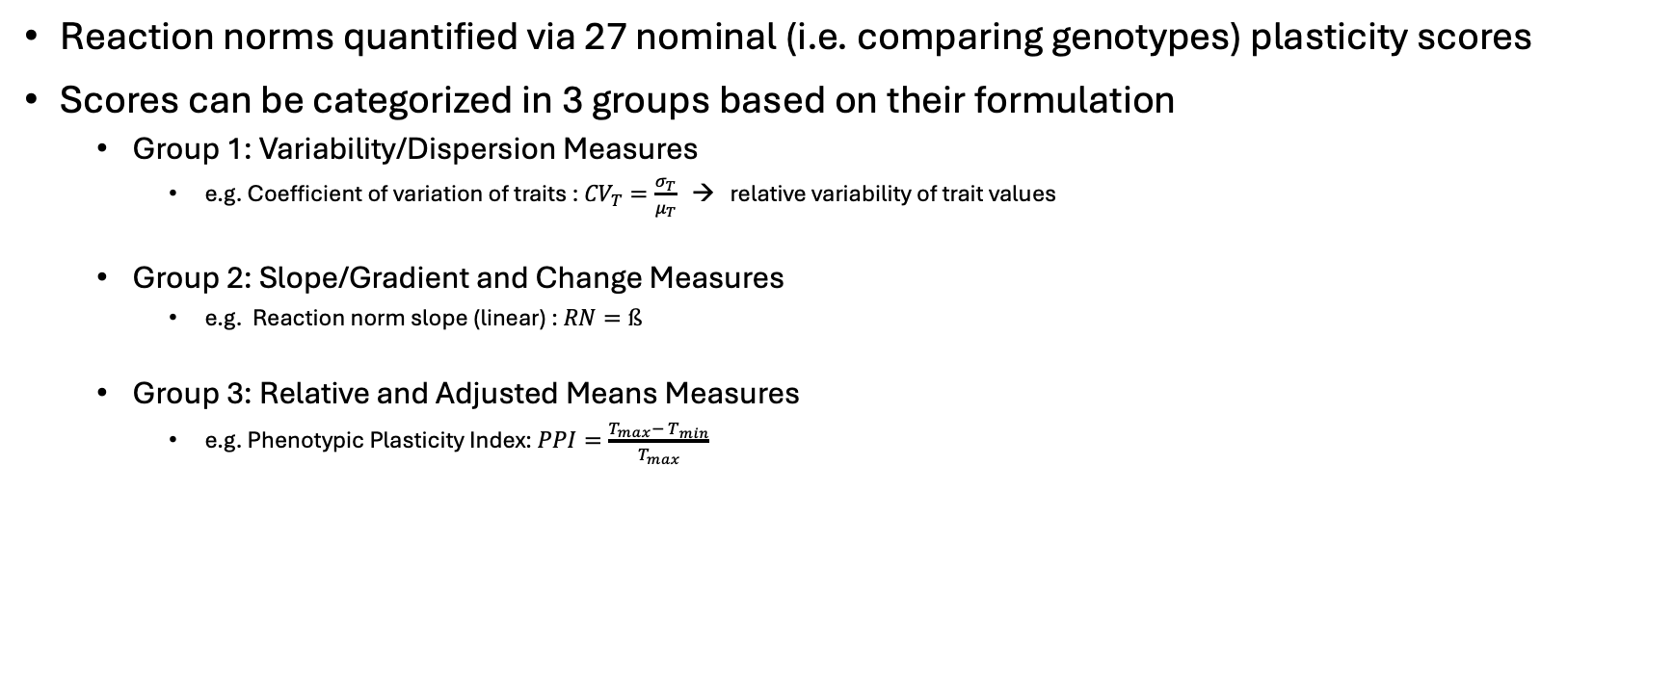
Plasticity scores
Reaction norms quantified via 27 nominal (i.e. comparing genotypes) plasticity scores
Scores can be categorized in 3 groups based on their formulation
  Group 1: Variability/Dispersion Measures
    e.g. Coefficient of variation of traits : ${CV}_{T}=\frac{σ_{T}}{μ_{T}}$ → relative variability of trait values
  Group 2: Slope/Gradient and Change Measures
    e.g. Reaction norm slope (linear) : $RN=ß$
  Group 3: Relative and Adjusted Means Measures
    e.g. Phenotypic Plasticity Index: $PPI=\frac{T_{max}− T_{min}}{T_{max}}$

Slide 5
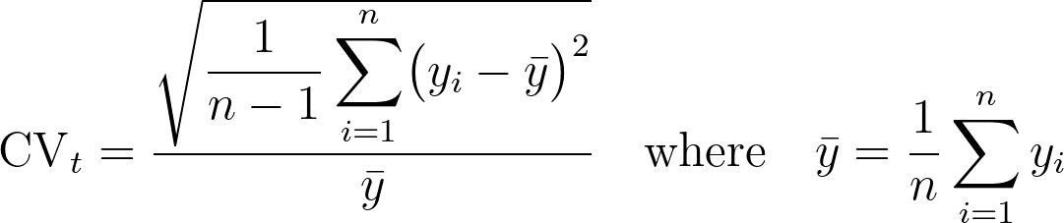
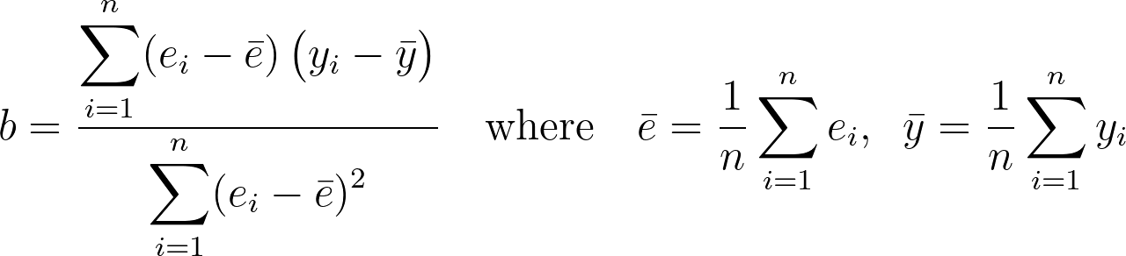
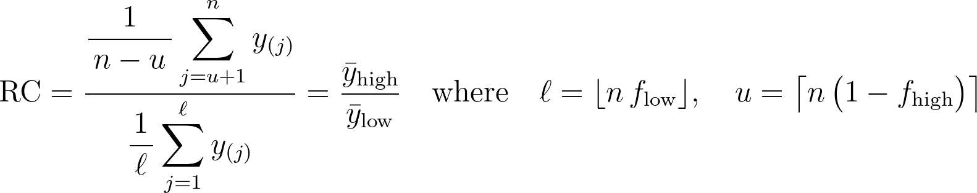
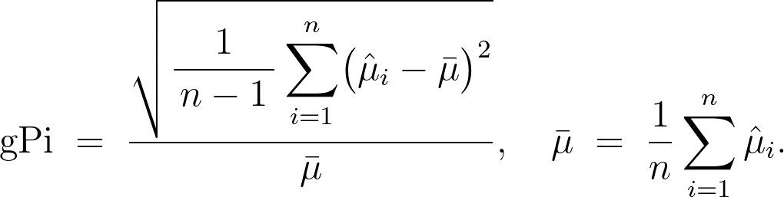
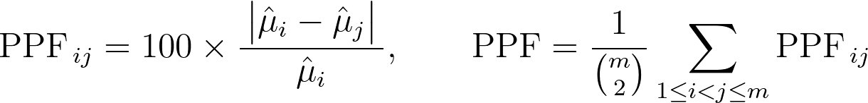
Plasticity score equations
Coefficient of Variation for Plasticity (CVt)
Slope of reaction norm (RN)
D Slope
Response Coefficient
Grand Plasticity (gPi)
Phenotypic Plasticity Factor
Reaction Norm non-linear (RNN)

Slide 6
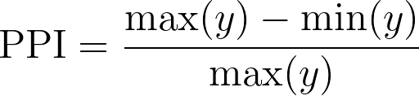
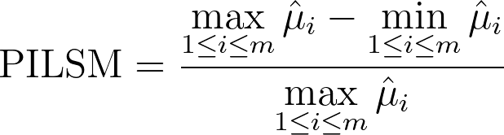
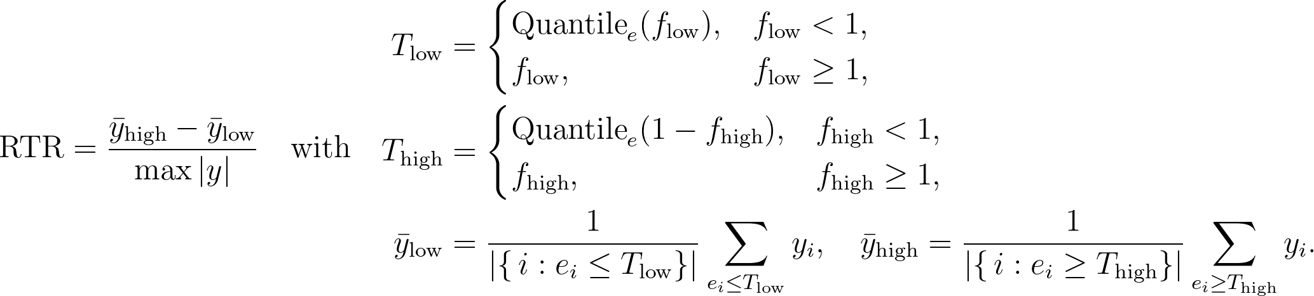
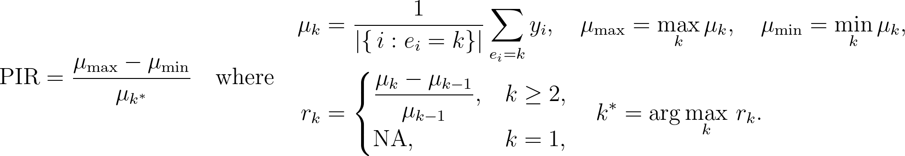
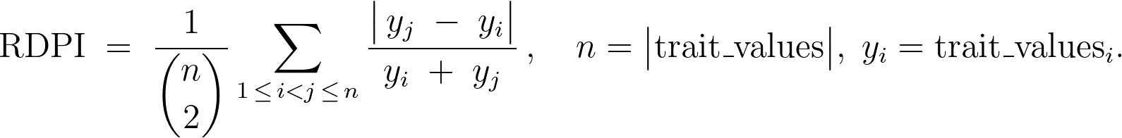
Plasticity score equations
Phenotypic Plasticity Index
Proportional Inter‐Median Difference (PImd)
Proportional Inter‐Least Square Mean Difference
Relative Trait Response
Phenotypic Instability Ratio
Relative Distance Plasticity Index
Environmental Sensitivity Performance Index
Environmental Sensitivity Performance Index for Individual Differences

Slide 7
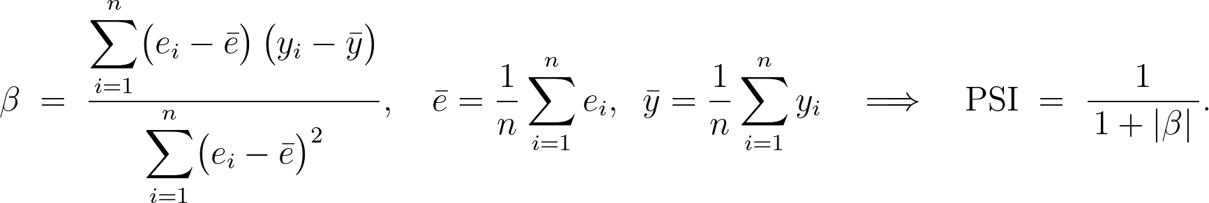
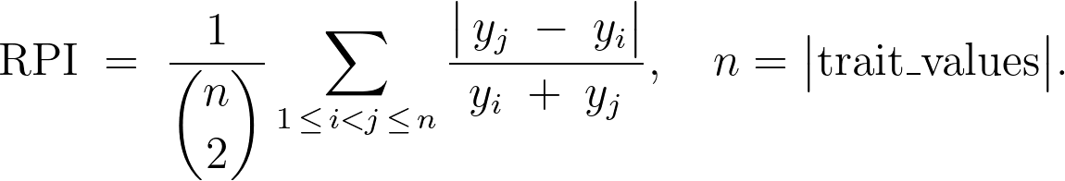
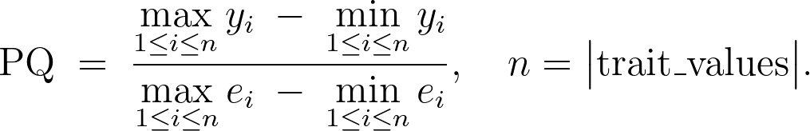
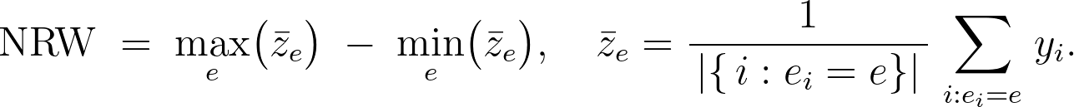
Plasticity score equations
Phenotypic Stability Index
Relative Plasticity Index
Plasticity Quotient
Phenotypic Range
Norm of Reaction Width
Environment‐Specific Plasticity
Coefficient of Environmental Variation
Phenotypic Flexibility Index
Absolute Plasticity Coefficient

Slide 8
Plasticity score equations
Stability Index
Relative Stability Index
Environmental Variance Sensitivity

Slide 9
Realisation and clustering of plasticity-score patterns in simulated data
Boxplots of the 27 plasticity scores, aggregated over all genotype forms, for a resolution of five equidistant measurements along a tenstep environmental gradient, showing medians, interquartile ranges, and outliers.
Hierarchical clustering of the plasticity-score realisations for the linear genotype form, using correlation distance; despite differences in form, the clustering structures between different genotype forms are highly concordant.
Adjusted Rand Index for pairwise comparisons of the clustering solutions, quantifying the agreement between genotype-specific and combined clusterings. Distributions and clusterings were obtained using a sampling size of 5 equidistant samples on the environmental spectrum.

Slide 10
Realisation of plasticity-score in simulated data
Boxplots of the 27 plasticity scores, aggregated over all genotype forms, for a resolution of five equidistant measurements along a ten step environmental gradient, showing medians, interquartile ranges, and outliers.

Slide 11
Clustering of plasticity-score in simulated data

Slide 12
Hierarchical clustering of plasticity-score correlation distances by genotype response type.
Dendrograms show complete-linkage clustering of plasticity indices based on their correlation distances, separately for (A) Gaussian, (B) Sinusoidal, and (C) Wave reaction-norm shapes, as well as (D) all shapes combined. Despite differing underlying genotype forms, the same clusters of plasticity scores emerge in each panel, indicating robust grouping of indices by their summary-statistic signatures.

Slide 13
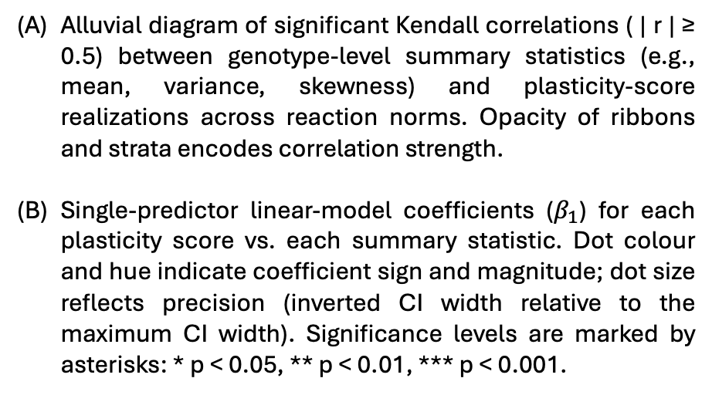
Links between trait-distribution statistics and plasticity indices
Alluvial diagram of significant Kendall correlations ( | r | ≥ 0.5) between genotype-level summary statistics (e.g., mean, variance, skewness) and plasticity-score realizations across reaction norms. Opacity of ribbons and strata encodes correlation strength.
Single-predictor linear-model coefficients ($β_{1}$) for each plasticity score vs. each summary statistic. Dot colour and hue indicate coefficient sign and magnitude; dot size reflects precision (inverted CI width relative to the maximum CI width). Significance levels are marked by asterisks: * p < 0.05, ** p < 0.01, *** p < 0.001.

Slide 14
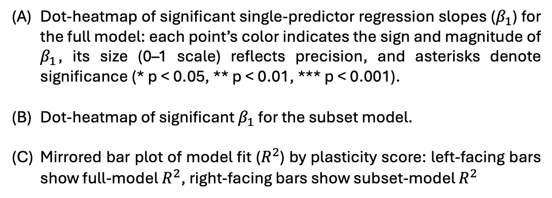
Comparison of regression coefficients and model fit across full and subset models.
Dot-heatmap of significant single-predictor regression slopes ($β_{1}$) for the full model: each point’s color indicates the sign and magnitude of $β_{1}$, its size (0–1 scale) reflects precision, and asterisks denote significance (* p < 0.05, ** p < 0.01, *** p < 0.001).
Dot-heatmap of significant $β_{1}$ for the subset model.
Mirrored bar plot of model fit ($R^{2}$) by plasticity score: left-facing bars show full-model${ R}^{2}$, right-facing bars show subset-model $R^{2}$

Slide 15
Effects of sampling resolution on plasticity-score and trait distribution metrics
Boxplots show the distribution of plasticity-score realizations (blue) and trait-distribution summary statistics (red) across sampling designs ranging from two extreme environments to fifty evenly spaced samples along the environmental gradient. Each paired boxplot illustrates how increasing the number of equidistant samples alters the distributions of plasticity scores, whereas the central tendency and dispersion of the underlying trait-distribution metrics remain essentially stable.

Slide 16
Sampling effort effects on plasticity scores and trait-statistic correlations
Dot-chart of per-metric slopes for the effect of sample size on plasticity-score realizations. Points are colored “robust” (blue) or “sample-size sensitive” (red) based on a combined magnitude–significance rule; horizontal bars denote 95% confidence intervals.
Heatmap of the slopes from linear models predicting each score–summary-statistic correlation as a function of sample size. Tile colors indicate the slope sign and magnitude and overlaid labels show the corresponding p-values.

Slide 17
Sampling effort effects on plasticity-score realizations
Dotchart of slope estimates from linear mixed-effects models quantifying the influence of sample size on each plasticity metric, with nine trait-distribution summary statistics included as confounders. Points are colored by classification—“robust” (blue) or “sample-size-sensitive” (red)—according to effect magnitude and BH-adjusted p-values, and horizontal bars denote 95% confidence intervals.

