Slide 1
Implementation of Routing in Plantage
Bachelor Thesis of Benedikt Schmidt
Supervisor: M.Sc. Pang-Yen Chou
Supervising Professor: PD Dr.-Ing. Helmut Gräb

Slide 2
Structure
analog circuits
Plantage
constraints for the layout
claims
overview of existing algorithms
implemented algorithm(s)
results

Slide 3
Analog Circuits
surroundings are analog
used in for example communications engineering
exact voltage level
problems with noise, temperature
more complex layouts
layout still often done manually

Slide 4
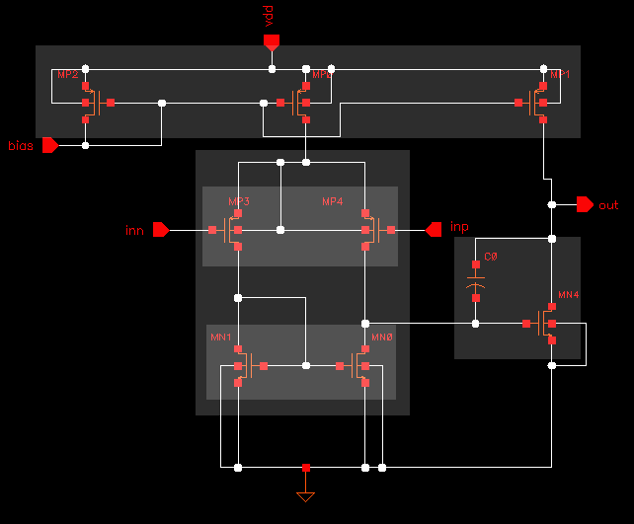
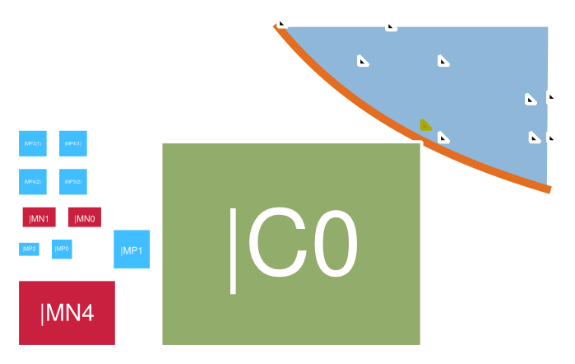
Plantage
hierarchical placer
several addition methods of shapes
no routing (beside common centroids)
produces several possible placements → shapefunction

Slide 5
Constraints for the Layout
not sensitive to noise
not sensitive to temperature gradients

Slide 6
Methods to fulfill the Constraints
symmetries
common centroids
guards

Slide 7
Constraints for the Routing
low resistance
small capacitive couplings
symmetric routes
design rule clean

Slide 8
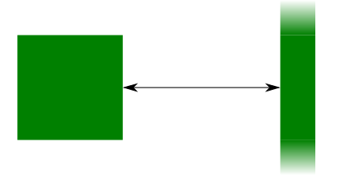
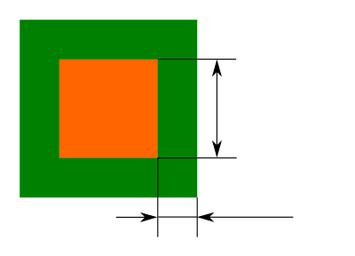
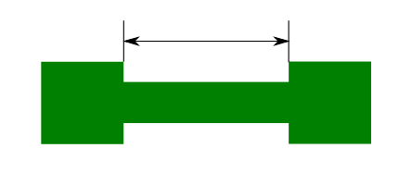
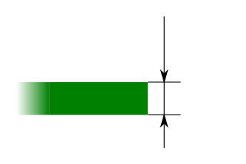
Design Rules
minimum distance
minimum enclosure
minimum notch
minimum width

Slide 9
Claims
Implementation of basic routing, considering
  design rules
  guard rings
  symmetries
  parasitics
easy to replace by different algorithm

Slide 10
Overview of existing Algorithms
basic algorithms
steiner routing
sophisticated algorithms
template based router
router integrated into the placer

Slide 11
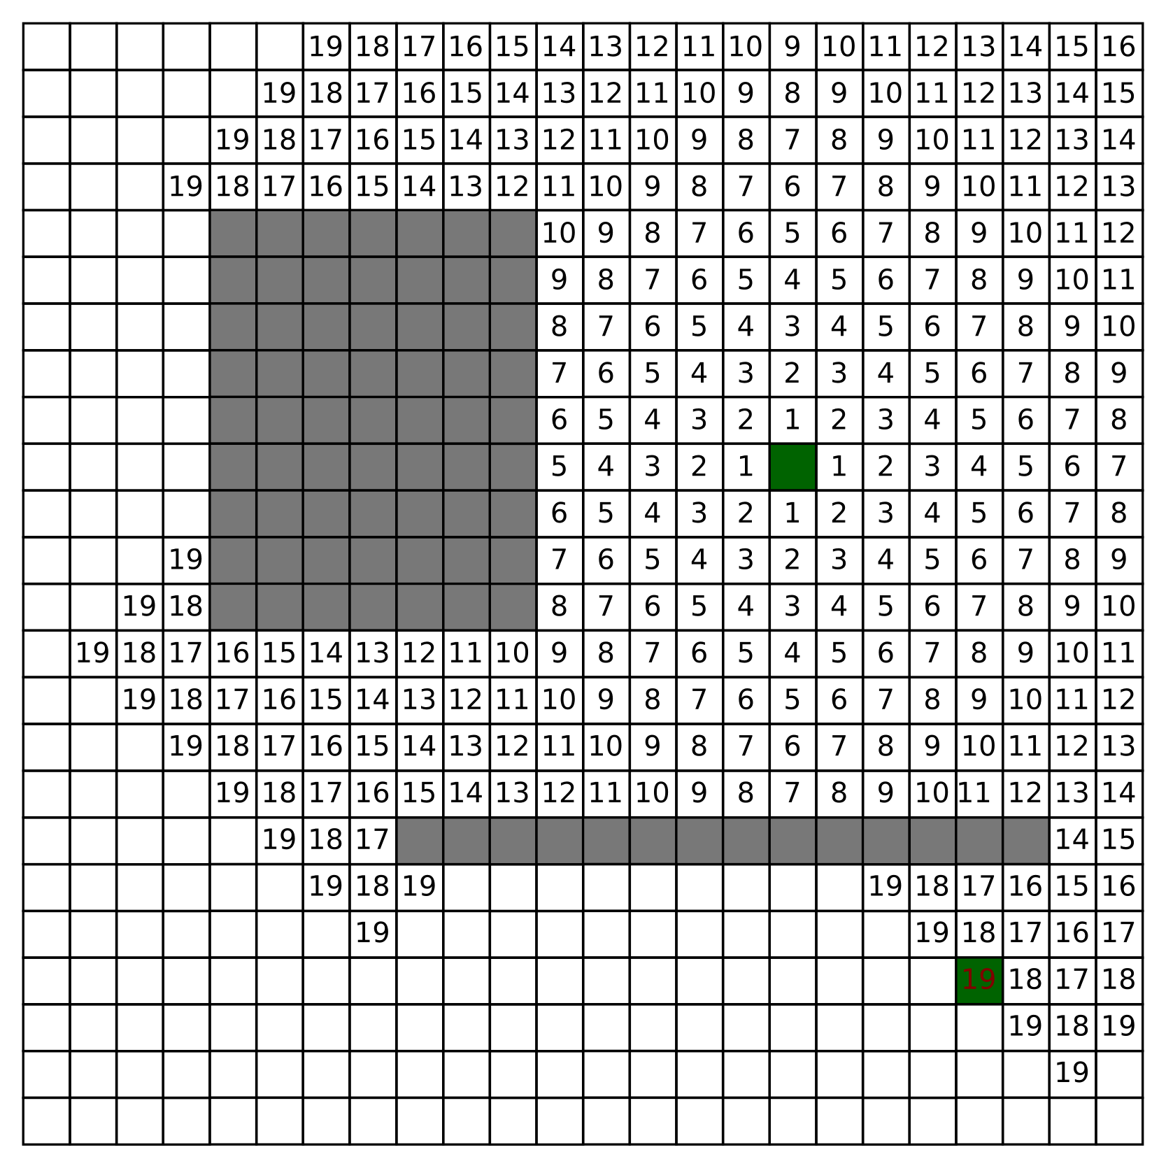
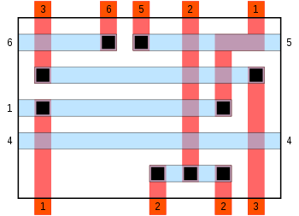
Basic Algorithms
Maze Router
Line Router
Channel Router

Slide 12
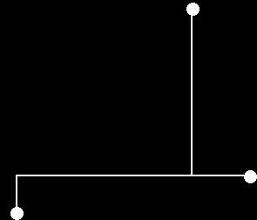
Steiner Routing

Slide 13
Sophisticated Algorithms
most based on a global-detailed approach
examples:
  ROSA
  MIGHTY
  ILAC
  SALIM
  SLAM
  … and many more

Slide 14
Template Based Router
require an already routed layout
try to adapt to for example another technology
nearly full control by the designer

Slide 15
Router integrated into the Placer
require an placement algorithm with routing in mind
Plantage wasn't thought for this

Slide 16
Implemented Algorithm(s)
Line Expansion Router
  no grid definition necessary
  easy to implement
modified version for pre-routing
modified version for consideration of capacitive couplings

Slide 17
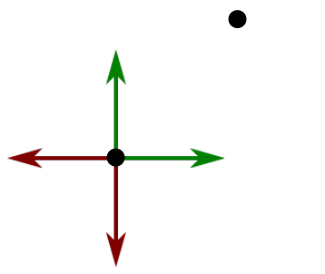
Line Expansion Router
good directions
  go as far as possible
bad directions
  go as far as necessary
recursive
chooses solution with smallest resistance
terminates on maximum count of bends

Slide 18
Resistance
only estimation
sheet resistance of the technology definition

Slide 19
Layers
low priority layers
  POLY1
high priority layers
  MET1
  MET2
  MET3
  MET4

Slide 20
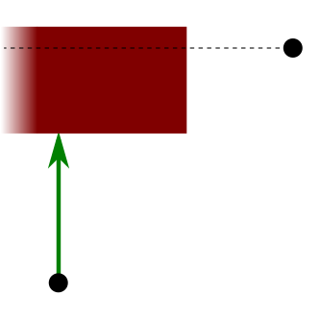
Good Directions
straight towards the target
beside an obstacle
for layer switch

Slide 21
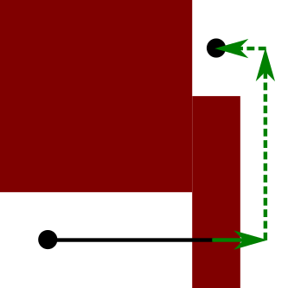
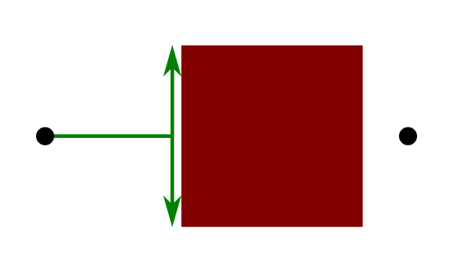
Bad Directions
beside an obstacle in front
beside an obstacle behind
for layer switch
above (below) an obstacle

Slide 22
Layer Switch
via is obstacle on three layers
  POLY1
  CONT
  MET1
minimum distance rules also on contacting-layers
vias of current route maybe also obstacles

Slide 23
Symmetries
connect symmetric pairs first
connect rest to the net

Slide 24
Priorities of Possibilities
Differ on layer priority
May stop if good enough result was found
Low
layer switch
enable layer switch
good directions
bad directions
High
good directions
layer switch
bad directions

Slide 25
Line Expansion Feasability Router
only one result
much faster than basic version
useful as pre-router

Slide 26

Extended Line Expansion Router
Chooses connection with smallest objective
objective is weighted sum of
  resistance
  edge capacity
  area capacity
reduces also capacitive parasitics

Slide 27

Area Capacity
capacity between two route parts on different layers
area capacity from technology definition

Slide 28

Edge Capacity
capacity between two route parts on same layer
edge capacity from technology definition

Slide 29
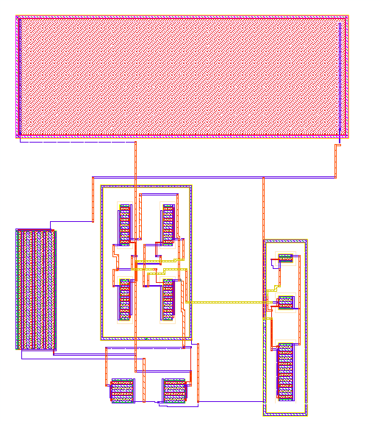
Result – Line Expansion Router

Slide 30
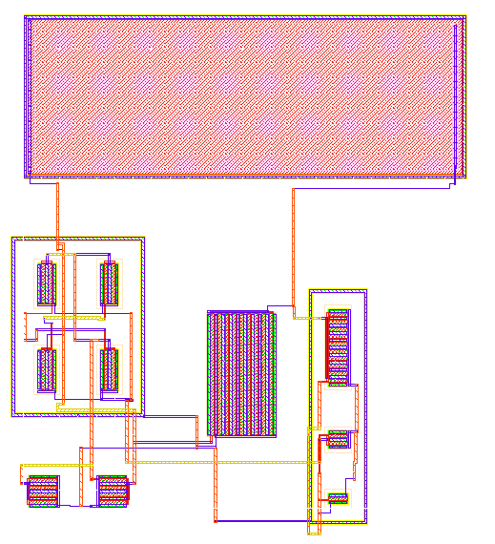
Result – Extended Line Expansion Router

Slide 31
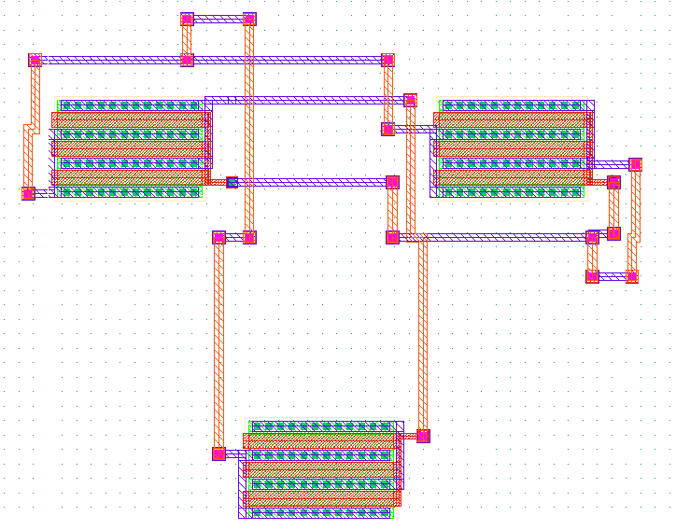
Result – Symmetry

Slide 32
Interactive Question-And-Answer

Slide 33
Simulation Results
MISSING

Slide 34
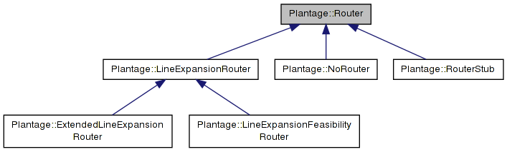
Results
Implementation of basic routing, considering
  design rules
  guard rings
  symmetries
  parasitics
easy to replace by different algorithm

Slide 35
Statistics - Plantage
 | previous | after
lines of code | 16018 | 44304
files | 110 | 458
average lines of code per file | 145 | 96
unit tests | 0 | 1595
revisions in subversion | 64 | 2037

Slide 36
Thank you for your attention.

