Slide 1

Lecture 10: Power-Flow studies
Instructor:
Dr. Gleb V. Tcheslavski
Contact: gleb@ee.lamar.edu
Office Hours:
TBD; Room 2030
Class web site: http://www.ee.lamar.edu/gleb/power/Index.htm
Image from http://top-car-wallpaper.blogspot.com/
0 to 60 mph in 3.9 s; Redline 14,000 rpm; ~250 hp; ~375 Nm,… Base price $109,000

Slide 2
Introduction
We should be able to analyze the performance of power systems both in normal operating conditions and under fault (short-circuit) condition. The analysis in normal steady-state operation is called a power-flow study (load-flow study) and it targets on determining the voltages, currents, and real and reactive power flows in a system under a given load conditions.
The purpose of power flow studies is to plan ahead and account for various hypothetical situations. For instance, what if a transmission line within the power system properly supplying loads must be taken off line for maintenance. Can the remaining lines in the system handle the required loads without exceeding their rated parameters?

Slide 3
Basic techniques for power-flow studies.
A power-flow study (load-flow study) is an analysis of the voltages, currents, and power flows in a power system under steady-state conditions. In such a study, we make an assumption about either a voltage at a bus or the power being supplied to the bus for each bus in the power system and then determine the magnitude and phase angles of the bus voltages, line currents, etc. that would result from the assumed combination of voltages and power flows.
The simplest way to perform power-flow calculations is by iteration:
Create a bus admittance matrix Y_{bus} for the power system;
Make an initial estimate for the voltages at each bus in the system;
Update the voltage estimate for each bus (one at a time), based on the estimates for the voltages and power flows at every other bus and the values of the bus admittance matrix: since the voltage at a given bus depends on the voltages at all of the other busses in the system (which are just estimates), the updated voltage will not be correct. However, it will usually be closer to the answer than the original guess.
Repeat this process to make the voltages at each bus approaching the correct answers closer and closer…

Slide 4
Basic techniques for power-flow studies.
The equations used to update the estimates differ for different types of busses. Each bus in a power system can be classified to one of three types:
1. Load bus (PQ bus) – a buss at which the real and reactive power are specified, and for which the bus voltage will be calculated. Real and reactive powers supplied to a power system are defined to be positive, while the powers consumed from the system are defined to be negative. All busses having no generators are load busses.
2. Generator bus (PV bus) – a bus at which the magnitude of the voltage is kept constant by adjusting the field current of a synchronous generator on the bus (as we learned, increasing the field current of the generator increases both the reactive power supplied by the generator and the terminal voltage of the system). We assume that the field current is adjusted to maintain a constant terminal voltage V_{T}. We also know that increasing the prime mover’s governor set points increases the power that generator supplies to the power system. Therefore, we can control and specify the magnitude of the bus voltage and real power supplied.

Slide 5
Basic techniques for power-flow studies.
3. Slack bus (swing bus) – a special generator bus serving as the reference bus for the power system. Its voltage is assumed to be fixed in both magnitude and phase (for instance, 1∠0˚ pu). The real and reactive powers are uncontrolled: the bus supplies whatever real or reactive power is necessary to make the power flows in the system balance.
In practice, a voltage on a load bus may change with changing loads. Therefore, load busses have specified values of P and Q, while V varies with load conditions.
Real generators work most efficiently when running at full load. Therefore, it is desirable to keep all but one (or a few) generators running at 100% capacity, while allowing the remaining (swing) generator to handle increases and decreases in load demand. Most busses with generators will supply a fixed amount of power and the magnitude of their voltages will be maintained constant by field circuits of generators. These busses have specific values of P and |V_{i}|.
The controls on the swing generator will be set up to maintain a constant voltage and frequency, allowing P and Q to increase or decrease as loads change.

Slide 6
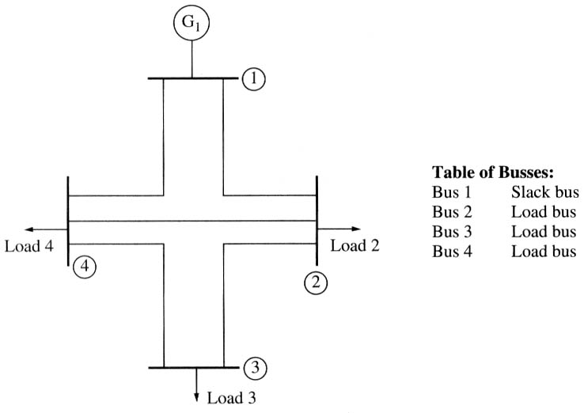
Constructing Y_{bus} for power-flow analysis
The most common approach to power-flow analysis is based on the bus admittance matrix Y_{bus}. However, this matrix is slightly different from the one studied previously since the internal impedances of generators and loads connected to the system are not included in Y_{bus}. Instead, they are accounted for as specified real and reactive powers input and output from the busses.
Example 11.1: a simple power system has 4 busses, 5 transmission lines, 1 generator, and 3 loads. Series per-unit impedances are:
line # | Bus to bus | Series Z (pu) | Series Y (pu)
1 | 1-2 | 0.1+j0.4 | 0.5882-j2.3529
2 | 2-3 | 0.1+j0.5 | 0.3846-j1.9231
3 | 2-4 | 0.1+j0.4 | 0.5882-j2.3529
4 | 3-4 | 0.5+j0.2 | 1.1765-j4.7059
5 | 4-1 | 0.5+j0.2 | 1.1765-j4.7059

Slide 7
Constructing Y_{bus} for power-flow analysis
The shunt admittances of the transmission lines are ignored. In this case, the Y_{ii} terms of the bus admittance matrix can be constructed by summing the admittances of all transmission lines connected to each bus, and the Y_{ij} (i ≠ j) terms are just the negative of the line admittances stretching between busses i and j. Therefore, for instance, the term Y₁₁ will be the sum of the admittances of all transmission lines connected to bus 1, which are the lines 1 and 5, so Y₁₁ = 1.7647 – j7.0588 pu.
If the shunt admittances of the transmission lines are not ignored, the self admittance Y_{ii} at each bus would also include half of the shunt admittance of each transmission line connected to the bus.
The term Y₁₂ will be the negative of all the admittances stretching between bus 1 and bus 2, which will be the negative of the admittance of transmission line 1, so Y₁₂ = -0.5882 + j2.3529.

Slide 8
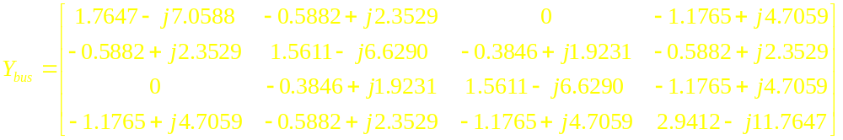
Constructing Y_{bus} for power-flow analysis
The complete bus admittance matrix can be obtained by repeating these calculations for every term in the matrix:

Slide 9
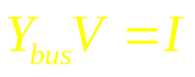
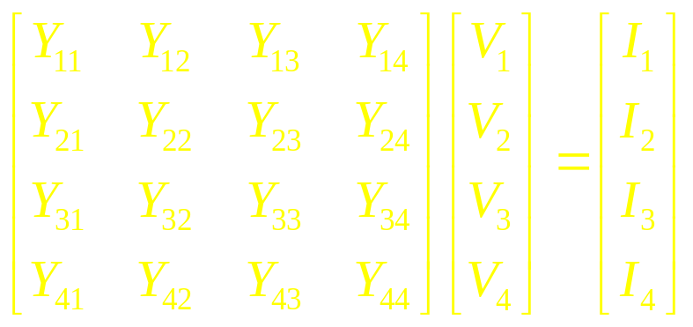
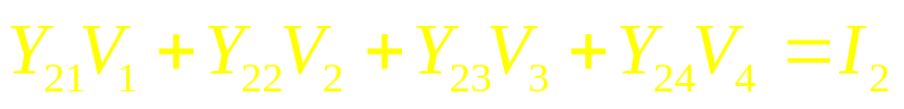
Power-flow analysis equations
The basic equation for power-flow analysis is derived from the nodal analysis equations for the power system:
(11.9.1)
For the four-bus power system shown above, (11.9.1) becomes
(11.9.2)
where Y_{ij} are the elements of the bus admittance matrix, V_{i} are the bus voltages, and I_{i} are the currents injected at each node. For bus 2 in this system, this equation reduces to
(11.9.3)

Slide 10
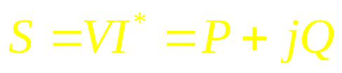
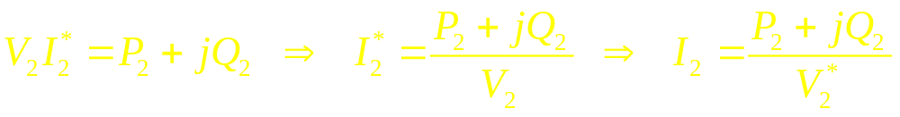
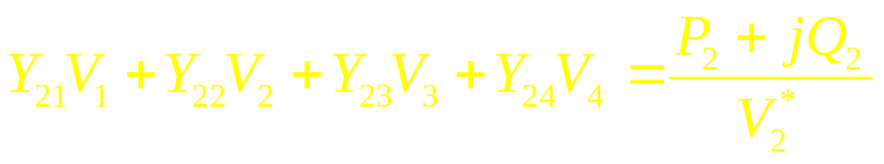
Power-flow analysis equations
However, real loads are specified in terms of real and reactive powers, not as currents. The relationship between per-unit real and reactive power supplied to the system at a bus and the per-unit current injected into the system at that bus is:
(11.10.1)
where V is the per-unit voltage at the bus; I* - complex conjugate of the per-unit current injected at the bus; P and Q are per-unit real and reactive powers. Therefore, for instance, the current injected at bus 2 can be found as
(11.10.2)
Substituting (11.10.2) into (11.9.3), we obtain
(11.10.3)

Slide 11
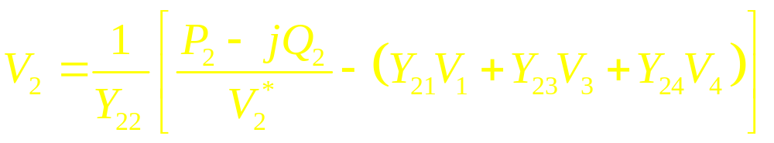
Power-flow analysis equations
Solving the last equation for V₂, yields
(11.11.1)
Similar equations can be created for each load bus in the power system.
(11.11.1) gives updated estimate for V₂ based on the specified values of real and reactive powers and the current estimates of all the bus voltages in the system. Note that the updated estimate for V₂ will not be the same as the original estimate of V₂* used in (11.11.1) to derive it. We can repeatedly update the estimate wile substituting current estimate for V₂ back to the equation. The values of V₂ will converge; however, this would NOT be the correct bus voltage since voltages at the other nodes are also needed to be updated. Therefore, all voltages need to be updated during each iteration!
The iterations are repeated until voltage values no longer change much between iterations.

Slide 12
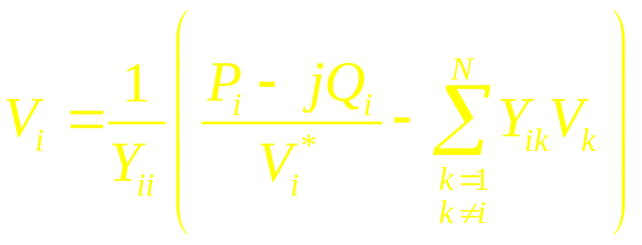
Power-flow analysis equations
This method is known as the Gauss-Siedel iterative method. Its basic procedure is:
Calculate the bus admittance matrix Y_{bus} including the admittances of all transmission lines, transformers, etc., between busses but exclude the admittances of the loads or generators themselves.
Select a slack bus: one of the busses in the power system, whose voltage will arbitrarily be assumed as 1.0∠0˚.
Select initial estimates for all bus voltages: usually, the voltage at every load bus assumed as 1.0∠0˚ (flat start) lead to good convergence.
Write voltage equations for every other bus in the system. The generic form is
(11.12.1)

Slide 13
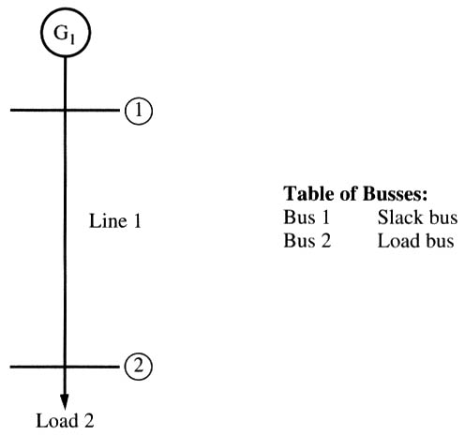
Power-flow analysis equations
5. Calculate an updated estimate of the voltage at each load bus in succession using (11.12.1) except for the slack bus.
6. Compare the differences between the old and new voltage estimates: if the differences are less than some specified tolerance for all busses, stop. Otherwise, repeat step 5.
7. Confirm that the resulting solution is reasonable: a valid solution typically has bus voltages, whose phases range in less than 45˚.
Example 11.2: in a 2-bus power system, a generator attached to bus 1 and loads attached to bus 2. the series impedance of a single transmission line connecting them is 0.1+j0.5 pu. The shunt admittance of the line may be neglected. Assume that bus 1 is the slack bus and that it has a voltage V₁ = 1.0∠0˚ pu. Real and reactive powers supplied to the loads from the system at bus 2 are P₂ = 0.3 pu, Q₂ = 0.2 pu (powers supplied to the system at each busses is negative of the above values). Determine voltages at each bus for the specified load conditions.

Slide 14
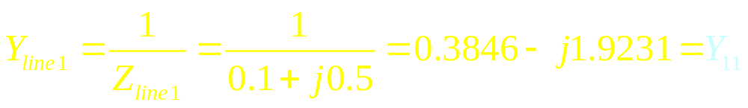
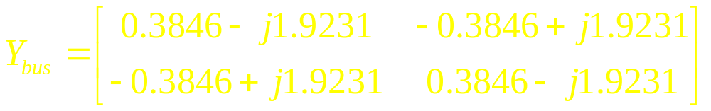
Power-flow analysis equations
1. We start from calculating the bus admittance matrix Y_{bus}. The Y_{ii} terms can be constructed by summing the admittances of all transmission lines connected to each bus, and the Y_{ij} terms are the negative of the admittances of the line stretching between busses i and j. For instance, the term Y₁₁ is the sum of the admittances of all transmission lines connected to bus 1 (a single line in our case). The series admittance of line 1 is
(11.14.1)
Applying similar calculations to other terms, we complete the admittance matrix as
(11.14.2)
2. Next, we select bus 1 as the slack bus since it is the only bus in the system connected to the generator. The voltage at bus 1 will be assumed 1.0∠0˚.

Slide 15
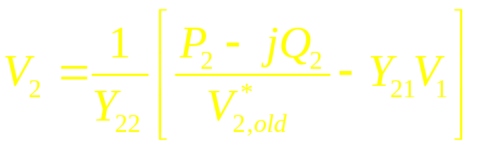
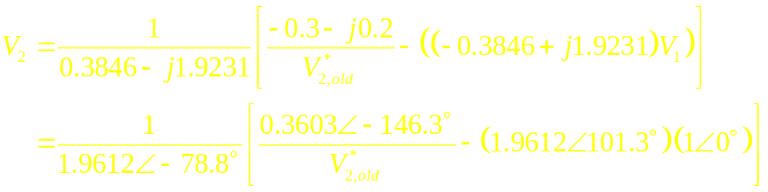
Power-flow analysis equations
3. We select initial estimates for all bus voltages. Making a flat start, the initial voltage estimates at every bus are 1.0∠0˚.
4. Next, we write voltage equations for every other bus in the system. For bus 2:
(11.15.1)
Since the real and reactive powers supplied to the system at bus 2 are P₂ = -0.3 pu and Q₂ = -0.2 pu and since Ys and V₁ are known, we may reduce the last equation:
(11.15.2)

Slide 16
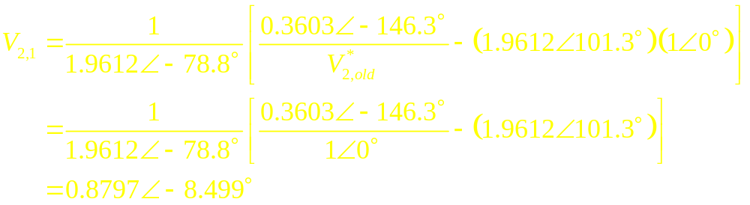
Power-flow analysis equations
5. Next, we calculate an updated estimate of the voltages at each load bus in succession. In this problem we only need to calculate updated voltages for bus 2, since the voltage at the slack bus (bus 1) is assumed constant. We repeat this calculation until the voltage converges to a constant value.
The initial estimate for the voltage is V_{2,0} = 1∠0˚. The next estimate for the voltage is
(11.16.1)
This new estimate for V₂ substituted back to the equation will produce the second estimate:

Slide 17
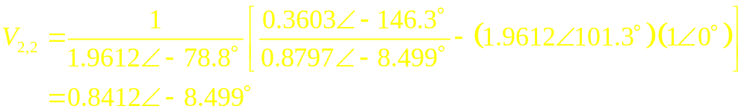
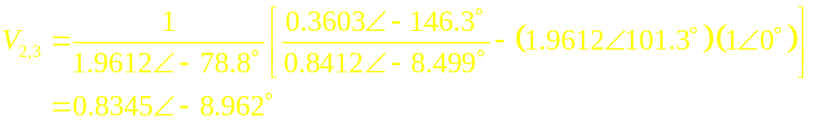
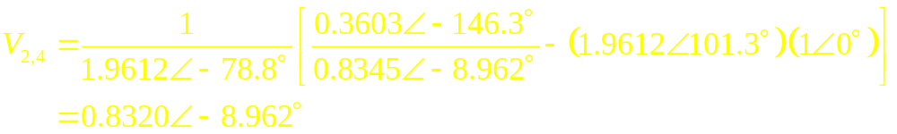
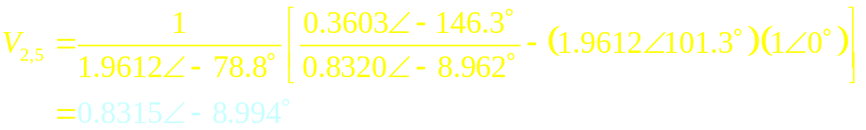
Power-flow analysis equations
(11.17.1)
The third iteration will be
(11.17.2)
The fourth iteration will be
(11.17.3)
The fifth iteration will be
(11.17.4)

Slide 18
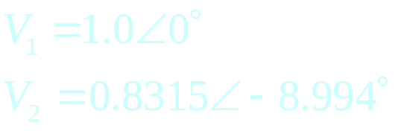
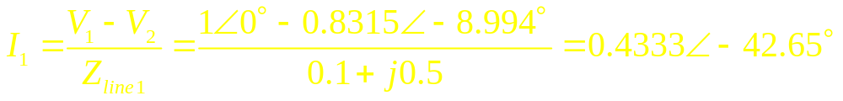
Power-flow analysis equations
6. We observe that the magnitude of the voltage is barely changing and may conclude that this value is close to the correct answer and, therefore, stop the iterations.
This power system converged to the answer in five iterations. The voltages at each bus in the power system are:
(11.18.1)
7. Finally, we need to confirm that the resulting solution is reasonable. The results seem reasonable since the phase angles of the voltages in the system differ by only 10˚. The current flowing from bus 1 to bus 2 is
(11.18.2)

Slide 19
Power-flow analysis equations
The power supplied by the transmission line to bus 2 is
This is the amount of power consumed by the loads; therefore, this solution appears to be correct.
Note that this example must be interpreted as follows: if the real and reactive power supplied by bus 2 is 0.3 + j0.2 pu and if the voltage on the slack bus is 1∠0˚ pu, then the voltage at bus 2 will be V₂ = 0.8315∠-8.994˚.
This voltage is correct only for the assumed conditions; another amount of power supplied by bus 2 will result in a different voltage V₂.
Therefore, we usually postulate some reasonable combination of powers supplied to loads, and determine the resulting voltages at all the busses in the power system. Once the voltages are known, currents through each line can be calculated.
The relationship between voltage and current at a load bus as given by (11.12.1) is fundamentally nonlinear! Therefore, solution greatly depends on the initial guess.

Slide 20
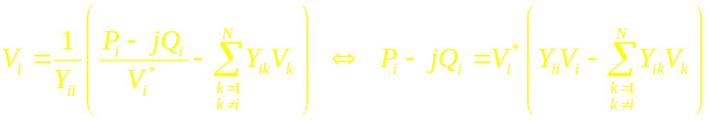
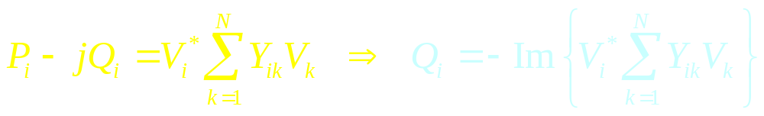
Adding generator busses to power-flow studies
At a generator bus, the real power P_{i} and the magnitude of the bus voltage |V_{i}| are specified. Since the reactive power for that bus is usually unknown, we need to estimate it before applying (11.12.1) to get updated voltage estimates. The value of reactive power at the generator bus can be estimated by solving (11.12.1) for Q_{i}:
(11.20.1)
Bringing the case k = I into summation, we obtain
(11.20.2)
Once the reactive power at the bus is estimated, we can update the bus voltage at a generator bus using P_{i} and Q_{i} as we would at a load bus. However, the magnitude of the generator bus voltage is also forced to remain constant. Therefore, we must multiply the new voltage estimate by the ratio of magnitudes of old to new estimates.

Slide 21
Adding generator busses to power-flow studies
Therefore, the steps required to update the voltage at a generator bus are:
Estimate the reactive power Q_{i} according to (11.20.2);
Update the estimated voltage at the bus according to (11.12.1) as if the bus was a load bus;
Force the magnitude of the estimated voltage to be constant by multiplying the new voltage estimate by the ratio of the magnitude of the original estimate to the magnitude of the new estimate. This has the effect of updating the voltage phase estimate without changing the voltage amplitude.

Slide 22
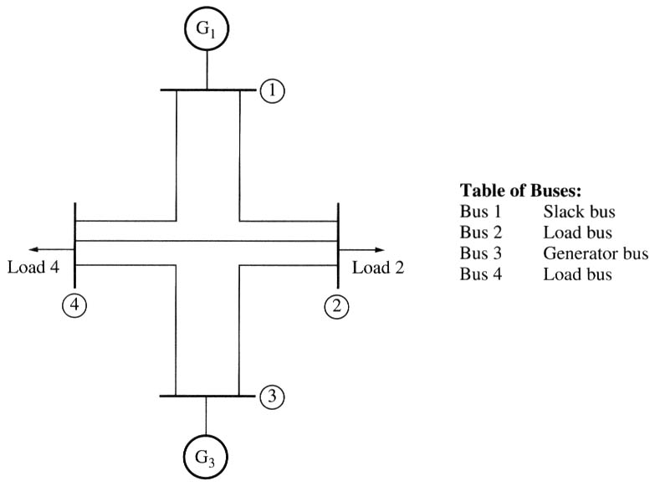
Adding generator busses to power-flow studies
Example 11.3: a 4-bus power system with 5 transmission lines, 2 generators, and 2 loads. Since the system has generators connected to 2 busses, it will have one slack bus, one generator bus, and two load busses. Assume that bus 1 is the slack bus and that it has a voltage V₁ = 1.0∠0˚ pu. Bus 3 is a generator bus. The generator is supplying a real power P₃ = 0.3 pu to the system with a voltage magnitude 1 pu. The per-unit real and reactive power loads at busses 2 and 4 are P₂ =
0.3 pu, Q₂ = 0.2 pu, P₄ = 0.2 pu, Q₄ = 0.15 pu (powers supplied to the system at each busses are negative of the above values). The series impedances of each bus were evaluated in Example 11.1. Determine voltages at each bus for the specified load conditions.

Slide 23
Adding generator busses to power-flow studies
The bus admittance matrix was calculated earlier as
Since the bus 3 is a generator bus, we will have to estimate the reactive power at that bus before calculating the bus voltages, and then force the magnitude of the voltage to remain constant after computing the bus voltage. We will make a flat start assuming the initial voltage estimates at every bus to be 1.0∠0˚.
Therefore, the sequence of voltage (and reactive power) equations for all busses is:

Slide 24
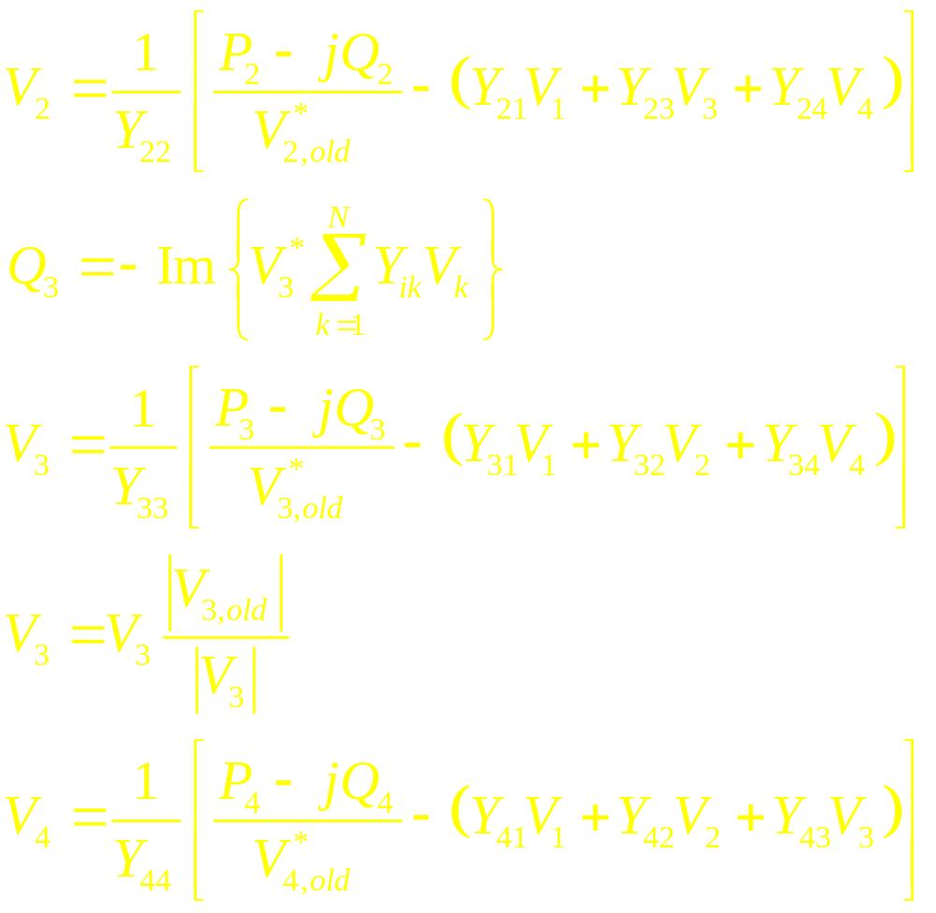
Adding generator busses to power-flow studies
(11.24.1)
(11.24.2)
(11.24.3)
(11.24.4)
(11.24.4)

Slide 25
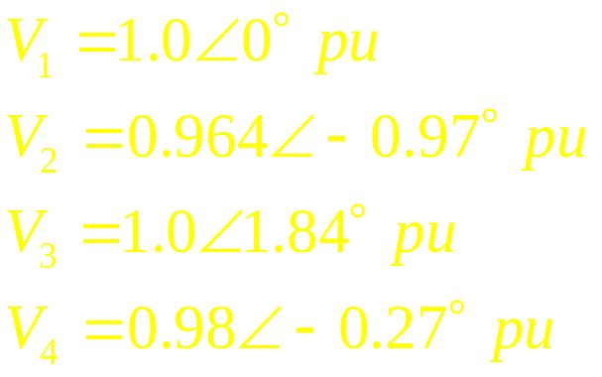
Adding generator busses to power-flow studies
The voltages and the reactive power should be updated iteratively, for instance, using Matlab.
Computations converge to the following solution:
(11.25.1)
The solution looks reasonable since the bus voltage phase angles is less than 45˚.

Slide 26
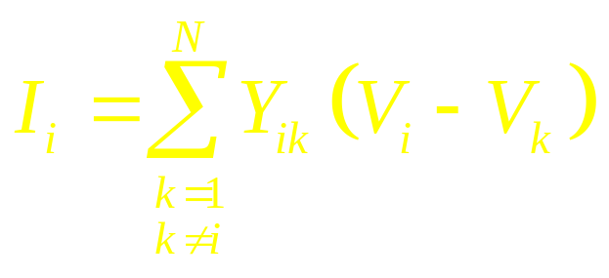
The information derived from power-flow studies
After the bus voltages are calculated at all busses in a power system, a power-flow program can be set up to provide alerts if the voltage at any given bus exceeds, for instance, ±5% of the nominal value. This is important since the power needs to be supplied at a constant voltage level; therefore, such voltage variations may indicate problems…
Additionally, it is possible to determine the net real and reactive power either supplied or removed from the each bus by generators or loads connected to it. To calculate the real and reactive power at a bus, we first calculate the net current injected at the bus, which is the sum of all the currents leaving the bus through transmission lines.
The current leaving the bus on each transmission line can be found as:
(11.26.1)

Slide 27
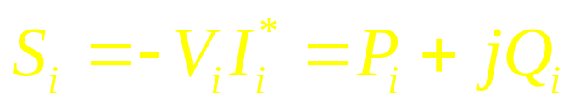
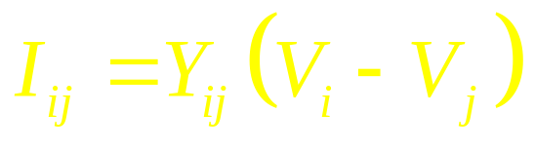

The information derived from power-flow studies
The resulting real and reactive powers injected at the bus can be found from
(11.27.1)
where the minus sign indicate that current is assumed to be injected instead of leaving the node.
Similarly, the power-flow study can show the real and reactive power flowing in every transmission line in the system. The current flow out of a node along a particular transmission line between bus i and bus j can be calculated as:
where Y_{ij} is the admittance of the transmission line between those two busses. The resulting real and reactive power can be calculated as:

Slide 28
The information derived from power-flow studies
Also, comparing the real and reactive power flows at either end of the transmission line, we can determine the real and reactive power losses on each line.
In modern power-flow programs, this information is displayed graphically. Colors are used to highlight the areas where the power system is overloaded, which aids “hot spot” localization.
Power-flow studies are usually started from analysis of the power system in its normal operating conditions, called the base case. Then, various (increased) load conditions may be projected to localize possible problem spots (overloads). By adding transmission lines to the system, a new configuration resolving the problem may be found. This estimated models can be used for planning.
Another reason for power-flow studies is modeling possible failures of particular lines and generators to see whether the remaining components can handle the loads.
Finally, it is possible to determine more efficient power utilization by redistributing generation from one locations to other. This variety of power-flow studies is called economic dispatch.

