Slide 1
ECE 476
POWER SYSTEM ANALYSIS
Lecture 14
Power Flow
Professor Tom Overbye
Department of Electrical and
Computer Engineering

Slide 2
Announcements
Be reading Chapter 6, also Chapter 2.4 (Network Equations).
HW 5 is 2.38, 6.9, 6.18, 6.30, 6.34, 6.38; do by October 6 but does not need to be turned in.
First exam is October 11 during class. Closed book, closed notes, one note sheet and calculators allowed. Exam covers thru the end of lecture 13 (today)
An example previous exam (2008) is posted. Note this is exam was given earlier in the semester in 2008 so it did not include power flow, but the 2011 exam will (at least partially)

Slide 3
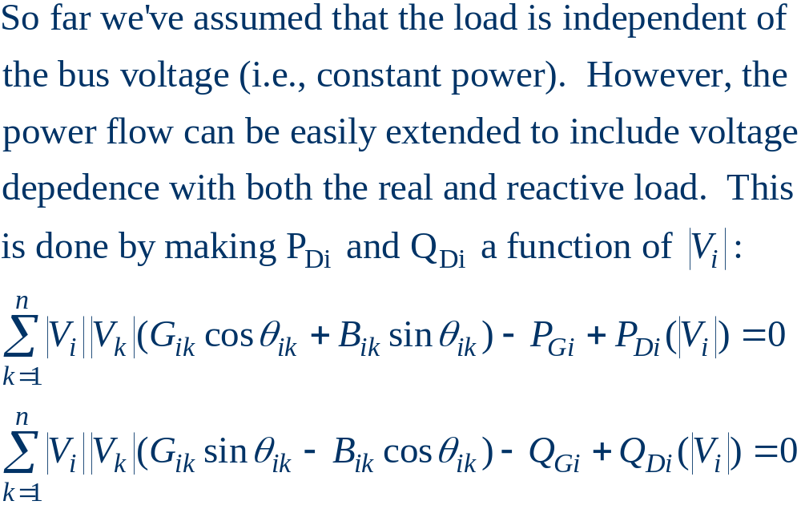
Modeling Voltage Dependent Load

Slide 4
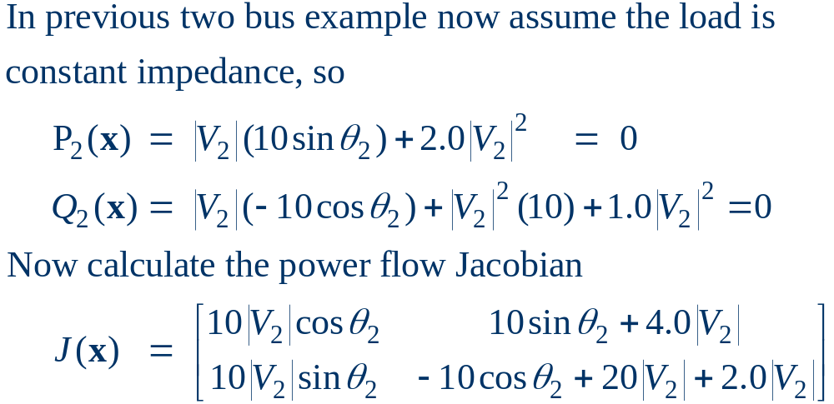
Voltage Dependent Load Example

Slide 5
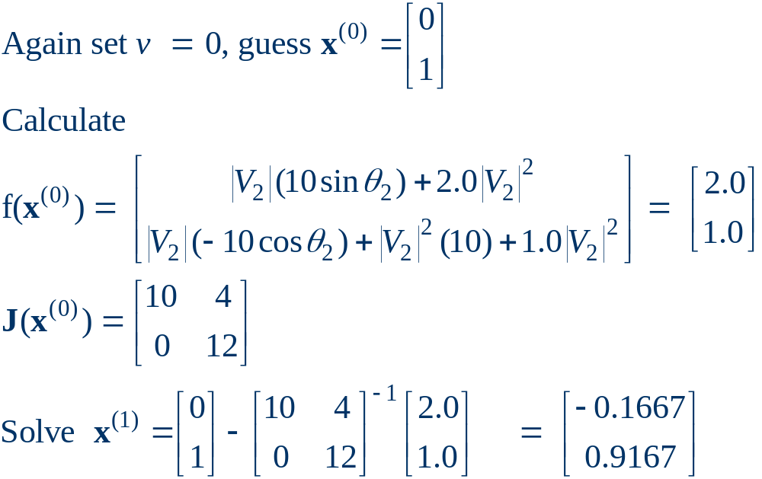
Voltage Dependent Load, cont'd

Slide 6
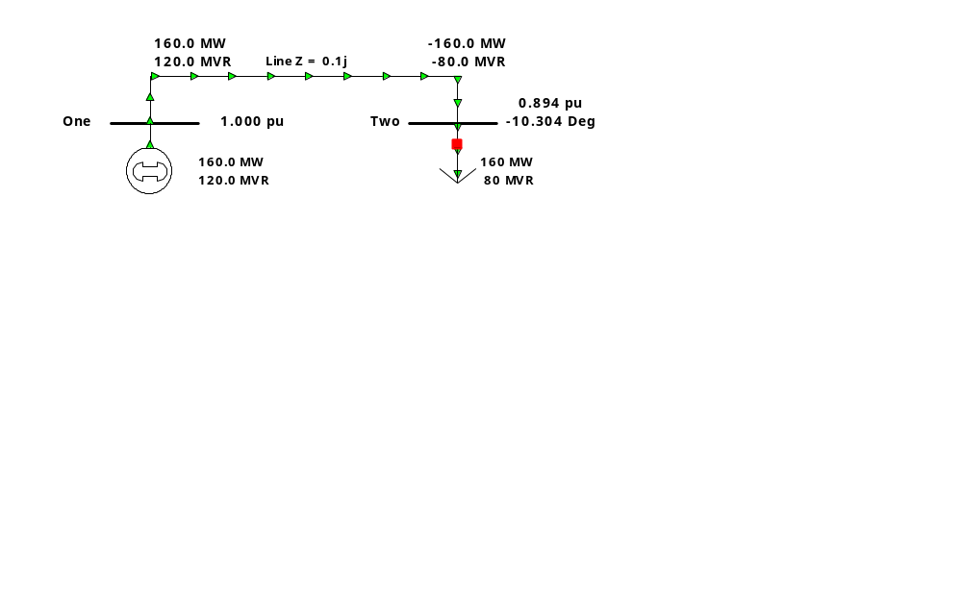
Voltage Dependent Load, cont'd
With constant impedance load the MW/Mvar load at
bus 2 varies with the square of the bus 2 voltage
magnitude. This if the voltage level is less than 1.0,
the load is lower than 200/100 MW/Mvar

Slide 7
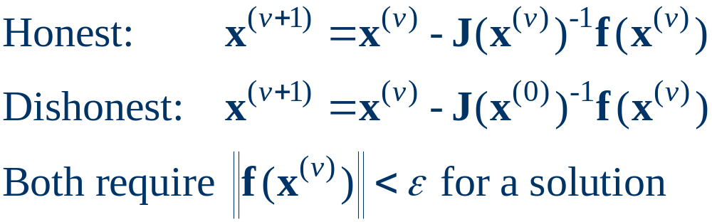
Dishonest Newton-Raphson
Since most of the time in the Newton-Raphson iteration is spend calculating the inverse of the Jacobian, one way to speed up the iterations is to only calculate/inverse the Jacobian occasionally
  known as the “Dishonest” Newton-Raphson
  an extreme example is to only calculate the Jacobian for the first iteration

Slide 8
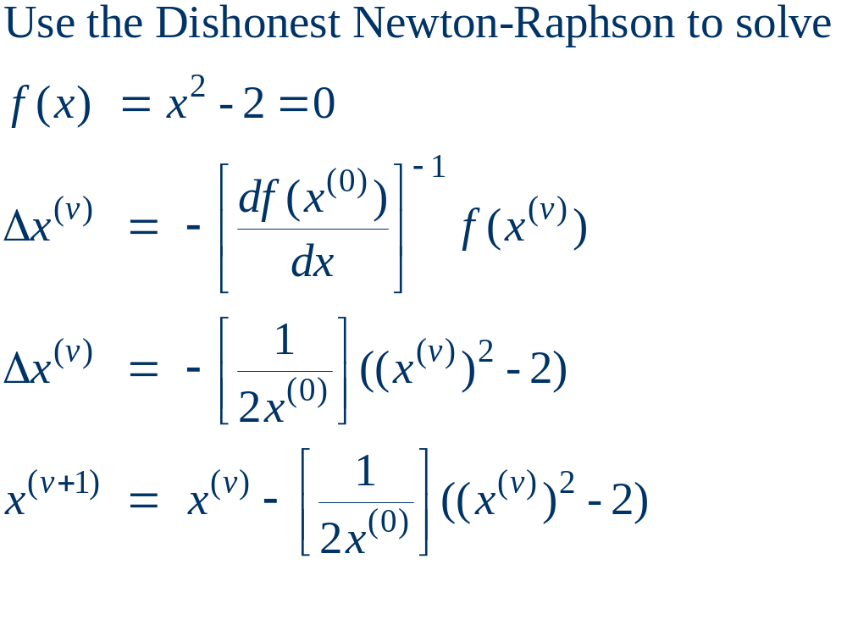
Dishonest Newton-Raphson Example

Slide 9
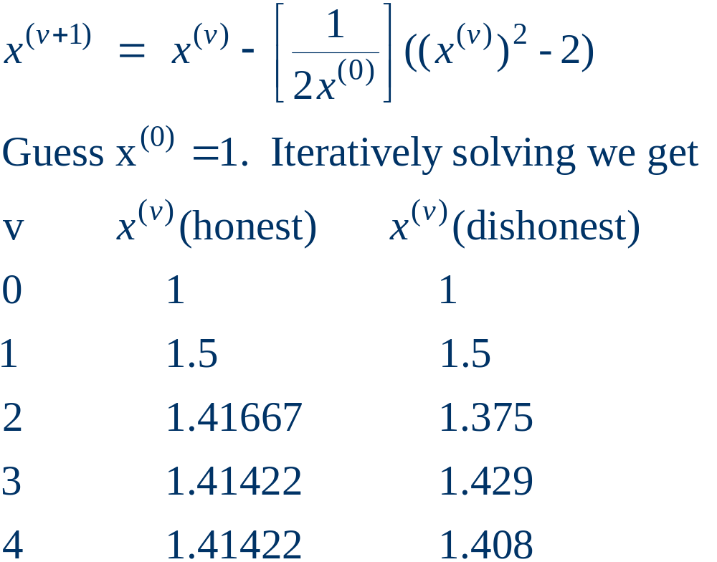
Dishonest N-R Example, cont’d
We pay a price
in increased
iterations, but
with decreased
computation
per iteration

Slide 10
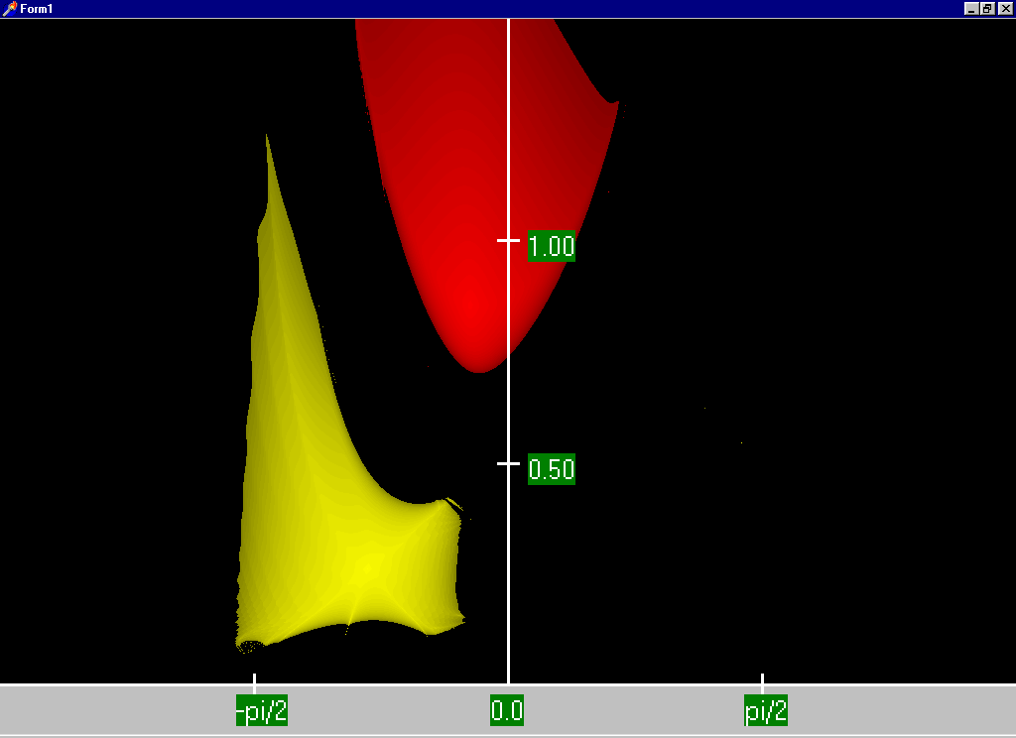
Two Bus Dishonest ROC
Slide shows the region of convergence for different initial
guesses for the 2 bus case using the Dishonest N-R
Red region
converges
to the high
voltage
solution,
while the
yellow region
converges
to the low
voltage
solution

Slide 11
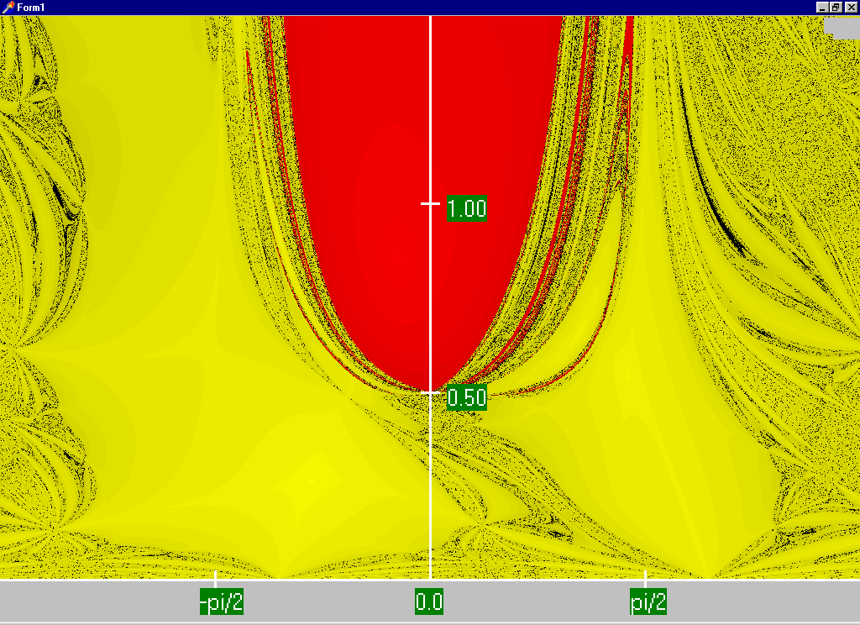
Honest N-R Region of Convergence
Maximum
of 15
iterations

Slide 12
Decoupled Power Flow
The completely Dishonest Newton-Raphson is not used for power flow analysis. However several approximations of the Jacobian matrix are used.
One common method is the decoupled power flow. In this approach approximations are used to decouple the real and reactive power equations.

Slide 13
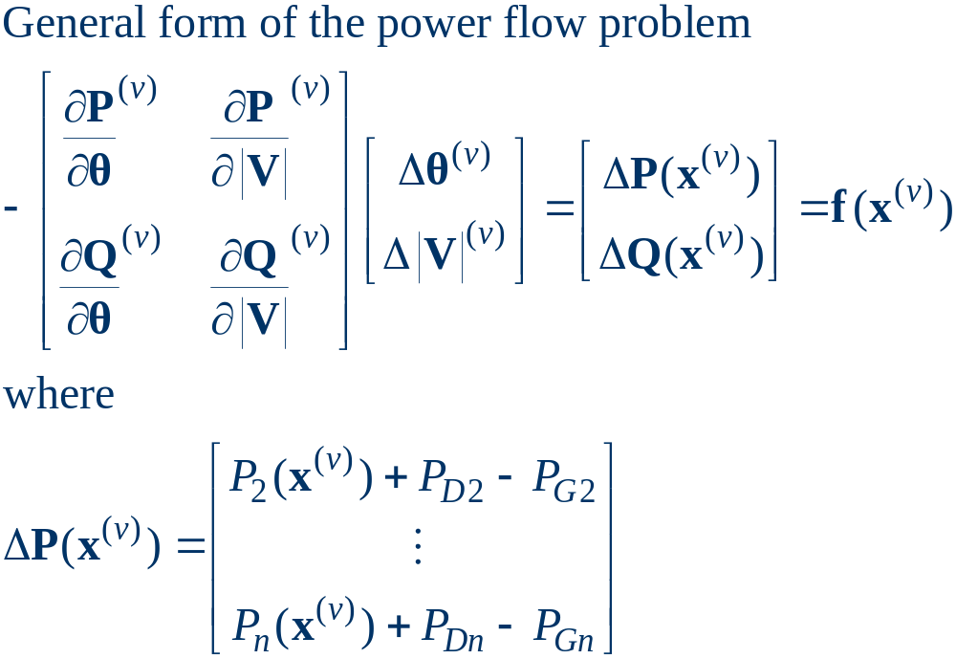
Decoupled Power Flow Formulation

Slide 14
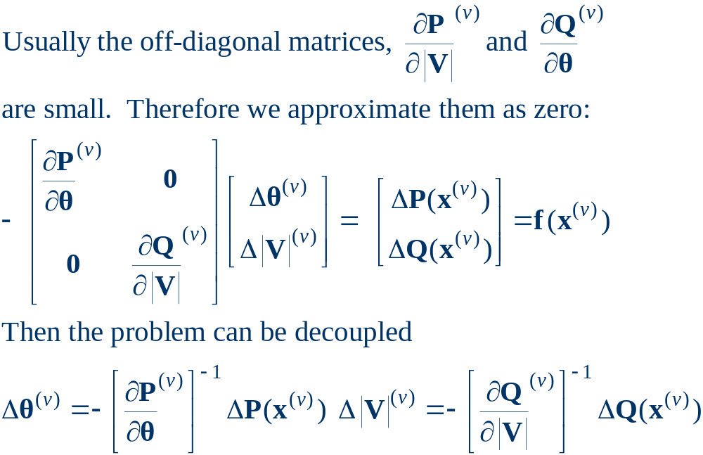
Decoupling Approximation

Slide 15
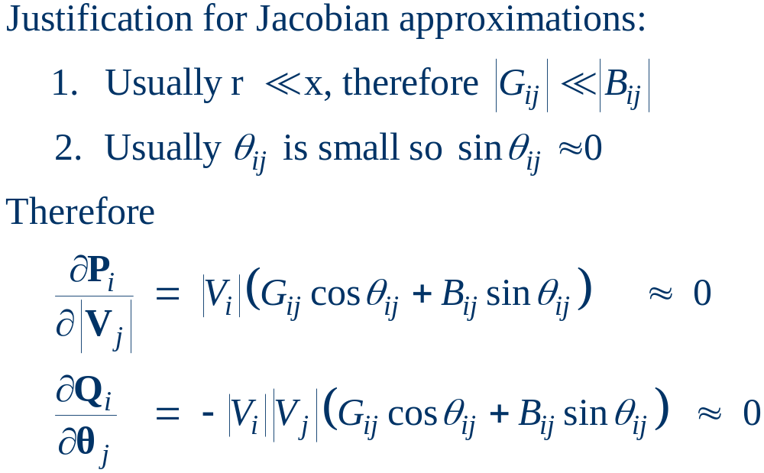
Off-diagonal Jacobian Terms

Slide 16
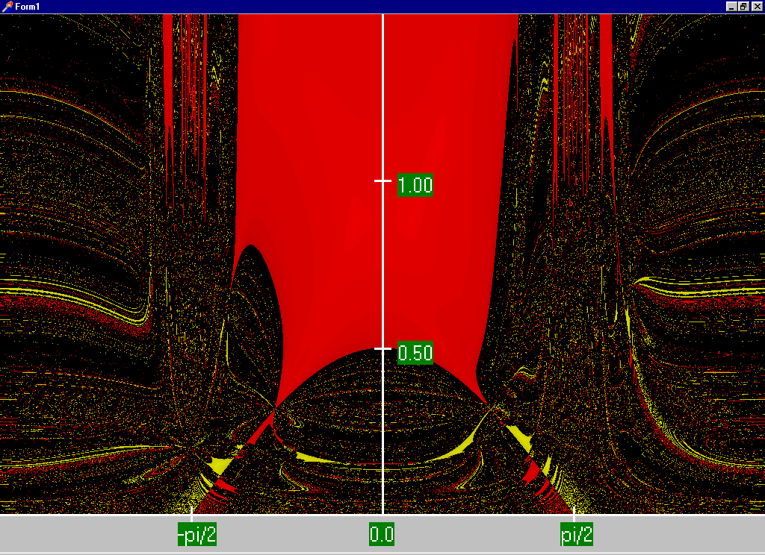
Decoupled N-R Region of Convergence

Slide 17
Fast Decoupled Power Flow
By continuing with our Jacobian approximations we can actually obtain a reasonable approximation that is independent of the voltage magnitudes/angles.
This means the Jacobian need only be built/inverted once.
This approach is known as the fast decoupled power flow (FDPF)
FDPF uses the same mismatch equations as standard power flow so it should have same solution
The FDPF is widely used, particularly when we only need an approximate solution

Slide 18
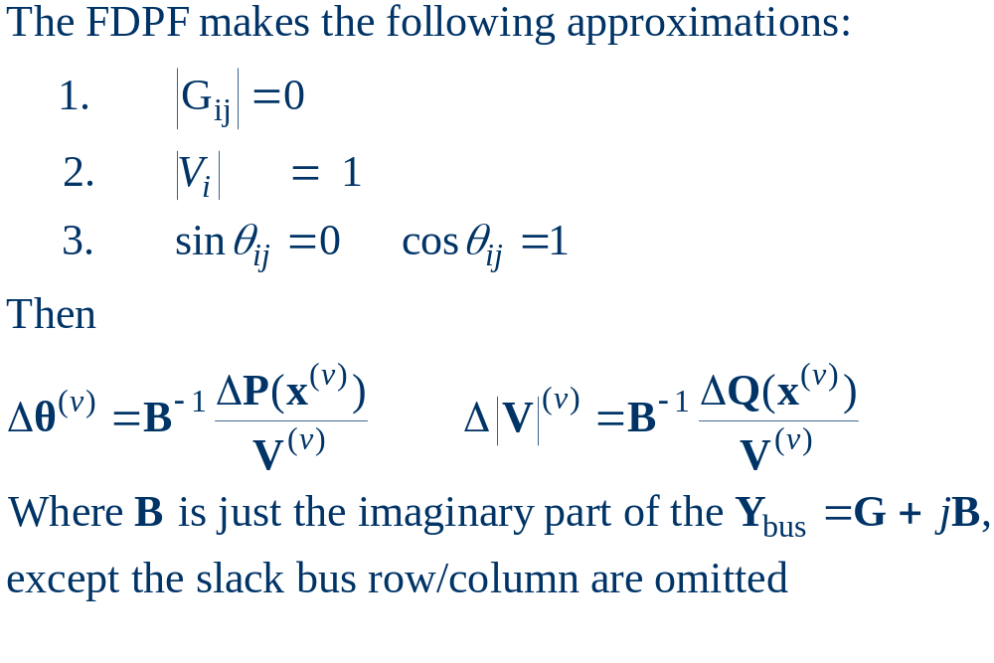
FDPF Approximations

Slide 19
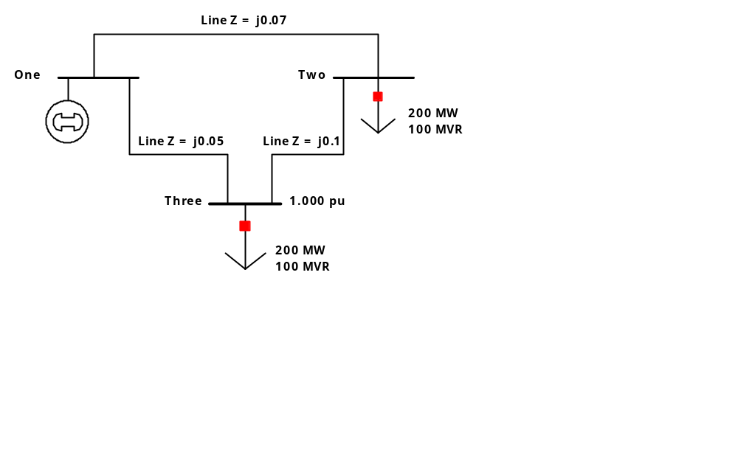
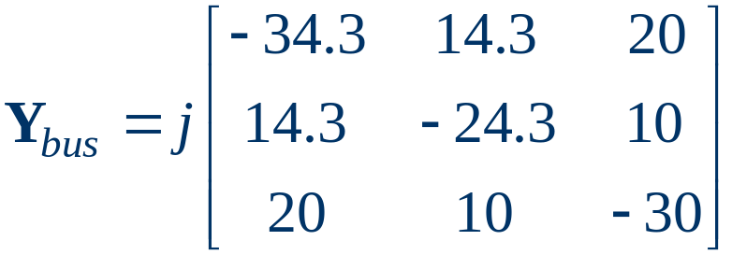
FDPF Three Bus Example
Use the FDPF to solve the following three bus system

Slide 20
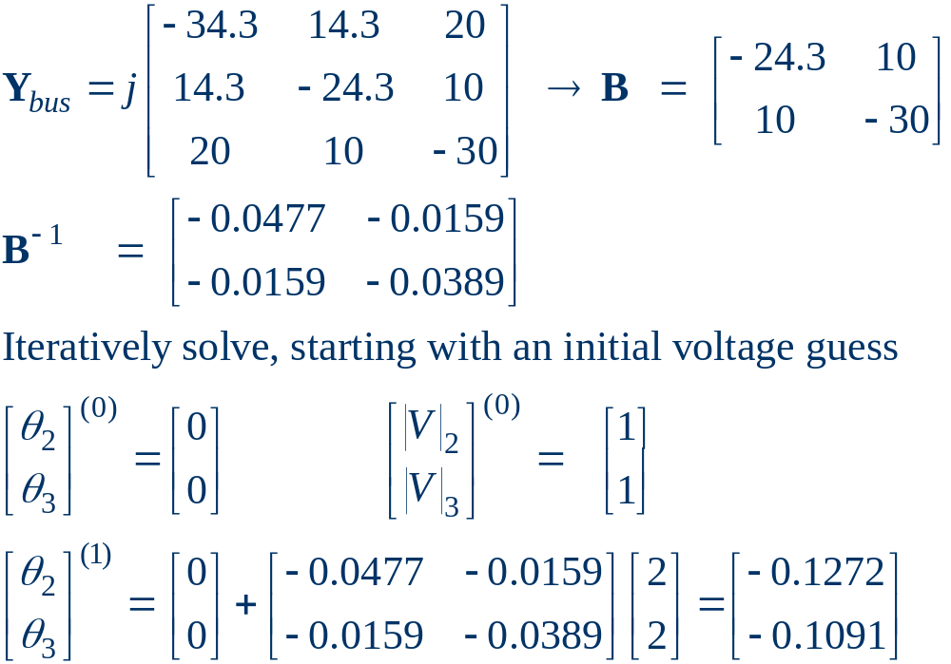
FDPF Three Bus Example, cont’d

Slide 21
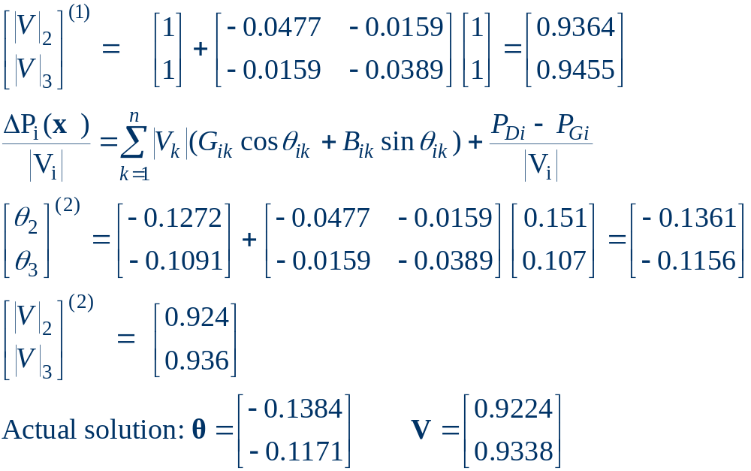
FDPF Three Bus Example, cont’d

Slide 22
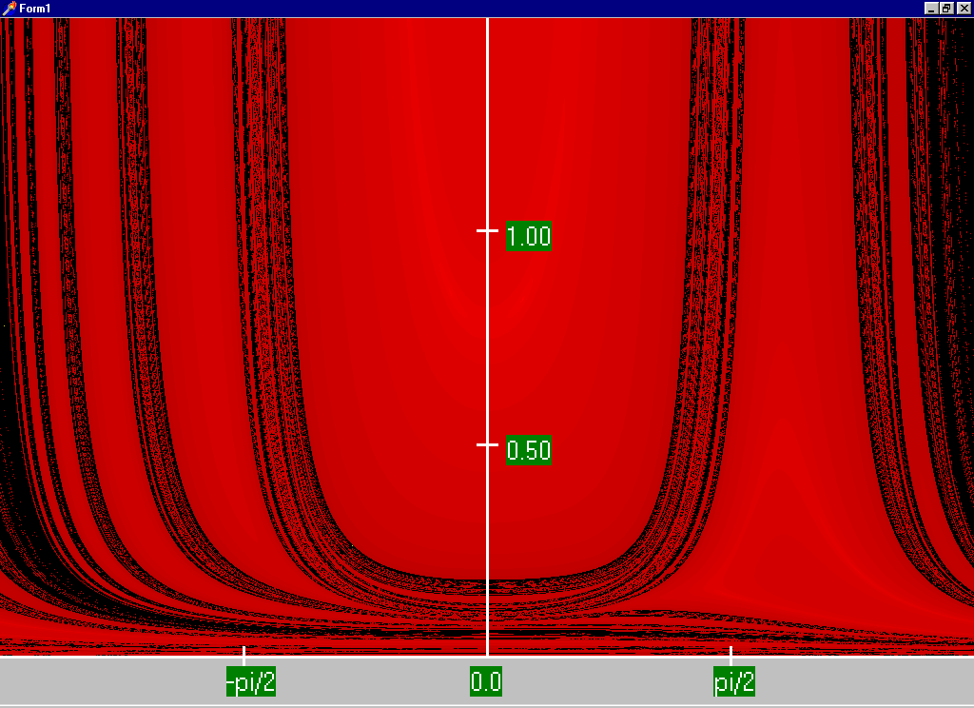
FDPF Region of Convergence

Slide 23
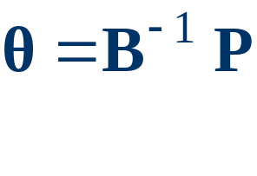
“DC” Power Flow
The “DC” power flow makes the most severe approximations:
  completely ignore reactive power, assume all the voltages are always 1.0 per unit, ignore line conductance
This makes the power flow a linear set of equations, which can be solved directly

Slide 24
Power System Control
A major problem with power system operation is the limited capacity of the transmission system
  lines/transformers have limits (usually thermal)
  no direct way of controlling flow down a transmission line (e.g., there are no valves to close to limit flow)
  open transmission system access associated with industry restructuring is stressing the system in new ways
We need to indirectly control transmission line flow by changing the generator outputs

Slide 25
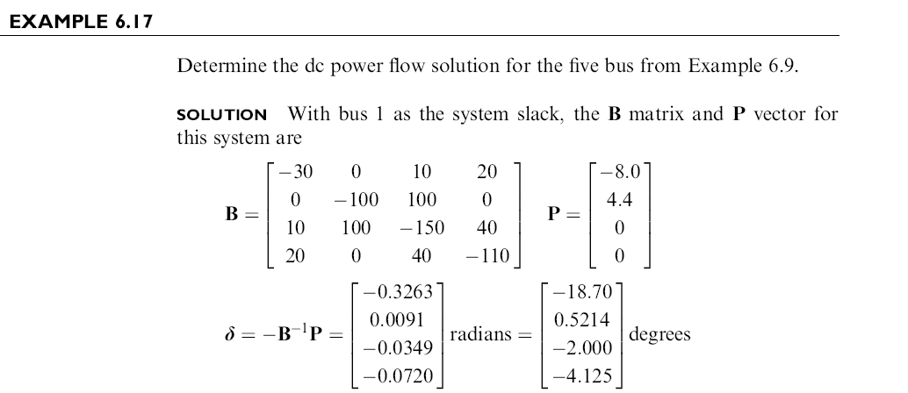
DC Power Flow Example

Slide 26
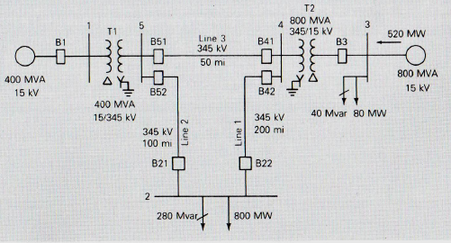
DC Power Flow Example

Slide 27
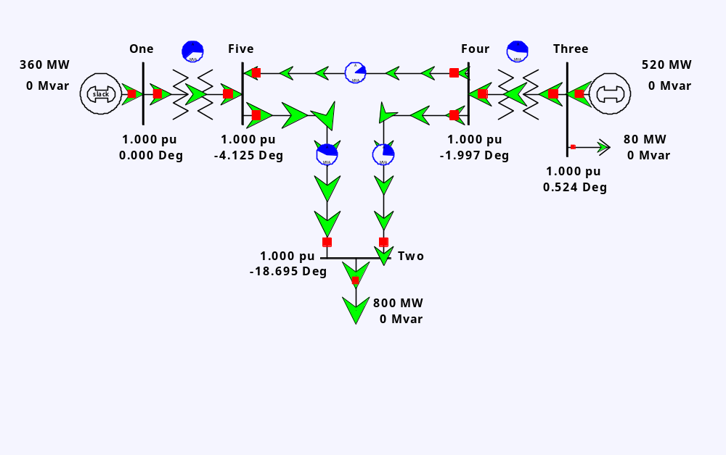
DC Power Flow 5 Bus Example
Notice with the dc power flow all of the voltage magnitudes are
1 per unit.

Slide 28
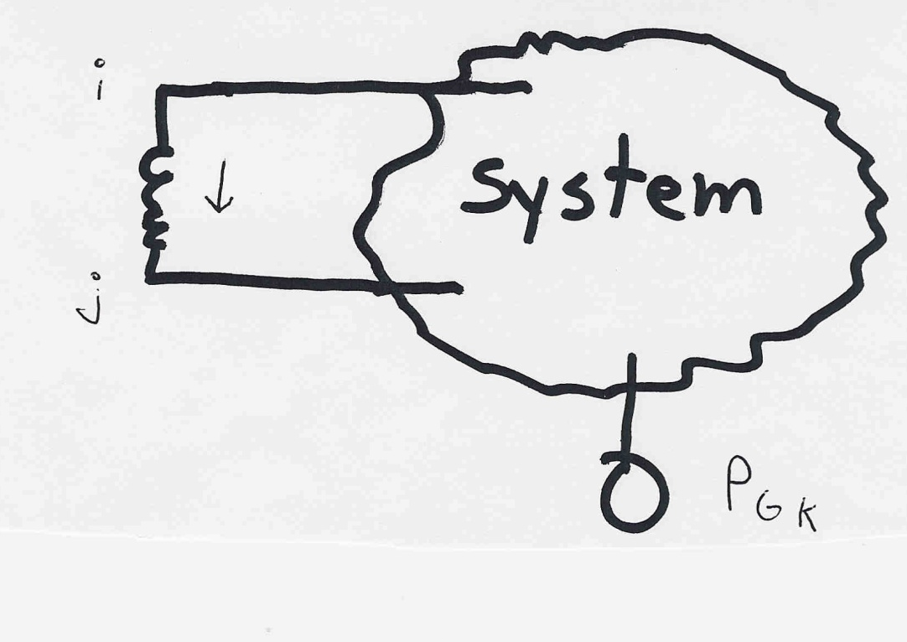
Indirect Transmission Line Control
What we would like to determine is how a change in
generation at bus k affects the power flow on a line
from bus i to bus j.
The assumption is
that the change
in generation is
absorbed by the
slack bus

Slide 29
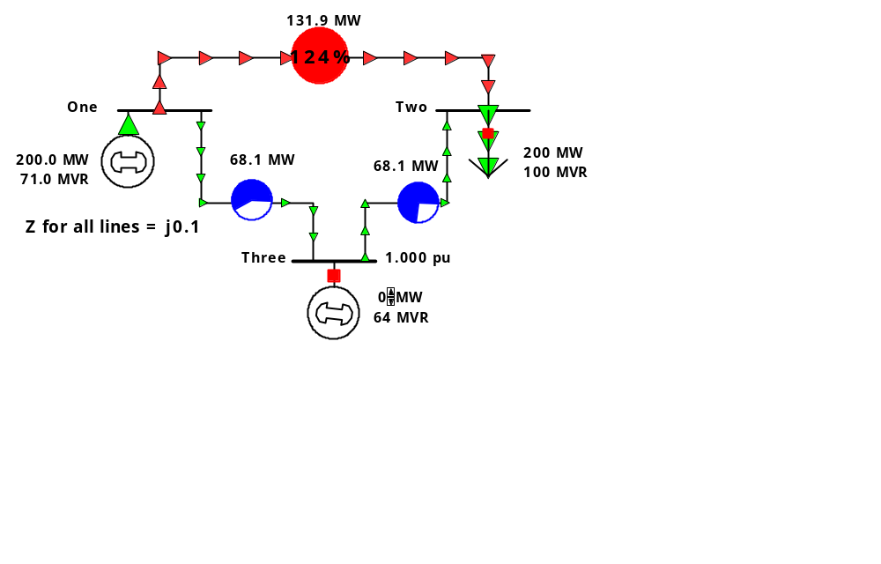
Power Flow Simulation - Before
One way to determine the impact of a generator change is to compare a before/after power flow.
For example below is a three bus case with an overload

Slide 30
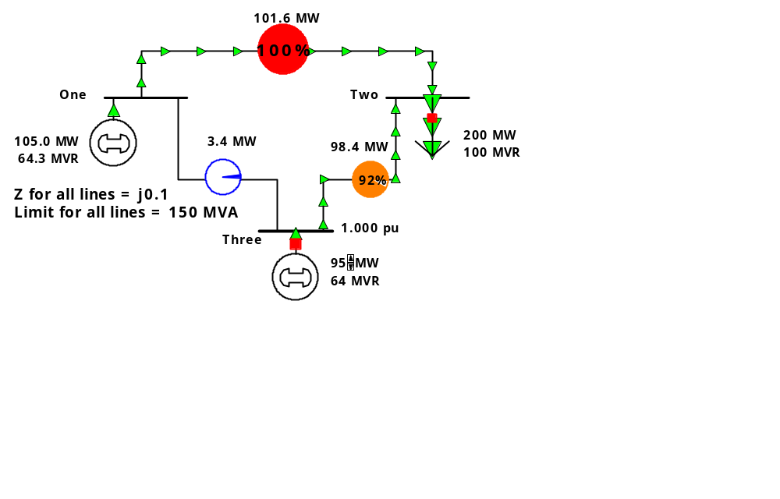
Power Flow Simulation - After
Increasing the generation at bus 3 by 95 MW (and hence
decreasing it at bus 1 by a corresponding amount), results
in a 31.3 drop in the MW flow on the line from bus 1 to 2.

Slide 31
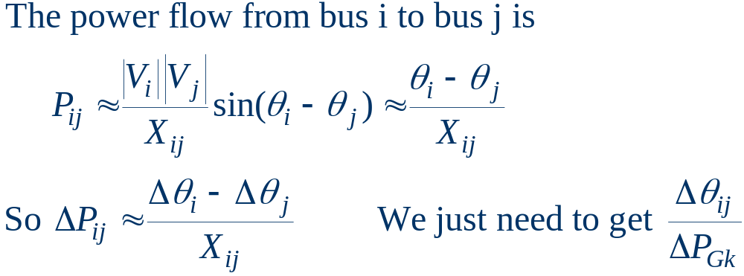
Analytic Calculation of Sensitivities
Calculating control sensitivities by repeat power flow solutions is tedious and would require many power flow solutions. An alternative approach is to analytically calculate these values

Slide 32
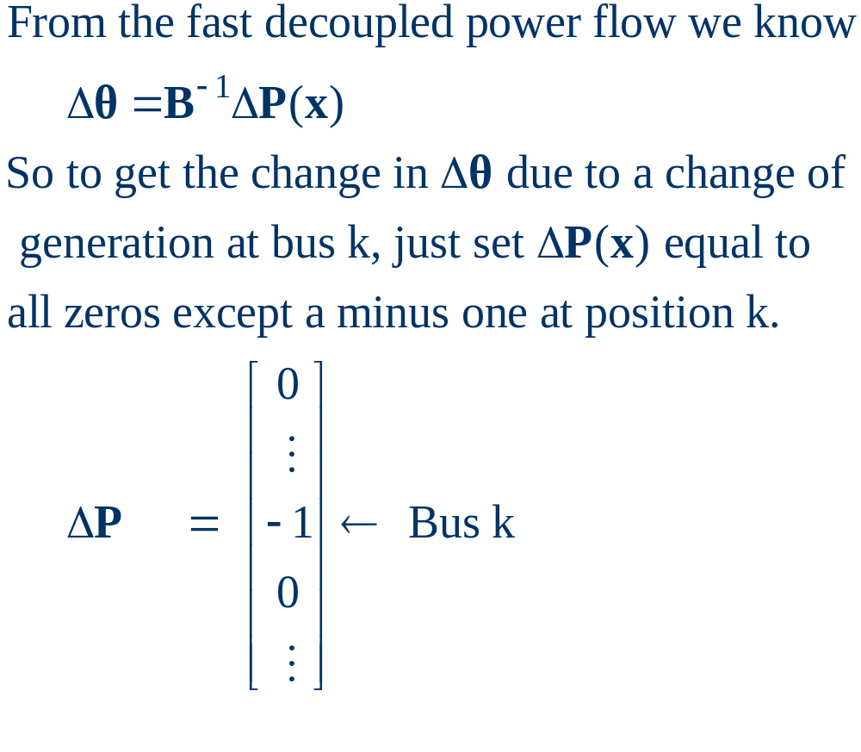
Analytic Sensitivities

Slide 33
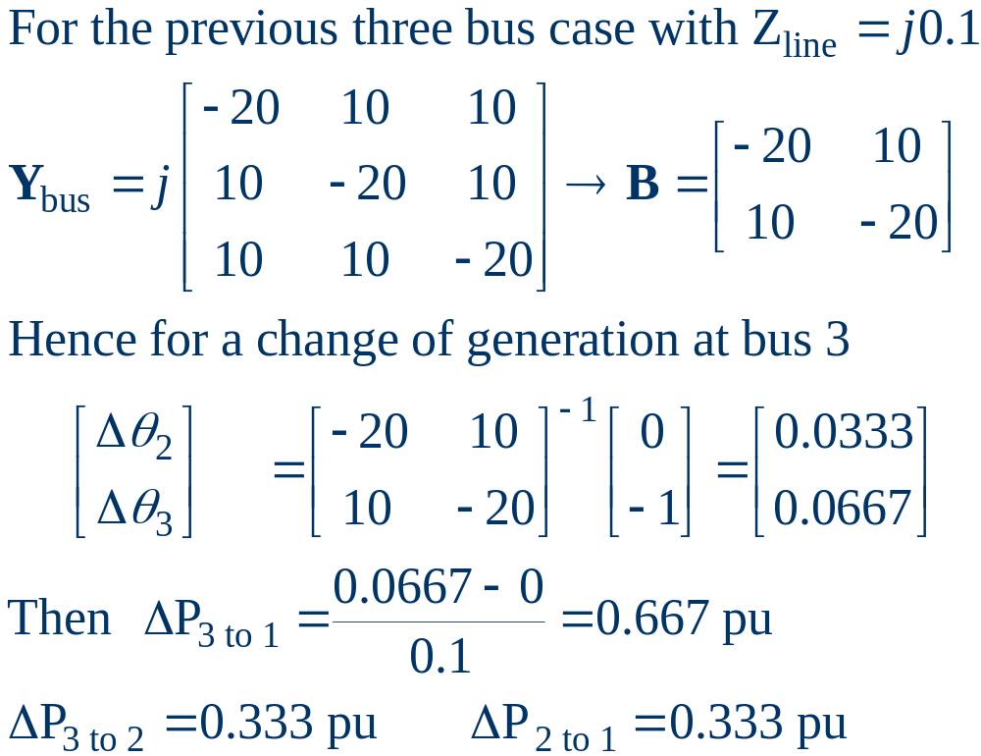
Three Bus Sensitivity Example

Slide 34
Balancing Authority Areas
An balancing authority area (use to be called operating areas) has traditionally represented the portion of the interconnected electric grid operated by a single utility
Transmission lines that join two areas are known as tie-lines.
The net power out of an area is the sum of the flow on its tie-lines.
The flow out of an area is equal to
total gen - total load - total losses = tie-flow

Slide 35

Area Control Error (ACE)
The area control error (ace) is the difference between the actual flow out of an area and the scheduled flow, plus a frequency component
Ideally the ACE should always be zero.
Because the load is constantly changing, each utility must constantly change its generation to “chase” the ACE.

Slide 36
Automatic Generation Control
Most utilities use automatic generation control (AGC) to automatically change their generation to keep their ACE close to zero.
Usually the utility control center calculates ACE based upon tie-line flows; then the AGC module sends control signals out to the generators every couple seconds.

Slide 37
Power Transactions
Power transactions are contracts between generators and loads to do power transactions.
Contracts can be for any amount of time at any price for any amount of power.
Scheduled power transactions are implemented by modifying the value of P_{sched} used in the ACE calculation

Slide 38
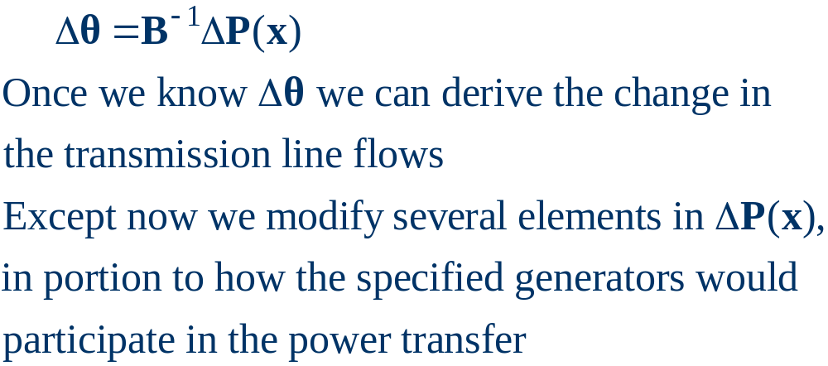
PTDFs
Power transfer distribution factors (PTDFs) show the linear impact of a transfer of power.
PTDFs calculated using the fast decoupled power flow B matrix

Slide 39
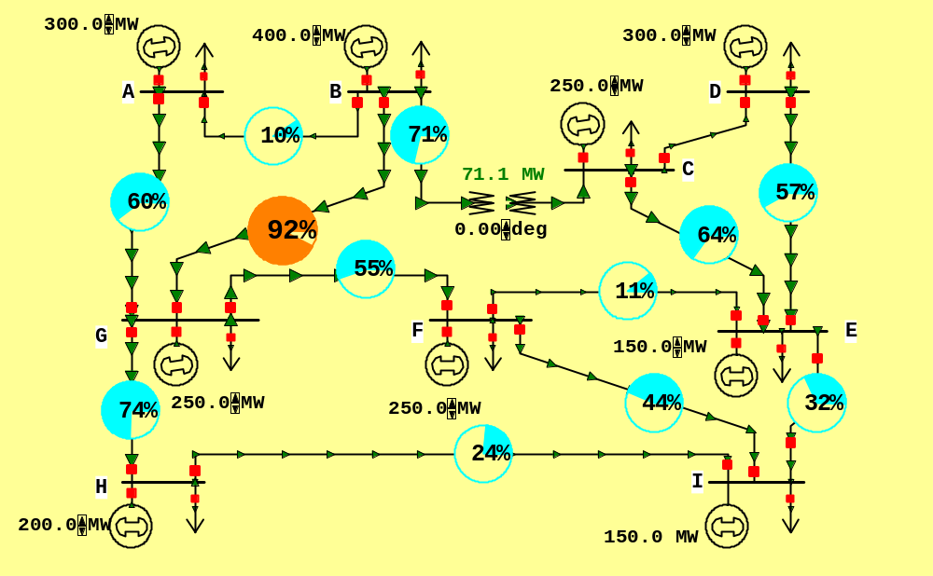
Nine Bus PTDF Example
Figure shows initial flows for a nine bus power system

Slide 40
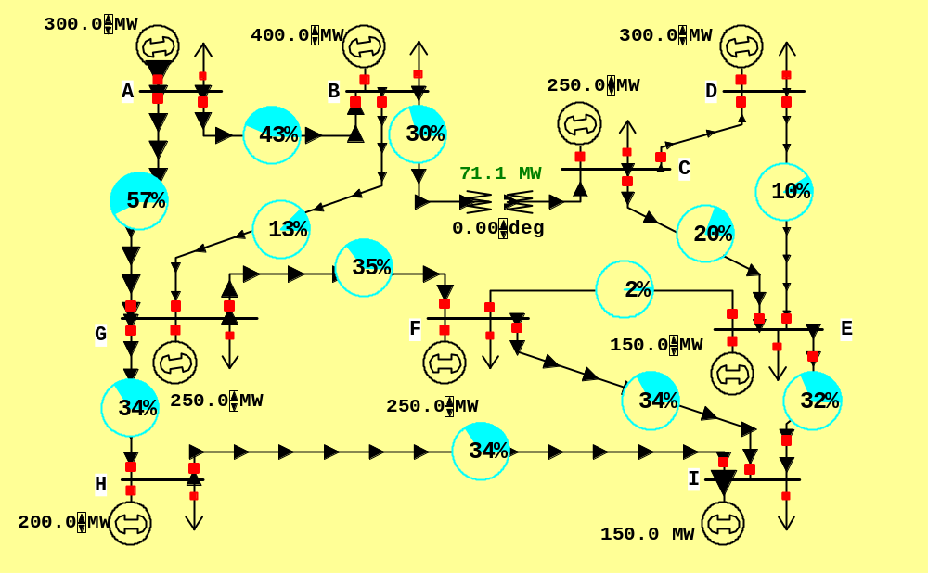
Nine Bus PTDF Example, cont'd
Figure now shows percentage PTDF flows from A to I

Slide 41
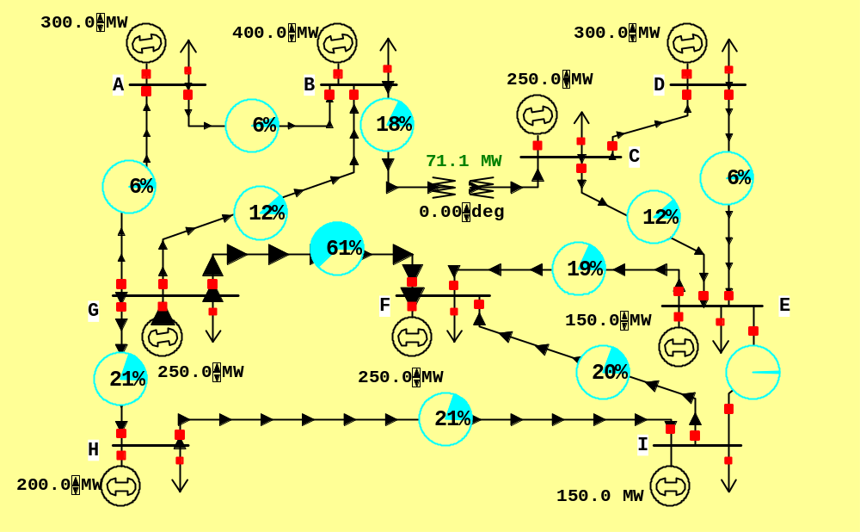
Nine Bus PTDF Example, cont'd
Figure now shows percentage PTDF flows from G to F

Slide 42
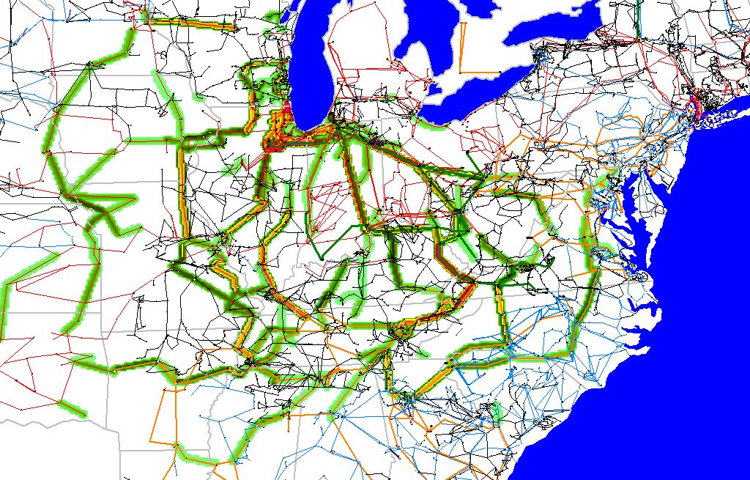
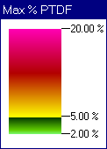
WE to TVA PTDFs

Slide 43
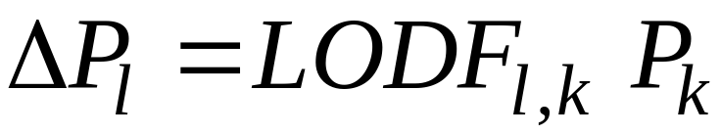
Line Outage Distribution Factors (LODFS)
LODFs are used to approximate the change in the flow on one line caused by the outage of a second line
  typically they are only used to determine the change in the MW flow
  LODFs are used extensively in real-time operations
  LODFs are state-independent but do dependent on the assumed network topology

Slide 44
Flowgates
The real-time loading of the power grid is accessed via “flowgates”
A flowgate “flow” is the real power flow on one or more transmission element for either base case conditions or a single contingency
  contingent flows are determined using LODFs
Flowgates are used as proxies for other types of limits, such as voltage or stability limits
Flowgates are calculated using a spreadsheet

Slide 45
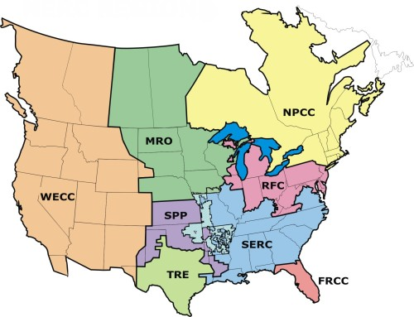
NERC Regional Reliability Councils
NERC
is the
North
American
Electric
Reliability
Council

Slide 46
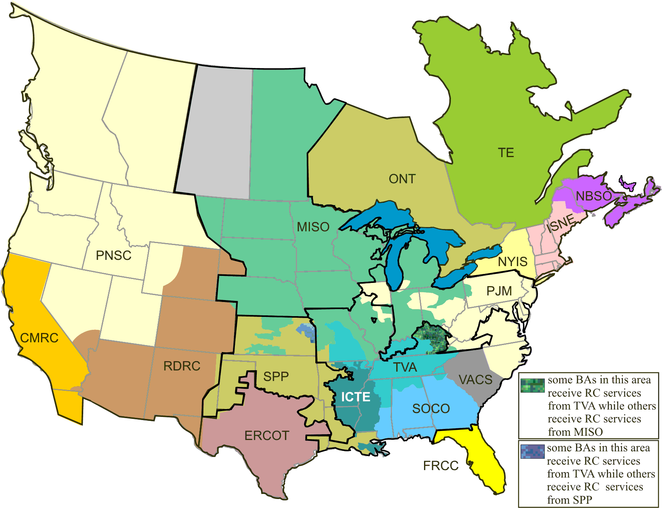
NERC Reliability Coordinators
Source: http://www.nerc.com/page.php?cid=5%7C67%7C206

