Slide 1
Higher Fidelity for Reactive Machine-Learning Potentials by Relabelling
MSc thesis defence
Benedikt Pabinger
Supervisors: Arghya Bhowmik, Emma Christine Lei Hovmand, Andreas Burger
Notes:
Title. One sentence on what the talk is about: raising the level of theory of a reactive machine-learning potential by recomputing labels, and where that works.

Slide 2
Machine-learned potentials make DFT cheap, but for reactions they had no data
What they are used for
  energy and forces in milliseconds instead of hours
  molecular dynamics
  screening thousands of molecules
  systems too large for DFT
  universal models: UMA, eSEN, trained on 10⁸ DFT calculations
The exception: reactions
  the datasets held equilibrium structures
  a transition state is far from equilibrium
  “limited success as surrogate potentials for reaction barrier search” (Transition1x paper, 2022)
  and barriers matter: they enter the rate exponentially, 43 meV is a factor of five
Notes:
A trained model gives energy and forces in milliseconds instead of hours. That is why they are used for dynamics, screening, and systems too large for DFT. Reactions were the exception: the data sat at equilibrium and a transition state is far from it. The Transition1x paper says it in one sentence. Barriers enter the rate exponentially: 43 meV, chemical accuracy, is a factor of five at room temperature.

Slide 3
Transition1x gave them the data, at a cheap level
10 073
9.6 million
ωB97X/6-31G(d)
reaction paths, every intermediate NEB geometry kept
DFT energies and forces on and around the paths
level chosen for cost and for compatibility with ANI-1x, not for barrier accuracy
Better levels exist. ωB97M-V/def2-TZVP is among the most accurate DFT methods for barriers.
A model trained on Transition1x is only as good as these labels.
Schreiner, Bhowmik, Vegge, Busk, Winther, Sci. Data 2022
Notes:
2022, from this group. Ten thousand reaction paths, every intermediate NEB geometry kept, 9.6 million calculations, at wB97X/6-31G(d). The level was chosen for cost and for compatibility with ANI-1x, not for barrier accuracy. Better levels exist. TRANSITION: So we want those labels at a better level. The obvious way is to run the ten thousand path searches again at that level: hundreds of gradients per search, at a level several times more expensive. Nobody does that.

Slide 4
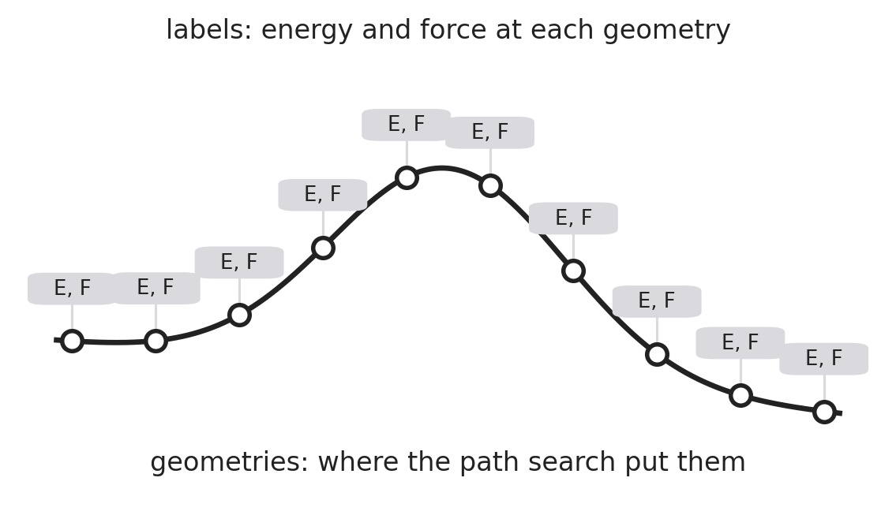
A dataset is geometries plus labels. Relabelling changes the labels and keeps the geometries
The geometries come from the path search. The labels are the energy and force at each one.
Only the labels are tied to the cheap level.
So recompute them: one single point per geometry at the better level. No new path search.
This is how the field raises fidelity.
OMol25, 2025: did it for all of Transition1x. Same geometries, new labels at ωB97M-V/def2-TZVPD, computed unrestricted, the way DFT can describe a half-broken bond.
Notes:
You do not have to. A dataset is geometries plus labels. The geometries come from the path search, the labels are energy and force at each geometry. Only the labels are tied to the cheap level. So recompute them: one single point per geometry, no new path search. That is how the field raises fidelity. And in 2025 OMol25 did it at full scale: all of Transition1x, same geometries, new labels at wB97M-V/def2-TZVPD, and computed the other way DFT can be run for singlets, unrestricted, which can describe a half-broken bond.

Slide 5
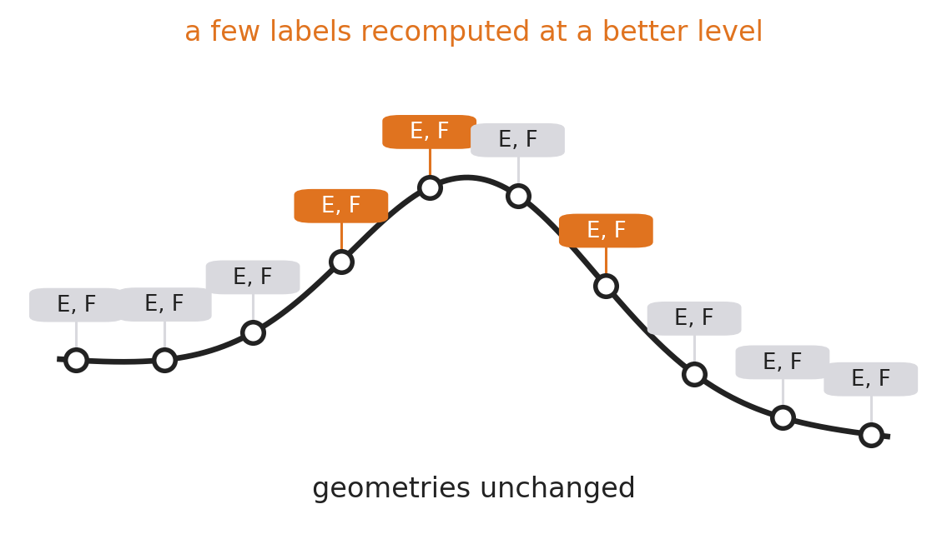
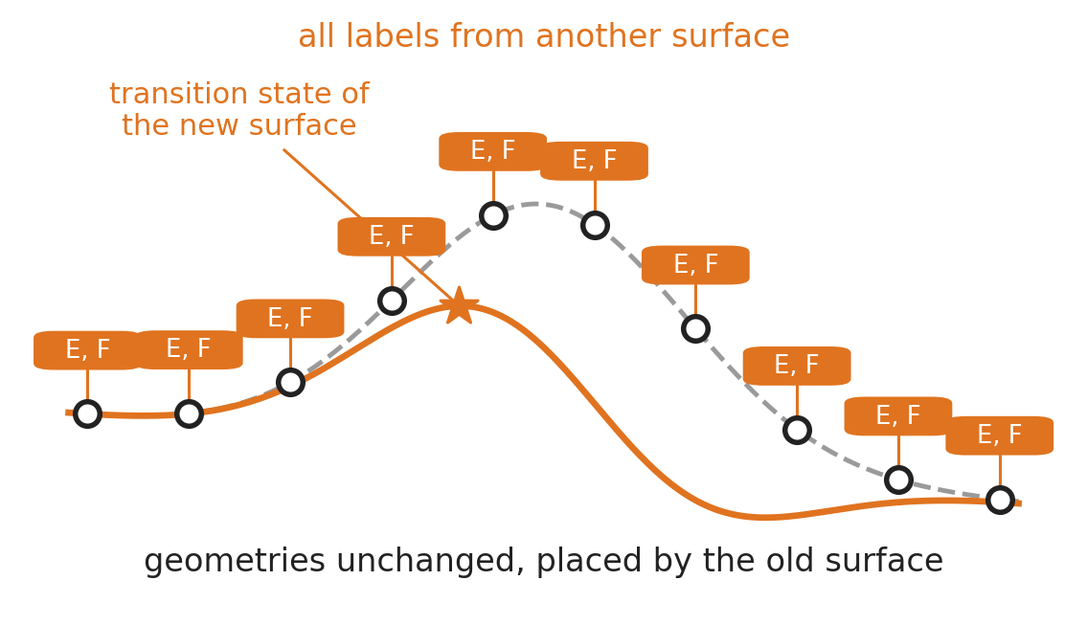
Two things you can do to that picture, and a question for each
RQ1 How few labels are enough to lift the model?
What we did: trained MACE on Transition1x, relabelled under 1 % of it at ωB97M-V/def2-TZVP, trained a small correction head on that.
Tested against DFT reference paths on 30 unseen reactions.
RQ2 Are the geometries still the right ones on the new surface?
What we did: let the three OMol25 models search transition states of 45 Transition1x reactions, checked every result with unrestricted DFT and a stability analysis.
Tested whether they do as well where the surface differs as where it does not.
Notes:
Left: swap a few labels for better ones. How few are enough? RQ1. We trained our own MACE, relabelled under one percent, trained a correction head, tested on 30 unseen reactions against DFT reference paths. Right: swap all labels for ones from a different surface, geometries untouched. Are the geometries still the right ones? RQ2. We took the three OMol25 models, let them search 45 reactions, checked every result with unrestricted DFT and a stability analysis. Both are edits to the same dataset, and both are what the field does today. The rest of the talk is these two experiments.

