Slide 1
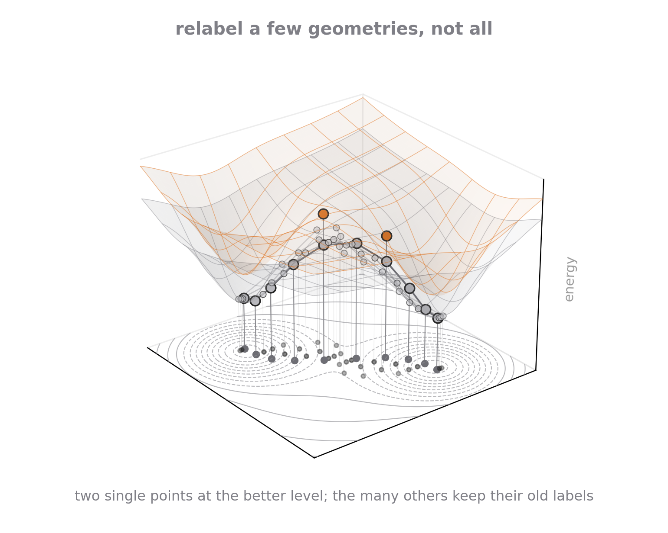
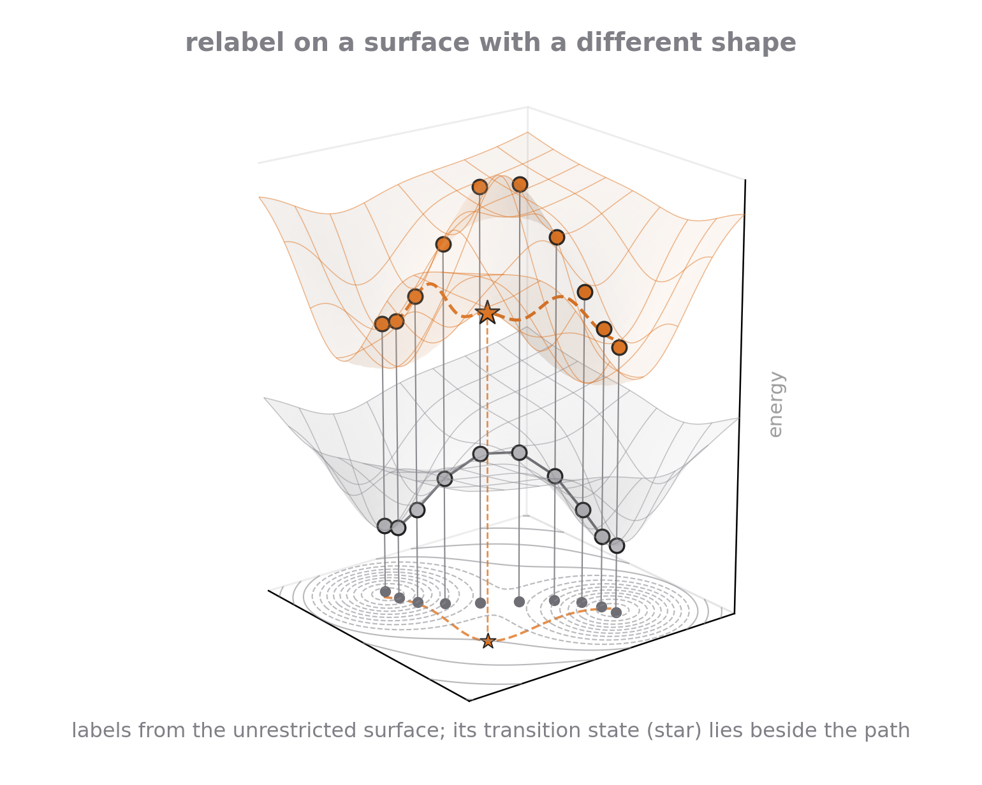
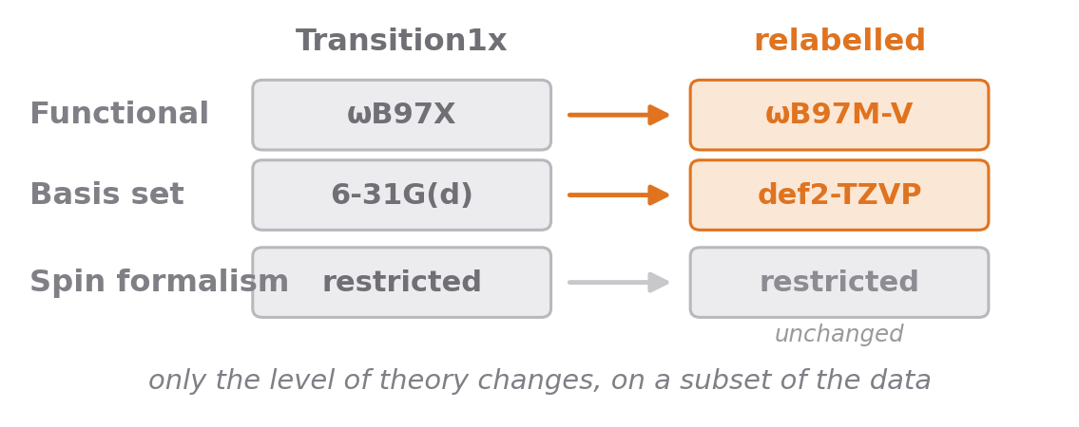
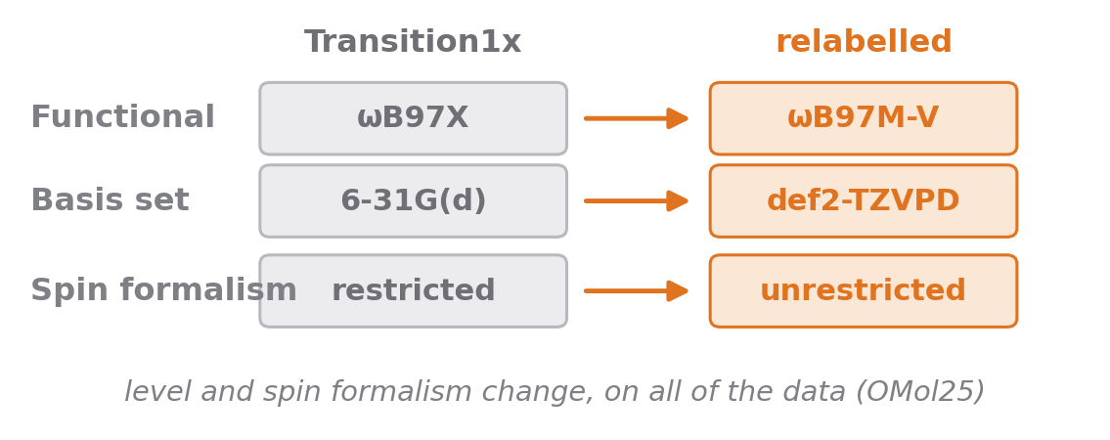
Two ways to relabel Transition1x
RQ1 Can a model be lifted to a higher level of theory by relabelling only a subset of its training data?
RQ2 Can a model learn a surface from paths that were never relaxed on that surface?
To investigate we relabel a subset ourselves and train a correction head on a MACE model
To investigate we test the OMol25 models, trained on all of Transition1x relabelled unrestricted
Both are edits of the same dataset. The first changes the labels on a subset. The second changes the surface the labels come from, and the geometries stay where the old surface put them.
Notes:
Both questions start from Transition1x and both relabel it. Left: only the level of theory changes, the spin formalism stays restricted, and we do it on a subset because the question is how few labels are enough. Right: the level changes and the spin formalism changes, which is what OMol25 did for all of Transition1x. For the first that means a few new labels on the same surface. For the second the surface has a different shape, and its transition state can be where no geometry is. So the second question is not about how many labels; it is about whether the geometries are still the right ones.

