Slide 1
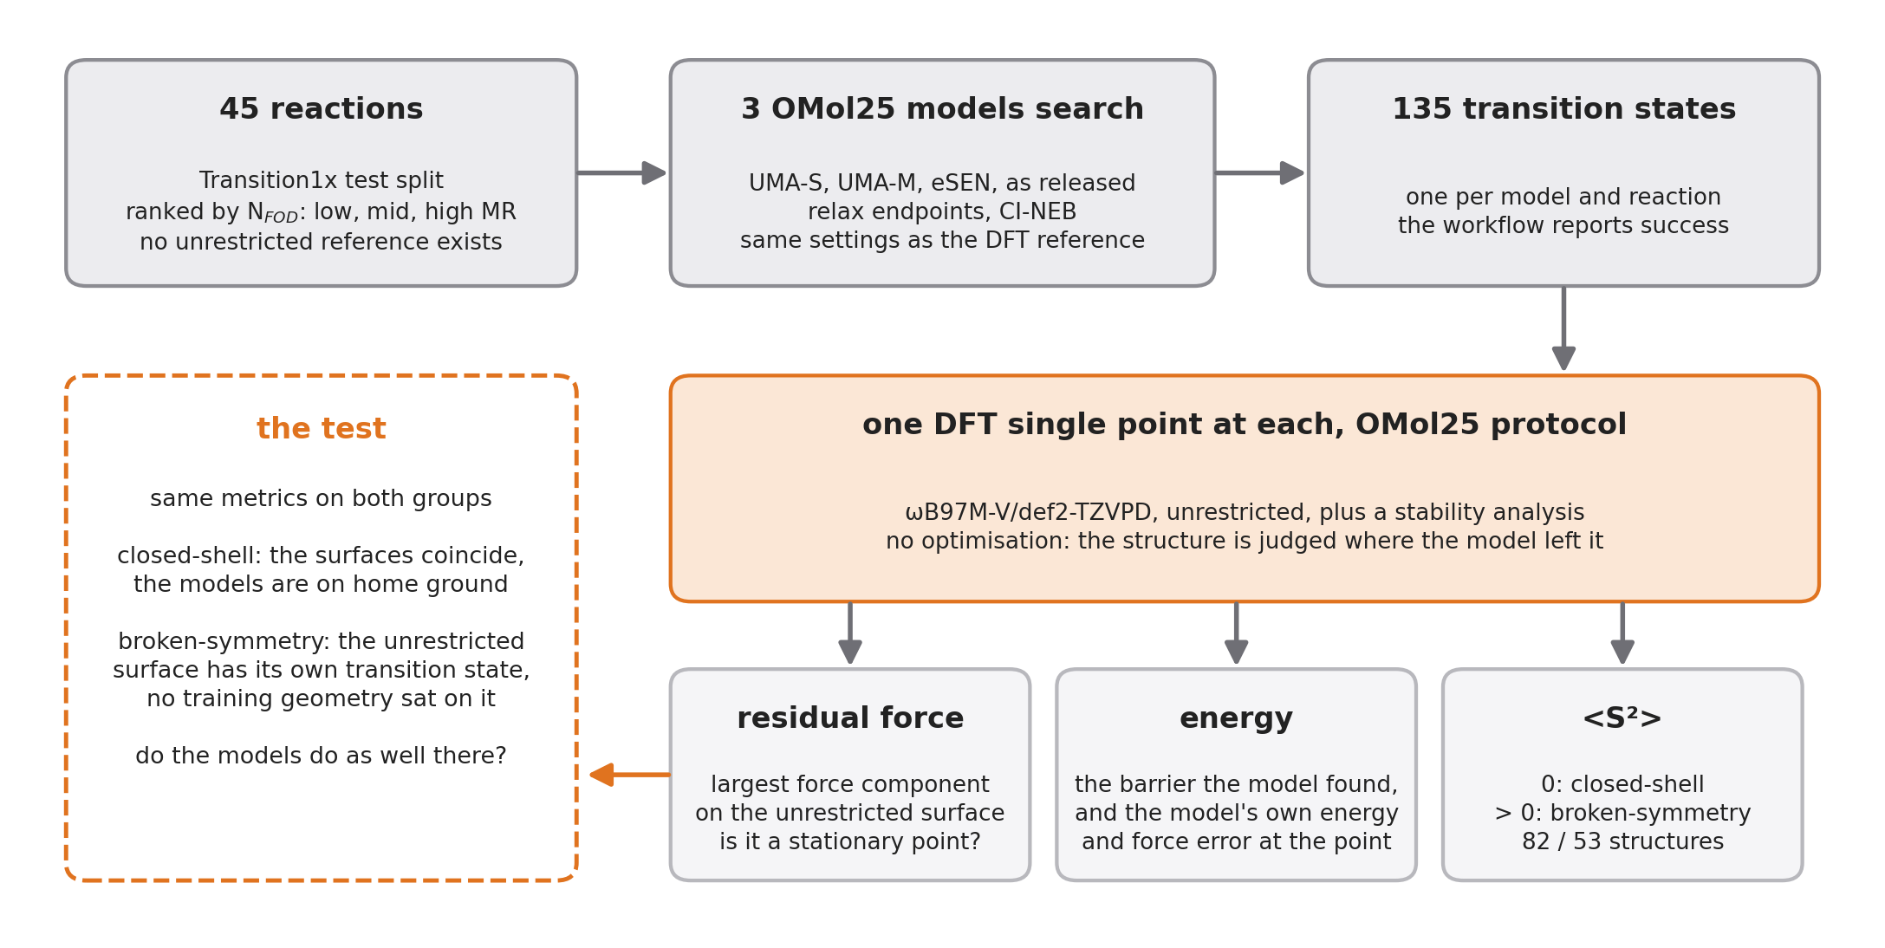
RQ2 – Higher-Fidelity Relabelling Without Re-optimising the Path Is Not Enough
Step 1
Select reactions where the two surfaces differ
Step 2
Let the OMol25 models search transition states
Step 3
Check every result with DFT on the unrestricted surface
Step 4
Sort into closed-shell and broken-symmetry, same metrics on both
Notes:
Same test as RQ1: the model searches, DFT checks. Two differences. The models are the OMol25 models, trained on all of Transition1x relabelled unrestricted. And the check is done on the unrestricted surface, because that is the surface the labels came from.

Slide 2
RQ2 – Higher-Fidelity Relabelling Without Re-optimising the Path Is Not Enough
Step 1 Select reactions
45 reactions from the Transition1x test split, ranked by multireference character (N_FOD): 15 low, 15 mid, 15 high
at high MR the restricted solution is expected to be unstable, so broken-symmetry transition states appear there
no unrestricted reference transition state exists for any of them. That is the point, so the check has to work without one
Notes:
The reactions are chosen so that the two surfaces differ for some of them and not for others. Nobody has an unrestricted reference for these transition states, and building one would answer the question by hand.

Slide 3
RQ2 – Higher-Fidelity Relabelling Without Re-optimising the Path Is Not Enough
Step 2 Search
three OMol25 models, used as released: UMA-S, UMA-M, eSEN
each runs the full workflow itself: relax reactant and product, CI-NEB with the same settings as the DFT reference
135 searches, 133 report success. The workflow never says it could not find one
Notes:
The models are not fine-tuned. They drive the same NEB machinery as the DFT reference, so what differs is the surface, not the search.

Slide 4
RQ2 – Higher-Fidelity Relabelling Without Re-optimising the Path Is Not Enough
Step 3 Check
one DFT single point at every transition state a model delivers, with the OMol25 protocol: ωB97M-V/def2-TZVPD, unrestricted, plus a stability analysis
no optimisation. The structure is judged where the model left it
it yields: the residual force on the unrestricted surface (is it a stationary point?), the energy (the barrier, and the model's own error at the point), and ⟨S²⟩
the residual force is the largest force component at the structure; zero at a transition state relaxed on that surface
Notes:
One single point per structure, the same calculation OMol25 used for its labels, plus the stability analysis that tells whether a lower unrestricted solution exists. Nothing is moved.

Slide 5
RQ2 – Higher-Fidelity Relabelling Without Re-optimising the Path Is Not Enough
Step 4 Sort and compare
⟨S²⟩ = 0: closed-shell, 82 structures. ⟨S²⟩ > 0: broken-symmetry, 53 structures. No borderline case
closed-shell: the two surfaces coincide, the models are on home ground
broken-symmetry: the unrestricted surface has its own transition state, and no training geometry sat on it
same metrics on both groups. Do the models do as well in the second?
the comparison is between the groups, not against a reference; the residual force says how far from a stationary point a structure is, on the surface the labels came from
Notes:
Where the restricted solution is stable the two surfaces are the same and the models are on home ground. Where it is unstable they are not. The results compare the two.

