Slide 1
Diabetes Risk Prediction
IE 500 – Data Mining Project

Slide 2
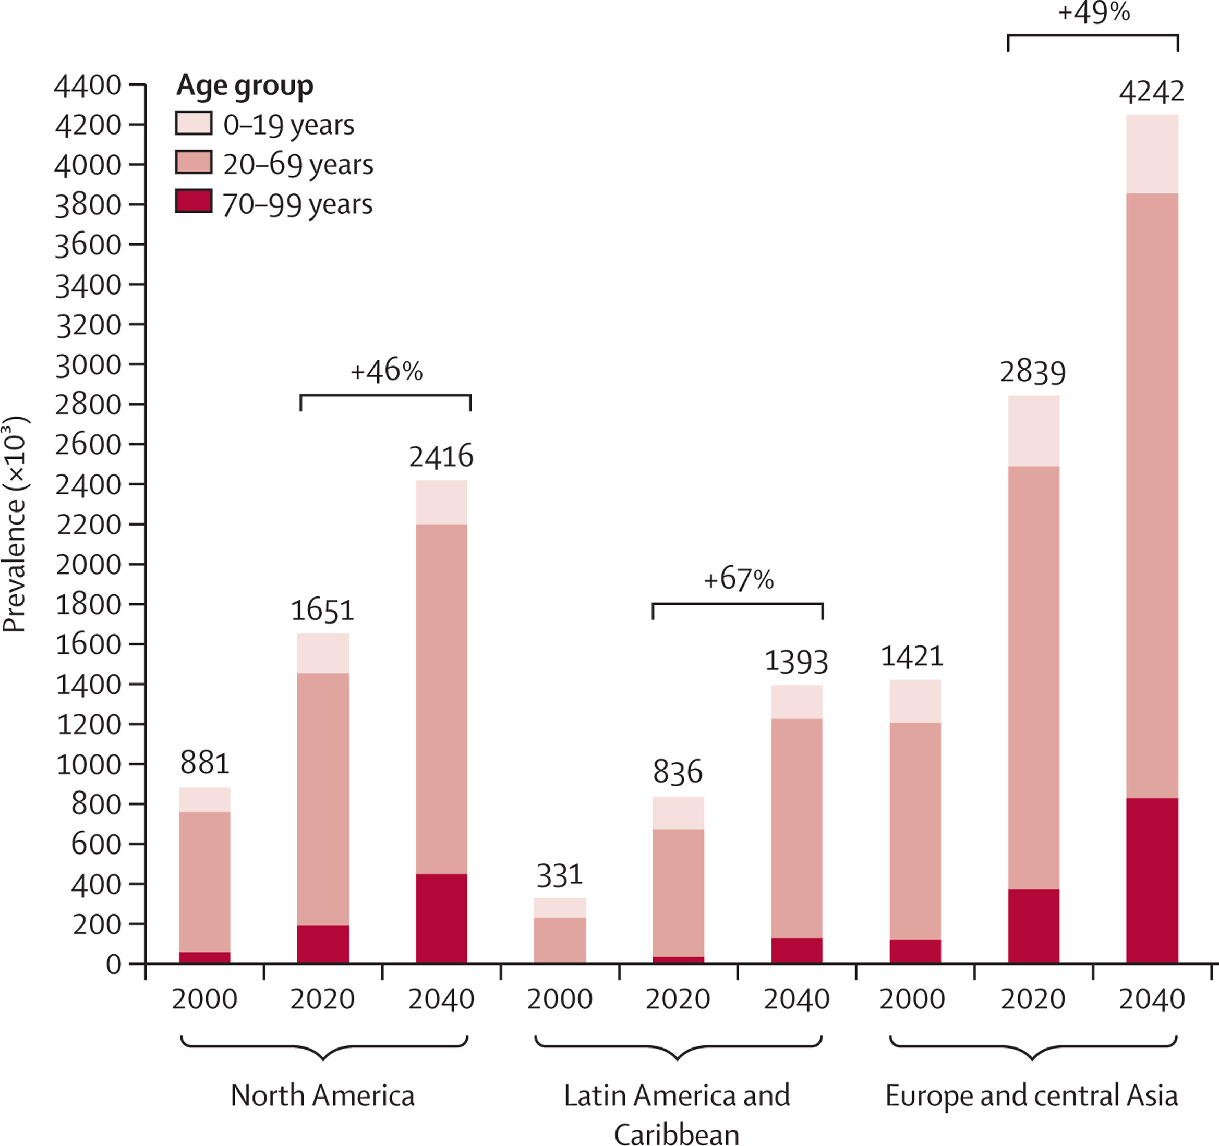



Diabetes: A Growing Disease with Serious Complications
Project Goal
Develop accurate predictive model to enable early diabetes detection and mitigate disease progression
Diabetes
Blood sugar disease
Body unable to produce or use insulin effectively
Prevalence in the US
34+ million Americans diagnosed (CDC, 2018)
88 million at risk due to prediabetes
$400 billion annual costs
Possible Complications
Heart diseases
Kidney Failure
Vision Loss
Source: Global incidence, prevalence, and mortality of type 1 diabetes in 2021 with projection to 2040: a modelling study

Slide 3
Diabetes: A Growing Disease with Serious Complications
Diabetes
Blood sugar disease
Body unable to produce or use insulin effectively
Project Goal
Develop accurate predictive model to enable early diabetes detection and mitigate disease progression
Prevalence in the US
34+ million Americans diagnosed (CDC, 2018)
88 million at risk due to prediabetes
$400 billion annual costs
Possible Complications
Heart diseases
Kidney Failure
Vision Loss
Source: Global incidence, prevalence, and mortality of type 1 diabetes in 2021 with projection to 2040: a modelling study

Slide 4
Dataset Overview and Preprocessing Steps
Dataset
Preprocessed Behavioral Risk Factor Surveillance System (BRFSS) dataset
253,680 observations with 22 features
1 target variable | Diabetes_012
14 binary features | e.g., Smoker, Stroke, HighBP
4 ordinal features | e.g., Education, Age
3 numerical features | e.g., BMI or MentHlth
Imbalanced
Target Variable
13.9%
1.9%
No Diabetes
Prediabetes
84.2%
Diabetes

Slide 5
Dataset Overview and Preprocessing Steps
Dataset
Preprocessed Behavioral Risk Factor Surveillance System (BRFSS) dataset
253,680 observations with 22 features
1 target variable | Diabetes_012
14 binary features | e.g., Smoker, Stroke, HighBP
4 ordinal features | e.g., Education, Age
3 numerical features | e.g., BMI or MentHlth
Imbalanced
Target Variable
13.9%
1.9%
No Diabetes
Prediabetes
84.2%
Diabetes
Preprocessing
Inconsistency checks (e.g., outlier detection, missing values, etc.)
Merging prediabetes and diabetes creating binary target
Processing of numerical features
Normalization of MentHlth and PhysHlth
Binning of BMI into medical classes, i.e., Underweight, Normal Weight, Overweight, Obesity

Slide 6
Defining Baseline Strategies and Selecting Binary Classification Models
Baselines
Majority Class
Stratified
Highest Correlation
Always predicting the most common class
Random predictions
based on class distributions
Prediction based on threshold of highest correlating feature
Accuracy: 0.84
Recall on Diabetes: 0
Accuracy: 0.73
Recall on Diabetes: 0.16
Accuracy: 0.79
Recall on Diabetes: 0.39

Slide 7
Defining Baseline Strategies and Selecting Binary Classification Models
Baselines
Majority Class
Stratified
Highest Correlation
Always predicting the most common class
Random predictions
based on class distributions
Prediction based on threshold of highest correlating feature
Accuracy: 0.84
Recall on Diabetes: 0
Accuracy: 0.73
Recall on Diabetes: 0.16
Accuracy: 0.79
Recall on Diabetes: 0.39
Model
Selection
Distance-Based
Tree-Based
Kernel-Based
K-Nearest Neighbors
Nearest Centroids
Decision Trees
Random Forest
AdaBoost Decision Tree
Support Vector Machines
Linear
Probabilistic
Deep Learning
Logistic Regression
Naïve Bayes
Neural Network

Slide 8
Model Training via Cross-Validation including Over- and Undersampling Techniques
Increasing Minority Class
Decreasing Majority Class
Random Oversampling
SMOTE Oversampling
SMOTE Tomek
and Links
Random Undersampling
Duplicate random samples of minority class
Generate synthetical new samples of minority class
SMOTE Oversampling + removing “noisy” samples of majority class
Removing random samples of majority class

Slide 9
Model Training via Cross-Validation including Over- and Undersampling Techniques
Increasing Minority Class
Decreasing Majority Class
Random Oversampling
SMOTE Oversampling
SMOTE Tomek
and Links
Random Undersampling
Duplicate random samples of minority class
Generate synthetical new samples of minority class
SMOTE Oversampling + removing “noisy” samples of majority class
Removing random samples of majority class
Cross Validation
Parameter grid includes
model-specific hyperparameters
as well as sampled datasets.
Ensure robust model performance
Select best parameter set
Exploitation of training data

Slide 10
Comparison and Evaluation of the Best Models of Each Classifier
 | Baseline Stratified | Logistic Regression | Decision Tree | Random Forest | AdaBoost Tree | SVM | KNN | Nearest Centroid | Naive Bayes
Accuracy
Precision 0
Precision 1
Recall 0 (specificity)
Recall 1 (sensitivity)
F1-Score 0
F1-Score 1
Classes: 0 (no-diabetes), 1 (diabetes)

Slide 11
Comparison and Evaluation of the Best Models of Each Classifier
 | Baseline Stratified | Logistic Regression | Decision Tree | Random Forest | AdaBoost Tree | SVM | KNN | Nearest Centroid | Naive Bayes
Accuracy | 0.7343 | 0.728 | 0.6988 | 0.7535 | 0.7467 | 0.4792 | 0.7433 | 0.6902 | 0.7356
Precision 0 | 0.8419 | 0.9431 | 0.9428 | 0.9341 | 0.9335 | 0.8809 | 0.9303 | 0.937 | 0.9354
Precision 1 | 0.1547 | 0.3395 | 0.3153 | 0.3583 | 0.3507 | 0.1857 | 0.3448 | 0.3051 | 0.3411
Recall 0 (specificity) | 0.8429 | 0.7205 | 0.684 | 0.7611 | 0.753 | 0.4415 | 0.7516 | 0.6779 | 0.737
Recall 1 (sensitivity) | 0.1538 | 0.7678 | 0.7781 | 0.7131 | 0.7132 | 0.6809 | 0.6988 | 0.7562 | 0.7279
F1-Score 0 | 0.8424 | 0.817 | 0.7928 | 0.8388 | 0.8336 | 0.5882 | 0.8314 | 0.7866 | 0.8244
F1-Score 1 | 0.1542 | 0.4708 | 0.4488 | 0.477 | 0.4702 | 0.2918 | 0.4617 | 0.4348 | 0.4645
Classes: 0 (no-diabetes), 1 (diabetes)

Slide 12
Comparison and Evaluation of the Best Models of Each Classifier
 | Baseline Stratified | Logistic Regression | Decision Tree | Random Forest | AdaBoost Tree | SVM | KNN | Nearest Centroid | Naive Bayes | Neural Network
Accuracy | 0.7343 | 0.728 | 0.6988 | 0.7535 | 0.7467 | 0.4792 | 0.7433 | 0.6902 | 0.7356 | 0.7775
Precision 0 | 0.8419 | 0.9431 | 0.9428 | 0.9341 | 0.9335 | 0.8809 | 0.9303 | 0.937 | 0.9354 | 0.9191
Precision 1 | 0.1547 | 0.3395 | 0.3153 | 0.3583 | 0.3507 | 0.1857 | 0.3448 | 0.3051 | 0.3411 | 0.3753
Recall 0 (specificity) | 0.8429 | 0.7205 | 0.684 | 0.7611 | 0.753 | 0.4415 | 0.7516 | 0.6779 | 0.737 | 0.8068
Recall 1 (sensitivity) | 0.1538 | 0.7678 | 0.7781 | 0.7131 | 0.7132 | 0.6809 | 0.6988 | 0.7562 | 0.7279 | 0.6205
F1-Score 0 | 0.8424 | 0.817 | 0.7928 | 0.8388 | 0.8336 | 0.5882 | 0.8314 | 0.7866 | 0.8244 | 0.8593
F1-Score 1 | 0.1542 | 0.4708 | 0.4488 | 0.477 | 0.4702 | 0.2918 | 0.4617 | 0.4348 | 0.4645 | 0.4677
Classes: 0 (no-diabetes), 1 (diabetes)

Slide 13
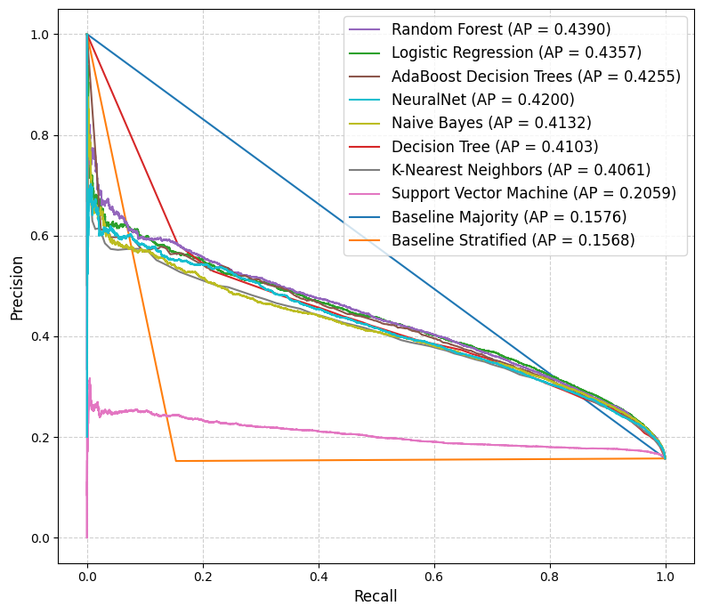
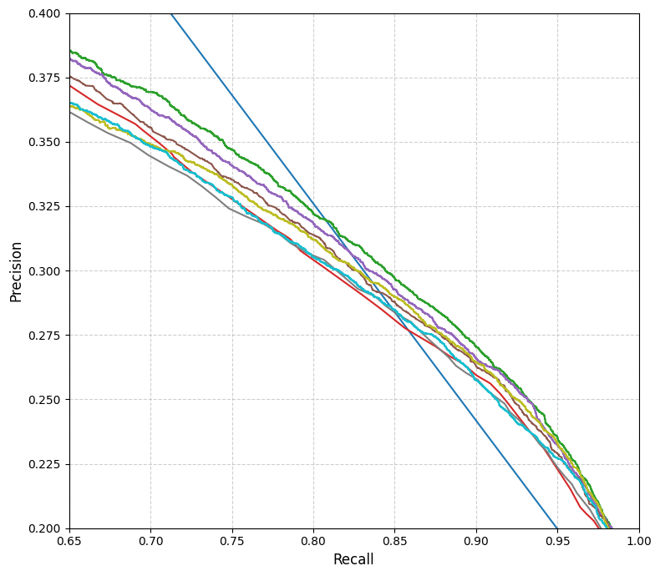
Evaluation
Fig 1: Precision-Recall Curve with Average Precision (AP)
Fig 2: Zoomed in Precision-Recall Curve

Slide 14
Key Take-Aways
Data Exploration
Sampling
Models
Metrics
Outlook

Slide 15
Key Take-Aways
Data Exploration
Sampling
Models
Metrics
Outlook
Imbalanced Dataset
No Diabetes (0): 86.07%
Diabetes (1): 13.93%

Slide 16
Key Take-Aways
(Random) Oversampling works best for most models
Balancing underrepresentation of minority class (Diabetes 1)
Data Exploration
Sampling
Models
Metrics
Outlook
Imbalanced Dataset
No Diabetes (0): 86.07%
Diabetes (1): 13.93%

Slide 17
Key Take-Aways
(Random) Oversampling works best for most models
Balancing underrepresentation of minority class (Diabetes 1)
Data Exploration
Sampling
Models
Metrics
Outlook
Imbalanced Dataset
Random Forest is best performing "traditional" model
No Diabetes (0): 86.07%
Diabetes (1): 13.93%
Averages predictions of multiple decision trees

Slide 18
Key Take-Aways
(Random) Oversampling works best for most models
Recall on positive class is important for our use case
Balancing underrepresentation of minority class (Diabetes 1)
False Positives more bearable than False Negatives
Data Exploration
Sampling
Models
Metrics
Outlook
Imbalanced Dataset
Random Forest is best performing "traditional" model
No Diabetes (0): 86.07%
Diabetes (1): 13.93%
Averages predictions of multiple decision trees

Slide 19
Key Take-Aways
(Random) Oversampling works best for most models
Recall on positive class is important for our use case
Balancing underrepresentation of minority class (Diabetes 1)
False Positives more bearable than False Negatives
Data Exploration
Sampling
Models
Metrics
Outlook
Imbalanced Dataset
Random Forest is best performing "traditional" model
Neural Networks very promising
No Diabetes (0): 86.07%
Diabetes (1): 13.93%
Good results with simple network and little training
Averages predictions of multiple decision trees

Slide 20
Any questions? Let’s discuss!
Thank you!

Slide 21
Team Information and Contact Details 11 - Support Vector Superstars
Matthias Fast, 2111111 – matthias.fast@students.uni-mannheim.de
Philipp Gänz, 1736316 – philipp.robert.gaenz@students.uni-mannheim.de
Salome Heckenthaler, 1742998 – salome.heckenthaler@students.uni-mannheim.de
Patricia Paskuda, 2119717 – patricia.paskuda@students.uni-mannheim.de
Benedikt Prisett, 2119134 – benedikt.prisett@students.uni-mannheim.de

Slide 22
Key Take-Aways
Stage | Observations / Assumptions | Results/ Conclusions
Data Exploration | Dataset highly imbalanced | No Diabetes (0): 86,07% Diabetes (1): 13,93%
Metrics | Recall on positive class important for our use case | Focus on capturing possible "Diabetes" (1) patients False positives more bearable than false negative predictions
Sampling | (Random) Oversampling works best for most models | Results of Hyperparameter Tuning Solution for underrepresentation of minority class in imbalanced "Diabetes_binary" dataset
Models | Random Forest overall best performing "traditional" model | Averages predictions of multiple decision trees Selects random subsets of training data and features
Outlook | Neural Networks very promising | Good results with simple network and little training Further possible investigations in the future

Slide 23
Key Take-Aways
(Random) Oversampling works best for most models
Recall on positive class is important for our use case
Balancing underrepresentation of minority class (Diabetes 1)
False Positives more bearable than False Negatives
Data Exploration
Sampling
Models
Metrics
Outlook
Dataset highly imbalanced
Random Forest is best performing "traditional" model
Neural Networks very promising
No Diabetes (0): 86.07%
Diabetes (1): 13.93%
Good results with simple network and little training
Averages predictions of multiple decision trees

Slide 24
Key Take-Aways
Recall on positive class is important
Random Forest is best "traditional" model
Medical Use Case
False Positives more bearable than False Negatives
Averages predictions of multiple trees
Samples random subsets of training data and features
Data Exploration
Metrics
Sampling
Models
Outlook
Imbalanced Dataset
(Random) Oversampling works best for most models
Neural Networks
No Diabetes (0): 86.07%
Diabetes (1): 13.93%
Good results with simple network and little training
Further investigations in the future
Results of Hyperparameter tuning
Solution for balancing target class

Slide 25
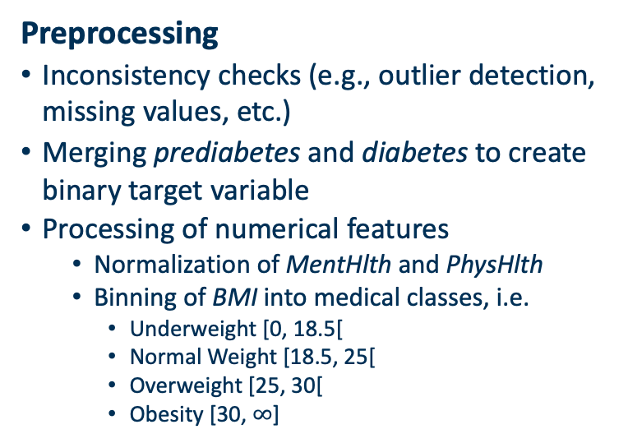
Dataset Overview and Preprocessing
Dataset
Preprocessed Behavioral Risk Factor Surveillance System (BRFSS) dataset
253,680 observations with 22 features
1 target variable | Diabetes_012
14 binary features | e.g., Smoker, Stroke, HighBP
4 ordinal features | e.g., Education, Age
3 numerical features | e.g., BMI or MentHlth
Imbalanced Target Variable
Preprocessing
Inconsistency checks (e.g., outlier detection, missing values, etc.)
Merging prediabetes and diabetes to create binary target variable
Processing of numerical features
Normalization of MentHlth and PhysHlth
Binning of BMI into medical classes, i.e.
Underweight [0, 18.5[
Normal Weight [18.5, 25[
Overweight [25, 30[
Obesity [30, $∞$]
13.9%
1.9%
No Diabetes
Prediabetes
Diabetes
84.2%

Slide 26
Model Training via Cross-Validation including Over- and Undersampling Techniques
Increasing Minority Class
Decreasing Majority Class
Random Oversampling
SMOTE Oversampling
SMOTE Tomek
and Links
Random Undersampling
Duplicate random samples of minority class
Generate synthetical new samples of minority class
SMOTE Oversampling + removing “noisy” samples of majority class
Removing random samples of majority class
Cross Validation
Parameter grid includes
model-specific hyperparameters
as well as sampled datasets
Ensure robust model performance
Select best parameter set
Select model with performance

Slide 27
Defining Baseline Strategies and Selecting Binary Classification Models
Baselines
Model Selection
Majority Class Prediction
Always predicts the most common class
Predict No Diabetes with 100%
Stratified Prediction
Random predictions for each instance based on observed class distributions
Predict No Diabetes with 86%
Predict Diabetes with 14%
Highest Correlation Prediction
Use feature with highest correlation to target variable for prediction
Threshold to distinguish between classes
Distance-Based
Linear
K-Nearest Neighbors
Nearest Centroids
Logistic Regression
Tree-Based
Probabilistic
Decision Trees
Random Forests
Naïve Bayes
Ensemble Methods
Kernel-Based
Bagging
Boosting
Support Vector Machines

Slide 28
Comparing and Evaluating the best Models of each Classifier
Too much oder? Joa glaube schon
Gut
War nen versuch wert ;)
 | Baseline Stratified | Logistic Regression | Decision Tree | Random Forest | AdaBoost Tree | SVM | KNN | Nearest Centroid | Naive Bayes
Accuracy | 0.7343 | 0.728 | 0.6988 | 0.7535 | 0.7467 | 0.4792 | 0.7433 | 0.6902 | 0.7356
Precision 0 | 0.8419 | 0.9431 | 0.9428 | 0.9341 | 0.9335 | 0.8809 | 0.9303 | 0.937 | 0.9354
Precision 1 | 0.1547 | 0.3395 | 0.3153 | 0.3583 | 0.3507 | 0.1857 | 0.3448 | 0.3051 | 0.3411
Recall 0 (specificity) | 0.8429 | 0.7205 | 0.684 | 0.7611 | 0.753 | 0.4415 | 0.7516 | 0.6779 | 0.737
Recall 1 (sensitivity) | 0.1538 | 0.7678 | 0.7781 | 0.7131 | 0.7132 | 0.6809 | 0.6988 | 0.7562 | 0.7279
F1-Score 0 | 0.8424 | 0.817 | 0.7928 | 0.8388 | 0.8336 | 0.5882 | 0.8314 | 0.7866 | 0.8244
F1-Score 1 | 0.1542 | 0.4708 | 0.4488 | 0.477 | 0.4702 | 0.2918 | 0.4617 | 0.4348 | 0.4645
Classes: 0 (no-diabetes), 1 (diabetes)

Slide 29
Comparison and Evaluation of the Best Models of Each Classifier
 | Baseline Stratified | Logistic Regression | Decision Tree | Random Forest | AdaBoost Tree | SVM | KNN | Nearest Centroid | Naive Bayes | Neural Network
Accuracy | 0.7343 | 0.728 | 0.6988 | 0.7535 | 0.7467 | 0.4792 | 0.7433 | 0.6902 | 0.7356 | 0.7775
Precision 0 | 0.8419 | 0.9431 | 0.9428 | 0.9341 | 0.9335 | 0.8809 | 0.9303 | 0.937 | 0.9354 | 0.9191
Precision 1 | 0.1547 | 0.3395 | 0.3153 | 0.3583 | 0.3507 | 0.1857 | 0.3448 | 0.3051 | 0.3411 | 0.3753
Recall 0 (specificity) | 0.8429 | 0.7205 | 0.684 | 0.7611 | 0.753 | 0.4415 | 0.7516 | 0.6779 | 0.737 | 0.8068
Recall 1 (sensitivity) | 0.1538 | 0.7678 | 0.7781 | 0.7131 | 0.7132 | 0.6809 | 0.6988 | 0.7562 | 0.7279 | 0.6205
F1-Score 0 | 0.8424 | 0.817 | 0.7928 | 0.8388 | 0.8336 | 0.5882 | 0.8314 | 0.7866 | 0.8244 | 0.8593
F1-Score 1 | 0.1542 | 0.4708 | 0.4488 | 0.477 | 0.4702 | 0.2918 | 0.4617 | 0.4348 | 0.4645 | 0.4677
Classes: 0 (no-diabetes), 1 (diabetes)

Slide 30

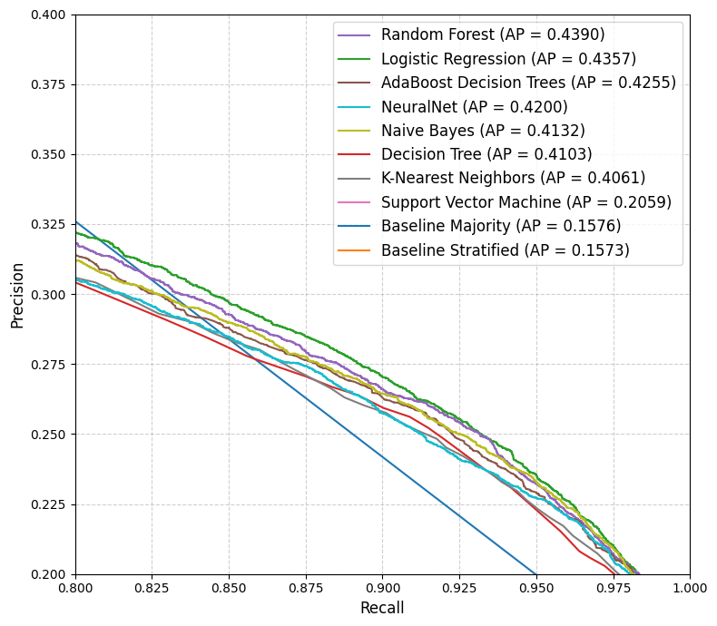
Evaluation
Fig 1: Precision-Recall Curve with Average Precision (AP)
Fig 2: Zoomed in Precision-Recall Curve

Slide 31
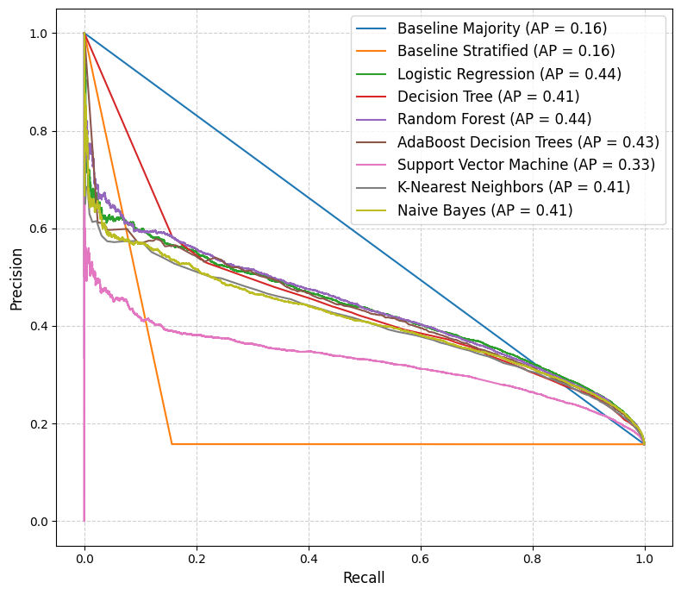
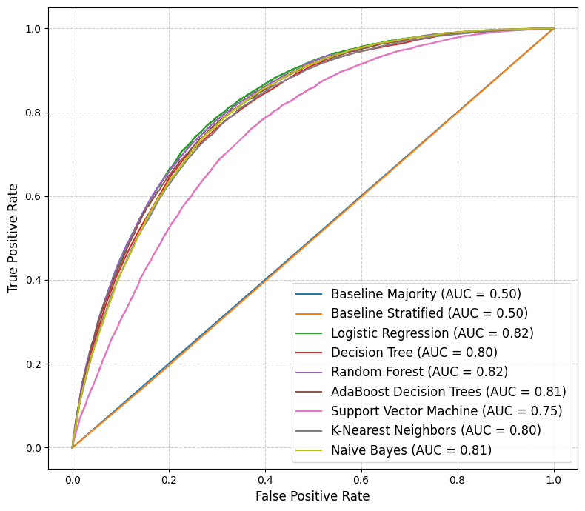
Evaluation
In die tabelle
Hier zoomen?
Fig 1: Precision-Recall Curve with Average Precision (AP)
Fig 2: ROC Curve with Area Under Curve (AUC)

Slide 32
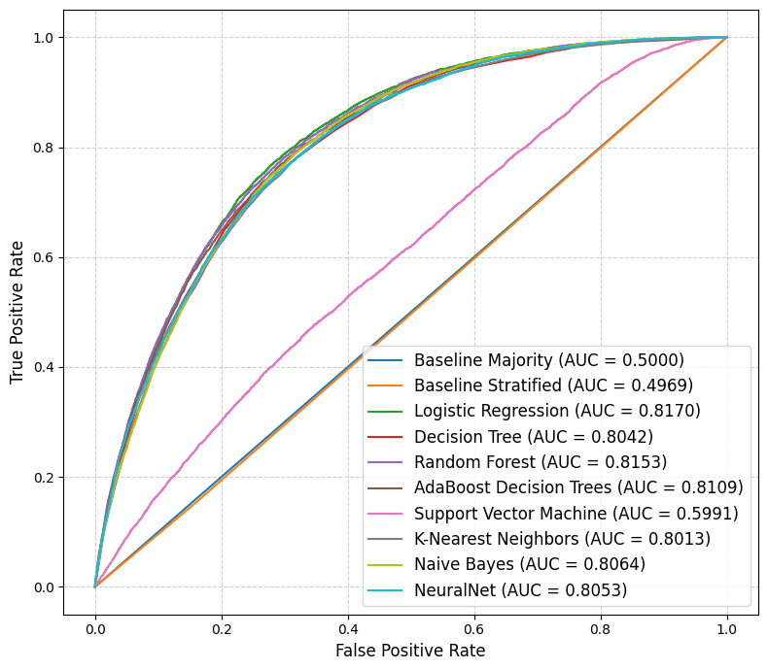

Slide 33
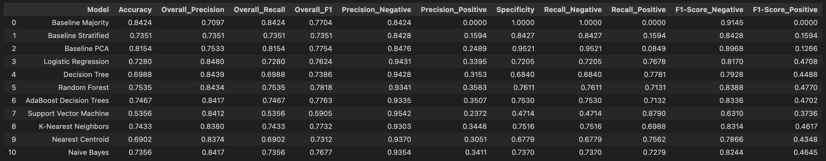
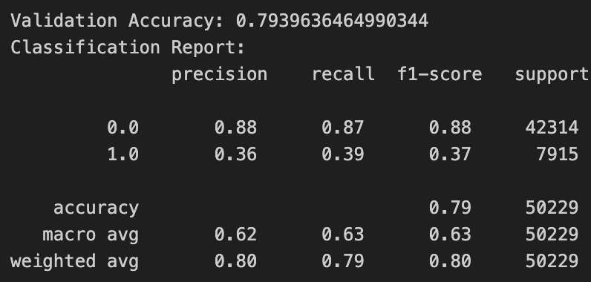
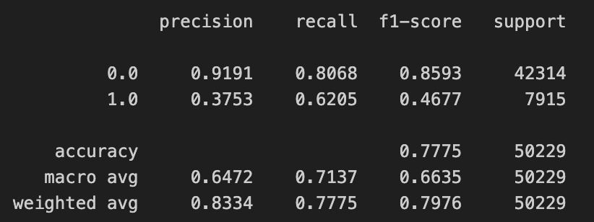
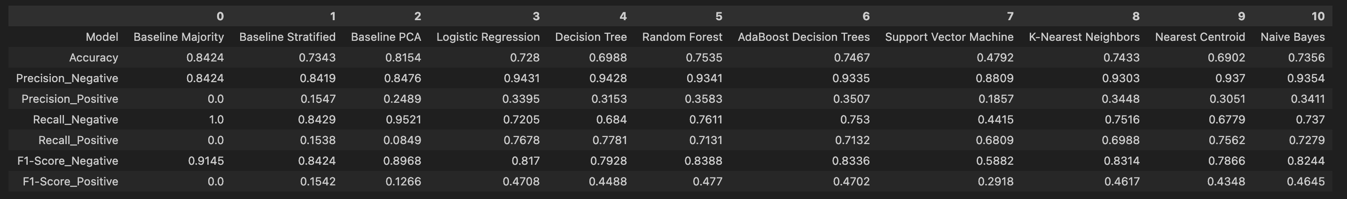
Evaluation
Neural Network
One feature

Slide 34
Key Take-Aways
Dataset highly imbalanced
Data Exploration
No Diabetes (0): 86.07% Diabetes (1): 13.93%
(Random) Oversampling works best for most models
Sampling
No Diabetes (0): 86.07% Diabetes (1): 13.93%
Dataset highly imbalanced
Models
No Diabetes (0): 86.07% Diabetes (1): 13.93%
Dataset highly imbalanced
Metrics
No Diabetes (0): 86.07% Diabetes (1): 13.93%
Dataset highly imbalanced
Outlook
No Diabetes (0): 86.07% Diabetes (1): 13.93%

Slide 35
Key Take-Aways
step
step
step
step
step

