Slide 1
Reinforcement Learning I
M. Beneitez – miguel.beneitez@manchester.ac.uk
Summer School in Hands-on ML 2026

Slide 2
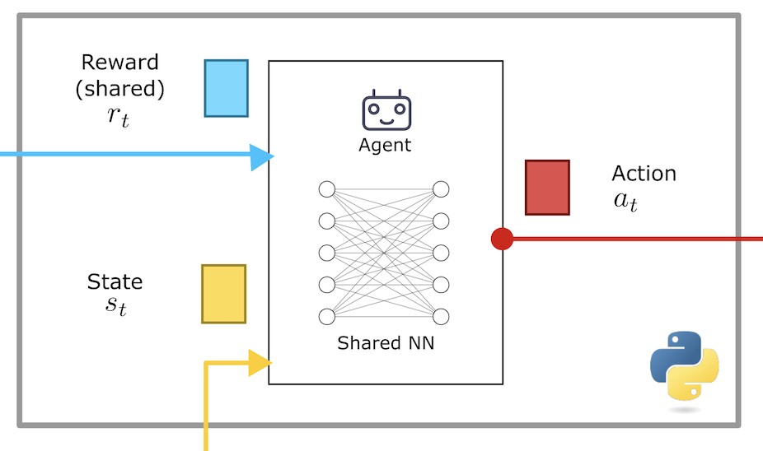
Reinforcement learning
What is reinforcement learning? Learning through interaction
The agent takes actions in an environment; the environment evolves and returns a new state and a reward signal. Over repeated interaction, the agent learns a policy that maximises cumulative reward.

Slide 3
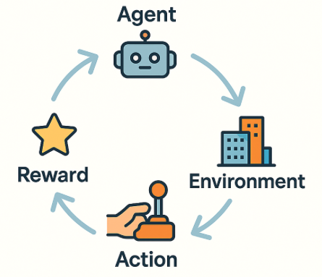
Introduction
Today’s content
Core concepts about reinforcement learning. Why do we learn? How do we learn?
What is a Markov decision process (MDP). Some formal work through dynamic programming
Q-learning and the Bellman equation
Why do we need deep RL?

Slide 4
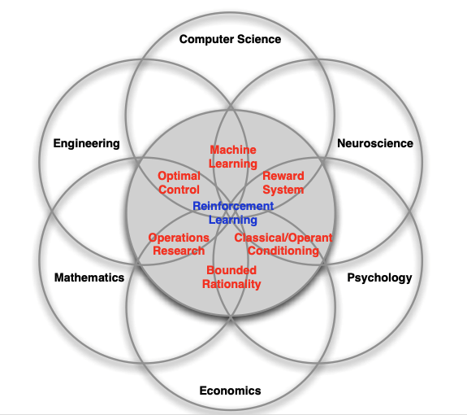
The place of RL
From David Silver’s slides

Slide 5
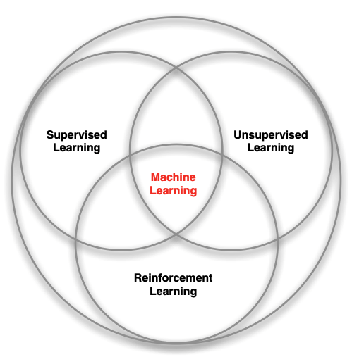
The place of RL
From David Silver’s slides

Slide 6
What makes RL different
There is no supervisor (no labels saying right or wrong)
Feedback is delayed, not instantaneous (remember cumulative rewards!)
Time (and order) really matter: sequential data
Agents actions affect the future data

Slide 7
The RL loop
The key idea
The reward hypothesis: any goal can be formalized as maximising the expected cumulative reward
Observation: the agent only ever sees this
State: is how the whole environment looks like
Observation = State
If the whole environment is observable

Slide 8
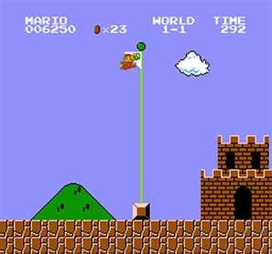
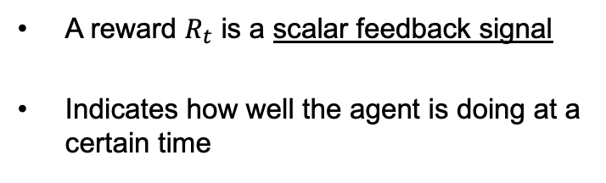


The elements of RL
The reward
A reward $R_{t}$ is a scalar feedback signal
Indicates how well the agent is doing at a certain time
Formal definition of what we try to maximise
Gₜ = Rₜ₊₁ + γRₜ₊₂ + γ²Rₜ₊₃ + ... = Σ γᵏ Rₜ₊ₖ₊₁ (sum over k = 0, 1, 2, ...)
$γ$ is called ”discount factor”
$G_{t}$ is called ”expected return”

Slide 9


The elements of RL
The reward
$γ$ is called ”discount factor”
$G_{t}$ is called ”expected return”
Gₜ = Rₜ₊₁ + γRₜ₊₂ + γ²Rₜ₊₃ + ... = Σ γᵏ Rₜ₊ₖ₊₁ (sum over k = 0, 1, 2, ...)
γ → 0
γ = 0.9
γ → 1
only immediate reward counts
Typical reasonable value, standard in many setups
far-sighted: future counts almost as much as now
Goal is to select actions to maximise the expected return
Actions might have long term consequences
Reward might be delayed
It might be better to sacrifice immediate reward to gain long-term reward
”A climber might need to go down a hill to get up a mountain”

Slide 10
The elements of RL
The environment and the state
State
The total complete description of the environment, e.g. the current state of a cartpole, the whole landscape in a navigation problem
Observation
What the agent actually perceives. This is often a part of the whole state or noisy, e.g. sensor readings, local pixels
History
The collection of past actions, rewards and observations that the agent uses to take the next action

Slide 11


Markov Decision Process
The current state contains all useful information from the history
$$P\left[S_{t+1} | S_{t}\right]=P\left[S_{t+1} | S_{t},S_{t−1},S_{t−2},…\right]$$
The future is independent of the past, given the present
Once the state is known, the history might be thrown away
The current state is sufficient statistic of the future
We will often assume the environment is Markov, the state is Markov and the history is Markov
Partially observed systems are NOT Markovian: we can still apply the same procedures as described below, but less guarantees regarding optimality

Slide 12
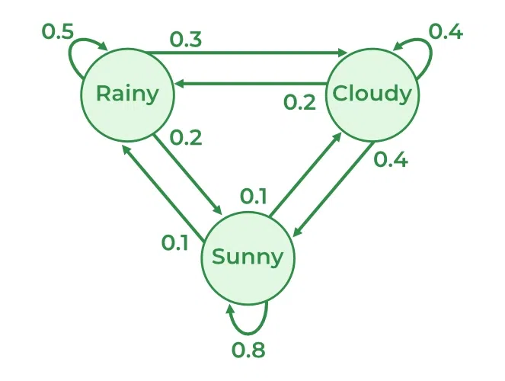
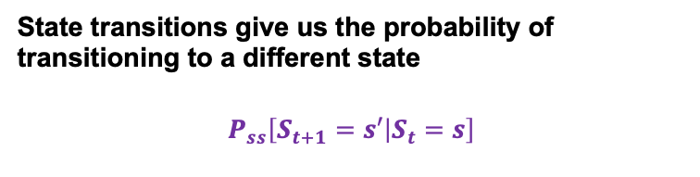
Markov Decision Process
State transitions give us the probability of transitioning to a different state
$$P_{ss}\left[S_{t+1}=s′ | S_{t}=s\right]$$

Slide 13
The elements of an RL agent
Can have one or several of:
Policy
Agent behaviour function
Value function (V)
How good is each state and/or action
Model
The agent representation of the environment
Example: What should the agent do given a few inputs
Example: In navigation problem, moving to the left in this square is great

Slide 14

The policy
A policy is the agent’s behaviour
It is a map from a state to action
The current state is sufficient statistic of the future
We will often assume the environment is Markov, the state is Markov and the history is Markov
Can be deterministic: $π\left(s\right)=a$
Or stochastic: $π\left(a|s\right)$
Often stochastic policies used while learning and deterministic for evaluation
Partially observed systems are NOT fully Markovian: we can still apply the same procedures as described below, but less guarantees regarding optimality

Slide 15
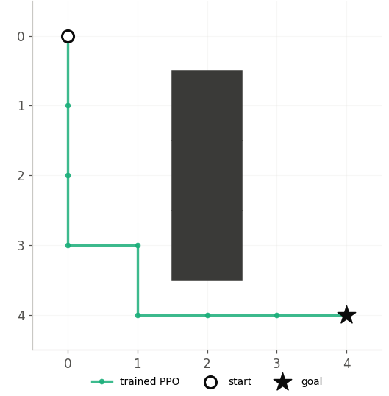
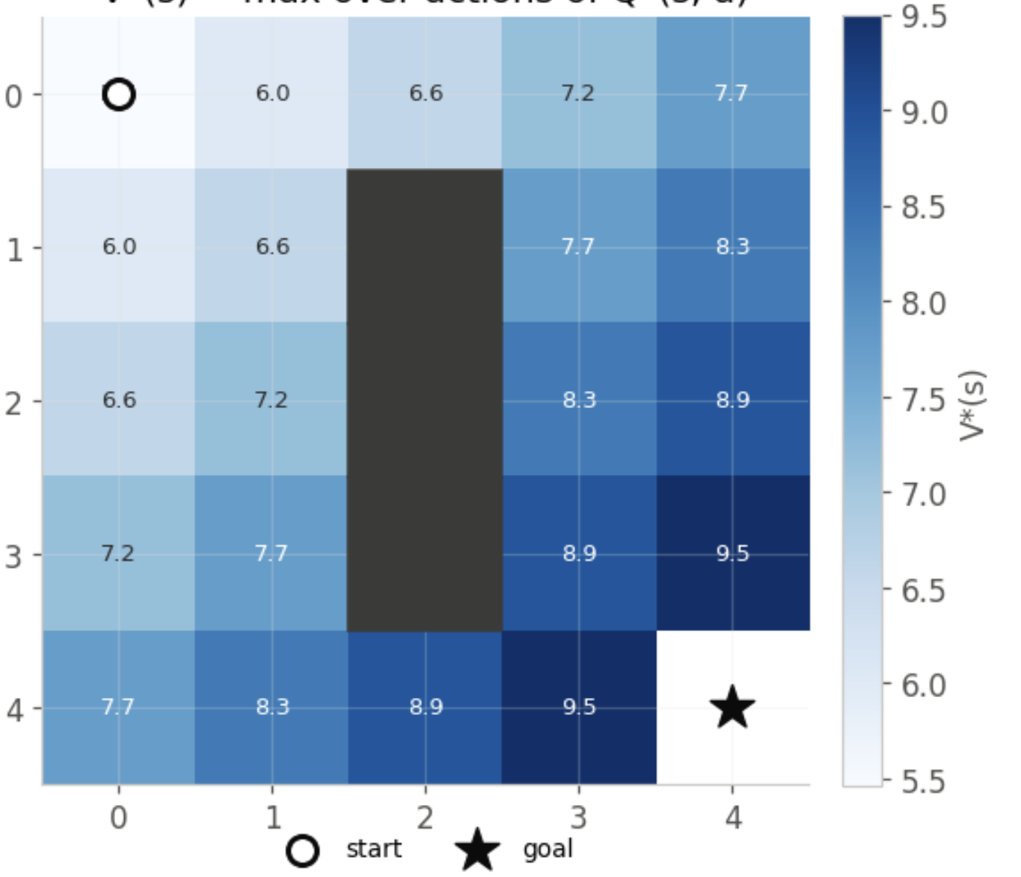
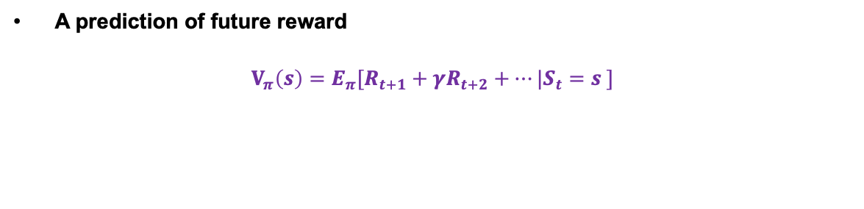
The state-value function
A prediction of future reward
$$V_{π}\left(s\right)=E_{π}[R_{t+1}+γR_{t+2}+…|S_{t}=s ]$$
Bellman’s equation
$$V_{π}\left(s\right)=E_{π}[R_{t+1}+γV_{π}(S_{t+1})|S_{t}=s ]$$

Slide 16

The action-value function
A prediction of future reward if we take a particular action
It is advantageous in RL because it tells us directly which action to take, without a model
$$Q_{π}\left(s,a\right)=E_{π}[R_{t+1}+γR_{t+2}+…|S_{t}=s, A=a_{t} ]$$
Related to the state-value function as
$$V_{π}\left(s\right)=Σπ\left(a | s\right)q_{π}(s,a)$$
This is the state value is the sum of the Q values (expected reward for an action and state) for all possible actions, multiplied by the probability of the policy choosing this action
Remember: we always want to find the best action value function

Slide 17





The elements of MDP
We need all the elements described above, and ML will learn/approximate/use some of them
States
Actions
Transitions
Reward
Discount
Possible situations
What to do
How we move in our ”world”
How well we are doing
How much does the future matter

Slide 18
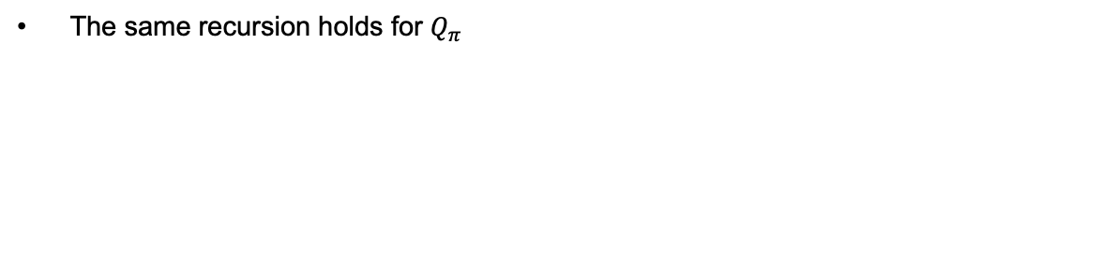
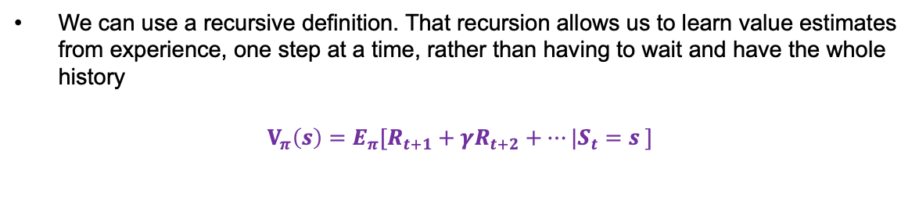
The Bellman equation
We can use a recursive definition. That recursion allows us to learn value estimates from experience, one step at a time, rather than having to wait and have the whole history
$$V_{π}\left(s\right)=E_{π}[R_{t+1}+γR_{t+2}+…|S_{t}=s ]$$
Bellman’s equation
$$V_{π}\left(s\right)=E_{π}[R_{t+1}+γV_{π}(S_{t+1})|S_{t}=s ]$$
The same recursion holds for $Q_{π}$
$$Q_{π}\left(s,a\right)=E_{π}[R_{t+1}+γq_{π}(S_{t+1},A_{t+1})|S_{t}=s, A_{t}=a]$$

Slide 19

The Bellman optimality eq
We consider now that we have the best policy $π_{∗}$
$$V_{∗}\left(s\right)=max_{π} V_{π}(s)$$
$$Q_{∗}\left(s,a\right)=max_{π} Q_{π}(s,a)$$
This means that if we take the best action available, the value of a state is the best of the immediate reward plus future value. We can then define:
$$V_{∗}\left(s\right)=max_{a} Q_{∗}(s,a)$$
Which in turns means:
Knowing $Q_{∗}$ is enough to act optimally
This is the basis of what is called Q-learning

Slide 20
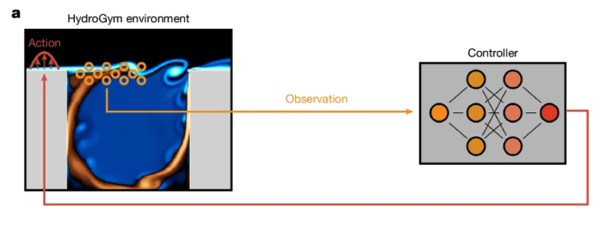
A note on solving MDPs
If we know the transitions P, and the rewards R, we then know how the model works.
If we know the MDP model (not ML model), we can iteratively solve an MDP, there is nothing to learn. Here, we don’t need ML or NN.
This is the field of Dynamic Programming.
In real-world/engineering applications, this is very rarely the case. Here model-free RL

Slide 21
Model-free RL
This is the most common approach in engineering/real-world applications. As we saw, what we want is to get approximations of the value function
Monte Carlo
Wait until the end of the episode, then update the value estimate using the actual observed return. This is unbiased, but can have a huge variance and needs a terminal case
Temporal Difference (TD)
Update the value function after every step, bootstrapping from the current value estimate of the next state. Lower variance, good for continuous tasks
Bootstrapping: means using one estimate to build another, TD updates its guess of V(s) using it’s own current guess of V(s’), rather than waiting for the true outcome.

Slide 22
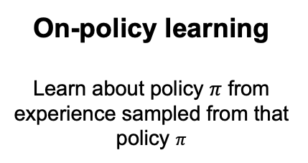
Model-free RL - Algorithms
We classify the algorithms in two groups
On-policy learning
Learn about policy $π$ from experience sampled from that policy $π$
Off-policy learning
Learn on a policy different than the one generating the data, e.g. one by another agent or a better on that it is currently following.
“Learn while on the job”
“Learn over someone’s shoulder”

Slide 23


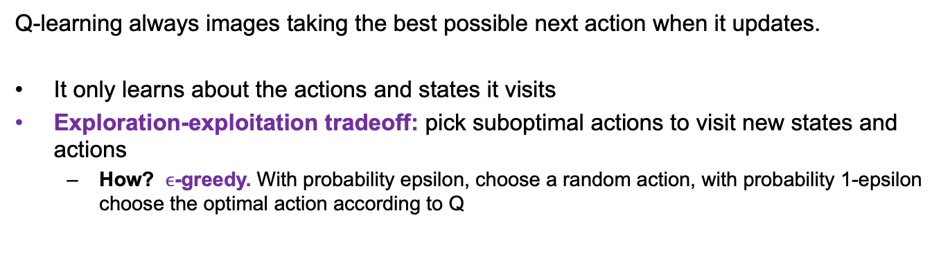
Q-learning
Today: we will take a look at a sample-based way to enforce the Bellman optimality equation Q-learning. Intro algorithm to see how to learn, on Monday we will look at common choice of algorithm and algorithm selection
Q$\left(s_{t},a_{t}\right)←Q\left(s_{t},a_{t}\right)+α[R_{t}+γ max_{a}Q\left(s_{t+1},a\right)−Q(s_{t},a_{t})]$
$α$ is the learning rate
$R_{t}+γ max_{a}Q\left(s_{t+1},a\right)$ is the TD (time difference) target
TD target $−Q(s_{t},a_{t})$ is the TD error
Q-learning always images taking the best possible next action when it updates.
It only learns about the actions and states it visits
Exploration-exploitation tradeoff: pick suboptimal actions to visit new states and actions
How? $ϵ$-greedy. With probability epsilon, choose a random action, with probability 1-epsilon choose the optimal action according to Q

Slide 24
Q-learning – Why does it work?
Visits all the corners of the problem
Explore! Every state-action is tried over and over and over. Q-learning only learns what it has visited
Slow down gradually
Updated sizes should reduce over time (schedulers exist for that). Big steps to learn quickly, small steps to settle.

Slide 25
Q-learning limitations
Q-learning typically stores all the states and actions in a table. One row per state, and one action per column
This doesn’t work for continuous spaces
Can only produce deterministic policies
Doesn’t directly scale. Issues in really big problems
Doesn’t handle partial observability
Has some issues in practice.
Remember: still no neural networks!
but they can solve these problems…

Slide 26
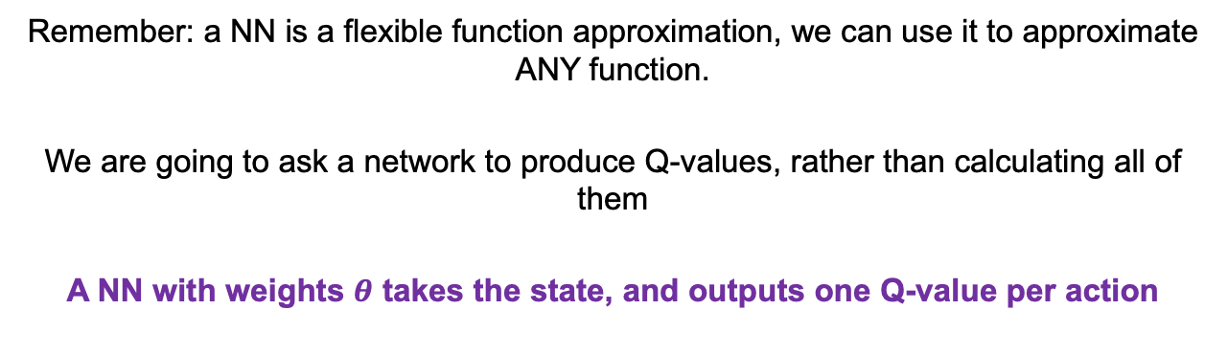
Deep Q-learning (DQN)
Remember: a NN is a flexible function approximation, we can use it to approximate ANY function.
We are going to ask a network to produce Q-values, rather than calculating all of them
A NN with weights $θ$ takes the state, and outputs one Q-value per action
$$Loss=E{\left[{(R}_{t}+γ max_{a}Q\left(s_{t+1},a\right)−Q\left(s_{t},a_{t}\right)\right)}^{2}]$$

Slide 27
Stabilising DQN
We can’t directly train on each transition as it happens: consecutive transitions are highly correlated.
Store
Sample
Reuse
Every (s,a,r,s’) transition is added to a large buffer as the agent acts.
Each training step draws a random mini-batch from the buffer, breaking temporal correlation.
Each transition can be trained on many times — far more sample-efficient than using it once.

Slide 28

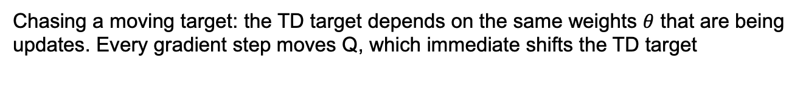
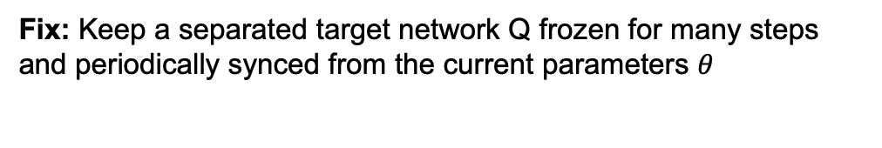
Stabilising DQN
Chasing a moving target: the TD target depends on the same weights $θ$ that are being updates. Every gradient step moves Q, which immediate shifts the TD target
Fix: Keep a separated target network Q frozen for many steps and periodically synced from the current parameters $θ$

Slide 29
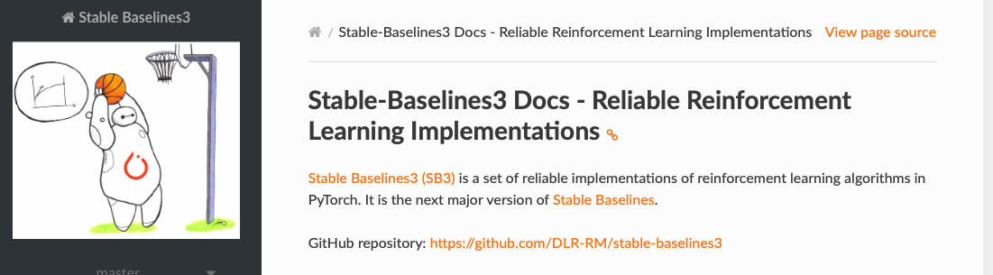
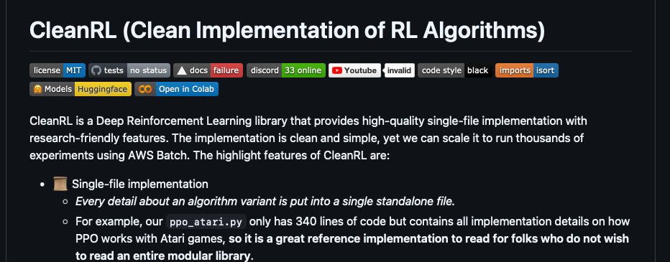
In practice
We rarely need to do our own RL implementations from scratch, algorithms have a lot of pitfalls and tricks.
Many available libraries and repositories to do this:

Slide 30
Thank you for your attention!
Happy to take any questions

