Slide 1
Reinforcement Learning II
Modern algorithms, algorithm selection, and practicalities of RL
M. Beneitez – miguel.beneitez@manchester.ac.uk
Summer School in Hands-on ML 2026

Slide 2
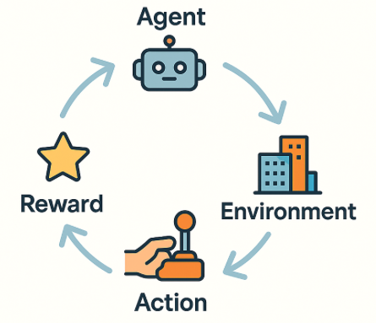
Recap
Revisiting some concepts
Core concepts about reinforcement learning.
What is a Markov decision process (MDP).
Q-learning and the Bellman equation
Why do we need deep RL?

Slide 3

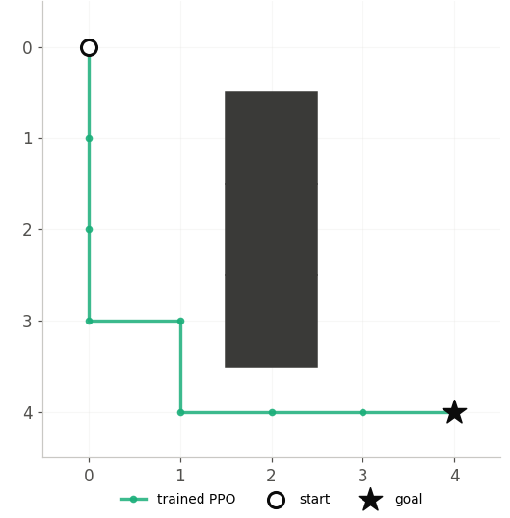
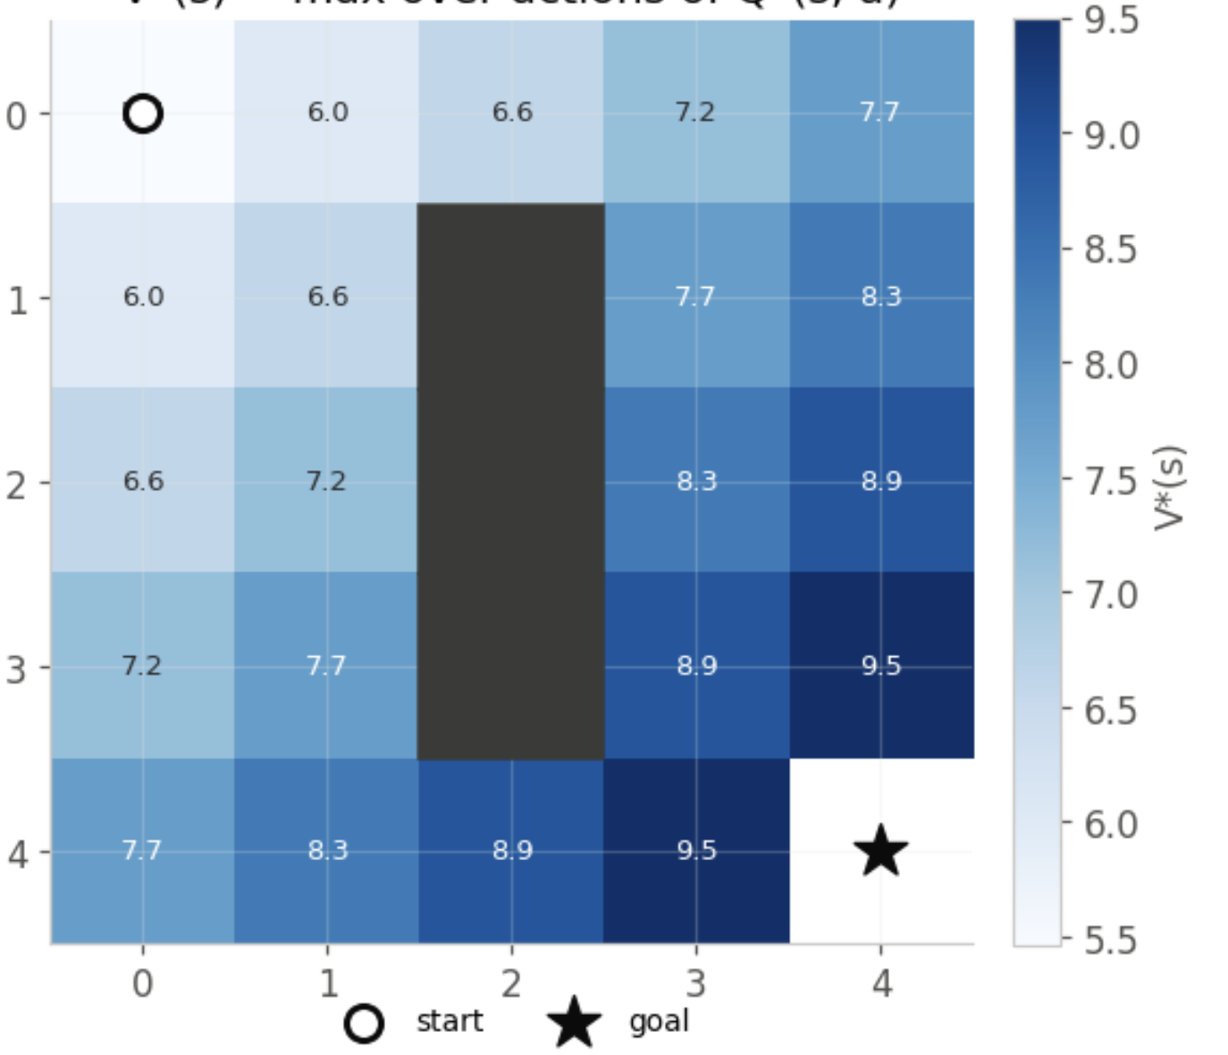
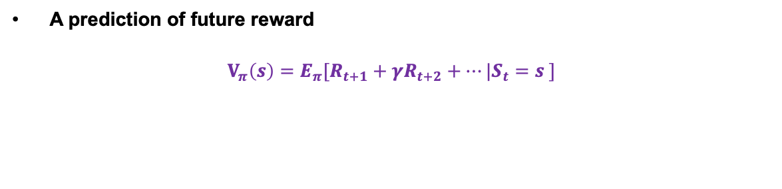
The state-value function
A prediction of future reward
$$V_{π}\left(s\right)=E_{π}[R_{t+1}+γR_{t+2}+…|S_{t}=s ]$$
Bellman’s equation
$$V_{π}\left(s\right)=E_{π}[R_{t+1}+γV_{π}(S_{t+1})|S_{t}=s ]$$

Slide 4

The action-value function
A prediction of future reward if we take a particular action
It is advantageous in RL because it tells us directly which action to take, without a model
$$Q_{π}\left(s,a\right)=E_{π}[R_{t+1}+γR_{t+2}+…|S_{t}=s, A=a_{t} ]$$
Related to the state-value function as
$$V_{π}\left(s\right)=Σπ\left(a | s\right)q_{π}(s,a)$$
If optimal Q* is found we can then find the policy: $π^{∗}(s)=arg max_{a}Q^{∗}(s,a)$

Slide 5
Recap
Where we left it:
Q-learning didn’t need any NN for small problems.
For large problems (but still discrete actions!) we considerd DQN, where we replaced a table by a NN approximating a function
Today:
Instead of learning Q -> Learn the policy
Popular/common algorithms (and how to select them!)
Tips and tricks, reward shaping, and real applications.

Slide 6
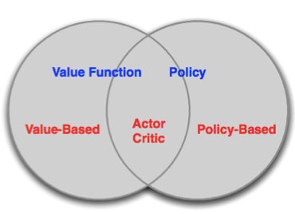

From value to policy
In basic Q-learning we kept track of all states and actions
In DQN, we approximated Q with a NN.
However:
We are still trying to find $Q(a,s)$ which requires discrete actions.
Instead:
Policy-based algorithms: No value function, and the policy is learned directly
Actor-critic-based algorithms: Learned value function and learnt policy

Slide 7

From value to policy
In basic Q-learning we kept track of all states and actions
In DQN, we approximated Q with a NN.
However:
We are still trying to find $Q(a,s)$ which requires discrete actions.
Instead:
Policy-based algorithms: No value function, and the policy is learned directly
Actor-critic-based algorithms: Learned value function and learnt policy
Cutting-edge methods

Slide 8
Deterministic or not?
Deterministic policies
So far we have considered deterministic policies (or epsilon-greedy)
Stochastic policies
When searching directly for policies directly in RL we focus heavily on stochastic policies

Slide 9
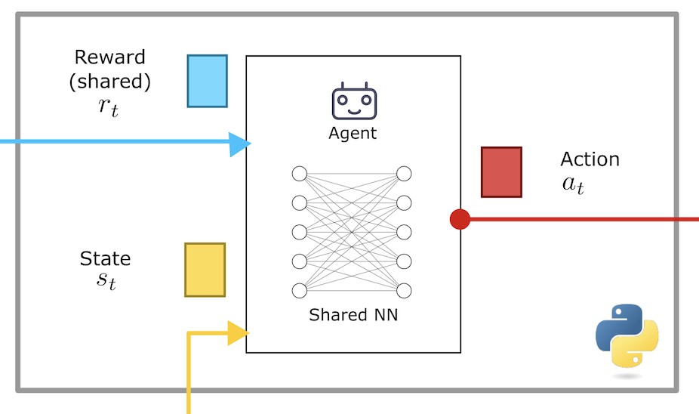
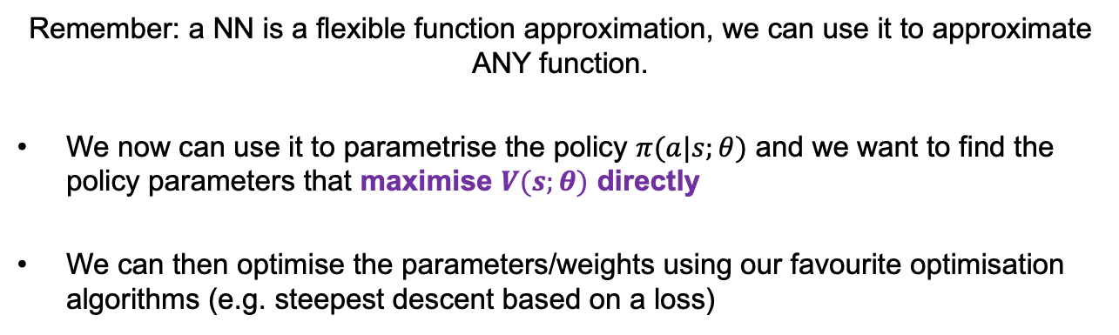
Policy optimisation
Remember: a NN is a flexible function approximation, we can use it to approximate ANY function.
We now can use it to parametrise the policy $π(a|s;θ)$ and we want to find the policy parameters that maximise $V(s;θ)$ directly
We can then optimise the parameters/weights using our favourite optimisation algorithms (e.g. steepest descent based on a loss)

Slide 10
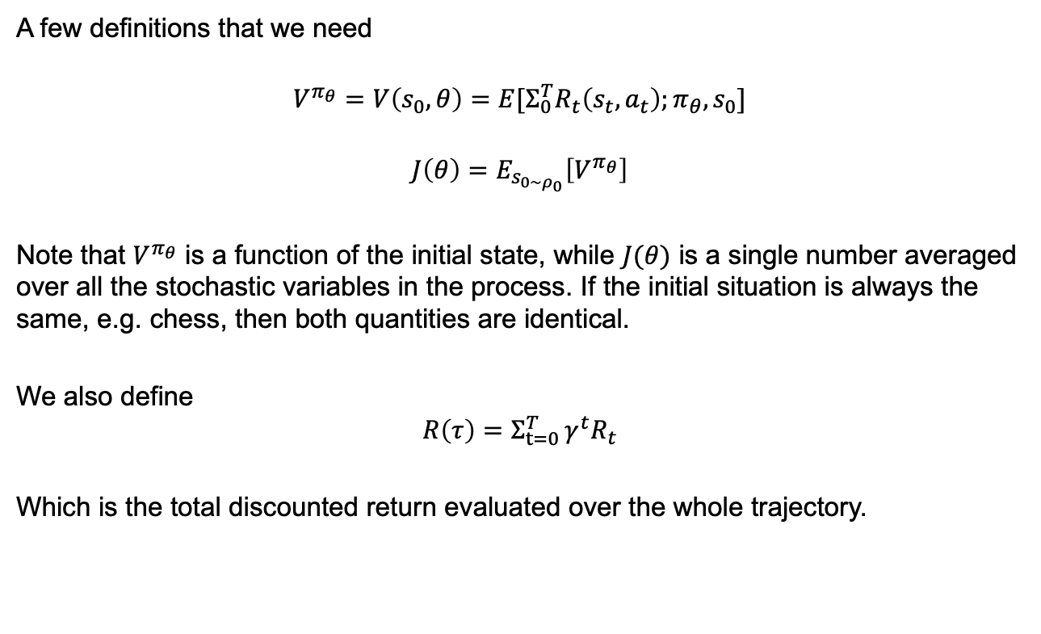
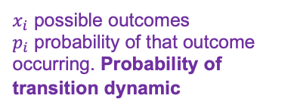

Policy optimisation
$$E\left[X\right]=x_{1}p_{1}+x_{2}p_{2}+…$$
$x_{i}$ possible outcomes
$p_{i}$ probability of that outcome occurring. Probability of transition dynamic
A few definitions that we need
$$V^{π_{θ}}=V\left(s_{0},θ\right)=E[Σ_{0}^{T}R_{t}\left(s_{t},a_{t}\right);π_{θ},s_{0}]$$
$$J\left(θ\right)=E_{s_{0∼ρ_{0}}}\left[V^{π_{θ}}\right]$$
Note that $V^{π_{θ}}$ is a function of the initial state, while $J(θ)$ is a single number averaged over all the stochastic variables in the process. If the initial situation is always the same, e.g. chess, then both quantities are identical.
We also define
$$R\left(τ\right)=Σ_{t=0 }^{T}γ^{t}R_{t}$$
Which is the total discounted return evaluated over the whole trajectory.

Slide 11
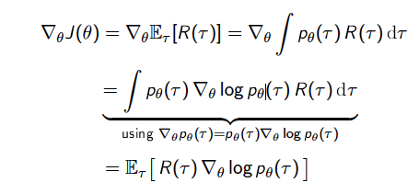

Policy optimisation
Using these ideas our goal is to find:
$$θ^{∗}=arg{\max_{θ}{J(θ)}}$$
And now we can apply gradient descent to optimise our policy for all possible initial states. We can’t find this gradient $∇_{θ}J\left(θ\right)$ just by sampling!
Applying the chain rule on our objective $J(θ)$

Slide 12

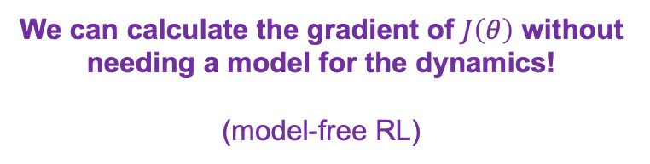
Policy optimisation
Now we can optimise this (since it is an expectation) using $m$ paths
$$∇_{θ}J\left(θ\right)≈\frac{1}{m}Σ_{i}^{m}R\left(τ\right)∇_{θ}\log{p_{θ}(τ)}$$
Where $p_{θ}\left(τ\right)=μ\left(s_{0}\right)Π_{0}^{T−1}π_{θ}p(s_{t+1}|s_{t},a_{t})$
That means that
$$∇_{θ}\log{p_{θ}(τ)}=Σ_{0}^{T−1}∇_{θ}\log{π_{θ}\left(a_{t} | s_{t}\right)}$$
We can calculate the gradient of $J\left(θ\right)$ without needing a model for the dynamics!
(model-free RL)

Slide 13
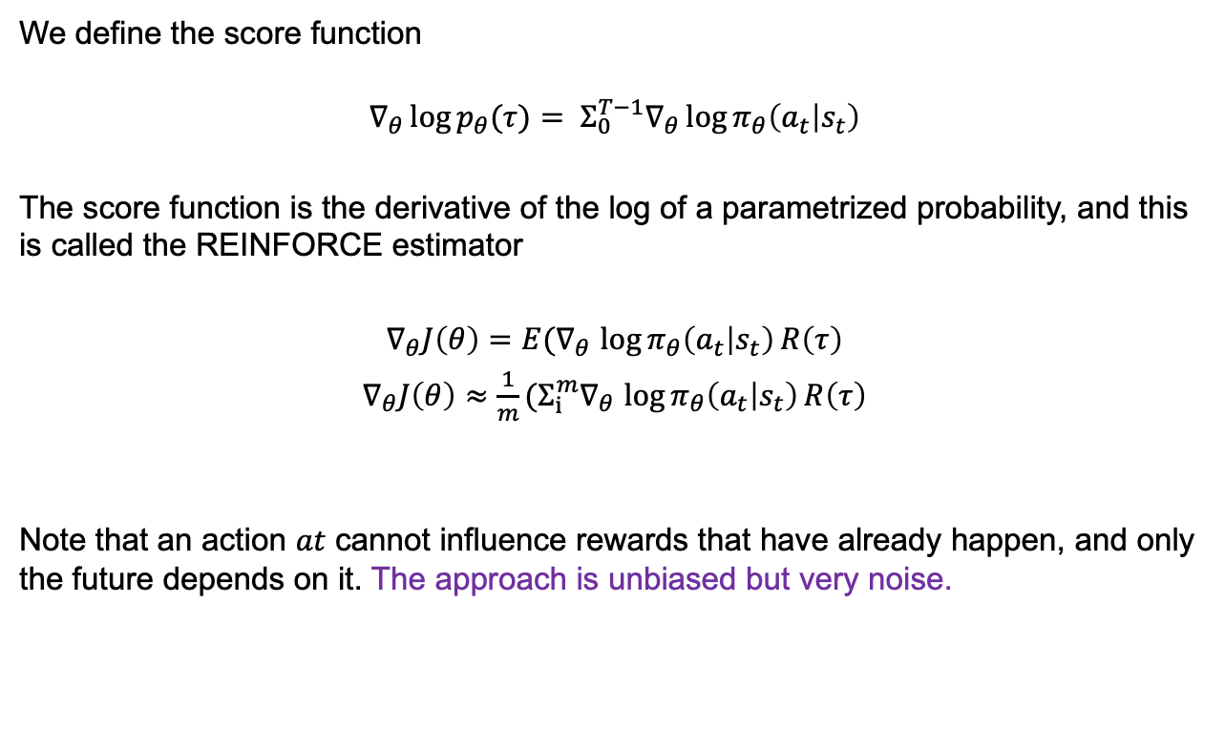
Policy optimisation
We define the score function
$$∇_{θ}\log{p_{θ}(τ)}= Σ_{0}^{T−1}∇_{θ}\log{π_{θ}\left(a_{t} | s_{t}\right)}$$
The score function is the derivative of the log of a parametrized probability, and this is called the REINFORCE estimator
$∇_{θ}J\left(θ\right)=E(∇_{θ}$ $\log{π_{θ}\left(a_{t} | s_{t}\right)}R\left(τ\right)$
$∇_{θ}J\left(θ\right)≈\frac{1}{m}(Σ_{i}^{m}∇_{θ}$ $\log{π_{θ}\left(a_{t} | s_{t}\right)}R\left(τ\right)$
Note that an action $at$ cannot influence rewards that have already happen, and only the future depends on it. The approach is unbiased but very noise.

Slide 14
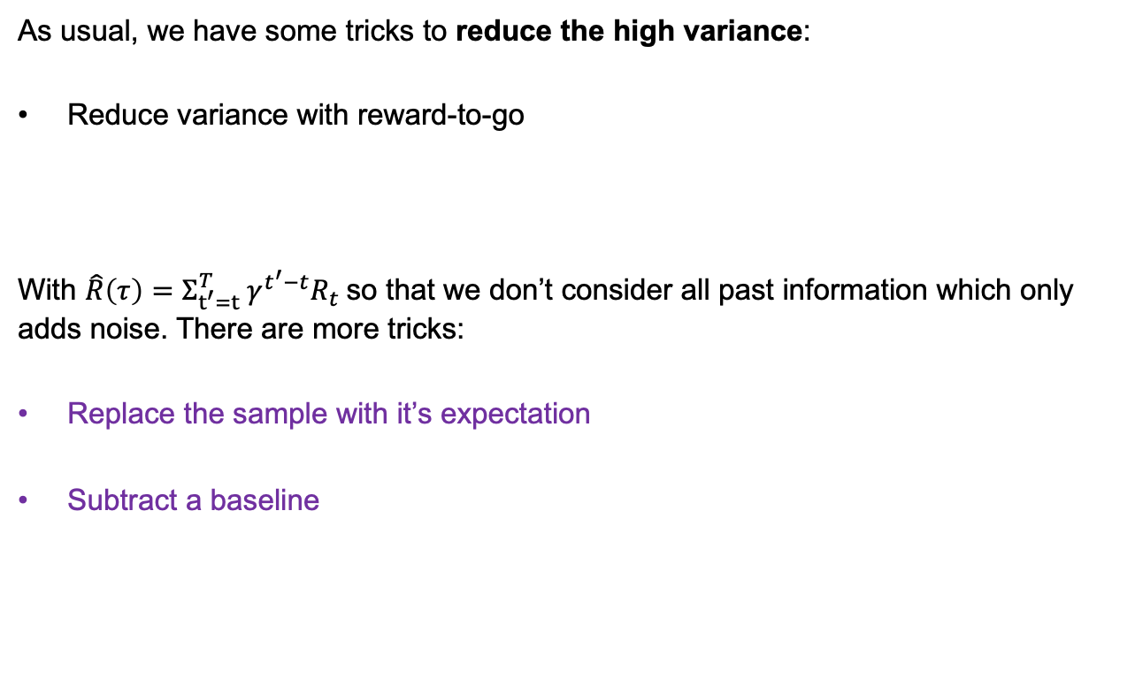

Policy optimisation
As usual, we have some tricks to reduce the high variance:
Reduce variance with reward-to-go
With $\hat{R}\left(τ\right)=Σ_{t^{′}=t}^{T} γ^{t^{′}−t}R_{t}$so that we don’t consider all past information which only adds noise. There are more tricks:
Replace the sample with it’s expectation
Subtract a baseline
$$∇_{θ}J\left(θ\right)≈\frac{1}{m}(Σ_{i}^{m}∇_{θ} \log{π_{θ}\left(a_{t} | s_{t}\right)}\hat{R}̂\left(τ\right)$$

Slide 15
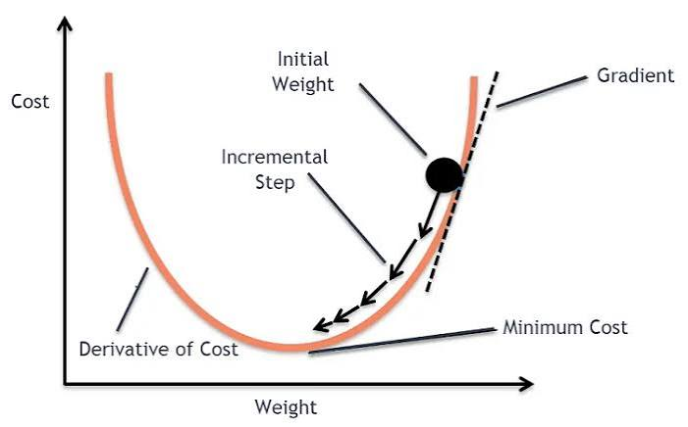
Policy gradient methods
There exist pure policy gradient methods in RL but they also have some issues
Even with tricks: high variance in gradient estimates
Sample inefficient: they are strictly on-policy to calculate a gradient, Tt must collect new trajectories using its current policy weights. Once a step is taken, all past experience is stale and discarded.
Actions can get unfairly pensalised: we are considering whole trajectories, if an agent does something good at step 5, but fails terrible the next 100, it gets unfairly penalized. No individual actions are evaluated.

Slide 16
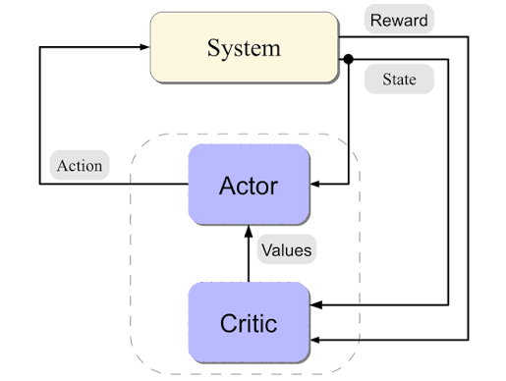
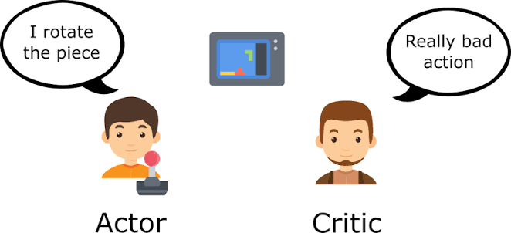
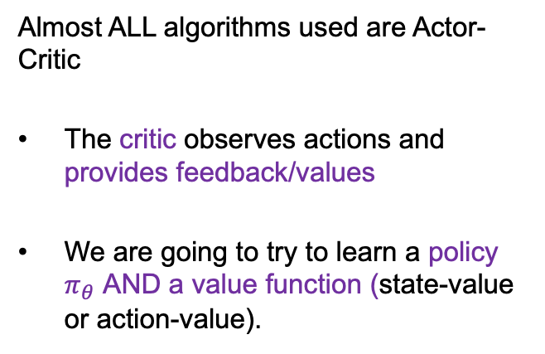
Actor-Critic algorithms
Almost ALL algorithms used are Actor-Critic
The critic observes actions and provides feedback/values
We are going to try to learn a policy $π_{θ}$ AND a value function (state-value or action-value).
Notes:
Critic: based on our altitude and speed, I expect us to score a +100 here
Actor: does something that improves to +115 and the critic provides it with an advantage of +15

Slide 17
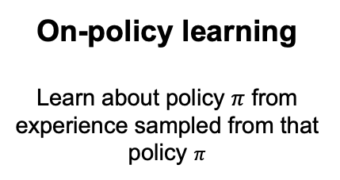
Recap on algorithm types
We classify the algorithms in two groups
On-policy learning
Learn about policy $π$ from experience sampled from that policy $π$
Off-policy learning
Learn on a policy different than the one generating the data, e.g. one by another agent or a better on that it is currently following.
“Learn while on the job”
“Learn over someone’s shoulder”
Notes:
Critic: based on our altitude and speed, I expect us to score a +100 here
Actor: does something that improves to +115 and the critic provides it with an advantage of +15

Slide 18
On or off policy
We classify the algorithms in two groups
On-policy learning
Safer during training
Tend to be more stable an easier to converge
Off-policy learning
More sampling effective
Can learn from logs (use a replay buffer)
Proximal Policy Optimization (PPO)
Soft Actor-Critic (SAC)

Slide 19
Separating algorithms
Separating the algorithms based on:
Can you reuse old data?
On-policy: data is only valid for the policy that collected it. Then throw away
Off-policy: keep a replay buffer
Where does exploration come from?
From the policy itself (stochastic policy)
Actively encouraged (add noise to actions, or add a reward that favours exploration, e.g. SAC)

Slide 20
Two popular algorithms
We will go conceptually through both, and in detail through PPO.
Can you reuse old data?
On-policy: data is only valid for the policy that collected it. Then throw away
Off-policy: keep a replay buffer
Where does exploration come from?
From the policy itself (stochastic policy)
Actively encouraged (add noise to actions, or add a reward that favours exploration, e.g. SAC)

Slide 21
Proximal Policy Optimization
PPO is one of the most popular RL algorithms. It is the closest to “just works”.
Key idea: we want to improve the training stability of the policy limiting the change we do (every time we collect experience).
Why?
Empirically, we know that smaller policy updates are more likely to converge to an optimal solution.
Taking to big a step can make us “fall of the cliff” and makes it hard to recover
An analogy: You run a batch of wind-tunnel experiments to design a controller. The results tell you how small tweaks will behave. They tell you nothing reliable about a radically different controller.

Slide 22

Proximal Policy Optimization
How do we limit the policy?
We measure how much the policy has changes with respect to the one using a ratio calculation between the current and former policy. And we clip this ratio in a range$\left[1 , −ε,1+ε\right]$, meaning that we remove the incentive for the current policy to go too far from the old one (that’s why it is called proximal policy).
From Hugging Face

Slide 23
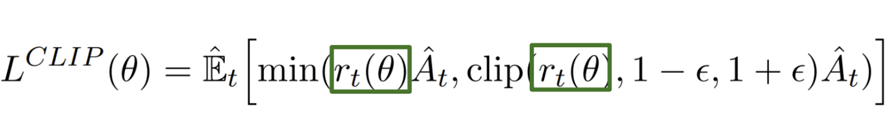
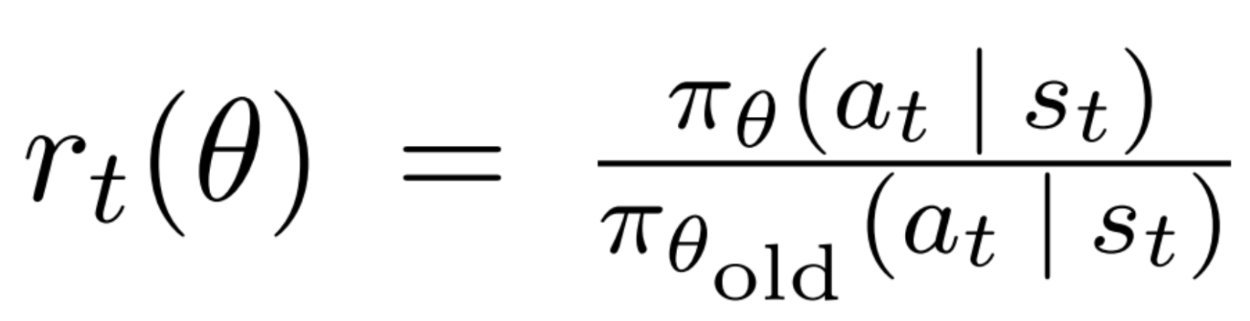
Proximal Policy Optimization
Instead of
$$∇_{θ}J\left(θ\right)=E[\log{π_{θ}\left(a_{t} | s_{t}\right)}R\left(τ\right)]$$
We use a clipped loss for the update
With ratio function:
From Hugging Face

Slide 24
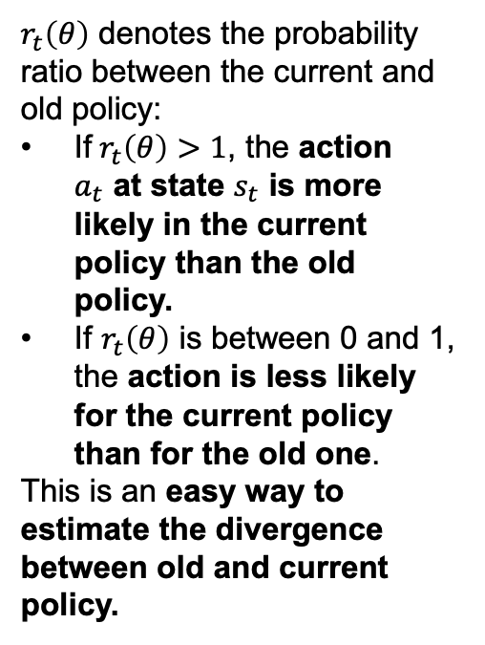
Proximal Policy Optimization
$r_{t}\left(θ\right)$ denotes the probability ratio between the current and old policy:
If$r_{t}\left(θ\right)>1$, the action $a_{t}$ at state $s_{t}$ is more likely in the current policy than the old policy.
If $r_{t}\left(θ\right)$ is between 0 and 1, the action is less likely for the current policy than for the old one.
This is an easy way to estimate the divergence between old and current policy.
We use a clipped loss for the update
With ratio function:
From Hugging Face

Slide 25
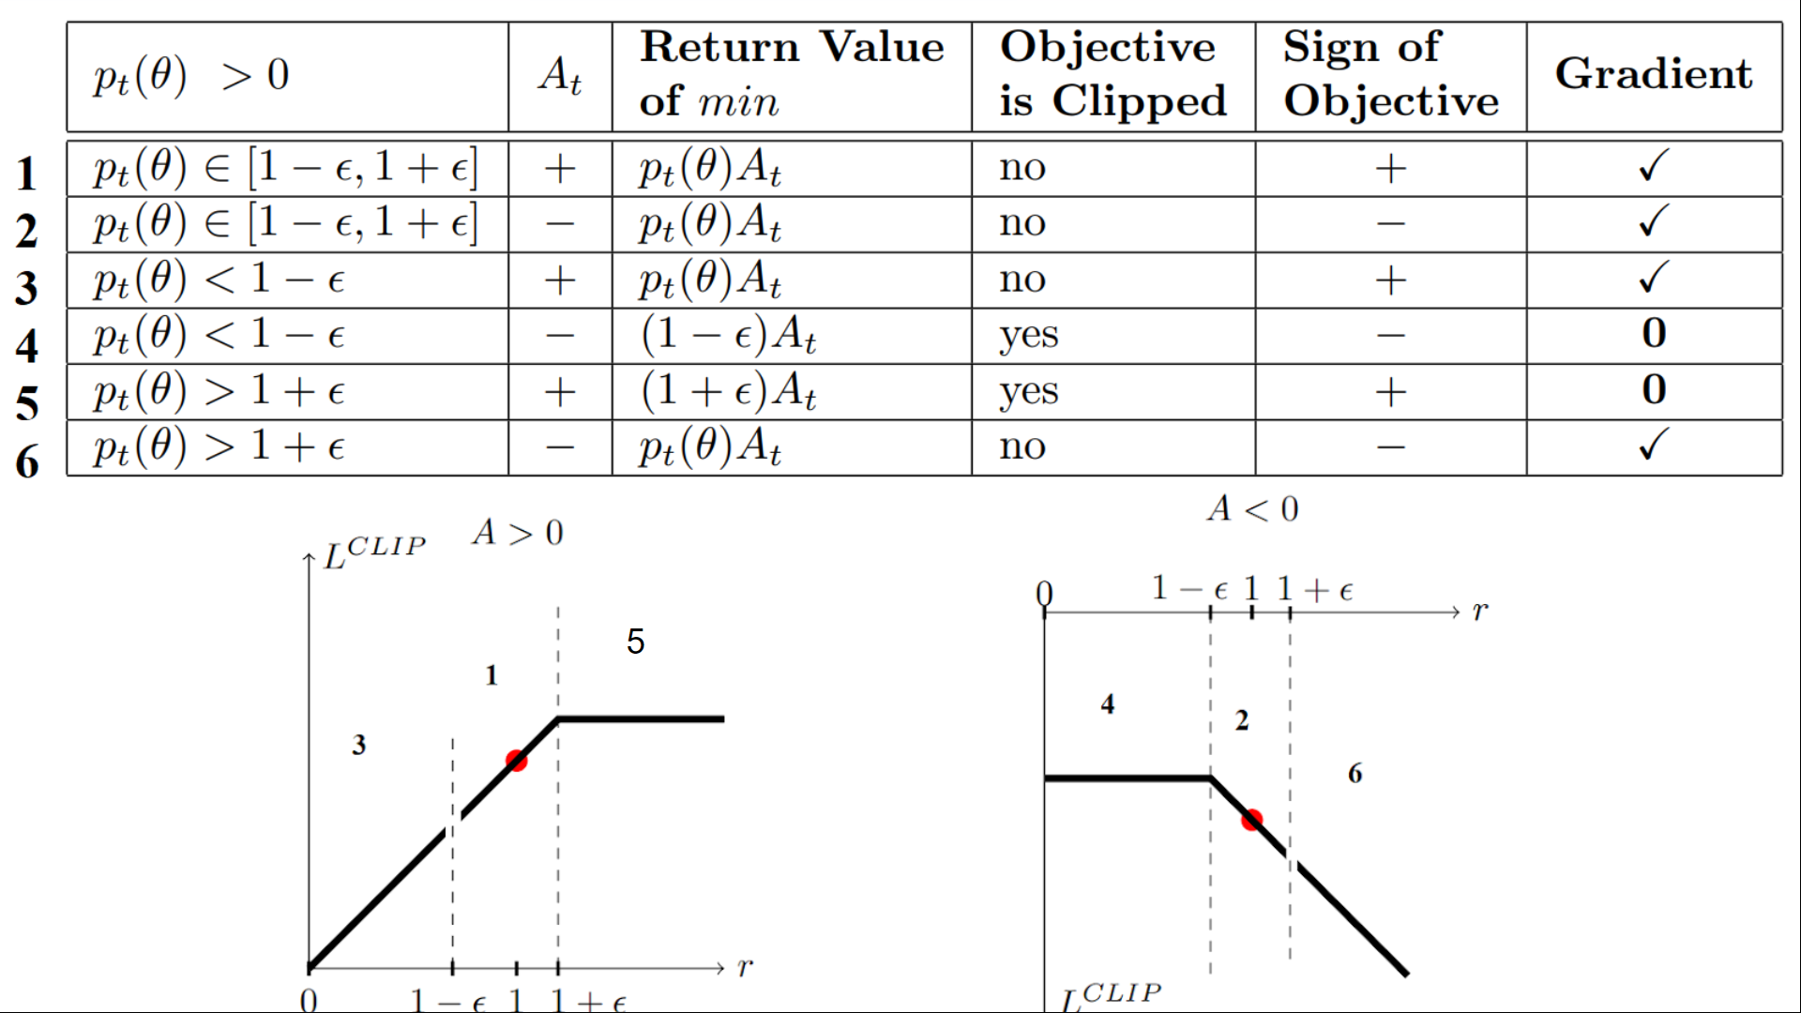
Proximal Policy Optimization
We use a clipped loss for the update
From Hugging Face

Slide 26
Soft Actor-Critic SAC
SAC is one of the more modern (and common algorithms)
Key idea: based on the Maximum Entropy Reinforcement Learning framework. The agent seeks to maximise both the return and the entropy simultaneously.
Some principles
It is off-policy, in PPO, the data is used for a while and then thrown away. If data is expensive (typical in engineering applications) we want to reuse it.
We actively reward the policy for staying random, if there are several options, choose the one that keeps more doors open.
An analogy: Exploring a design space, we do focus only on the first workable design. We keep several candidates alive, because the first one may be fragile once you test it.

Slide 27

Soft Actor-Critic SAC
Definition of entropy:
$$H\left(π\left( ., s\right)\right)=−E_{a∼π}[\log{π(a|s)}]$$
It is a measure of how spread out the action distribution is.
The good about SAC:
Exploration is automatic, since entropy is in the loss.
Robustness to model errors: several near similar strategies don’t degrade too badly.
Better conditioned optimisation: entropy produces a better landscape.

Slide 28
Soft Actor-Critic SAC
SAC is off-policy, so it has similar issues to DQN.
There are a bunch of technical aspects:
It has a replay buffer
It has twin critics and takes the most conservative one.
It has twin target networks (for each of the critics)

Slide 29
Selecting algorithms
Loads of options
There are many many many options to choose from, typically libraries (e.g. Stable Baselines 3) have a guide.
Considerations
Consider: continuous vs discrete actions, importance of sampling, cost of the simulation, etc
Difficulty
The real difficulty is usually not in the algorithm (although it is usually a good idea to try PPO since it is very forgiving). Difficulty in environment design, design of the reward, evaluation of the model

Slide 30
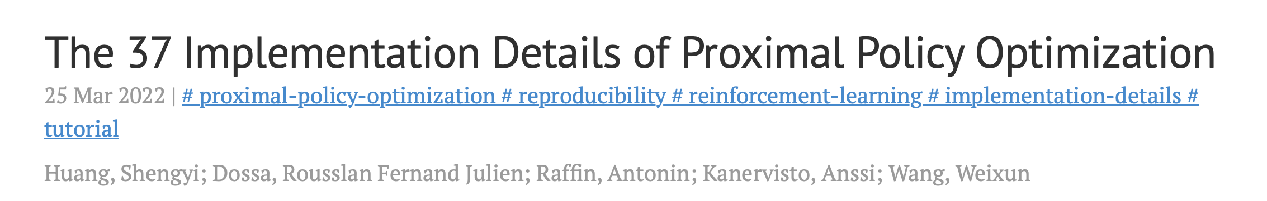
Practical considerations
Normalise
These are statistical tools and statistics work best between 0 and 1 (or -1 and 1). Make sure you normalize your observations, actions, and reward
When to normalize?
Normalise the inputs and outputs of the RL algorithm, undo these normalisations when interacting with the environment.
Don’t implement from scratch
It is almost always possible to find a RL algorithm + environment for simple problems from e.g. cleanRL, you don’t need to do all the work every time!

Slide 31
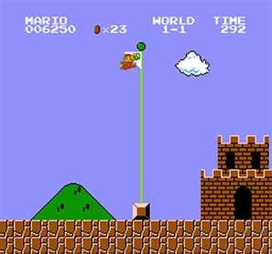

Reward shaping
How should we choose our reward?
Sparse rewards are usually not very good, The agent can get lost without any progress.
Reaching a target in engineering applications matter, but also: the energy spent, the smoothness of the control, the actuator wear,…
Example: penalising very energetic actions:
$$R_{t}=R_{t}−λ{\left|\left|a\right|\right|}^{2}$$

Slide 32

Reward hacking
Example: penalising very energetic actions:
$$R_{t}=R_{t}−λ{\left|\left|a\right|\right|}^{2}$$
Agents then to find loopholes
If lambda is too large, it might find that the best to do is to not anything at all!
Practically: don’t just train and wait, evaluate your policy every few episodes to make sure it is doing what it meant to do!

Slide 33
What typically goes wrong
Even though RL is great, sometimes it doesn’t work
The reward might be unlearnable: it is too sparse or badly scaled against the penalty
The process is not Markov: something is too dependent on history, e.g. hysteresis process.
The episode is too long: giving rewards for a very long time is a hard task
We are limited by data: very commonly, engineering applications require expensive simulations which are the real bottleneck here.
Consider all these before thinking about the algorithms or the hyperparameters!

Slide 34
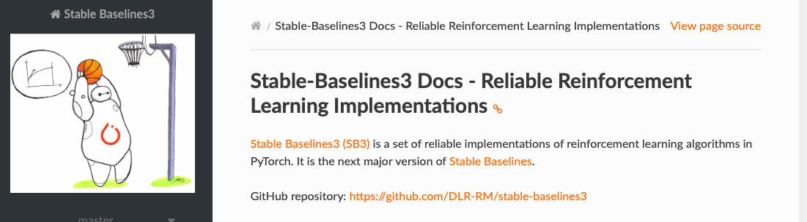
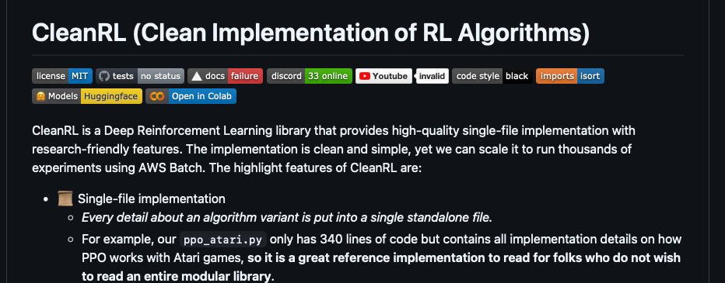
In practice
We rarely need to do our own RL implementations from scratch, algorithms have a lot of pitfalls and tricks.
Many available libraries and repositories to do this:

Slide 35
Thank you for your attention!
Happy to take any questions

