Slide 1

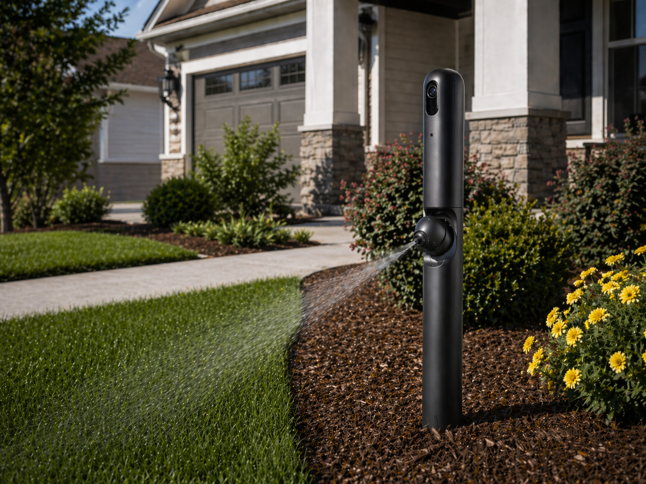
NEREUS-LC (Lawn Care)
Event-Triggered Animal Waste Detection, Deterrence, and Targeted Remediation
CPT_S 440/540 | Jesse Beneventi
1

Slide 2
Problem & Motivation
Why a closed-loop system matters
66-71% of U.S. households own pets
Static irrigation wastes water and is not designed for cleanup
Pet waste creates turf burn, odor, and health risks
Goal: Create a sprinkler that reacts only when an animal event occurs, then localize and remediate the affected grass.
2

Slide 3
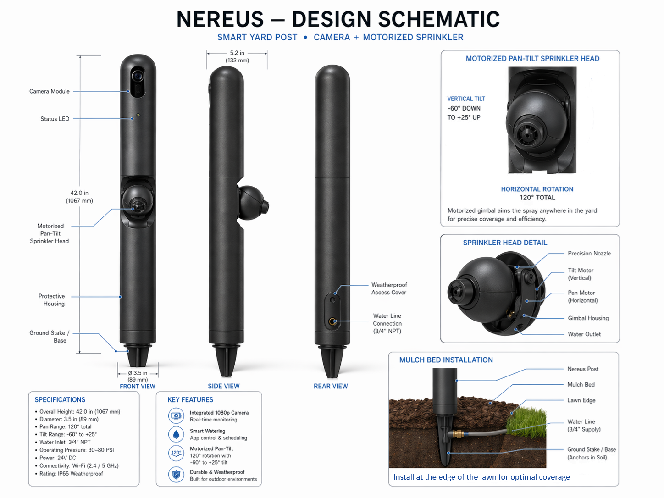
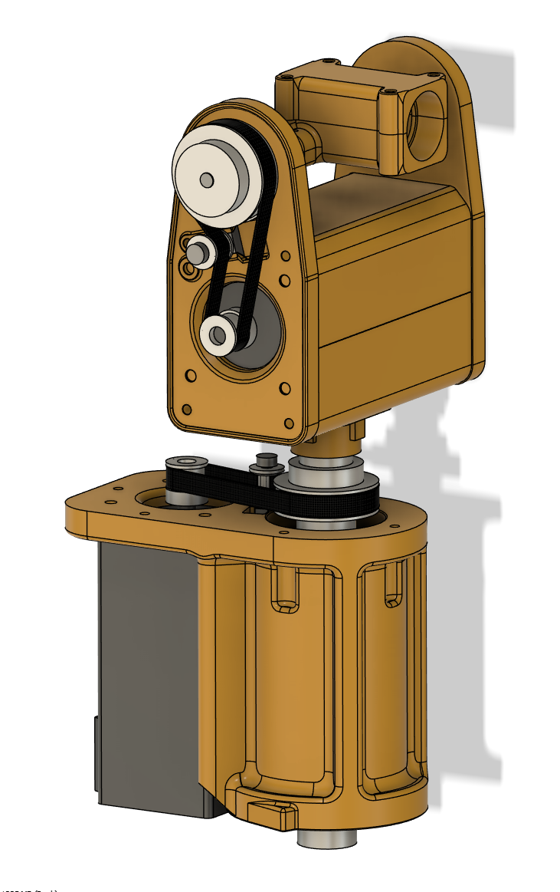
Fixed Station Setup
Post-mounted camera + aimable sprinkler station
• RGB/HDR camera watches for animals, posture, and waste events
• Station has water input w/ optional treatment fluid
• The fixed station localizes the event and targets only the affected spot
Fixed-Station Design
CAD Drawing of Sprinkler Motor
3

Slide 4
AI Pipeline
From detection to stable event decision
Detect dog
Crop region
Stabilize
Confirm event
Act
YOLO / camera feed
dog box + grass patch
EMA + hysteresis
CLIP prompt scores
snapshot + station cue
Contrastive Language–Image Pretraining (CLIP) prompt examples (from the most successful test to date):
prompt_groups = { neutral: ["a dog"],
poop: [“a dog pooping"],
pee: [“a dog peeing"] }
4
Notes:
Nereus-LC is now a hybrid runtime: YOLO detects the dog, MobileNet gates give posture events, Contrastive Language–Image Pretraining (CLIP) confirms pee/poop labels. EMA helps to stabilize events (no instantaneous “IT’S POOPING!”, and the system saves snapshots, and post-event crops – for comparing before and after images, and annotated video, - for the customer

Slide 5
Prompt Engineering Test (CLIP)
Prompt wording strongly changes CLIP scores
Good (Simple Prompts)
Bad (Multiple/Complex Prompts)
Minimal prompts:
neutral: "a dog"
poop: “a dog pooping"
pee: “a dog peeing"
Observed:
pee score ≈ 0.536-0.653
poop score ≈ 0.406-0.421
neutral score ≈ 0.028-0.031
Richer prompts:
neutral: ["a dog standing on grass",
"a dog walking on grass",
"a dog sniffing the ground",
"a dog sitting outside",]
poop: ["a dog pooping on grass",
"a dog defecating outside",
"a dog squatting to poop",
pee: ["a dog peeing on grass",
"a dog urinating outside",
"a dog lifting a leg to pee",
"a dog squatting to pee",
pee score ≈ 0.190–0.259
poop score ≈ 0.134–0.191
neutral score ≈ 0.023–0.024
Takeaway on CLIP:
CLIP is useful as a runtime confirmation layer (and perhaps when used as a lookout), but not yet reliable as the primary classifier.
Observed issues:
Pee is a strong winner of all prompts – even when dog is doing neither
6
Notes:
Hard negatives: negative examples that are difficult to distinguish from real pee/poop events.
Calibrated thresholds: you should not just pick a random cutoff like: if pee_score > 0.12 → pee event

Slide 6
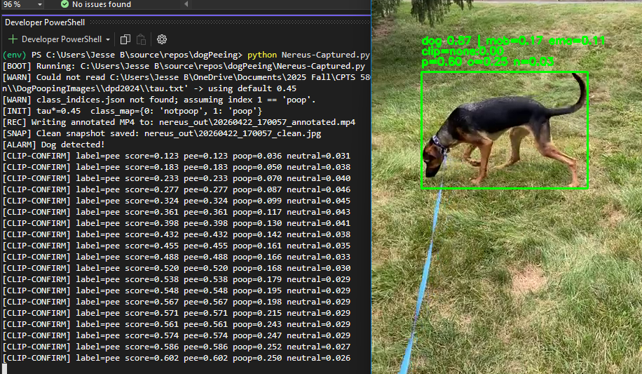
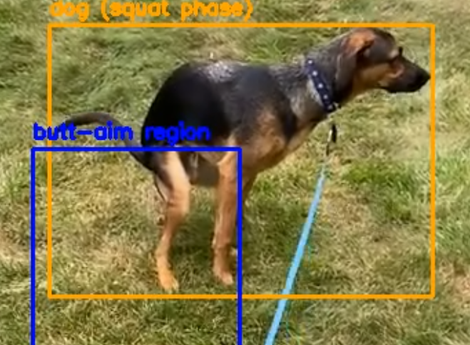
Live Capture Evidence
Detector triggers region crops and annotated output
[ALARM] Dog detected!
[POSE] Held 0.04s (ema=0.48)
[CLIP-CONFIRM] label=pee score=0.552
pee=0.552 poop=0.412 neutral=0.029
region @ (58, 296, 208, 442)
[INFO] End of video or read error; exiting.
• Event log exposes model confidence by class
• Region coordinates enable snapshot/crop storage and comparison imaging
• EMA value provides a tunable temporal stability signal
5
Notes:
mob=0.17 The raw MobileNetV2 poop-posture score for the current frame/crop. Here, it thinks there is only a 0.17 chance of poop/squat posture.
ema=0.11 The smoothed version of mob over time using Exponential Moving Average. It changes more slowly so the system does not flicker between event / no-event every frame.

Slide 7
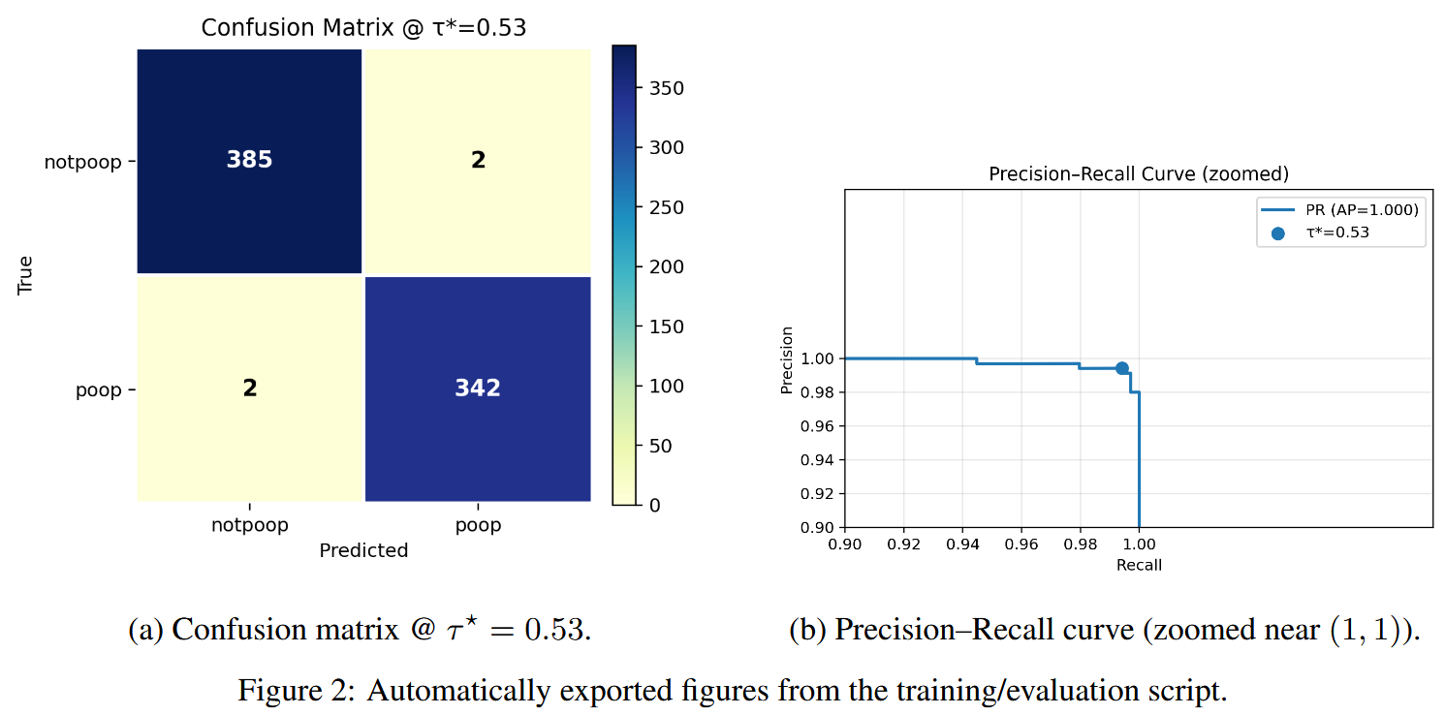
Poop Posture Classifier
MobileNetV2 remains the strongest trained module
• Fine-tuned MobileNetV2 for pooping vs. not-pooping
• ~70/15/15 split with strong augmentation (~4,800 images)
• AdamW + cosine annealing + label smoothing ε = 0.05
• Test accuracy = 99.5%; F1 = 0.994 at τ* = 0.53
• Inference under 15 ms/frame on RTX 2080
Dog Pooping dataset pulled from: https://www.kaggle.com/datasets/wengjiyao/dog-poop-dataset
7
Notes:
AdamW: The optimizer used to train the model. It updates the model weights while also using weight decay to reduce overfitting.
cosine annealing: The learning rate schedule. The learning rate starts higher, then gradually curves downward during training so the model makes smaller updates near the end.
label smoothing ε = 0.05: Instead of training the model to be 100% confident, it softens the labels slightly. So “poop” is not treated as exactly 1.0; it might be treated more like 0.95. This helps prevent overconfidence.
F1 = 0.994: Balance between precision and recall: The model had a very strong balance between precision and recall. In plain English: it caught almost all poop-posture cases while making very few false alarms.
τ* = 0.53: This is the decision threshold. The model outputs a probability, and if the poop probability is at least 0.53, you classify it as poop/squat posture.
1000 / 15 ≈ 66 frames per second – fast enough for live video on a 2080. Won’t be quite so good on a HAT+2

Slide 8
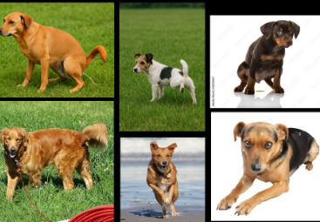
Pee Detection: YOLO Dataset Lessons
Roboflow model was useful, but biased
• Custom pee vs. not-pee annotated dataset in Roboflow
• ~1,200 augmented positive images and ~850 negatives
• YOLOv11 posture model over-predicted “peeing” on videos
• Train accuracy 99.6%; validation accuracy 86.9%
• Classifier is biased toward pee
Positive and negative examples show why geometry is subtle
Confusion matrix
Acc=86.7%
Not pee
Pee
Not pee
286
86
Pee
8
336
8
Notes:
overfitting

Slide 9
Stabilizing Event Decisions
EMA + hysteresis prevent flicker
EMA smooths probability over time. ON/OFF thresholds create stable entry/exit conditions.
Raw score
EMA
ON threshold
OFF threshold
Snapshot/crop
per-frame confidence
smoothed score
start event
end event
station action evidence
Stable event = ema > tau_on for hold_time; event exits when ema < tau_off. This avoids repeated alarms and captures one useful crop per event.
11
Notes:
This slide is about reducing flicker in the event decision. The raw classifier or CLIP score can bounce up and down frame by frame, so I smooth it with EMA. Then I use separate ON and OFF thresholds: the event starts only after the smoothed score crosses the ON threshold, and it stays active until the score drops below the lower OFF threshold. This prevents repeated alarms and helps the system save one useful post-event crop instead of many noisy ones.

Slide 10
Future Work & Impact… and FINI!
What must improve before field deployment
01
Expand/Refine pee dataset
02
Integrate all dog software and get physical alarm working
03
Add ExG / VARI algorithms (Lawn health)
04
Test water savings, Integrate hardware
Impact: privacy-preserving, low-maintenance lawn care that uses targeted water or treatment only where the event occurred.
12

