Slide 1

Java SE – The road forward, 2011 edition

Slide 2

The following is intended to outline our general product direction. It is intended for information purposes only, and may not be incorporated into any contract. It is not a commitment to deliver any material, code, or functionality, and should not be relied upon in making purchasing decisions.
The development, release, and timing of any features or functionality described for Oracle’s products remains at the sole discretion of Oracle.

Slide 3
Agenda
Past
Present
Future

Slide 4

Past
Notes:
What was the state of the union before Oracle bought Sun?

Slide 5
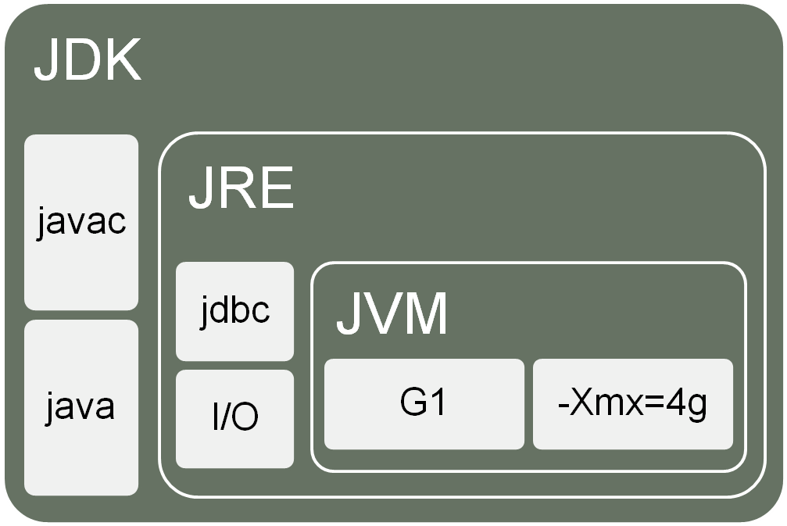
Apples and Pears
Notes:
I’d like to start with a little bit of Theory. The “Java hierarchy” can lead to some confusion.
At the root of this diagram is the JVM – the Java Virtual Machine. Today, Oracle has two (known…) JVMs. Hotspot and JRockit. The JVM is the Machine that runs the Java code, optimizes it, handles garbage collection and so forth.
The JVM must follow the Java specification, but there typically is a lot of room for the JVM implementor to decide on how to fulfill the spec. Things like the G1 garbage collector is an example of something that Sun did that was a part of their JVM but was outside of the Java Spec. Another example is the JRockit Flight Recorder Feature. Things like startup flags is mostly up to the JVM, which leads to all kinds of joy for anyone that want to switch JVM.
The JRE – Java Runtime Environment has all the Java classes and libraries. This is the part that is most controlled by the specification. On the JVM level there is competition between companies, on the JRE level – very little. They mostly use the same JRE that is in OpenJDK. The JRE contains the JVM, and has everything you need to run a Java program.
The JDK, Java Development Kit holds the JRE, and by extension the JVM, as well as all the tools you need to develop in Java. The Java complier, Javadoc and so forth.
So – After hearing this, you should be able to explain why the question “Will G1 be a part of Java 7” is invalid. (Garbage collecors are typically not a part of Java versions, it may be a part of Oracles JDK 7, but not Java 7)

Slide 6
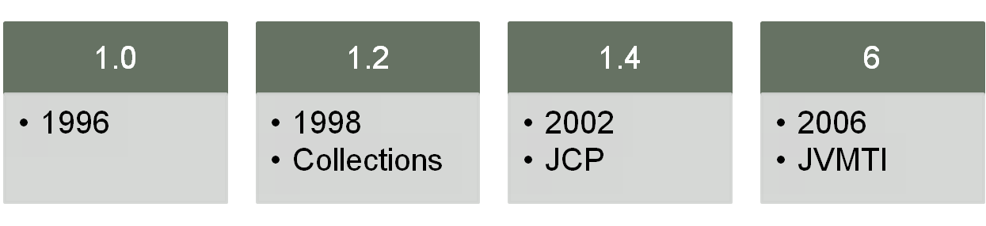
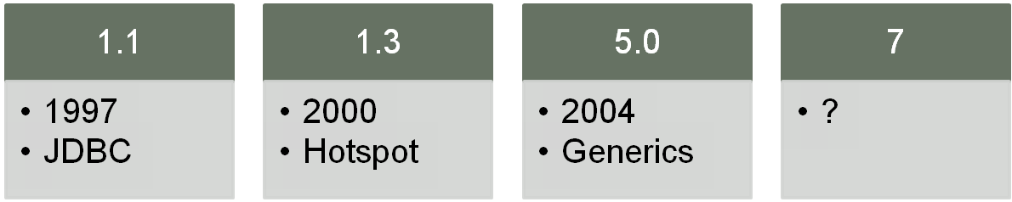
Language
Notes:
Java 1.0 , codename “Oak”, was released in 1996. It can be considered a revolution in software development. Neither object orientation , virtual machines nor garbage collection were new ideas, but Java was the first language that got real traction. At the time the other big thing was C++.
1997 and ‘98 saw “quick” follow up releases, and things like JDBC and collections were added and the language matured. With 1.2 we were taught to call it Java 2 instead of 1.2
Java 1.3 came in 2000, the biggest change was probably the inclusion of the Hotspot JVM in the JRE. It was also the first to follow the unwritten “2 years between releases”- rule.
Java 1.4, still following the 2 year rule. The JCP is introduced as controlling organ for the Java language.
Java 5.0 was a huge release, introducing things like Generics, for-each loops and annotations.
In 2006 we saw the last release to follow the 2 year rule for a while. Java 6 didn’t change the world for developers as 5.0 did.
After Java 6, the JCP got completely stuck over a fight about licensing terms between Apache and Sun. This led to no new Java JSRs filed for quite some time, and a complete breakdown of the 2 year cycles.

Slide 7
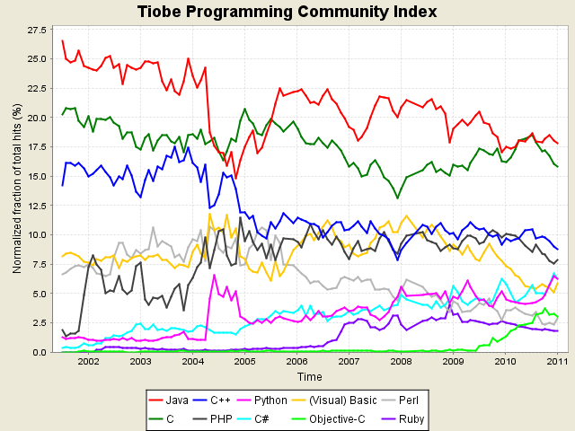
Working In Java
http://www.tiobe.com/index.php/content/paperinfo/tpci/index.html
Notes:
At this time in the distant past, before Oracle bought Sun, there were voices that said that Java was the new Cobold. To some extent they were referring to the lack of language evolution that the JCP controversy led to. The other part probably came from Java being “old” and not new and sexy anymore.
The lack of new releases was a correct criticism and was becoming a problem for Java, and in a way to the industry as a whole. Java has for quite some time been the most used programming language. In this picture we see TIOBEs graph on how popular/used different programming languages are.
For you in the back – Java is the red one, C is the dark green.

Slide 8
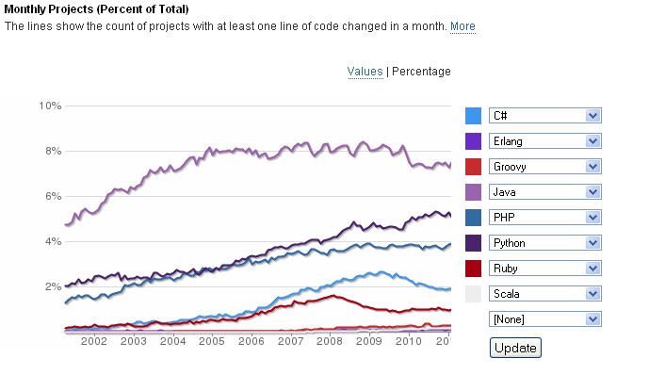
Working In Java
http://www.ohloh.net/languages/compare?measure=projects&percent=true&l0=csharp&l1=erlang&l2=java&l3=php&l4=python&l5=ruby&l6=scala&l7=groovy&commit=Update
Notes:
Another way of looking at it – Counting number of active, public projects, sorted by language.
Java is on top, Python second, PHP third.
I think its fair to assume that a larger percentage of C# projects are “closed” than for other languages, so this comparison of popularity is probably not fair to .NET

Slide 9
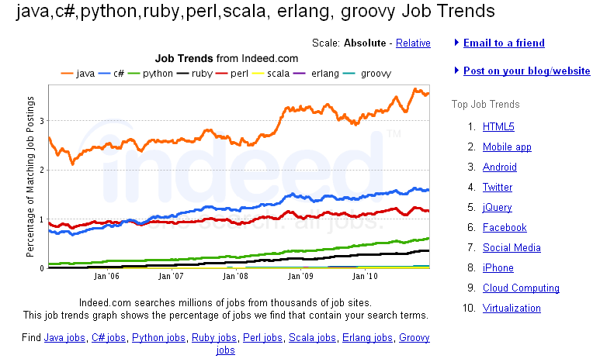
Work in Java
http://www.indeed.com/jobtrends?q=java%2Cc%23%2Cpython%2Cruby%2Cperl%2Cscala%2C+erlang%2C+groovy&l=
Notes:
Perhaps the most important way of counting popularity – How many job offerings are there?
Java is on top, C# second, Perl third.
Counting like this will be biased towards languages with a large install base, and not be kind at all to new, cool, languages.
While you may want to code in the new coolness, the number of employers that want to pay you to do that is more limited.

Slide 10
JRockit products
JROCKIT MISSION CONTROL
JROCKIT REAL TIME
JROCKIT VIRTUAL EDITION
Complete insight into application & JVM behavior
Zero performance overhead in production environments
No application modification or configuration required
High-performance real-time solution for standard Java
Industry leading Deterministic Garbage Collector
Millisecond response times with “five nines” guarantee
Improve application performance & latency with unique tooling
Fly-weight Java container for virtualized environments
Improve datacenter efficiency - do more with less
Simpler and more powerful VM management
2002
2006
2009
JROCKIT JVM
Server-side focus
World-class performance
Powerful diagnostics
2000
Notes:
On the Oracle side of the world, we have The JRockit product family.
At the core of it all is the JRockit JVM. Where Sun had to be as good as possible for everyone, JRockit could (and did) focus on ”Long running server side applications”. The typical installation was a modern server, fast CPUs, lots of RAM, no graphics to speak of, restarting once per day or never. With that use case, JRockit made some choices that makes it very well adapted to run server apps, to the possible expense of client apps. To this day our reccomendation of JVM is ”Client – Use Hotspot, Server (unless solaris) use JRockit”.
The next part is JRockit Mission Control. A set of extremly powerful tools for diagnostics and analysis of a running JVM. If you havent tried JRMC, I strongly reccomend that you attend the hands on lab on tooling, or download JRCM and play around with it yourself. It’s designed for use in a production envirnoment, so we have taken a lot of care to ensure that it has no negative impact to the running system. In marketing speak we say ”zero performance overhead”, in tech speak we say ”Usually unmeasurable, and worst case 0.5-2% overhead”. Most installations does not have the tools to measure a 2% throughput hit, thus the ”zero overhead” part. Other tools that give similar or less insight into the JVM usually comes at overheads measured in 10’s of percent. JRMC cheats heavily to be able to do what it does with no overhead. Where other tools have to beg, borrow and steal the information from the JVM, the operating system and custom libraries, JRMC has a client part build into the JRockit JVM, allowing the JVM to ”give” the information to JRMC at minium cost. JRMC requires no custom code, no restarts, no recompilations or included libraries.
JRockit Real Time is, at its core, a garbage collection algorithm for soft real time. ”Soft real time” means two things – You dont have to change a single line of code to get real time behaviour, but – it will not promise you 100% real time, it will give you a SLA. Like 4 or 5 nines. You set your GC pause time target to something, lets say 5ms, and the JVM will do its utmost to keep alll GC pauses at 5ms or less. And usually does this, 99.999% of the time. JRockit Real time is not for everyone though, you get short and predicable garbage collection pauses, but you pay in throughput. 30% throughput reduction is not unusual. For the costomers of JRRT, this problem is solved by throwing more hardware at the problem.
Finally we have JRockit Virtual Edition. Extremely simplified, JRockit VE is a JVM, with its own built in Operating system. Or to say it another way, it’s an operating system, 2 orders of magnitude smaller than Linux, that can run only one program – a JVM.

Slide 11
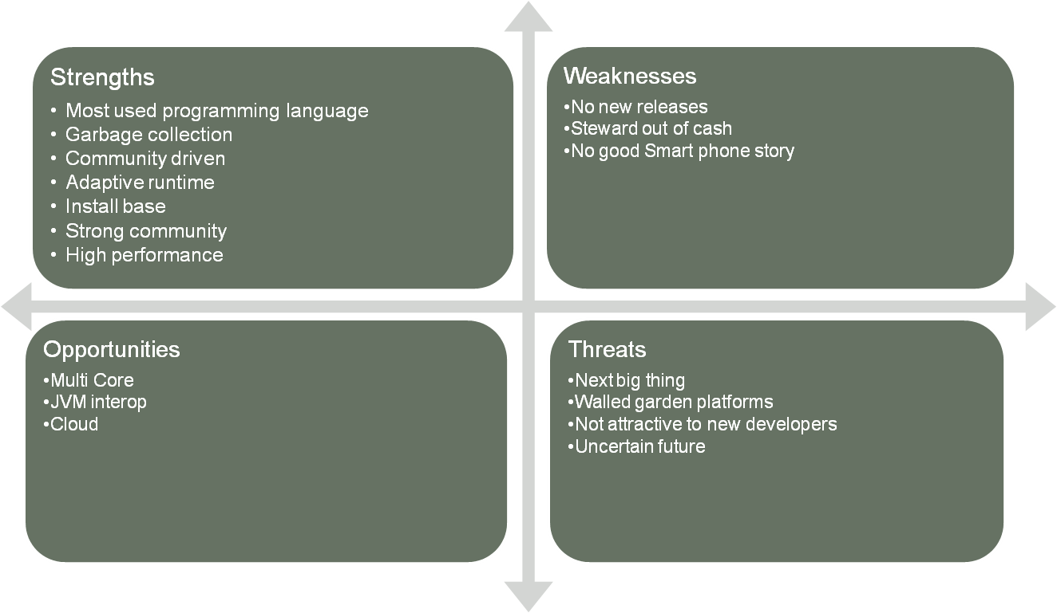
Java SWOT – Sun days
Notes:
I must add a disclaimer here – This is not the “formal Oracle SWOT” for Java. It took all of 10 minutes to create, and was created by people way lower in pay-grade than anyone that would be trusted in making the formal one. For those of you that have had the luck to never see a SWOT – it’s a favorite exercise for MBA type people, and is usually done with most of the C*O people of a company, and takes a day or two at a retreat do create.
So – take this for what it is.
Strengths – It’s the most used programming language as we have seen. We have a large number of technical strengths – No one wants to go back to a world without garbage collection. With an adaptive runtime we can get performance comparable to well written C, and much better than poorly written C. A strong and active community, and an install base that could rival Windows. This list could be made very long. Java has so many things speaking for it that it’s hard to limit oneself to the most important ones.
Weakness – 5 years since the last release. It’s public knowledge that Suns business wasn’t going great at the time. With the power over Java that Sun has, this is a point that leads to worry to parts of the industry. Java also lacks a good story for the Smart phones.
Threats – I’m saving Opportunities until last to end on a slightly positive note. The “next big thing”. There may come a language that outcompetes Java. With some of the weaknesses listed earlier there may be an “in” for someone to take market and mind share. Walled garden platforms are a threat to the Java install base. One of the strenghts is that Java is everywhere, run once and all that. But with a closed platform, we would not be “everywhere” unless they let us in. Java is not new and sexy, so its not as attractive to new developers as we would like it to be. The public perception of the future of Java is uncertain. With a blocked JCP and a semi hostile press, the public image on what Javas future is, is very bleak.
Opportiunites – Multi core is coming in a big way. This surprises no one. Parallel programming is a hard problem. Avoiding deadlocks, optimizing pararelization… Its hard. Memory management used to be a hard problem, until the modern Garbage collector. Java has an opportunity to solve a large part of the multi core “problem” for the developer.
It turns out that the JVM is and extremely powerful adaptive runtime, and that it can run other languages that just Java. By making it easier for different languages to co-exist on the JVM, we can strengthen both Java and the other languages, allowing the programmer to use the language most suitable to the given task.
Everyone must say cloud. No matter what the truth is, you must have a slide that says “Cloud” in some way. For Java, we can actually mean it. Java and the JVM seems extremely suitable to use in a cloud installation. Well known language, easy to limit memory usage, easy to deploy, restart. Add to that all the cloud specific options we can add to the JVM and it’s a clear opportunity.

Slide 12
Present

Slide 13
What occupies our days?
Dev
  Java 7
  JDK 7
  Convergence
“Misc”
  Reconnecting with community
  Java 8
  Java 9+
Notes:
So, what are we at Oracle doing now?
The dev organization are working on JDK7, and some on Java 7. A lot of man hours goes into our convergence project, more about this in a bit.
The “misc” part of our org are also trying to reconnect with the Java community. Sun was a very different company that Oracle is, and Oracle must adapt a bit to the community and the community must get used to Oracle.
On the minus side. Oracle is more close mouthed, and slower to comment on things than Sun was. On the plus side, I would say that Oracle is more straight that Sun was. We don’t promise as much, but we will (fingers crossed) have a better delivery ratio than Sun had.
We are also looking at Java 8 and onward.

Slide 14
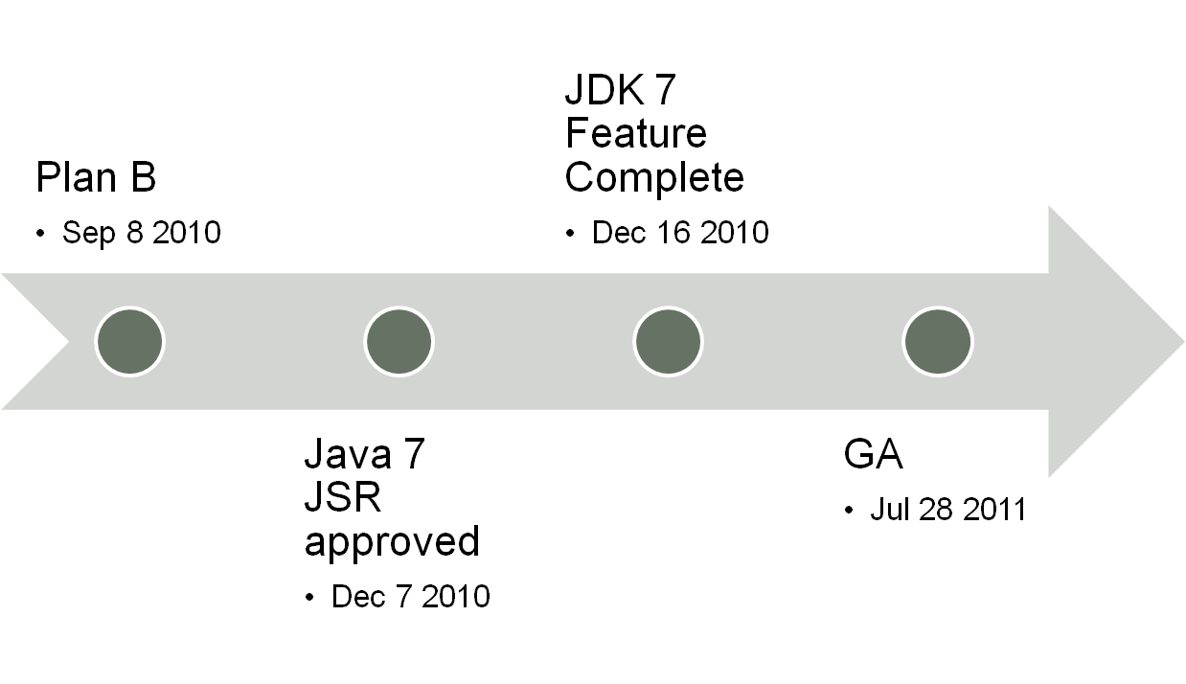
JDK 7 / Java 7
Notes:
The JDK 7 and Java 7 project –
In September 2010, Mark R made a post on his blog basically saying “Our time estimates for JDK7 were way off. We have two options, ship it all in late 2012, or ship parts in 2011 and the rest in 2012” The second option was known as Plan B.
The community reaction, as well as Oracle internal, was pretty much unanimous. Ship often, ship early.
In November the JSRs for Java 7 were submitted, and December 7th they were approved by the JCP EC. A new version of Java was on the public schedule again.
This was extremely controversial, but without in any way belittling the impact and importance of the issue – this has been talked about in great length in other presentations and will keep coming back, so I’m going to just brush passed it here.
December 16, a big day for the project – FC, or Feature Complete. This means that no new features may be added, and only bug fixes and enhancements are allowed. In practice this means that the fight between release management and development starts. To my untrained eye, a lot of the “bug fixes” that just have to go in look a lot like new features.
July 28, 2011, is our planned release date for JDK7. I’m guessing that you will be hearing a lot more from us before and around that date.
By the way, the beta for JDK7 is available for download, if you want to play around with it.

Slide 15
2 teams enter, one team leave…
Hotspot
Notes:
So, I mentioned Convergence.
With the acquisition, all of a sudden we had two JVM, and two JVM teams.
Merging the teams was as easy as you would expect. We have a group of extremely talented developers, they speak the same language and they think in very similar ways. Put them in a room for 10 minutes they are best friends for ever. Well, either that or they will refuse to speak to each other because they use VI instead of Emacs, but that’s the type of conflict you will se within any dev team. The cultures are similar enough so that the merging as such is painless.
But what about the products? Which one do we chose?

Slide 16
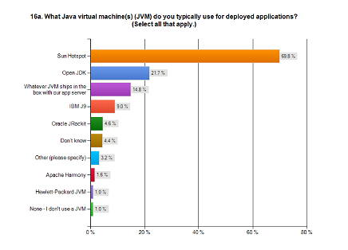
2010 Eclipse Community survey
69,8 + 21.7%
vs
4.6%
Notes:
In an Eclipse community survey Hotspot had 70%, OpenJDK 22% against Jrockits 5%.
Take this for what it is – Respondees could choose multiple options, and Eclipse users are hardly representative for the Java install base as a whole (As in – they are more likely to actively choose their JVM, in this case giving JRockit better numbers in comparison)

Slide 17
2 teams enter, one team leave…
Hotspot
  Market share
Notes:
So the market share for hotspot is a lot larger than JRockit. With absolutely no statistics to support it, I’m going to claim that Hotspot has an install base that is at least 100 times larger than JRockit.

Slide 18
2 teams enter, one team leave…
Hotspot
  Market share
  Client and Server version
  Quality
Notes:
One of Hotspots advantages over JRockit is it’s client and server version. JRockit only has one version, optimized for server.
Also, having that many users Hotspot is probably one of the most field tested pieces of software in existence. Just surviving that indicates a good quality. Not saying that JRockit has bad quality, but it’s a lot less tested.

Slide 19
2 teams enter, one team leave…
Hotspot
  Market share
  Client and Server version
  Quality
JRockit
  Value adds
    JRockit Mission Control
    JRockit Flight Recorder
    JRockit Virtual Edition
  Optimized for the Oracle stack
Notes:
On the JRockit side – We have all the JRockit value adds, in the form of JRockit Mission Control, the flight recorder, JRockit Real Time, JRockit Virtual Edition. Oh, and no permgen. It’s also been optimized for the Oracle stack, which makes Oracle happy, but does perhaps not mean that much for the general public.
So we wanted to keep all the advantages, but as anyone in development knows, it costs a lot of time to keep two code bases alive. We decided to merge, or converge the JVMs. But how do we choose?

Slide 20
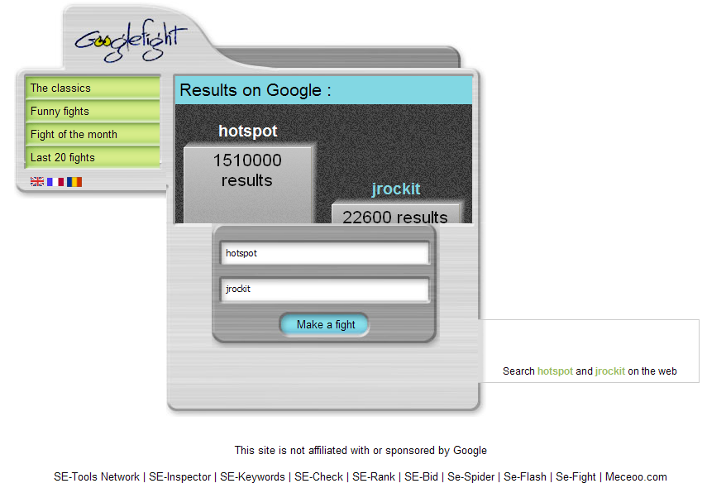
Hmm…
Notes:
Perhaps not the most scientific method…
In truth, this illustrates one of the most important factors – install base.
We did our technical due-dilligence and moving all the good features from one into the other would take approximately the same amount of time no matter which code base we chose to use as the “core”. Choosing to use Hotspot as the base would probably scare less people, and possibly affect less people, than using JRockit.

Slide 21
Convergence
1 + 1 = 3 ?
Notes:
If I was in marketing, I would try to sell you the myth that 1+1 = 3, that the sum would be greater than the parts. This is not quite true.

Slide 22

Convergence
JRockit
HotRockit
Hotspot
Notes:
The truth is that there are a lot of common features in both the JVMs, so converging them will add, lets just make up a number, 15%, new features to the combined JVM.
We haven't decided on what we are calling the combined JVM yet, and there is a lot of different opinions internally on what a good name is. I have my opinion… (click)

Slide 23
How big was your first checkin?
+++ b/src/share/vm/utilities/top.hpp Wed Feb 02 13:23:17 2011 +0100
+++ b/src/share/vm/utilities/utf8.cpp Wed Feb 02 13:23:17 2011 +0100
+++ b/src/share/vm/utilities/utf8.hpp Wed Feb 02 13:23:17 2011 +0100
+++ b/src/share/vm/utilities/vmError.cpp Wed Feb 02 13:23:17 2011 +0100
+++ b/src/share/vm/utilities/vmError.hpp Wed Feb 02 13:23:17 2011 +0100
+++ b/src/share/vm/utilities/workgroup.cpp Wed Feb 02 13:23:17 2011 +0100
+++ b/src/share/vm/utilities/workgroup.hpp Wed Feb 02 13:23:17 2011 +0100
+++ b/src/share/vm/utilities/xmlstream.cpp Wed Feb 02 13:23:17 2011 +0100
+++ b/src/share/vm/utilities/xmlstream.hpp Wed Feb 02 13:23:17 2011 +0100
+++ b/src/share/vm/utilities/yieldingWorkgroup.cpp Wed Feb 02
13:23:17 2011 +0100
+++ b/src/share/vm/utilities/yieldingWorkgroup.hpp Wed Feb 02
13:23:17 2011 +0100
[ stefank @ stefank02 : 13:23:38 : 1034 ] ~/hg/perm.objarray $ less apa2.txt | grep "+++" | wc
1652 13216 126612
Notes:
Meanwhile, on another planet. Jrockit developer Stefan Karlsson makes his first check in to OpenJDK. Changing 1652 files.
Don’t try this at home boys and girls, Stefan K is a trained professional.
In the days of old, HotSpot and OpenJDK used something called makedeps and includeDB. It was a non standard way of handling cpp-header files. At the time they were introduced they solved a problem, but as other tools improved it became just “a non standard way”. No IDE currently available could understand it either. Removing these from the toolchain was a real acto of mercy.
We could claim that we did this just to lower the barrier for new developers with modern IDEs to work on OpenJDK. While this is certainly true, our main motivation may just possibly have been self interest. We do what we can to stop our JRockit developers from hurting themselves or others while working with the code.

Slide 24
Official roadmap, from JavaOne 2010
JDK 7 – 2011
JDK 8 – 2012
Open JDK unchanged
JVM Merge -> Open JDK
JDK/JRE still free, same license
Premium
  (Such as: JFR, JRMC, JFB, Support)
Notes:
JavaOne is the time of the year when we really are allowed to speak of the future. At JavaOne 2010 we stated that we planned to relase JDK7 in 2011, JDK8 in 2012 (still in planning, please don’t kill me if it becomes January 2013…). OpenJDK would be unchanged in how it works. In retrospect we have actually added more people and partners to OpenJDK. We will merge the JVMs, and most of the code resulting from this will go into OpenJDK.
The JRE and JDK will still be free to use and download, under the same license as Sun had.
We will have premium features, for example the Jrockit value adds and a Java for business support offering.

Slide 25
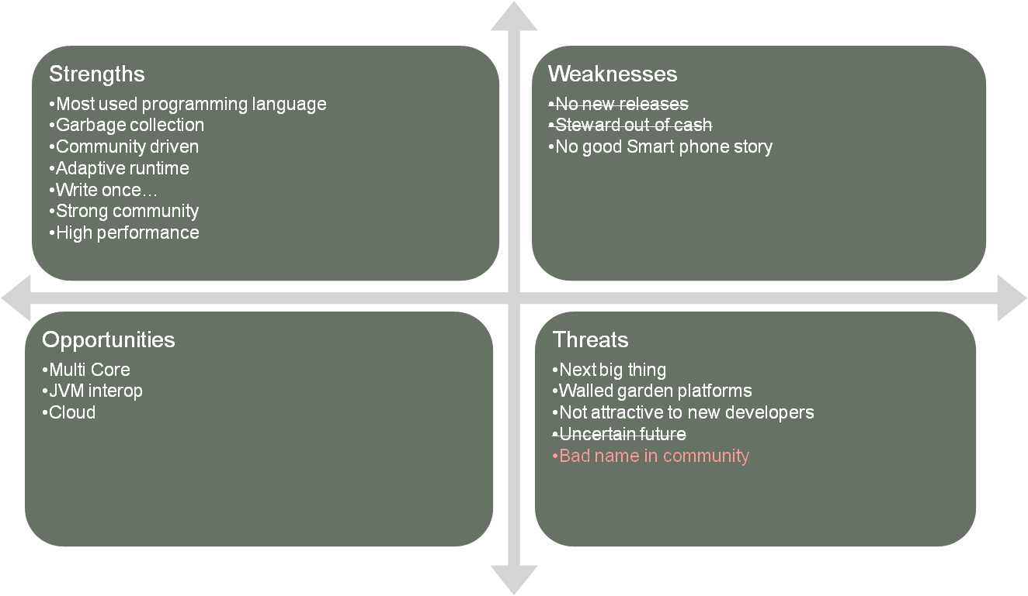
Java SWOT – Oracle
Notes:
So, going back to the SWOT.
The “no new releases” and “Steward ouf of chash” weaknesses are gone. We will release Java 7, and Oracle does quite ok financially, thanks for asking.
I would also argue that the future is not really uncertain anymore. Oracle publishes public roadmaps once or twice a year, and are quite good at sticking to them.
We have added a new threat though . Oracle has a bad name in the Java community. I could probably sugar coat that point, but you know what I mean.
In my eyes, it’s mostly undeserved, but it’s mostly up to us to prove that.

Slide 26
Future

Slide 27
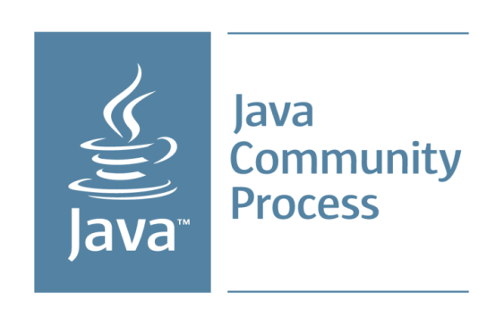

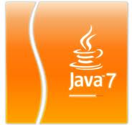

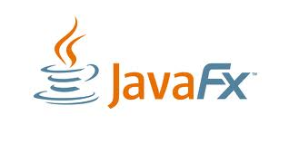
Notes:
JSR Reform – Make it easier to participate. We think its extremely relevant, but we want to make it more clear to everyone that it is. Patric Curran has spoken about his goals, they include creating a less intimidating “contract” for participants, increase transparency (make transparecy mandatory, not just “encouraged” as it is today).
As we already mentioned, we will release Java 7, and onward.
OpenJDK is becoming more and more important, we hope to add more partners and developers in the future.
JavaFX will be released. It’s too early to reveal our long term roadmap for FX here, so this is just a teaser.

Slide 28
Trends
Multi Core processors
Dynamic Languages
Domain specific Languages
Cloud
Smart phones and tablets
Notes:
At this time, I will not speak about our ideas about long term roadmap, for many reasons:
We are not done thinking
Some parts will have to go through the JCP, and it would be impolite of us to talk to the general public before we talk to our JCP members
We like to keep some things secret until we are 100% sure we can deliver them.
By the way, if you think you have seen these trends in the SWOT earlier, you are probably right.
With this slide, I just want to ensure you that we also see these trends…
Multi core processors are coming in a big way.
Dynamic and Domain specific languages are becoming more popular and more relevant.
Cloud is the new Web. Everyone must be on it. But to be serious – There are a lot of exciting things that can be done in and with the cloud.
When I say smart phone, I mean iPhone and Androids. Just to be clear. And tablets means iPads and anything that will survive from the iPad copies. I’m not sure that the laptop and destop is dead, but a lot of use is moving to smart phones and tables.

Slide 29


