Slide 1

Notes:
9
Bring up on stage two customers to tell the audience about their experiences.
Manpower Associates is a $14.9B global company with 27,000 employees in the temporary staffing business. Manpower runs a combined PeopleSoft Enterprise and JD Edwards EnterpriseOne shop. These experts in human resources use Enterprise HCM for their own staffing and EnterpriseOne Payroll and Service Billing for handling the large volumes of US-based temporary staff. Manpower is very happy with Oracle’s support since purchasing PeopleSoft and is looking forward to a long relationship with Oracle.
Spokesperson will be Jay Schaudies, Vice President, Global eCommerce.
Welch Foods is the food processing and marketing arm of National Grape Cooperative Association. Organized in 1945, National Grape is a grower-owned agricultural cooperative with 1,461 members. The company, headquartered in Concord, Massachusetts, operates six plants located in Michigan, New York, Pennsylvania and Washington. The company was running a mix of legacy, home grown, and manual systems that failed to provide senior management with accurate and timely cost and production information. Welch’s required a centralized manufacturing and financial information system to improve management decision making. The solution had to be hot-pluggable with existing technologies, for example, Welch’s Plumtree portal.
Welch Foods chose Oracle over SAP for this business-critical application. The key to the customer’s business problem was their ability to manage costs. The company’s costs are driven by fruit solid content in each of their products, and they use a specialized technique called BRIX for measuring and calculating the cost of materials. Welch’s compared SAP and Oracle SAP’s software was too rigid and, therefore, unable to include the BRIX calculation in their manufacturing solution. Only Oracle’s OPM could bind this custom cost method into the Quality Management Process.
Technology customer yet to be determined. Current possibilities include eBay and FTD Florists.

Slide 2

JavaFX 2.0 Deep Dive
Angela Caicedo
Technology Evangelist

Slide 3
The following is intended to outline our general product direction. It is intended for information purposes only, and may not be incorporated into any contract. It is not a commitment to deliver any material, code, or functionality, and should not be relied upon in making purchasing decisions.
The development, release, and timing of any features or functionality described for Oracle’s products remains at the sole discretion of Oracle.
Notes:
9
Just the standard disclaimer here. We’re obviously going to be talking about pre-release software so exercise an appropriate level of common sense here.

Slide 4
What is JavaFX 2.0
JavaFX is the evolution of the Java rich client platform, designed to address the needs of today’s and tomorrow’s customers.
Notes:
The JavaFX platform is the evolution of the Java client platform designed to enable application developers to easily create and deploy rich internet applications (RIAs) that behave consistently across multiple platforms. Built on Java technology, the JavaFX platform provides a rich set of graphics and media API with high-performance hardware-accelerated graphics and media engines that simplify development of data-driven enterprise client applications.

Slide 5
What make JavaFX Special?
JavaFX defines itself as being a well designed, cross platform application development platform. It is fast. It is flexible. It delivers exceptional value to developers and end users. Most importantly, it leverages the massive existing Java ecosystem. Nobody else offers the complete package – exceptional developer experience, user experience, cross platform development and massive ecosystem.
Notes:
Investing in the JavaFX platform provides the following advantages to Java developers and companies that are part of the Java ecosystem:
* Because the JavaFX platform is written in Java, Java developers can leverage their existing skills and tools to develop JavaFX applications.
* Because Java is widely used, it is easy to find experienced Java developers who can quickly become productive building JavaFX applications.
* By using a homogenous set of Java technologies for both the server and the client platforms, the JavaFX platform reduces the risk of investment by reducing the complexity of the business solutions.
* Development costs are also reduced because of the aforementioned advantages.
* The JavaFX platform provides developers with a development framework and runtime environment to create enterprise and business applications that run across multiple platforms that support Java.

Slide 6
Programming Languages
Java is our primary programming language
  Release Java APIs for all of JavaFX
  Expose JavaFX Binding, Sequences as Java APIs
Embrace all JVM languages
  Standard JVM Languages
    JRuby, Jython, Scala, Groovy, …
  JavaScript
  Emerging / Niche JVM Languages
    Gosu, Visage, ...
Notes:
Java APIs for JavaFX that provide all the familiar language features (such as generics, annotations, and multithreading) that Java developers are accustomed to using. The APIs are designed to be friendly to alternative JVM languages, such as JRuby and Scala. Because the JavaFX capabilities are available through Java APIs, you can continue to use your favorite Java developer tools (such as IDEs, code refactoring, debuggers, and profilers) to develop JavaFX applications.

Slide 7
Getting Started
javafx.application.Application
  JavaFX applications extends this class
  destroy(): convenient place to destroy resources.
  init(): initialization method.
  launch(Class<? extends Application> appClass, String[] args) static method to launch a standalone app
  launch(String[] args) static method to launch a standalone application.
  start(Stage primaryStage): main entry point for all JavaFX applications.
  stop(): convenient place to stop animation, and prepare for application exit.Utility class to launch a standalone application.
Notes:
When you want to create your FX apps, the first class you need to know is the Application class. Your class should extend this one, provide the entry point to your application implementing the start method, and then start your app by calling a launch method, normally on your main method.
NOTE: The constructor and the init() method are not called on the JavaFX Application Thread. An application must not construct a Scene or a Stage in either the constructor or in the init() method. An application may construct other JavaFX objects in this method, but must use Platform.runLater() to perform any operation on the scene itself.

Slide 8
Creating a Simple Application
public class MyApp extends Application {
@Override public void start(Stage stage) {
Group root = new Group();
Scene scene = new Scene(root,500, 400);
scene.setFill(Color.BLACK);
stage.setScene(scene);
stage.setVisible(true);
}
public static void main(String[] args) {
Application.launch(args);
}
}
9
Notes:
As we mentioned in the previous slide, your class need to extend from Application. Then there are key elements in the code:
- Stage: is the top-level container for the application
- Scene is the drawing surface for the application's content. Everything that is going to be render in the application, will follow a scene graph programming model, and in this case root (Group) will be the root of that tree, that is the reason why we pass root as one parameter for the Scene constructor, as well as the drawing area dimensions
You set the scene for your stage, and you make it visible.
Finally you launch your application trough the Application's static method launch

Slide 9
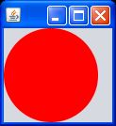
Let's Compare: JavaFX 1.x
import javafx.application.*;
import javafx.scene.shape.*;
import javafx.scene.paint.*;
Stage {
scene:Scene{
Content:[
Circle {
centerX: 50
centerY: 50
radius: 50
fill: Color.RED
}
]
}
}
Notes:
If you played with JavaFX 1.x, this piece of code should look familiar. In a declarative way you created a Stage, with an associated Scene, and the Scene has a set of contents that will be rendered, in this case just a Circle.

Slide 10
Let's Compare: JavaFX 2.0
public class JavaFXTest extends Application {
@Override public void start(Stage stage) {
Group root = new Group();
Scene scene = new Scene(root,100,100);
stage.setScene(scene);
Circle c1 = new Circle();
c1.setFill(Color.RED);
c1.setCenterX(50.0f);
c1.setCenterY(50.0f);
c1.setRadius(50.0f);
root.getChildren().add(c1);
stage.setVisible(true);
}
public static void main(String[] args) {
Application.launch(args);
}
}
Notes:
Now with JavaFX 2.0 is pretty much the same idea. You still have your Stage as your top level container. You have a scene, that will render a set of components, in this case just a circle c1.
As root is the designated root for your scene graph, you add the circle to the children of that root.
Finally you make your stage visible and launch your application.

Slide 11

Launching JavaFX Apps
From the command line
  java -jar myapp.jar
  java -cp jfxrt.jar:myapp.jar MyApp
  javafx -cp myapp.jar MyApp
From any IDE
  Just setup classpath and run as normal
9

Slide 12


Graphical Objects

Slide 13
Scene Graph
Directed Acyclic Graph
Parents & children
Representation of a GUI
Drawing primitives and controls
Notes:
A scene graph is a tree data structure, most commonly found in graphical applications and libraries such as vector editing tools, 3D libraries, and video games. The JavaFX scene graph is a retained mode API, meaning that it maintains an internal model of all graphical objects in your application. At any given time, it knows what objects to display, what areas of the screen need repainting, and how to render it all in the most efficient manner. Instead of invoking primitive drawing methods directly, you instead use the scene graph API and let the system automatically handle the rendering details. This approach significantly reduces the amount of code that is needed in your application.
The individual items held within the JavaFX scene graph are known as nodes. Each node is classified as either a branch node (meaning that it can have children), or a leaf node (meaning that it cannot have children). The first node in the tree is always called the root node, and it never has a parent.

Slide 14
Types of Nodes
Shapes
Images
Media
Web browser
Text
Controls
Charts
Group
Container

Slide 15
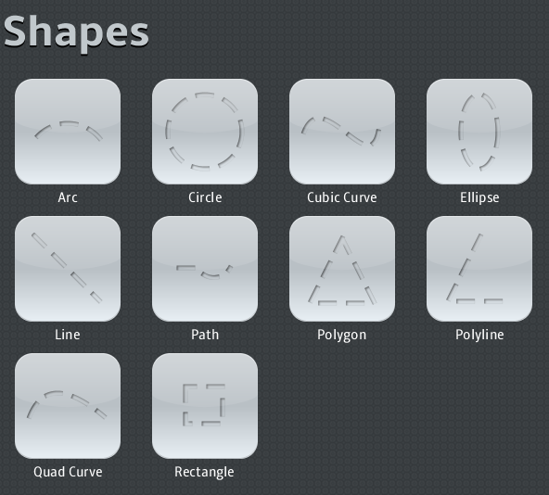

Shapes
Polyline polyline2 = new Polyline(
new double[]{135, 10, 100, 80,
170, 80, 135, 10,
});
polyline2.setStroke(Color.DODGERBLUE);
polyline2.setStrokeWidth(2);
polyline2.setFill(Color.DARKBLUE);
Notes:
First lets look into the shapes. One example will be the Polyline, where you specify the coordinates for each corner.
Then you set the color for the stroke, then the with for that stroke and finally the filling color for the entire Polyline.

Slide 16

Images
ImageView sample1 = new ImageView(
new Image(url, 30, 70, false, true));
ImageView sample2 = new ImageView(new Image(url));
sample2.setFitWidth(250); //preferred width
sample2.setPreserveRatio(true);
ImageView sample3 = new ImageView(new Image(url));
sample3.setFitWidth(40);
sample3.setFitHeight(80);
sample3.setPreserveRatio(false);
sample3.setSmooth(true); //better filter
sample3.setRotate(90);
ImageView sample4 = new ImageView(new Image(url));
sample4.setFitHeight(60);
sample4.setPreserveRatio(true);
Rectangle2D rectangle2D = new Rectangle2D(0,0,120,60);
sample4.setViewport(rectangle2D); //image's viewport
HBox hBox = new HBox();
hBox.setSpacing(30);
hBox.getChildren().addAll(sample1, sample3, sample4);
VBox vb = new VBox(10);
vb.getChildren().addAll(hBox, sample2);
root.getChildren().add(vb);
Notes:
Now lets look into image creation and configuration. For rendering an image we use ImageView, that is the node for your scene graph. Each ImageView will have an Image (represents graphical images and is used for loading images from a specified URL) to render.
Sample1 is creating and image from the specified url, with a given width and height, which doesn't want to preserve the ratio (preserveratio = false) and want to use better filtering (smooth = true )
Sample2, just create the image from a url, and then use the ImageView methods to set the FitWidth(width of the bounding box within which the source image is resized as necessary to fit) and to set that we want to preserve the ratio.
Sample3, similar as sample2 create and image from a url and then set it's properties through method calls. Note here the setRotate method, to rotate the image 90 degrees.
Sample4, add a new interesting twist, setting a view port. The method setViewPort set the rectangular viewport into the image, like seen trough a window, your image is there but you only see what you can see trough that window. The viewport is specified in the coordinates of the image, prior to scaling or any other transformations.
Then you organize your images into layers, we will talk more about it later.

Slide 17
Media
JavaFX supports both visual and audio media
Cross platform JavaFX Media file (fxm, mp3)
Media class represents a media file
MediaPlayer plays a Media file
MediaView is-a Node which displays the Media
  Many MediaViews can have the same MediaPlayer
    And it is cheap to do so
  MediaViews can scale the media proportionally or disproportionally
  MediaView does not come with pre-built playback controls (you need a MediaControl)
9
Notes:
The MediaPlayer class provides the controls for playing media. It is used in combination with the Media and MediaView classes to display and control media playback. Note that MediaPlayer does not contain any visual elements so must be used with the MediaView class to view the media.
MediaView is the node that provides a view of Media being played by a MediaPlayer.

Slide 18
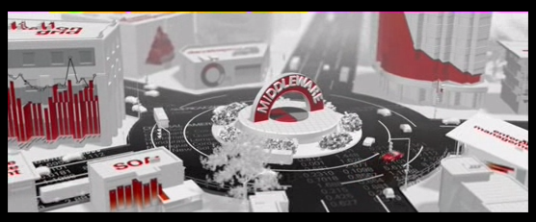
Media
public class JavaFXTest extends
Application {
private static final String MEDIA_URL =
"http://webcast-west.sun.com/oow2010.flv";
private MediaPlayer mediaPlayer;
@Override public void start(Stage stage) {
Group root = new Group();
Scene scene = new Scene(root,400,400);
stage.setScene(scene);
mediaPlayer = new MediaPlayer(new Media(MEDIA_URL));
mediaPlayer.setAutoPlay(true);
MediaView mediaView = new MediaView();
mediaView.setMediaPlayer(mediaPlayer);
mediaView.setLayoutX(20);
mediaView.setLayoutY(20);
root.getChildren().add(mediaView);
stage.setVisible(true);
}
public static void main(String[] a) {
Application.launch(a);
}
}
Notes:
You create a Media object, that represents a media resource. It is created from the string form of a source URI. You pass that new media to your MediaPlayer.
You set the autoplay (if true media will play as soon as possible.)
Then you set the mediaPlayer to your MediaView using the setMediaPlayer method. Finally set the X and Y coordinates and you are done!

Slide 19
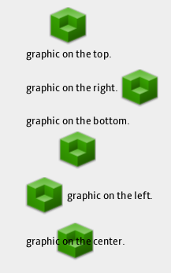
Text
VBox box = new VBox(10);
ImageView imageView = new ImageView(ICON_48);
Label label = new Label("graphic on the top.", imageView);
label.setContentDisplay(ContentDisplay.TOP);
box.getChildren().add(label);
imageView = new ImageView(ICON_48);
label = new Label("graphic on the right.", imageView);
label.setContentDisplay(ContentDisplay.RIGHT);
box.getChildren().add(label);
imageView = new ImageView(ICON_48);
label = new Label("graphic on the bottom.", imageView);
label.setContentDisplay(ContentDisplay.BOTTOM);
box.getChildren().add(label);
imageView = new ImageView(ICON_48);
label = new Label("graphic on the left.", imageView);
label.setContentDisplay(ContentDisplay.LEFT);
box.getChildren().add(label);
imageView = new ImageView(ICON_48);
label = new Label("graphic on the center.", imageView);
label.setContentDisplay(ContentDisplay.CENTER);
box.getChildren().add(label);
getChildren().add(box);
Notes:
Here we show how to create Labels, or non-editable text control with or without graphics.
You can call the setContentDisplay to set the graphics either on top, bottom, right, left or center.

Slide 20
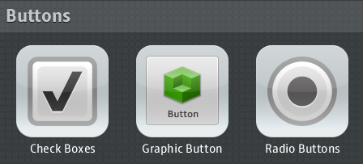
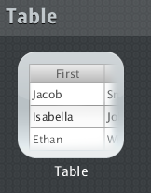
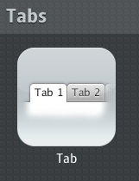
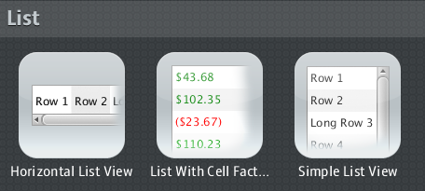
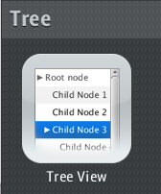
Controls
Many more...

Slide 21
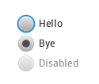
RadioButton
ToggleGroup tg = new ToggleGroup();
VBox vbox = new VBox();
vbox.setSpacing(5);
vbox.setLayoutX(100);
vbox.setLayoutY(100);
RadioButton rb1 = new RadioButton("Hello");
rb1.setToggleGroup(tg);
RadioButton rb2 = new RadioButton("Bye");
rb2.setToggleGroup(tg);
rb2.setSelected(true);
RadioButton rb3 = new RadioButton("Disabled");
rb3.setToggleGroup(tg);
rb3.setSelected(false);
rb3.setDisable(true);
vbox.getChildren().addAll(rb1,rb2,rb3);
getChildren().add(vbox);
Notes:
This code show how to use ToggleGroups and RadioButtons. ToggleGroup contains a reference to all Toggles whose selected variables should be managed such that only a single Toggle within the ToggleGroup may be selected at any one time.
For each RadioButton that you create you provide the text to be use as its label. Then you set the ToggleGroup that will manage the RadioButton, finally you set if the RadioButton will be selected or not, and if it's disable or not.

Slide 22
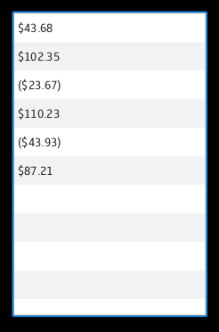
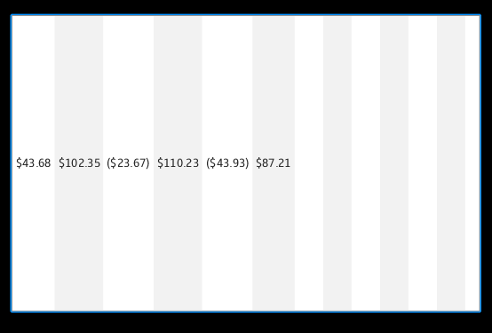
ListView
ListView listView = new ListView();
//listView.setVertical(false);
listView.setItems(FXCollections.ObservableArrayList(“$43.68”, “$102.35”,
“($23.67)”, “$110.23”, “($43.93)”, “$87.21”));
//listView.setOrientation(Orientation.HORIZONTAL);
listView.getSelectionModel().setSelectionMode(
SelectionMode.MULTIPLE_INTERVAL_SELECTION);
getChildren().add(listView);
Notes:
A ListView displays a horizontal or vertical list of items from which the user may select, or with which the user may interact. A ListView is able to have its generic type set to represent the type of data in the backing model. Doing this has the benefit of making various methods in the ListView, as well as the supporting classes (mentioned below), type-safe.
You set the items you want to display in the list, and specify if the list is multiple selection or not.

Slide 23
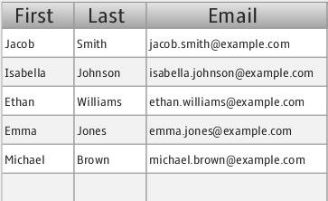
Table
final ObservableList<Person> data = FXCollections.ObservableArrayList(
new Person("Jacob", "Smith", "jacob.smith@example.com" ),
New Person(“Isabella”, “Johnson”, “isabella.johnson@example.com”), ...
);
...
TableColumn<String> firstNameCol = new TableColumn<String>();
firstNameCol.setText("First");
firstNameCol.setDataRetriever(new Callback<TableColumn.CellDataFeatures<String>, String>() {
@Override public String call(CellDataFeatures<String> p) {
return ((Person)p.getValue()).firstName;
}
});
TableColumn lastNameCol = new TableColumn();
lastNameCol.setText("Last");
...
TableColumn emailCol = new TableColumn();
emailCol.setText("Email");
emailCol.setMinWidth(200);
emailCol.setDataRetriever(
new Callback<TableColumn.CellDataFeatures<String>, String>() {
@Override public String call(CellDataFeatures<String> p) {
return ((Person)p.getValue()).email;
}
TableView tableView = new TableView();
tableView.setItems(data);
tableView.getColumns().addAll(firstNameCol, lastNameCol, emailCol);
root.getChildren().add(tableView);
Notes:
To create a table you will need to use the node TableView. For this table you will have to create the TableColumns you want to display. Each TableColumn in a table is responsible for displaying (and editing) the contents of that column. Lets see the code.
First we are creating a data object collection, which contains Person, each person has a name, last name and email, and this information is the one we'll be using for populating the table.
We create the first TableColumn, firstNameCol. We set the text to be showed in the header of this column, using the setText method. Then we call setDataRetriever, with this method we want to provide a callback object with a call method. This method will be called to provide the value that will fill out the value of the cells. For the firstNameCol, the name will be retrieve from the data collection, getting the first name of the person.
In the same way we use the last name to populate the second column lastNameCol and the email to populate the third column, emailCol.
Once the columns are ready, we need to add them to the current columns of the tableView, using the line, tableView.getColumns().addAll(firstNameCol, lastNameCol, emailCol)

Slide 24
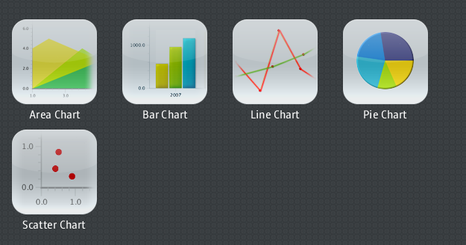
Charts

Slide 25
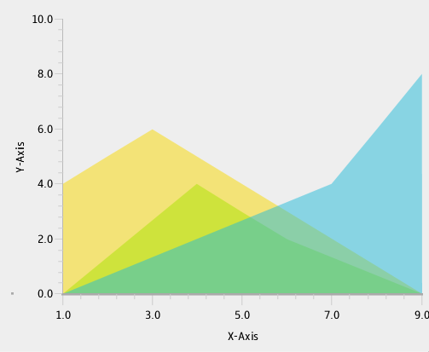
AreaCharts
NumberAxis xAxis = new NumberAxis(
"X-Axis", 1.0d, 9.0d, 2.0d);
xAxis.setTickLabelGap(8.0f);
xAxis.setTickLength(12.0f);
NumberAxis yAxis = new NumberAxis(
"Y-Axis", 0.0d, 10.0d, 2.0d);
ObservableList<AreaChart.Series> areaChartData = FXCollections.observableArrayList(
new AreaChart.Series(“Series1”, FXCollections.ObservableArrayList(
new AreaChart.Data(1,4),
new AreaChart.Data(2,5),
new AreaChart.Data(3,6))),
new AreaChart.Series(“Series2”, FXCollections.ObservableArrayList(
new AreaChart.Data(4,4),
new AreaChart.Data(5,3),
new AreaChart.Data(6,2))),
new AreaChart.Series(“Series3”, FXCollections.ObservableArrayList(
new AreaChart.Data(7,4),
new AreaChart.Data(8,6),
new AreaChart.Data(9,8))));
AreaChart chart = new AreaChart(xAxis, yAxis, areaChartData);
getChildren().add(chart);
Notes:
AreaChart will plots the area between the line that connects the data points and the 0 line on the Y axis. Here we create an areaChart with the given axis and data. First lets look at the axis.
Each axis is defined by a NumberAxis, and when you create it, you provide the axis' label, the upper bound, lower bond and thick unit. You can then set things like tick label gap and tick length.
One you create the x and y axis, you can now create the data that will populate the chart. In this case we create an ObservabeList holding types AreaChar.Series. Each Series have a collection of AreaChart.Data which specified the x and y coordinate to be plotted.
Finally we put everything together, when we create the AreaChart chart.

Slide 26
JavaFX 2.0 UI Controls
Button
Cell
CheckBox
ChoiceBox
Hyperlink
IndexedCell
Label
ListCell
ListView
PasswordBox
ProgressBar
ProgressIndicator
RadioButton
ScrollBar
ScrollPane
Separator
Slider
TextBox
ToggleButton
ToggleGroup
ToolTip
CheckMenuItem
CustomMenuItem
GridPane
Menu
MenuBar
MenuButton
MenuItem
PopupMenu
RadioMenuItem
SplitMenuButton
ToolBar
TreeCell
TreeView
Accordion
SplitPane
Table
Tab
TabPane
TitledPane
AreaChart
BarChart
BubbleChart
Chart
LineChart
PieChart
ScatterChart
XYChart

Slide 27
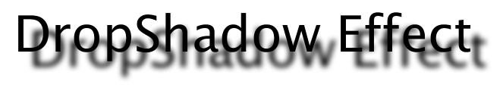
Effects
Text sample = new Text(0,40,"DropShadow Effect");
sample.setFont(Font.font("Amble",
FontWeight.BOLD,66));
final DropShadow dropShadow = new DropShadow();
dropShadow.setOffsetX(20);
dropShadow.setOffsetY(20);
sample.setEffect(dropShadow);
getChildren().add(sample);

Slide 28

Effects
ImageView sample = new ImageView(BOAT);
final Reflection reflection = new Reflection();
reflection.setFraction(0.2);
sample.setEffect(reflection);
getChildren().add(sample);

Slide 29


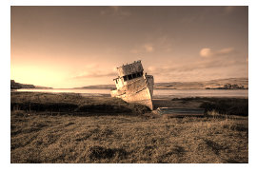
And Many More Effects...
GaussianBlur
InnerShadow
SepiaTone

Slide 30
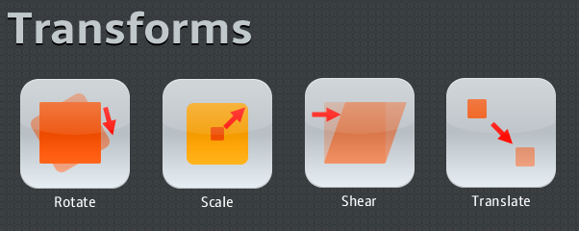
Transforms

Slide 31
Transforms
Transform the coordinate space
  translate (move something in the x, y, z planes)
  scale (resize in the x, y, z planes)
  rotate (angle of rotation and a vector to rotate about)
  affine (3x3 matrix, used in 2D)
  perspective projection (4x4 matrix, used in 3D)
As you can see, we support 2D & 3D transforms
All Nodes can be transformed
  Convenience variables:
    translateX, translateY, translateZ, scaleX, scaleY, ...
  Transform sequence: Sequence<Transform> transforms

Slide 32





Transforms
Rectangle rect=new Rectangle(0,0,60,60); rect.setFill(Color.DODGERBLUE); rect.setArcWidth(10);
rect.setArcHeight(10);
rect.setRotate(45);
rect.setScaleX(2);
rect.setScaleY(0.5);
Shear shear = new Shear(0.7, 0);
rect.getTransforms().add(shear);
rect.setTranslateX(40);
rect.setTranslateY(10);

Slide 33
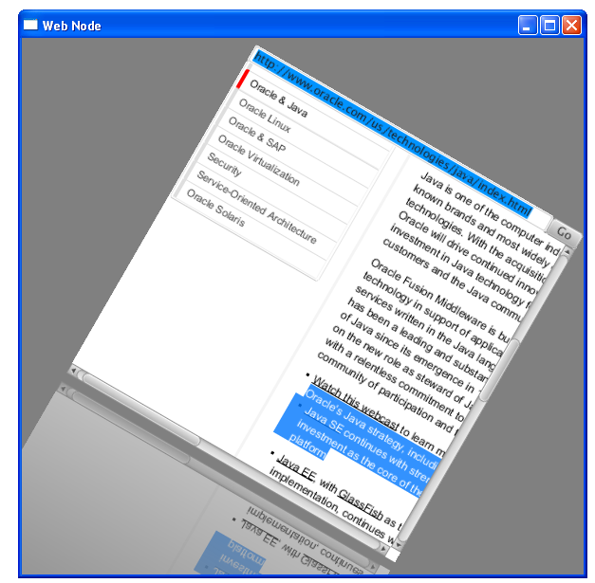
Adding HTML Content to JavaFX Applications: The embeded browser
WebEngine
  Provides basic web page browsing functionality.
  Renders web pages
  Supports user interaction: navigating links, submitting HTML forms.
WebView
  Extension of a Node class
  Encapsulates a WebEngine object
  Incorporates HTML into the scene
    To apply effects and transformations
Policy Interface
  loading web pages, opening new browser windows, or running scripts

Slide 34
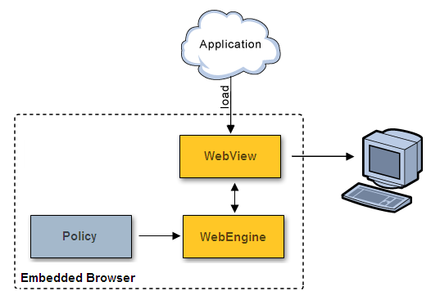
The Embeded Browser Architecture

Slide 35
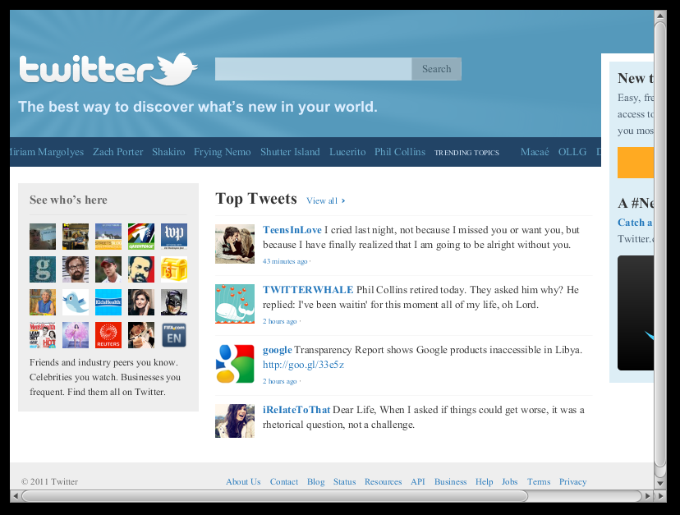
Web Components
public class JavaFXTest extends
Application {
@Override public void start(Stage stage){
Group root = new Group();
Scene scene = new Scene(root,400,400);
stage.setScene(scene);
WebEngine myweb = new WebEngine();
try{
myweb.setURL(new URL("http://www.twitter.com"));
}catch(Exception e){...}
WebView webView = new WebView(myweb);
webView.setLayoutX(100);
webView.setLayoutY(100);
root.getChildren().add(webView);
stage.setVisible(true);
}
public static void main(String a[]) {
Launcher.launch(JavaFXTest.class, null);
}
}

Slide 36
Layout
A surprisingly hard problem!
We’ve made fairly substantial changes in each release so far and we’re going to do so again!
Design Goals:
  Easy to program with by hand
  Works with animated transitions
  Can be manipulated from CSS
  Easy to use with RAD tools
10
Notes:
Richard

Slide 37
Layouts
Pane
AnchorPane
BorderPane
FlowPane
GridPane
HBox
StackPane
TilePane
VBox

Slide 38

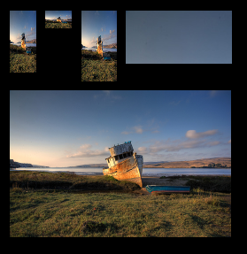
Layouts
BorderPane borderpane=new BorderPane();
borderpane.setTop(rect);
borderpane.setLeft(rect2);
borderpane.setCenter(rect3);
borderpane.setRight(rect4);
borderpane.setBottom(rect5);
borderpane.setTopPos(Pos.CENTER);
borderpane.setBottomPos(Pos.CENTER);
getChildren().add(borderpane);
HBox hBox = new HBox();
hBox.setSpacing(10);
hBox.getChildren().addAll(sample1,
sample3, sample4, sample5);
VBox vb = new VBox(10);
vb.getChildren().addAll(hBox, sample2);
getChildren().add(vb);

Slide 39
Layout Gotchas
setWidth/setHeight on Resizable was a mistake
  It was to be called by the layout manager, but folks would naturally want to call it and then get surprised when it didn’t hold. setWidth was not the same as setting the preferred width!
HBox and VBox were too complicated
We might be backing away from layout specific containers and going back to layout managers
The primary reason has to do with layout from CSS
  Let the CSS author define the layout algorithm
But layout by hand works better with containers
10

Slide 40
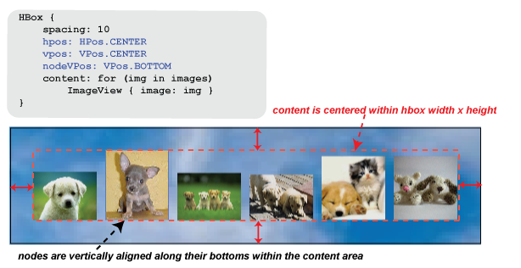
HBox

Slide 41
Binding

Slide 42
Binding
Assembled from one or more sources: dependency
Observes its dependencies for changes and updates its own value according to changes
Any binding can serve as a source for other bindings → very complex bindings from simple ones.
Lazily called: marked as invalid, recalculated when needed
  A binding can become invalid without the value actually changing.
  The value of a binding might change without an invalidation event being generated.
Two options: High level binding and low level binding

Slide 43
ObservableValue
Entity that wraps a value and allows to observe the value for changes
Subinterfaces: one per each primitive type
  ObservableBooleanValue (with appropriate get method)
May support Lazy evaluation
Generates change events and invalidation events:
  InvalidationListener, ChangeListener
addListener(ChangeListener<? super T> l)
addListener(InvalidationListener<? super T> l)
T getValue()
removeListener(ChangeListener<? super T> l)
removeListener(InvalidationListener<? super T> l)

Slide 44
Expressions
Abstract classes, Implement sub-interfaces of ObservableValue.
Provide convenience methods to generate binding in fluent style
BooleanExpression, DoubleExpression, StringExpression etc
Concrete subclasses have to implement the get method, that provides the actual value of this expression
Entry point for Fluent API

Slide 45
BooleanExpression
BooleanBinding and(ObservableBooleanValue other)
StringBinding asString()
static BooleanExpression booleanExpression (ObservableBooleanValue value)
Boolean getValue()
BooleanBinding isEqualTo(ObservableBooleanValue other)
BooleanBinding isNotEqualTo(ObservableBooleanValue other)
BooleanBinding or(ObservableBooleanValue other)

Slide 46
IntegerExpression
DoubleBinding add(double other)
FloatBinding add(float other)
IntegerBinding add(int other)
LongBinding add(long other)
DoubleBinding divide(double other)
...
Integer getValue()
static IntegerExpression integerExpression (ObservableIntegerValue o)
DoubleBinding multiply(double other)
...
IntegerBinding negate()
DoubleBinding subtract(double other)
...

Slide 47
Expression Example
Defining expressions with Fluent API:
result = a*b + c*d
DoubleExpression a,b,c,d;
DoubleBinding result = a.multiply(b).add(c.multiply(d));

Slide 48
Property
Extends of an Expression, allows to set the value manually (set() methods).
One per each primitive type plus ObjectProperty and StringProperty for Strings.
Allow to define locale variables that are used as sources in bindings.
Class Slider extends Control{
...
DoubleProperty valueProperty()
}
slider2.valueProperty().bind(slider1.valueProperty());

Slide 49
High Level Binding API
Simple approach to define bindings with the most common operations:
  arithmetic operations, comparisons, getting the minimum and maximum, boolean operations etc.
The result of a HLB binding can again be used to construct even more bindings
Two possibilities to define the same operation:
  Fluent API
  Factory methods in the Bindings class.

Slide 50
Bindings Class
Helper class with a lot of utility functions to create simple bindings:
  add, bindWithInverse, concat, convert, divide, iqual, greaterThan, max, min, greaterThanOrEqual, lessThan, not, or, lessThanOrEqual, multiply, notEqual, substract, select, unbindWithInverse, when.
result = a*b + c*d
import static javafx.beans.binding.Bindings.*;
NumberBinding foo = add (multiply(a, b),multiply(c,d));

Slide 51
Fluent API Vs Bindings Factory Methods
Main difference -> Fluent API requires at least one of the operands to be an Expression
  Every Expression contains a static method that generates an Expression from an ObservableValue.)
The return type of the Fluent API is different in the examples above.
  Fluent API allows to be more specific about the returned type

Slide 52
Ternary Expression
foo = Bindings.when(cond).then(value1). otherwise(value2);
The expression cond needs to be a ObservableBooleanValue.
Based on the value of cond, the binding contains:
  Value of value1 (if cond.getValue() == true) or
  value2 (if cond.getValue() == false).
The values value1 and value2 have to be of the same type, can be constant values or implementations of ObservableValue.
The return type of the whole expression depends on the type of the parameters value1 and value2.

Slide 53
Low Level Binding
High Level Binding enough in most cases, but sometimes insufficient
  Evaluate expressions & Performance issues
Low Level Binding
  All the flexibility you need
  High performance
  Low memory consumption
To create LLB, extends one of the Binding classes, depending on the type of the result
  If result is double → extend DoubleBinding

Slide 54
Low Level Binding example
DoubleBinding to calculates the square-root of a ObservableDouble
ObservableDoubleValue moo;
DoubleBinding foo = new DoubleBinding() {
{
super.bind(moo); //bind to dependencies
}
@Override protected double computeValue() {
//returns current value of the binding
return Math.sqrt(moo.getValue());
}
};

Slide 55
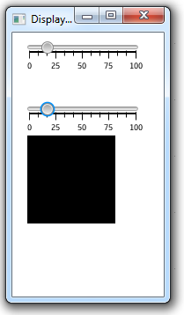
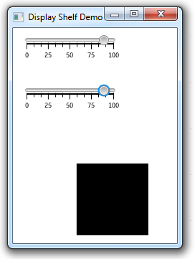
Example: Putting all together... (1 of 3)

Slide 56
Example: Putting all together... (2 of 3)
public class BindingTest extends Application {
@Override public void start(Stage stage) {
stage.setTitle("Display Shelf Demo");
Group root = new Group();
final Scene scene = new Scene(root, 600, 300);
final Slider slider1 = new Slider(0, 100, 50);
slider1.setBlockIncrement(10);
slider1.setShowTickMarks(true);
slider1.setShowTickLabels(true);
slider1.setLayoutX(10);
slider1.setLayoutY(10);
final Slider slider2 = new Slider(0, 100, 50);
slider2.setBlockIncrement(10);
slider2.setShowTickMarks(true);
slider2.setShowTickLabels(true);
slider2.setLayoutX(10);
slider2.setLayoutY(80);

Slide 57
Example: Putting all together... (3 of 3)
//slider2.valueProperty().bind(slider1.valueProperty());
Bindings.bindWithInverse(slider1.valueProperty(), slider2.valueProperty());
Rectangle r = new Rectangle(10, 160, 100, 100);
r.xProperty().bind(slider2.valueProperty());
DoubleBinding db = new DoubleBinding() {
{ super.bind(slider1.valueProperty());}
@Override
protected double computeValue() {
return (100 +slider1.valueProperty() .getValue());
}
};
r.yProperty().bind(db);
root.getChildren().addAll(slider1, slider2, r);
stage.setScene(scene);
stage.setVisible(true);
}

Slide 58
Animations

Slide 59
Animations
Timeline-based keyframe animation
Animated transitions
How the value changes over time
Key value
radius = 30
radius = 300
0s
1s
2s
3s
4s
5s
6s
Keyframes
Notes:
Jasper

Slide 60
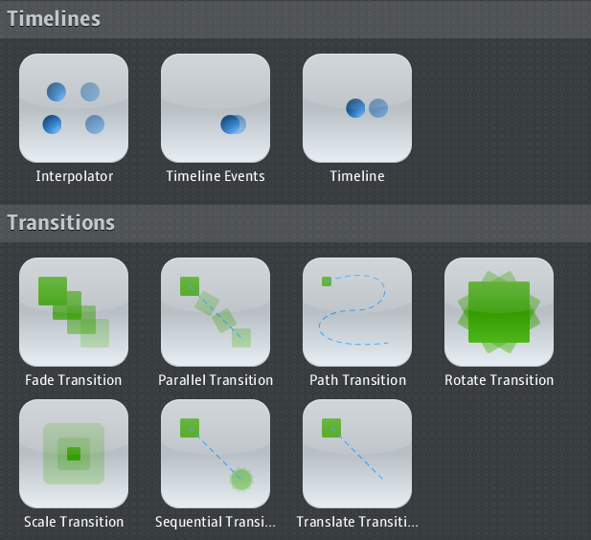
Animations

Slide 61
Timeline-Based Animation
Timeline
  Modifies values of variables specified by KeyFrames
  Doesn’t necessarily do any animation itself
KeyFrame: specifies that a variable should have...
  A particular value
  At a particular time
KeyValue: key value to be interpolated for a particular interval
How is animation actually done?
  Arrange for a KeyFrame to modify an interesting Node variable
    x, rotate, opacity, fill, ...

Slide 62

Timeline Animation Example
Timeline timeline;
Circle circle = new Circle(25,25, 20, Color.web("1c89f4"));
circle.setEffect(new Lighting());
//create a timeline for moving the circle
timeline = new Timeline();
timeline.setCycleCount(Timeline.INDEFINITE);
timeline.setAutoReverse(true);
//create a keyValue with factory for horizontal translation
KeyValue keyValue = KeyValue.keyValue(
circle.translateXProperty(), 205);
//create a keyFrame, the keyValue is reached at time 4s
Duration duration = new Duration(4000);
KeyFrame keyFrame = new KeyFrame(duration, keyValue);
//add the keyframe to the timeline
timeline.getKeyFrames().add(keyFrame);
timeline.play(); //timeline.pause();
//timeline.stop();
//timeline.playFromStart();

Slide 63
Timeline Events Example
final StackPane stack = new StackPane();
stack.getChildren().addAll(circle, text);
timeline = new Timeline();
timeline.setCycleCount(Timeline.INDEFINITE);
timeline.setAutoReverse(true);
timeline.setOnEnterFrame(new Runnable() {
public void run() {
text.setContent(i.toString());
i++;
}});
KeyValue kValueX = KeyValue.keyValue(stack.scaleXModel(),2);
KeyValue kValueY = KeyValue.keyValue(stack.scaleYModel(),2);
Duration dur = Duration.valueOf(2000);
EventHandler<ActionEvent> onFinished = new EventHandler<ActionEvent>(){
public void handle(ActionEvent t) {
stack.setTranslateX(random()*200-100);
i = 0;
}};
KeyFrame kFrame = new KeyFrame(dur, onFinished, kValueX, kValueY);
timeline.getKeyFrames().add(kFrame);
getChildren().add(stack);
timeline.play();

Slide 64
Animated Transitions
Predefined, single-purpose animations
  Fade, Path, Pause, Rotate, Scale, Translate
  Can specify to, from, and by values
Container transitions
  Parallel, Sequential
  Can be nested arbitrarily
Transitions and Timelines have a similar ancestry
  A timeline can be added to a Parallel / Sequential transition
Transitions are being optimized for speed in 2.0
11

Slide 65
Animated Transitions Example
Translate/Rotate/Scale/Fade...
Circle circle = new Circle(20, Color.CRIMSON);
getChildren().add(circle);
TranslateTransition translateTransition = new
TranslateTransition(Duration.valueOf(4000),circle);
translateTransition.setFromX(20);
translateTransition.setToX(380);
translateTransition.setCycleCount(Timeline.INDEFINITE);
translateTransition.setAutoReverse(true);
translateTransition.play();
parallelTransition = new ParallelTransition();
parallelTransition.getChildren().addAll( fadeTransition, translateTransition,
rotateTransition, scaleTransition);
parallelTransition.setCycleCount(Timeline.INDEFINITE);
parallelTransition.play();
Parallel/Sequential...

Slide 66
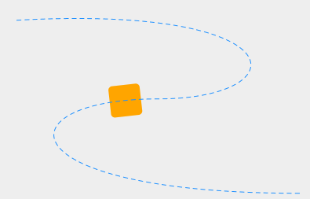
PathTransition Example
Rectangle rect = new Rectangle (0, 0, 40, 40);
rect.setArcHeight(10);
rect.setArcWidth(10);
rect.setFill(Color.ORANGE);
getChildren().add(rect);
Path path = new Path();
path.getElements().add(new MoveTo(20,20));
path.getElements().add(new CubicCurveTo(380, 0, 380, 120, 200, 120));
path.getElements().add(new CubicCurveTo(0, 120, 0, 240, 380, 240));
path.setStroke(Color.DODGERBLUE);
path.getStrokeDashArray().setAll(5d,5d);
getChildren().add(path);
pathTransition = new PathTransition();
pathTransition.setDuration(Duration.valueOf(4000));
pathTransition.setPath(AnimationPath.createFromPath(path));
pathTransition.setNode(rect);
pathTransition.setOrientation(OrientationType.ORTHOGONAL_TO_TANGENT);
pathTransition.setCycleCount(Timeline.INDEFINITE);
pathTransition.setAutoReverse(true);
pathTransition.play();

Slide 67
Event Handling

Slide 68
Event Handling
All of our events extend an Event object
Event flow:
  Capturing
  Bubbling
EventHandler callback for events
  setOnMouseClicked(EventHandler<MouseEvent>)
  addMouseHandler(MouseEventID, EventHandler)
  addMouseFilter(MouseEventID, EventHandler)
Events can be consumed
Capture
Bubbled up
Parent
Child
11

Slide 69
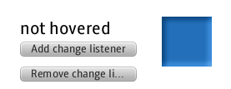
Events Example
Rectangle rect = new Rectangle(150,0,60,60); ...
Text text = new Text(0,0, "Add a hover listener"); ...
Button buttonAdd = new Button("Add change listener"); ...
ChangeListener hoverListener = new ChangeListener() {
public void handle(Bean bean, PropertyReference<?> pr) {
if (rect.isHover()) {
text.setContent("hovered");
} else {
text.setContent("not hovered");
}}};
buttonAdd.setOnAction(new EventHandler<ActionEvent>() {
public void handle(ActionEvent t) {
rect.addChangeListener(Rectangle.HOVER, hoverListener);
text.setContent("listerer added");
}});
Button buttonRemove = new Button("Remove change listener"); ...
buttonRemove.setOnAction(new EventHandler<ActionEvent>() {
public void handle(ActionEvent t) {
rect.removeChangeListener(Rectangle.HOVER, hoverListener);
text.setContent("listerer removed");
}});
getChildren().addAll(rect, buttonAdd, buttonRemove, text);

Slide 70
Swing Integration
We are FINALLY supporting embedding of JavaFX into existing Swing applications!
Accomplishing this requires 3 objectives:
  Java APIs for JavaFX
  Ability to embed hardware accelerated 2D/3D scenes
  Swing API for embedding the scene
We are currently making progress on the last two issues
However (shed a tear), we are not going to support embedding Swing components in JavaFX scene graphs
11

Slide 71
Experiments & Blueprints
At the same time we are working on the platform, we are building experiments and blueprints
Experiments:
  Small applications meant for outside developers to see and play with, but who’s code is not necessarily ideal
Blueprints:
  Larger applications meant to simulate (or actually be) real world, and who’s code is representative of a best practice and intended to be copied by developers
Notes:
Jasper

Slide 72
Roadmap

Slide 73
JavaFX 2.0 Timeline
CYQ1 2011
CYQ2 2011
CYQ3 2011
JavaFX 2.0 EA
(Early Access)
JavaFX 2.0 Beta
JavaFX 2.0 GA
(General Availability)
Notes:
Jasper

Slide 74
JavaFX 2.0 Roadmap
Early Access
Beta
General Availability
Port JavaFX Script to Java
JavaFX Binding APIs
Sequence, Observable List
Hardware Accelerated Graphics
High Performance Transitions
Triangle
Texture Paint
High-def Media
WebView
WebEngine & WebSource
Low Latency Audio
Full Screen Video
Programmatic Media Markers
Multithreading Improvements
Focus Management
3D Transitions
3D Transforms for 2D Systems
3D Vector Math
Redesigned Layout Container API
Grid Layout Container
HTML DOM
CSS Animations
TableView Control
SplitView Control
TabView Control
MediaPlayer Control
Dynamic Footprint Improvements
Static Footprint Improvements
Improved Startup Performance
Updated Public Benchmarks
Blueprints & Samples
Synch’d Media & Animations
Prism Capable Plugin
Rich Text
See http://javafx.com/roadmap for the official version

Slide 75
Get Ready!!!
IT'S ALMOST HERE...

Slide 76
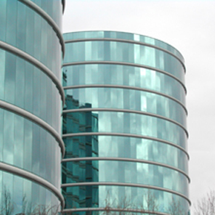
Thank You
Notes:
11

