Slide 1
Building and Testing in the Cloud
Bernard Kowalski
benekk2002@yahoo.com
@benekk

Slide 2
Outline
The challenge – run full CI and End-to-End UI/Integration tests in the cloud environment.
Available CI platforms
A look at hosted Team Foundation Server…
Running test as a part of build process
Available options for UI tests
Running selenium (webdriver) tests
Putting it together – executable specifications with SpecFlow
Into the clouds - Sauce Labs’ cloud testing platform
Discussion

Slide 3
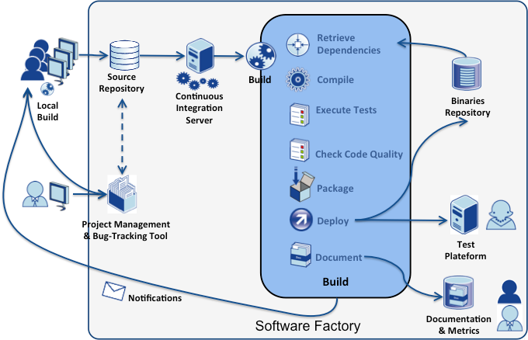
Continuous Integration overview…
Continuous Integration is a software development practice where members of a team integrate their work frequently, usually each person integrates at least daily - leading to multiple integrations per day. Each integration is verified by an automated build (including test) to detect integration errors as quickly as possible.
Martin Fowler
Intranet

Slide 4
How about running Continuous Integration in the Cloud…

Slide 5










Available CI platforms
Hosted

Slide 6
A look at hosted Team Foundation Server…
Project Management ( Features, tasks, story board, bug tracking, etc)
Source repository – including git
Build Server functionality
and more…

Slide 7
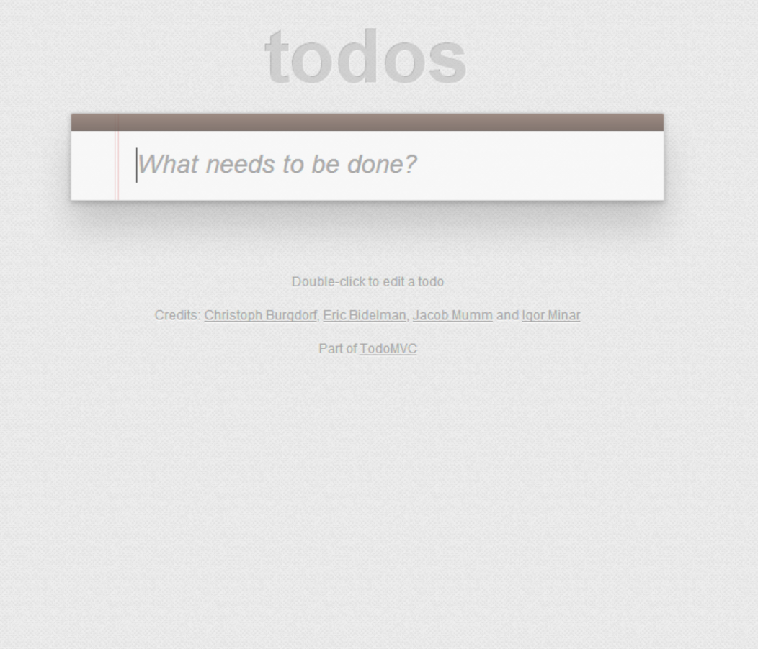
What are we going to integrate ?

Slide 8
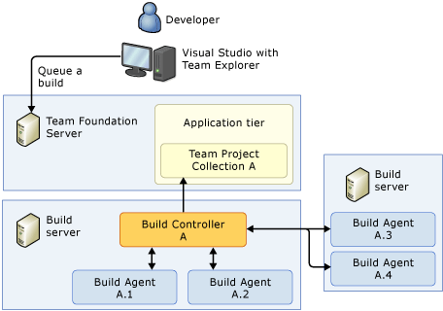
And how?

Slide 9
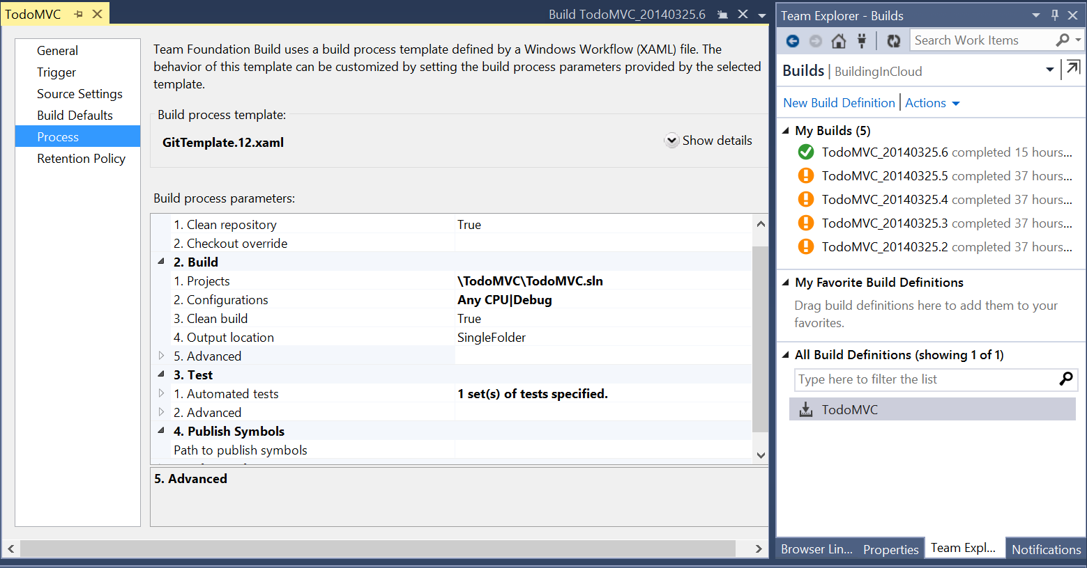
And how?

Slide 10



Running tests as a part of build process
MS Test

Slide 11


UI Testing frameworks
Coded UI Tests
WatiN

Slide 12
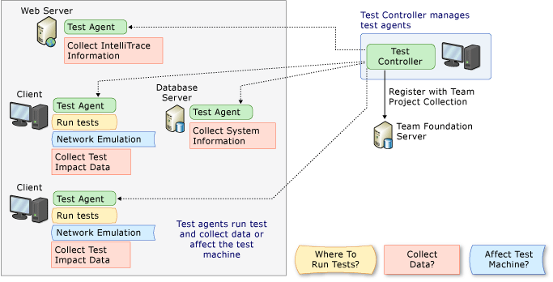
Available options for UI tests

Slide 13
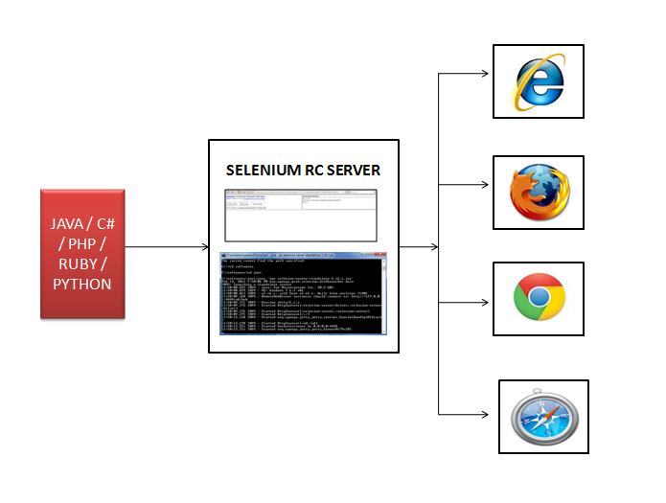
Available options for UI tests

Slide 14
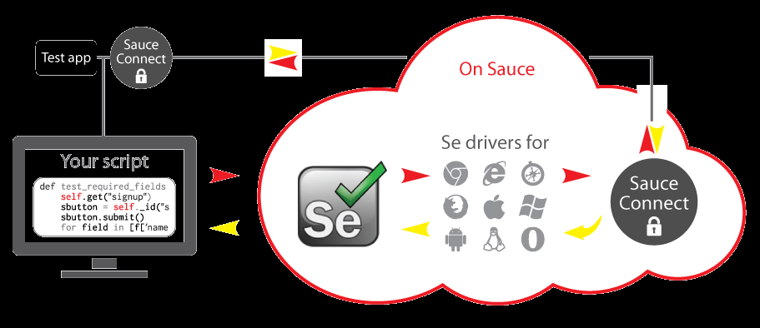
Available options for UI tests

