Slide 1
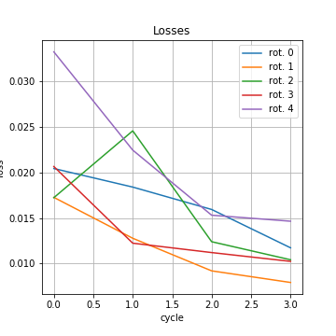
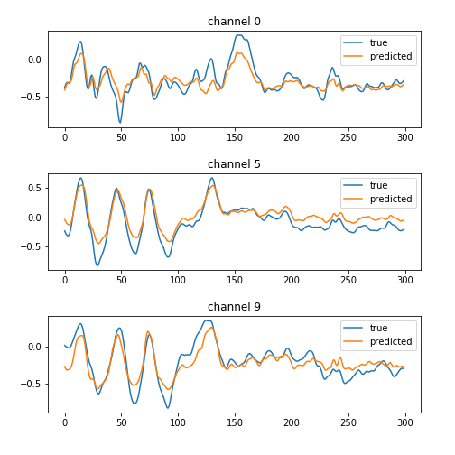
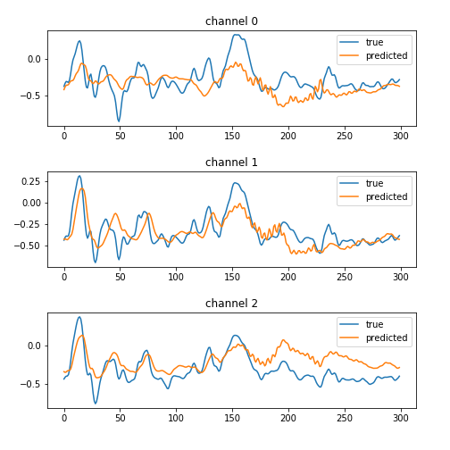
Training:
- 10 Channels
- 5 Output Rotations: [[0, 5], [1, 6], [2, 7], [3, 8], [4, 9]]
- 1 Epoch for each rotation
- 4 Rotation cycles
- Learning rate decay after 2nd rotation cycle

Slide 2
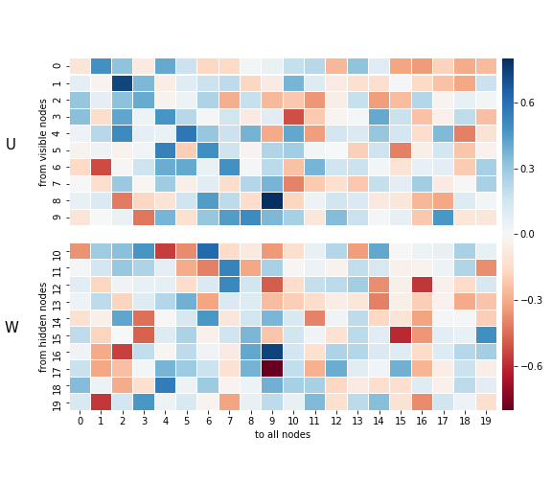
Weights: Attention(!): “from” and “to” is reversed

