Slide 2
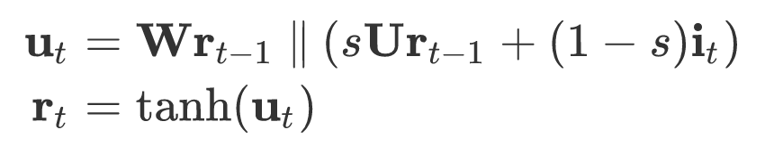
u(t-1)
r(t-1)
u(t)
r(t)
u(t+1)
r(t+1)
W, U
W, U
Hidden Units
tanh
tanh
tanh
Visible Units
i(t-1)
i(t)
i(t+1)
Input Units

Slide 3
u(t-1)
r(t-1)
u(t)
r(t)
u(t+1)
r(t+1)
W, U
W, U
Hidden Units
tanh
tanh
tanh
Visible Units
i(t-1)
i(t)
i(t+1)
Input Units

Slide 5
r(t)

