Slide 1
Q1 2026 数据报告
Growth Overview & Key Metrics
$1.2M
50,230
+23.5%
Total Revenue
Active Users
Growth Rate

Slide 2
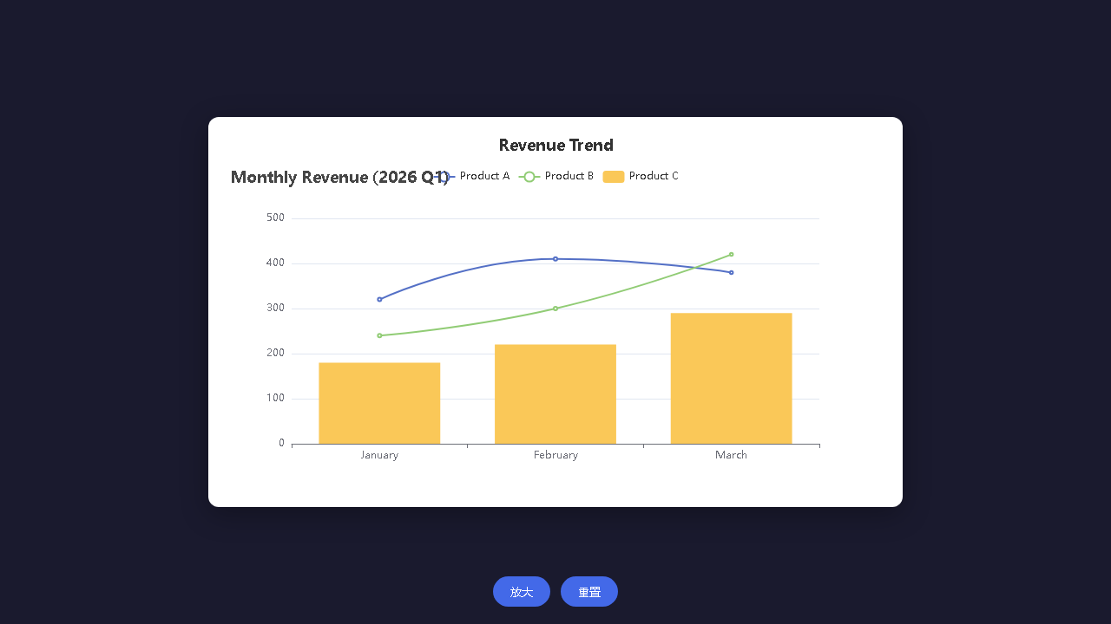
Monthly Revenue Trend
Q1 monthly revenue shows steady growth across all segments

Slide 3
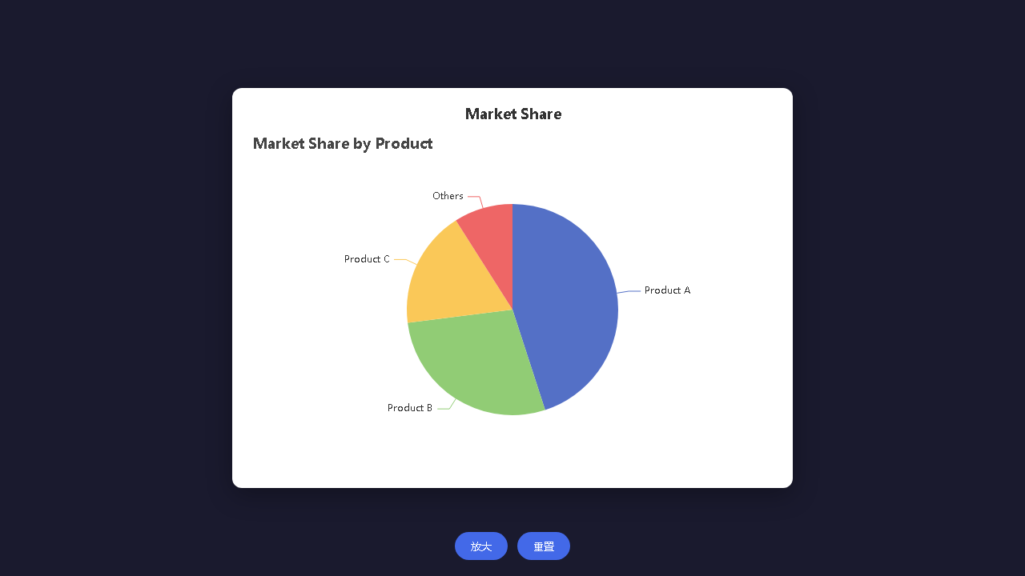
Market Share Distribution
Product A leads with 45% market share

Slide 4
Key Insights
Q1 shows 23.5% overall growth with Product B emerging as the fastest-growing segment
Product A
Revenue grew 18.75% QoQ
Market leader with 45% share
Customer retention rate: 92%
Product B
Highest growth at 75% QoQ
Market share increased from 22% to 28%
New feature adoption rate: 67%
Product C
Stable performance with 61% growth
Enterprise segment expanded 40%
Average deal size increased 15%

Slide 5
Thank You
Q1 2026 Full Report Available

