Slide 1


Improving datacenter traffic pattern using VM locality in service chain deployments
By: Benyamin Eslami
Advisor: Prof. Nasser Yazdani

Slide 2
Agenda
Network Service chaining in datacenter
Proposed mechanism
Simulation and Evaluation
Future works

Slide 3
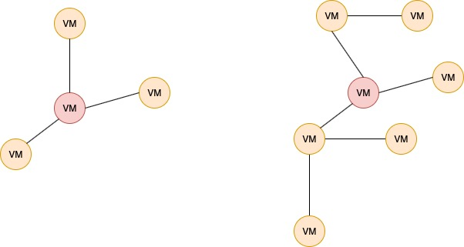
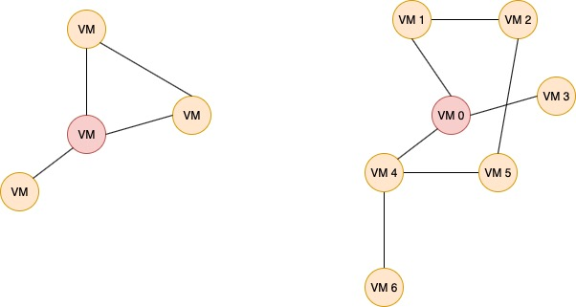
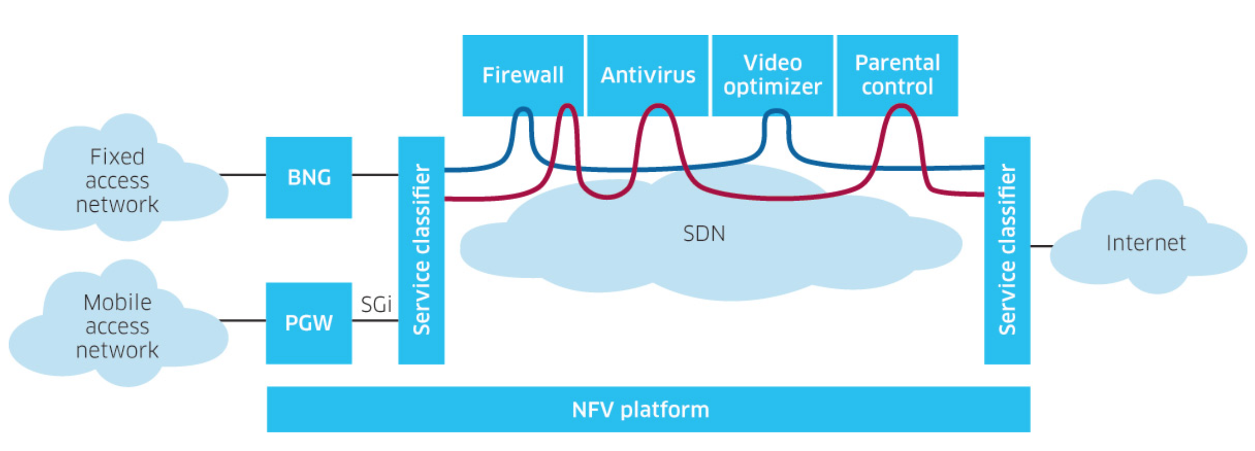
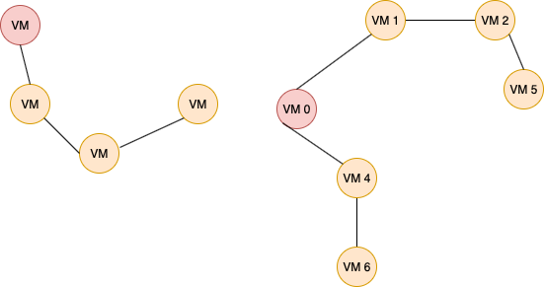
Network Service chaining in datacenter
Service Chaining or Service Function Chaining (SFC) is a capability which uses SDN capabilities to create a service chain of connected network services and connects them in a virtual chain.
Service Processing Function
Service Chain
Service Chaining
Service Path
Service Flow
Response Time
SLA violation ratio
Overall Energy consumption
Notes:
Service Processing Function:
a logical entity which can provide one or more service processing functions for packets/frames such as firewall, DPI (Deep Packet Inspection), LI (Lawful Intercept) and etc. Usually these processing functions are computation intensive.
Service Chain:
one or more service processing functions in a specific order which are chained to provide a composite service, and packets/frames from one or more service flow should follow
Service Chaining:
a mechanism of building service chains and forwarding packets/frames of service flows through them
Service Path:
a path that traffic flows are forwarded through in a service chain. There might be multiple paths in a service chain.
Service Flow:
packets/frames with specific service characteristics (e.g., packets matching a specific tuple of fields in Ethernet, IP, TCP, HTTP headers and etc.) or determined by some service policies (such as access port and etc.)
در multi tenant data center ها ، هر tenant یک درخواست سرویس به همراه یک SLA می دهد. این درخواست برای راه اندازی احتیاج به تعدادی ماشین دارد. تعیین مکان مناسب برای استفرار ماشین ها و میزان فاصله ماشین ها از یکدیگر، تعیین کننده پارامتر های اصلی قید شده در این پایان نامه است.
Service chaining tradeoffs:
1- increased stretch through the network -> more injected traffic into the data center network
2- additional latency and delay through the network -> increase response time
May cause SLA violations and increase in the amount of overall energy consumption
These VMs communicate with each other to execute distributed processing. The performance of such distributed processing depends on the amount of traffic communicated by the VMs because the increase in traffic volume causes network congestion, which leads to packet losses and high transmission delay.
we should consider the capacities of physical servers. VMs are assigned to and removed from physical servers according to resource requirements of tenants, which are stochastically generated with time and use the resources of the physical servers in a certain period of time. In such dynamic situations, it is often the case that VMs for other tenants already exist when new VMs for a tenant are assigned to physical servers. In this case, the residual capacities of physical servers, i.e., the numbers of VMs that can be assigned to the physical servers, are probably uneven.

Slide 4
Agenda
Network Service chaining in datacenter
Proposed mechanism
Simulation and Evaluation
Future works

Slide 5
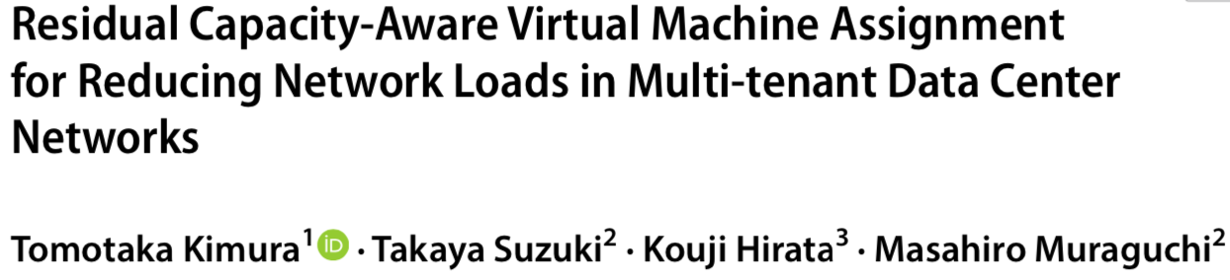
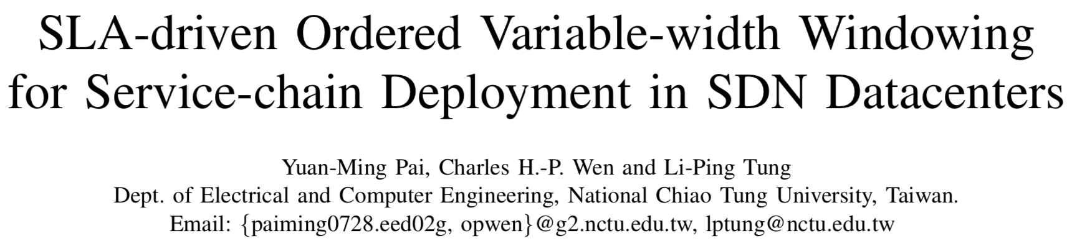
Proposed mechanism
Assigns a set of VMs based on the tenant’s request.
VM migration with the aim of reducing response time, reducing SLA violations and reducing overall energy consumption.
The process of Migration occurs based on the current condition of the DC ( Pre-defined threshold).
When the required capacity exceeds the available resources.

Slide 6
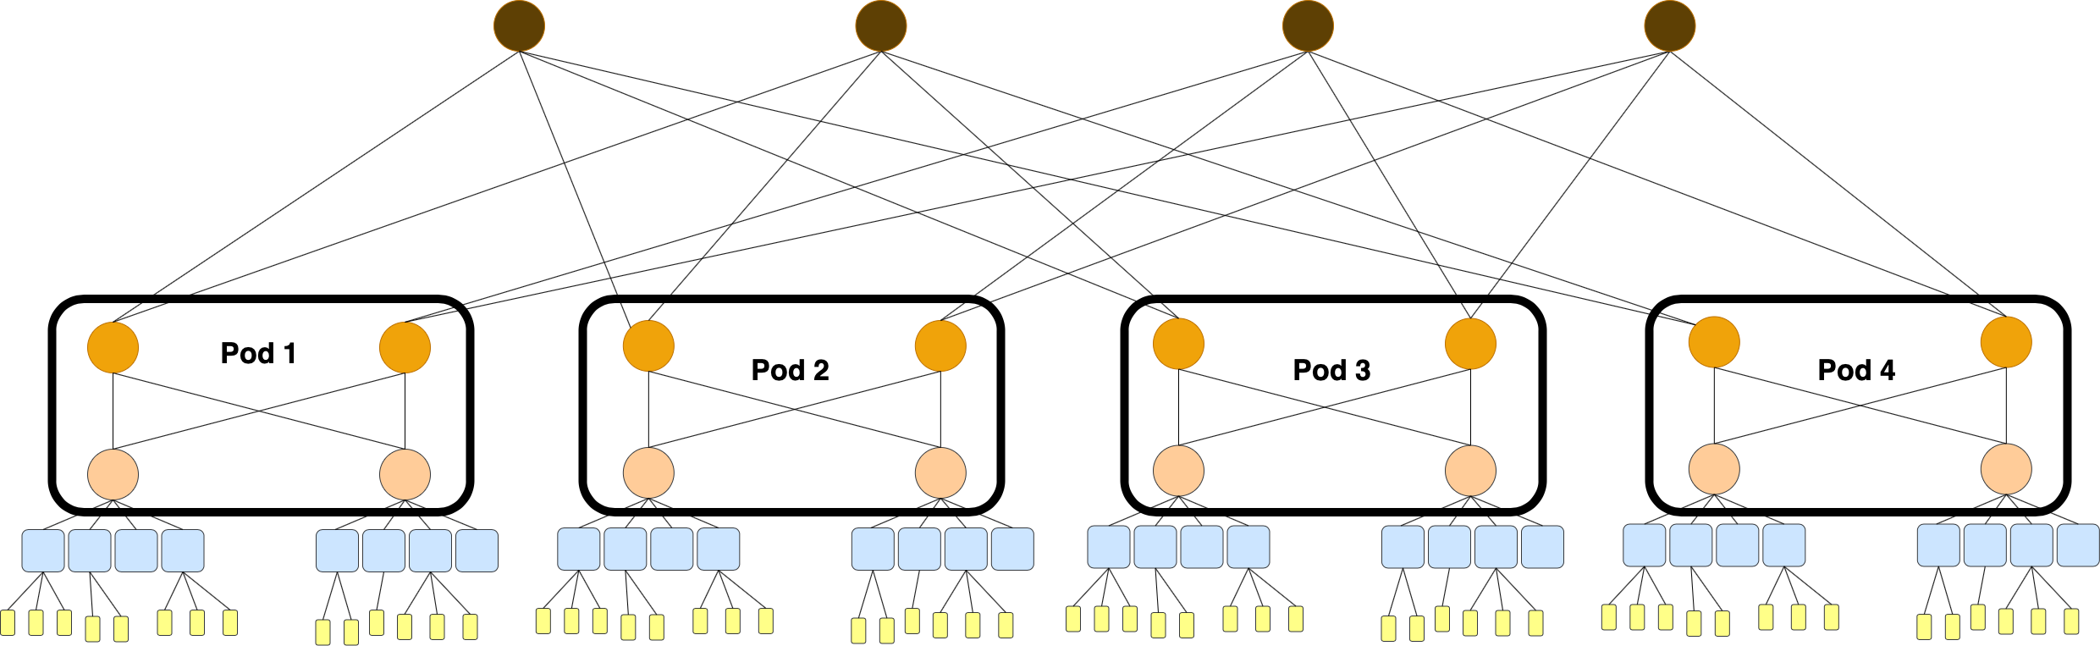
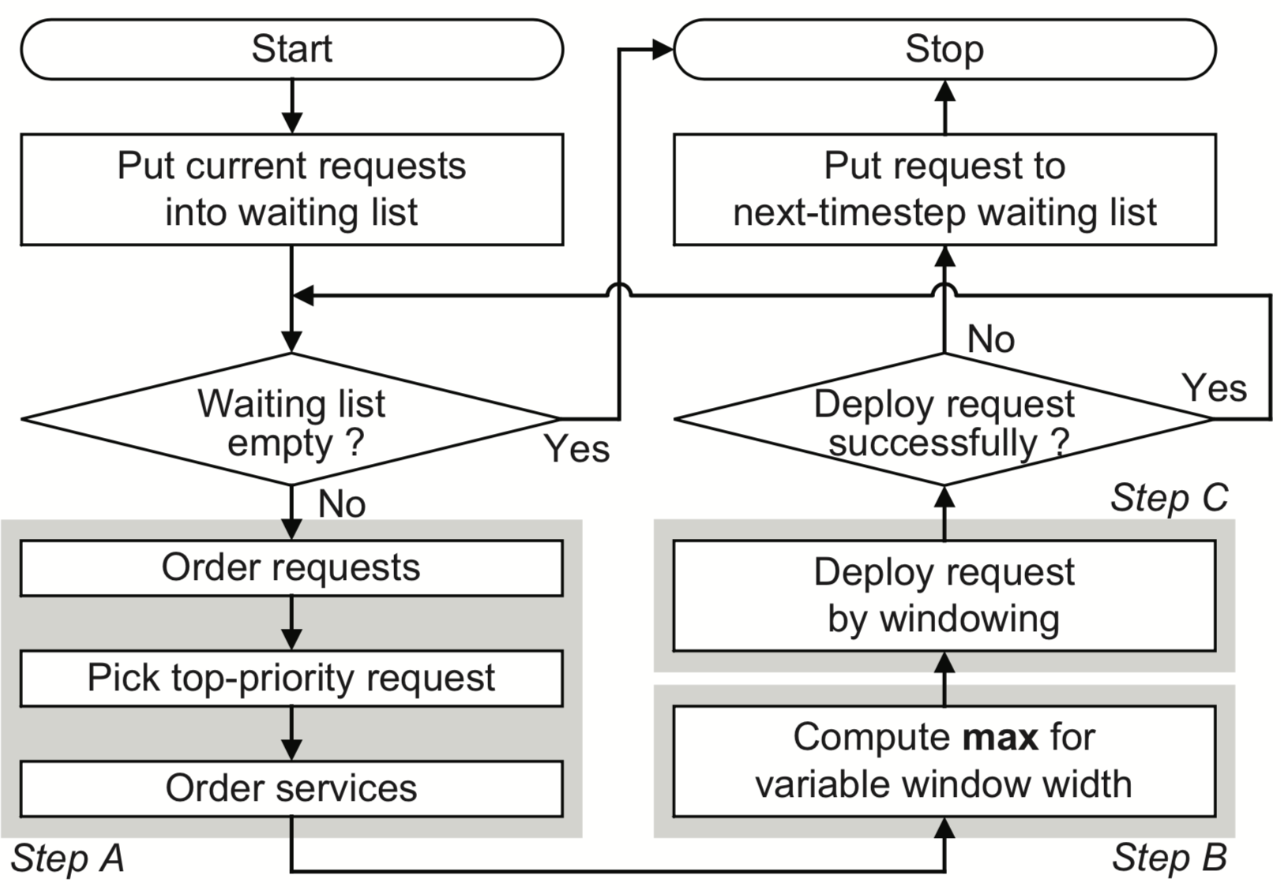
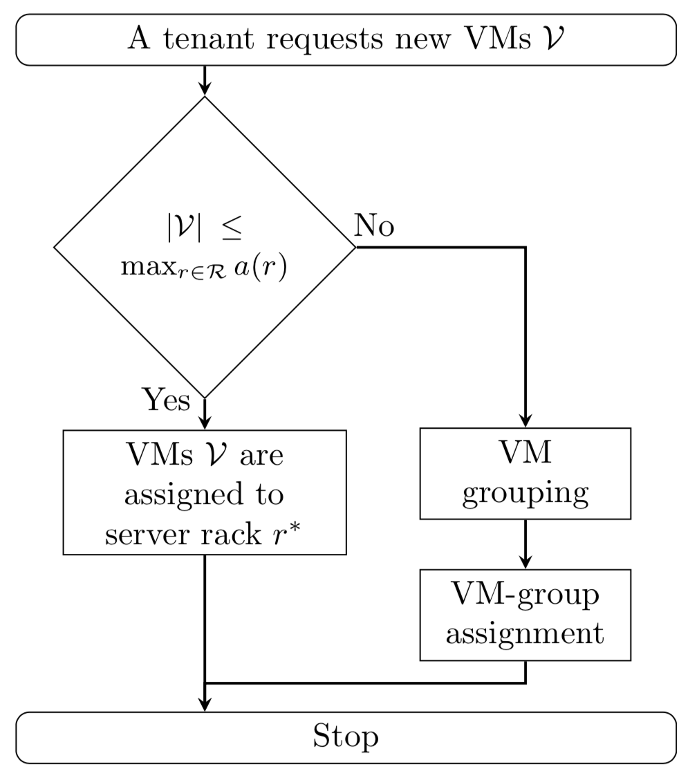
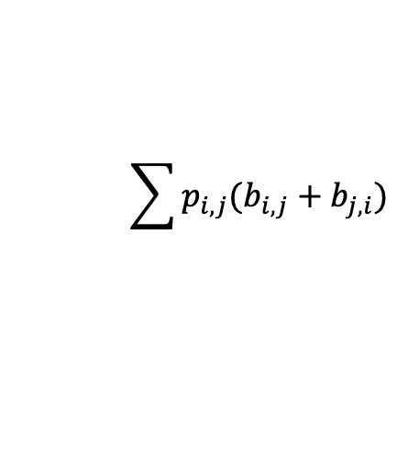
Proposed mechanism
$$\sum{p_{i,j}(b_{i,j}+b_{j,i})}$$
Notes:
1:
A) Since the time line is divided into T timesteps in the problem formulation. For each timestep, there are multiple arrival user requests. At the beginning, SOVWin puts all the requests of this timestep into a waiting list. Next, SOVWin sorts the requests in a decreasing order by their sum of required capacities and then picks the top-priority one.
B) The second key step of SOVWin is to compute the maximum value (max) for variable window-width for exploration. Before a legitimate service deployment can be derived in a window of a fixed width, its width needs to be known first.
C) After the maximum value (max) for variable window-width is computed for a request, SOVWin explores all legitimate deployments within a window. After all solutions are obtained, we calculate the number of latency hops for each solution, and select the minimum one to allocate correspond VMs onto HM(s) . If no solution can be found from the above windowing process, a request violation occurs.
Measured parameters: User Acceptance Rate (UAR) and SLA violation rate
------------------------------------------------------------------------------------------------------------------------------------------------------------------------------------------------------------
2:
Measured parameters:
Network load
A) RCA assigns the VM groups to server racks based on the network load. Note that RCA assigns not each VM to a physical server but each VM group to a server rack in order to reduce computational complexity. This procedure is done whenever a new resource requirement is submitted. We focus on assignment for new VMs and do not consider migration of VMs in this paper.

Slide 7
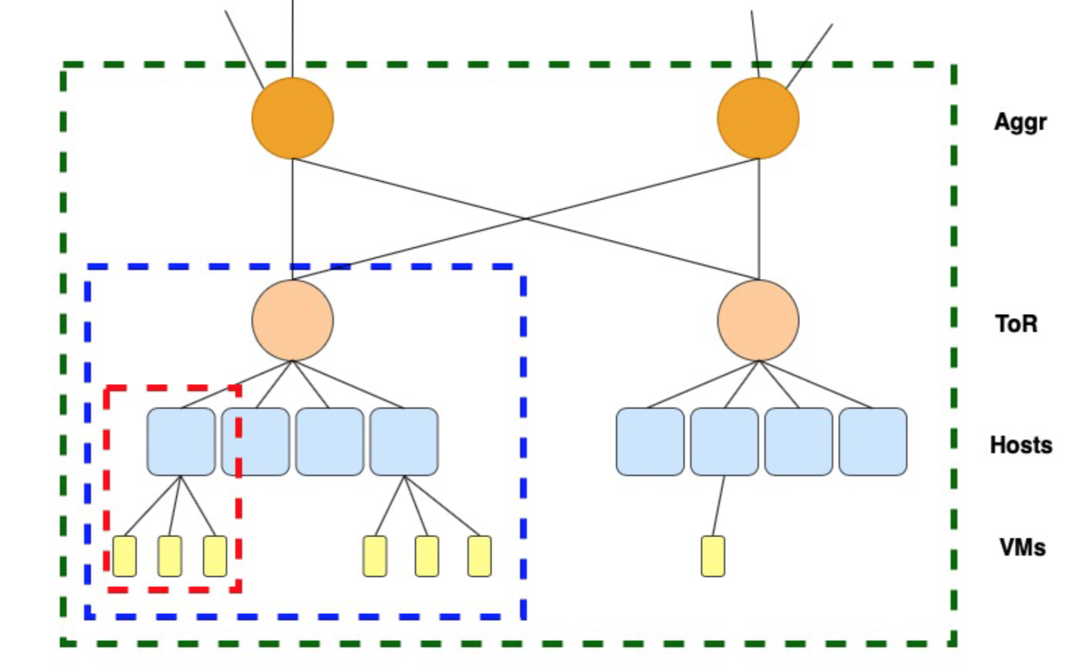
Proposed mechanism
Fat-Tree topology
Hierarchy:
Rack
Pod

Slide 8
Agenda
Network Service chaining in datacenter
Proposed mechanism
Simulation and Evaluation
Future works

Slide 9
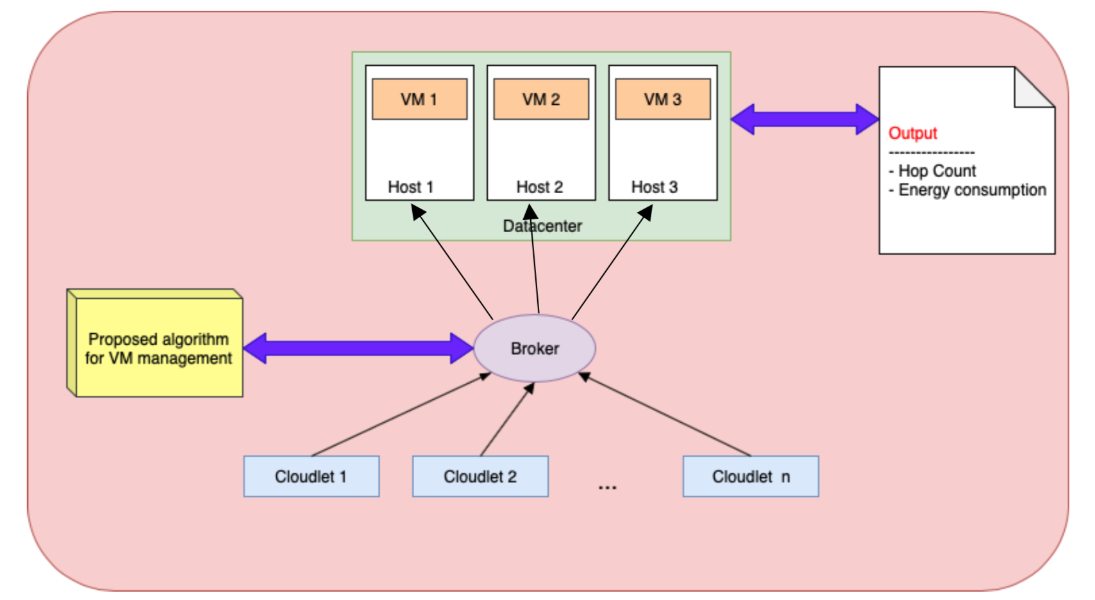
Simulation and Evaluation
CloudSim
Cloudlet
broker
Datacenter
Host
VM
Proposed algorithm
Correlation among:
Response time
SLA violation rate
Energy Consumption
Notes:
Cloudlet: این کلاس، کار مدل کردن انواع وظایف که وارد سیستم می­شود را انجام می­دهد. هر برنامه در شبیه ساز Cloudsim، توسط مشخصاتی از قبیل حجم انتقال داده، حجم پردازش و ... قبل از اجراء مشخص می­شود. در واقع تکه ابرها همان کارها یا وظایفی هستند که قرار است در محیط ابری انجام شوند.
1-length_task : تعداد محاسباتی که یک تکه ابر برای اجرا لازم دارد.
2-fileSize_task : سایز تکه ابر را مشخص می کند که همان داده ورودی ابر می باشد.
3-outputSize_task : سایز خروجی تکه ابر را مشخص می­کند که در واقع تکه ابر در این سایز خروجی می دهد.
تخصیص cloudelet ها به ماشین های مجازی از آیتم های مهمی می باشد که در مدیریت منابع از اهمیت برخوردار است. با توجه به خصوصیات متفاوتی که هر ابر و هر ماشین مجازی دارد باید بهترین ماشین برای هر ابر در نظر گرفته شود، که با این تخصیص درست می توان میزان مصرف انرژی و زمان پاسخ دهی را کاهش داد.
Broker: کارها (cloudlet) را برای اجرا به ماشین­های مجازی بدهد.
Datacenter: برای تعریف دستگاه­های فیزیکی که استفاده می شوند، به کار می­رود . در این بخش از مدل، مقدار حافظه و قدرت پردازش و تعداد CPU و... تعریف می­گردند. موجودیت Datacenter یک تعداد از موجودیت ­های میزبان را مدل می­کند.
Host: در این کلاس منابع فیزیکی را مدل می­کنیم، پارامترهایی مانند مقدار حافظه جانبی و حافظه دائمی و یک لیست از پردازنده­ها و تعداد هسته­های آن­ها

Slide 10
Agenda
Network Service chaining in datacenter
Proposed mechanism
Simulation and Evaluation
Future works

Slide 11
Future works
Data Center simulation in CloudSim.
Measuring and comparing Response Time, SLA violation Rate and Overall Energy Consumption.
Use Statistics to find out correlations among RT, SLA and OEC.
Issues:
Datasets
Evaluation method

