Slide 1
Weekly Report
Feb 12, 2021

Slide 2
Configuration
Chiplet 0
SM_ID = [0-31]
LLC_ID = [128-143]
port = 192
Chiplet 1
SM_ID = [32-63] LLC_ID = [144-159] port = 193
192
193
195
194
Chiplet 3
SM_ID = [96-127]
LLC_ID = [176-191] Port = 195
Chiplet 2
SM_ID = [64-95] LLC_ID = [160-175] port = 194

Slide 3
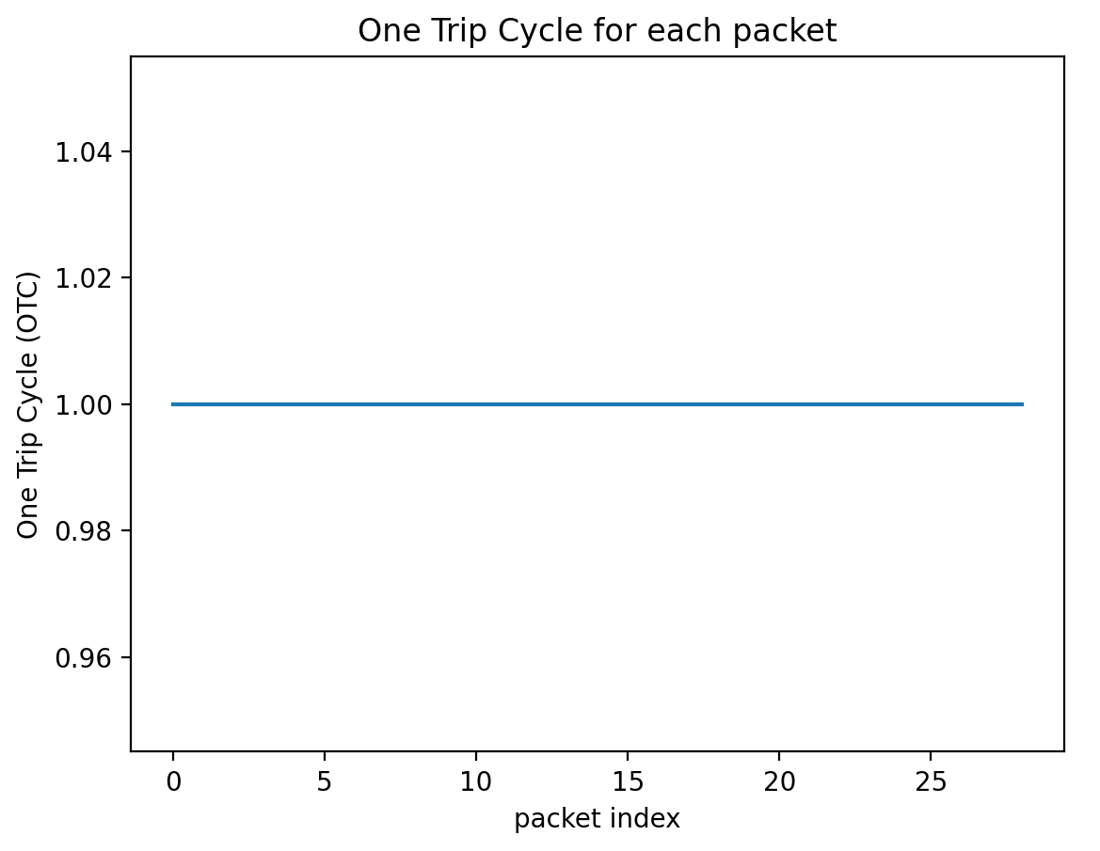
Some packets are one way and one hop
['push', '1261320', '193', '192', '192', 'READ_REQUEST', '136', '9998']
['pop', '1261320', '193', '192', 'READ_REQUEST', '136', '9999’]
192
193
195
194

Slide 4
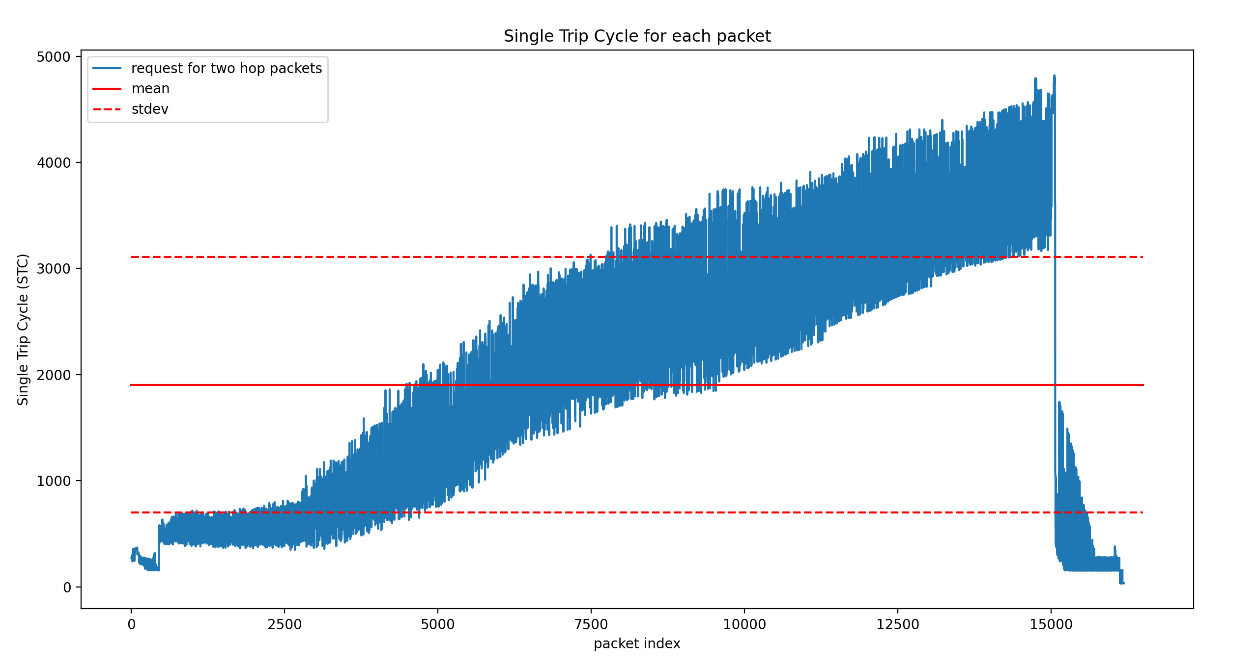
Some packets are one way and two hops
['push', '1252693', '194', '192', '193', 'READ_REQUEST', '136', '9961’] 9995 – 9961 = 34
['pop', '1252693', '194', '192', 'READ_REQUEST', '136', '0', '9962']
['push', '1252693', '193', '192', '192', 'READ_REQUEST', '136', '9994']
['pop', '1252693', '193', '192', 'READ_REQUEST', '136', '0', '9995']
192
193
195
194

Slide 5
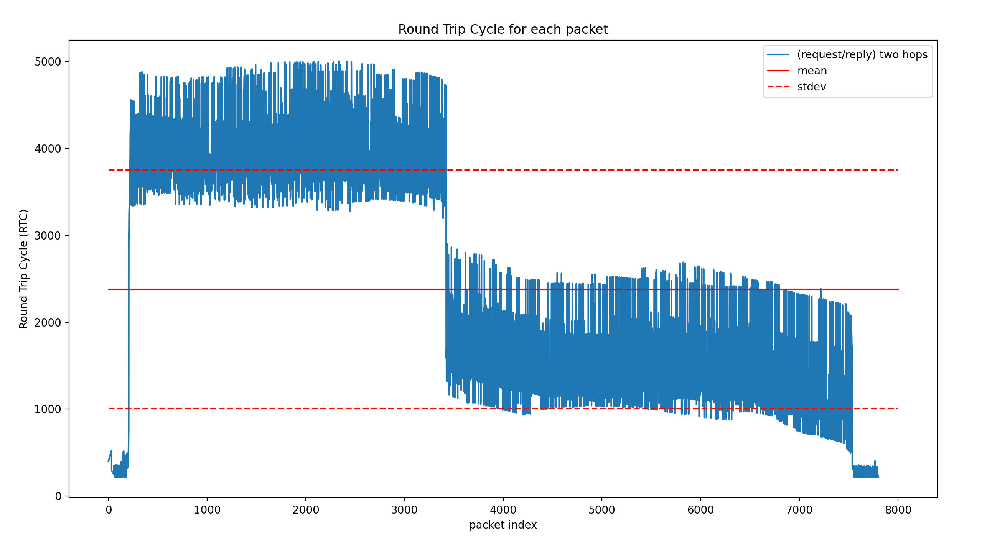
Some packets are two way and two hops
['push', '1208921', '194', '192', '193', 'READ_REQUEST', '136', '9775']
['pop', '1208921', '194', '192', 'READ_REQUEST', '136', '9776']
['push', '1208921', '193', '192', '192', 'READ_REQUEST', '136’, '9775’]
['pop', '1208921', '193', '192', 'READ_REQUEST', '136’, '9809']
['push', '1208921', '192', '194', '195', 'READ_REPLY', '136', '9963']
['pop', '1208921', '192', '194', 'READ_REPLY', '136', '9963']
['push', '1208921', '195', '194', '194', 'READ_REPLY', '136', '9995']
['pop', '1208921', '195', '194', 'READ_REPLY', '136', '9996']
192
193
195
194

Slide 6
One hop and two hops traffic proportions:
one hop traffics: 0.0012074277625114497
two hops traffics: 0.9987925722374885

Slide 7
Weekly Report
Feb 22, 2021

Slide 8
Configuration
Chiplet 0
SM_ID = [0-31]
LLC_ID = [128-143]
DRAM_ID = [0-7]
port = 192
Chiplet 1
SM_ID = [32-63] LLC_ID = [144-159] DRAM_ID = [8-15] port = 193
192
193
195
194
Chiplet 3
SM_ID = [96-127]
LLC_ID = [176-191] DRAM_ID =[24-31]
Port = 195
Chiplet 2
SM_ID = [64-95] LLC_ID = [160-175] DRAM_ID = [16-23] port = 194

Slide 9
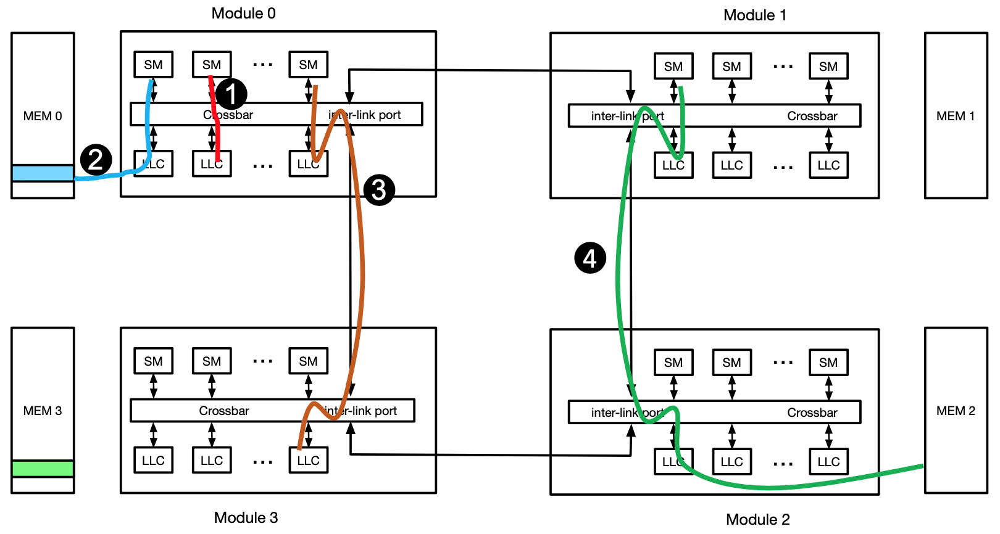
Configuration
Notes:
3 – local L1 miss ????
4-

Slide 10
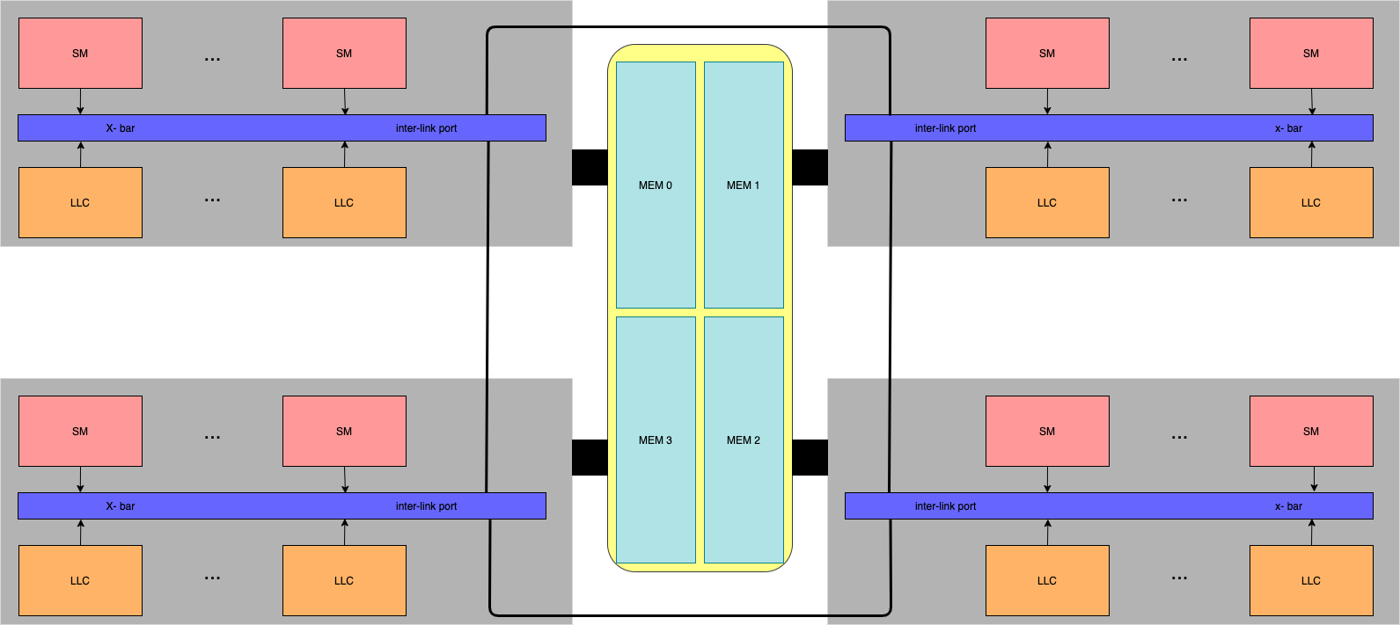
Configuration

Slide 11
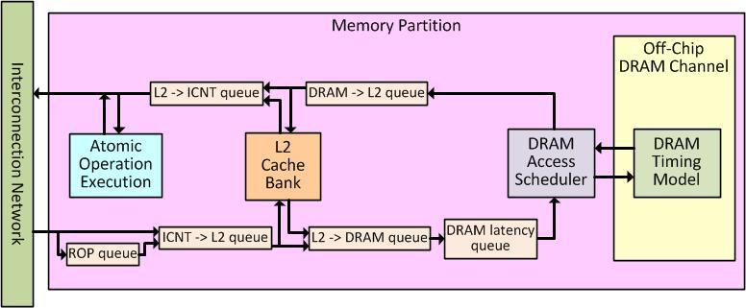
Configuration
Notes:
How many bytes are accessed locally/remotely
Fraction of the access are local/remote
Which factor is dominant in the path

Slide 12
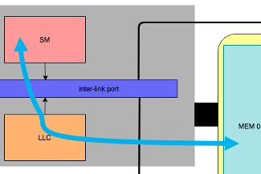
Configuration
Cache miss packet_num: 1 chiplet: 0 cycle: 1
L2(mem2device) packet_type: 0 src: 0 dst: 128 packet_num: 1 chiplet: 0 cycle: 2
push packet_type: 0 src: 0 dst: 128 packet_num: 1 move request from incoming queue to ROP queue in chiplet 0 cycle: 2
DRAM 3: packet type: 0 src: 0 dst: 128 packet_num: 1 transfer packet from DRAM latency queue to DRAM, cycle: 225
DRAM 1 : packet type: 2 src: 0 dst: 128 packet_num: 1 dest_spid: 0 the packet is pushed from DRAM to LLC input queue, cycle: 240
push packet_type: 2 src: 0 dst: 128 packet_num: 1 L2 local cache MISS write back in chiplet: 0 cycle: 240
push packet_type: 2 src: 0 dst: 128 packet_num: 1 packet is pushed to L2-2-ICNT outgoing queue in chiplet 0 cycle: 241
core packet_num: 1 is popped from cluster 0 queue in chiplet 0 and is about to be processed cycle: 242

Slide 13
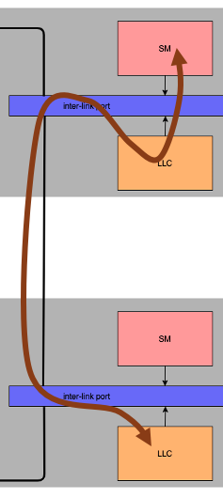
Configuration
Cache miss packet_num: 117 chiplet: 0 cycle: 1
request arrive packet_type: 0 src: 195 dst: 192 packet_num: 117 packet is pushed to incoming queue in chiplet: 0 cycle: 3
push packet_type: 0 src: 195 dst: 192 packet_num: 117 move request from incoming queue to ROP queue in chiplet 0 cycle: 75
pop packet_type: 0 src: 195 dst: 192 packet_num: 117 popped from ROP queue and pushed to ICNT-2-L2 queue in chiplet: 0 cycle: 244
pop packet_type: 0 src: 195 dst: 192 packet_num: 117 packet is popped in the destination chiplet :0 from incoming queue. It's cache hit or miss! cycle: 273
pop packet_type: 0 src: 195 dst: 192 packet_num: 117 packet is popped in the destination from incoming queue. It's cache hit or miss! cycle: 274
pop packet_type: 0 src: 195 dst: 192 packet_num: 117 packet is popped in the destination from incoming queue. It's cache hit or miss! cycle: 275
push packet_type: 2 src: 195 dst: 192 packet_num: 117 cache HIT. move from cache bank to L2-2-ICNT queue cycle: 276
reply arrive packet_type: 2 src: 192 dst: 195 packet_num: 117 reply is pushed to processing queue cycle: 277

Slide 14
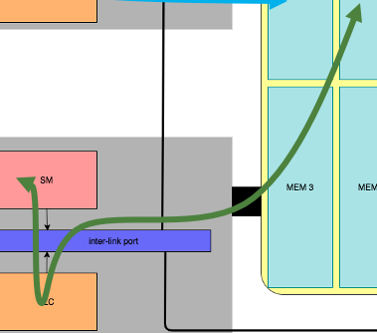
Configuration
Cache miss: packet_num: 87 src: 0 address: 4026531840
ICNT2 (request forward) : packet type: 0 src: 194 dst: 192 packet_num : 87 sid : 86 chiplet: 1 the packet is pushed to the forwarding queue, cycle: 3
CORE(forward_waiting_pop): packet type: 0 src: 194 dst: 192 packet_num: 87 sid: 86 chiplet: 1 packet is popped from outgoing queue and is about to be sent, cycle: 35
ICNT2 (request arrive): packet type: 0 src: 193 dst: 192 packet_num: 87 sid: 86 chiplet: 0 packet is pushed to incoming queue, cycle: 36
1- L2 (push) : packet type: 0 src: 193 dst: 192 packet_num: 87 move mem request from icnt to ROP queue, cycle: 120
1- L2 (pop) : packet type: 0 src: 193 dst: 192 packet_num: 87 popped from ROP queue and pushed to ICNT-2-L2 queue, cycle: 424
1- L2 (pop) : packet type: 0 src: 193 dst: 192 packet_num: 87 packet is popped in the destination from incoming queue. It's cache hit or miss!, cycle: 453
1- L2 (pop) : packet type: 0 src: 193 dst: 192 packet_num: 87 packet is popped in the destination from incoming queue. It's cache hit or miss!, cycle: 454
1- L2 (pop) : packet type: 0 src: 193 dst: 192 packet_num: 87 packet is popped in the destination from incoming queue. It's cache hit or miss!, cycle: 455
1- L2 (pop) : packet type: 0 src: 193 dst: 192 packet_num: 87 packet is popped in the destination from incoming queue. It's cache hit or miss!, cycle: 456
1- L2 (push) : packet type: 2 src: 193 dst: 192 packet_num: 87 cache HIT. move from cache bank to L2-2-ICNT queue, cycle: 456
ICNT(1)(remote): packet type: 2 src: 192 dst: 194 packet_num: 87, packet is about to be sent, cycle: 457
ICNT2 (reply forward) : packet type: 2 src: 192 dst: 194 packet_num: 87 sid: 86 chiplet: 3 the packet is pushed to the forwarding queue, cycle: 457
CORE(forward_waiting_pop): packet type: 2 src: 192 dst: 194 packet_num: 87 sid: 86 chiplet: 3 packet is popped from outgoing queue and is about to be sent, cycle: 489
ICNT2 (reply arrive): packet type: 2 src: 195 dst: 194 packet_num: 87 sid: 86 chiplet: 2 reply is pushed to processing queue, cycle: 490
packet num: 87 is popped from cluster 86 queue and is about to be processed in core, cycle: 522

