Slide 1
Traffic Characterization

Slide 2
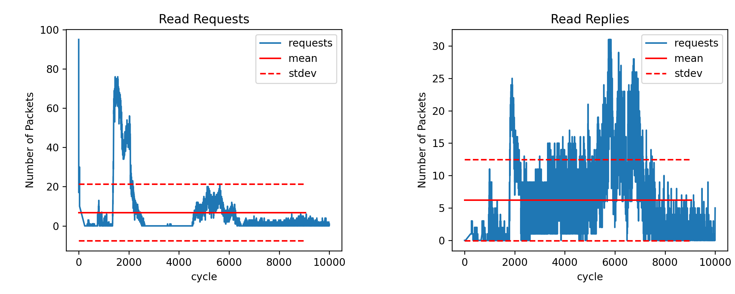
Launchar.config_NN-ispass

Slide 3
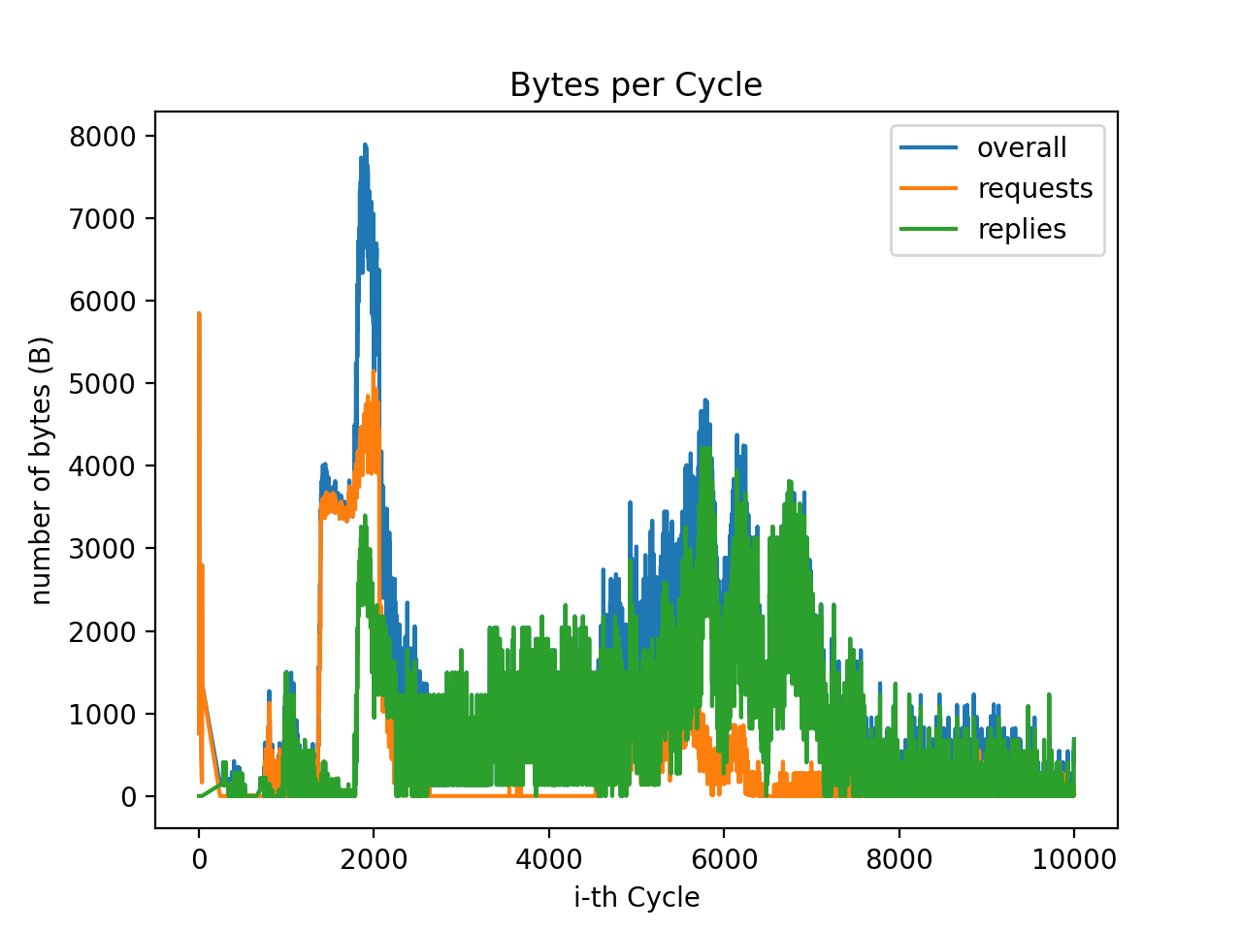
Launchar.config_NN-ispass

Slide 4
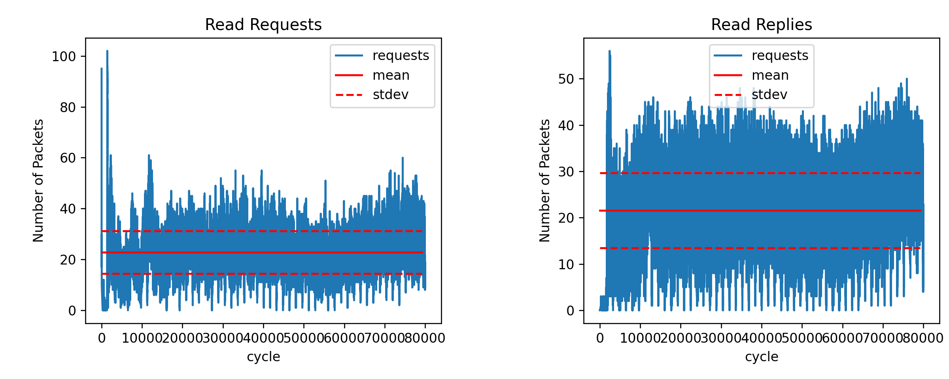
Launcher.config_random

Slide 5
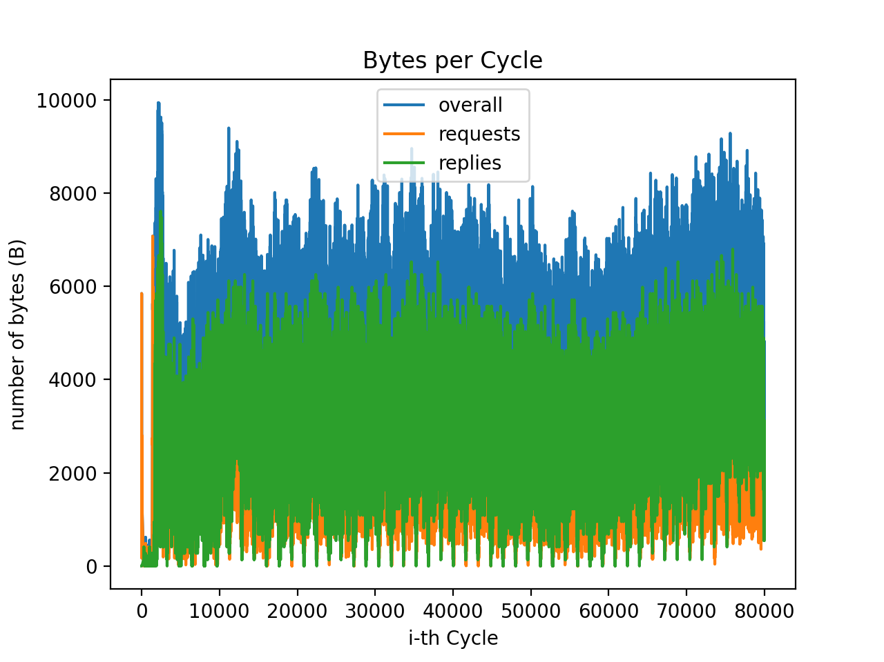
Launcher.config_random

Slide 6
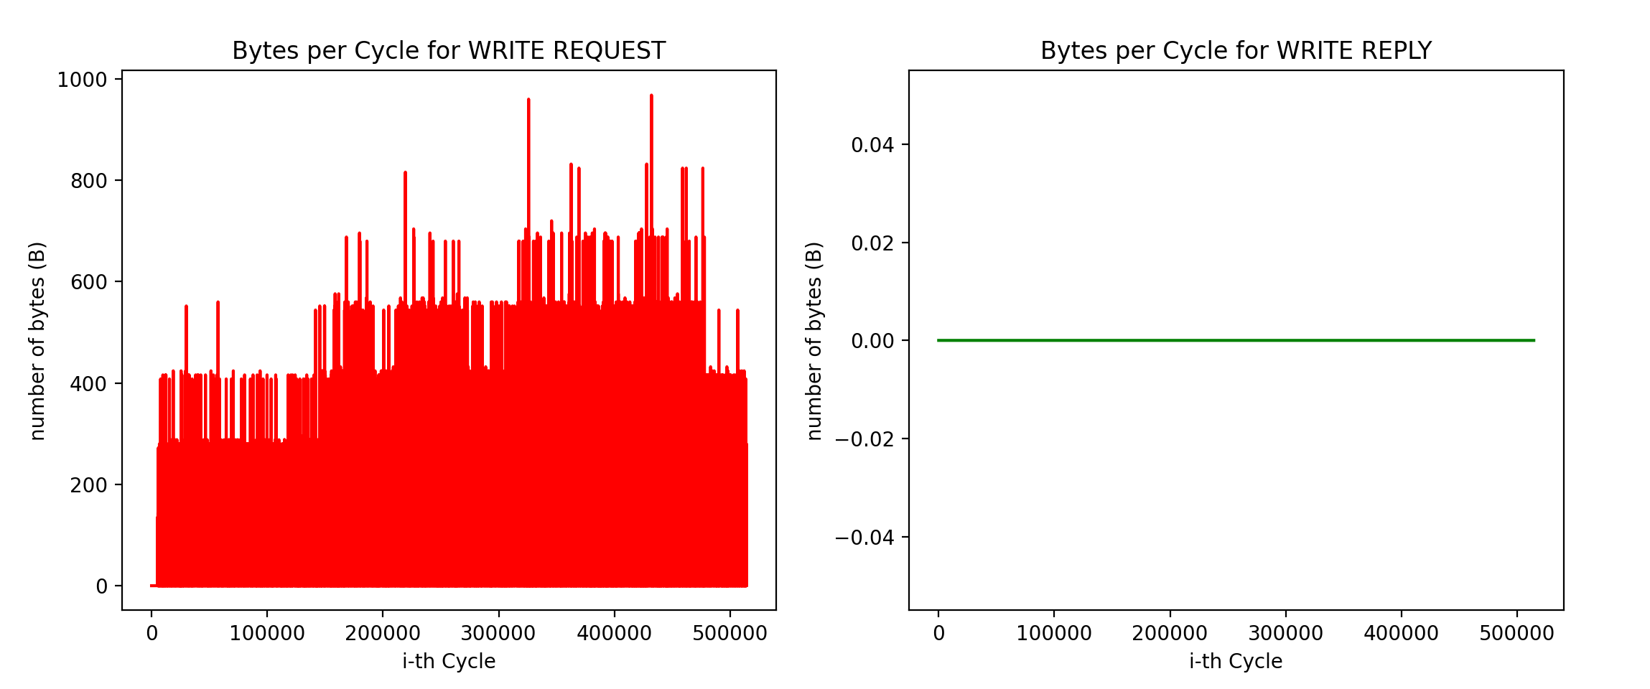
launcher.config_atax.exe

Slide 7
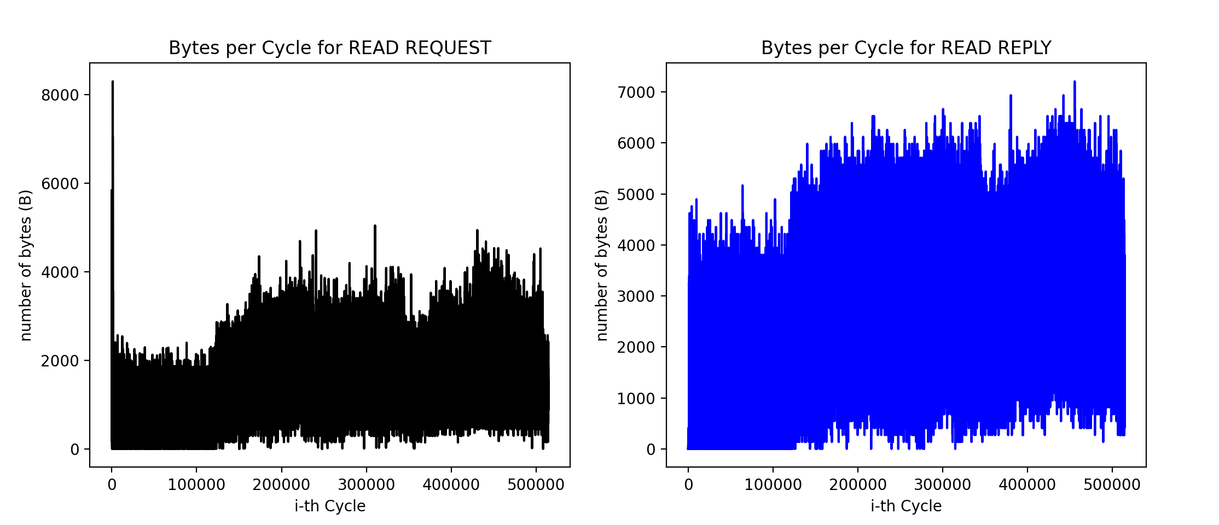
launcher.config_atax.exe

Slide 8
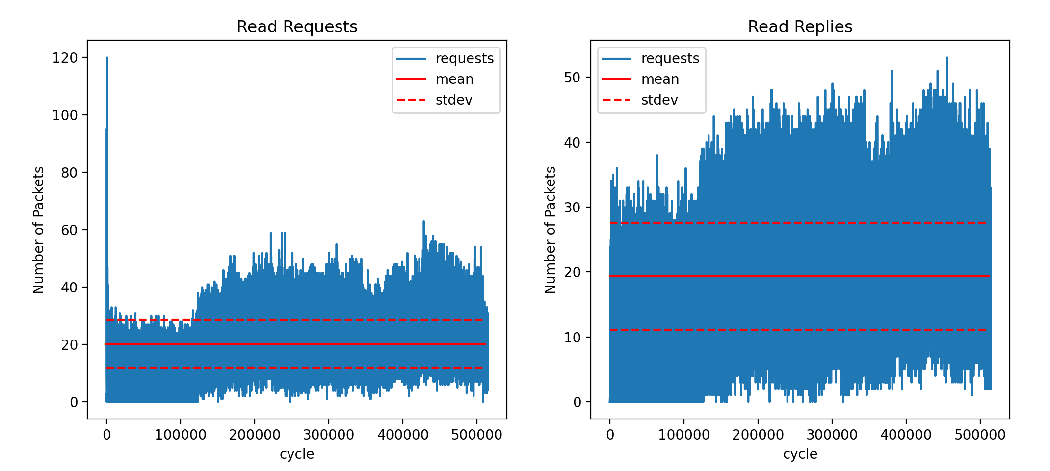
launcher.config_atax.exe

Slide 9
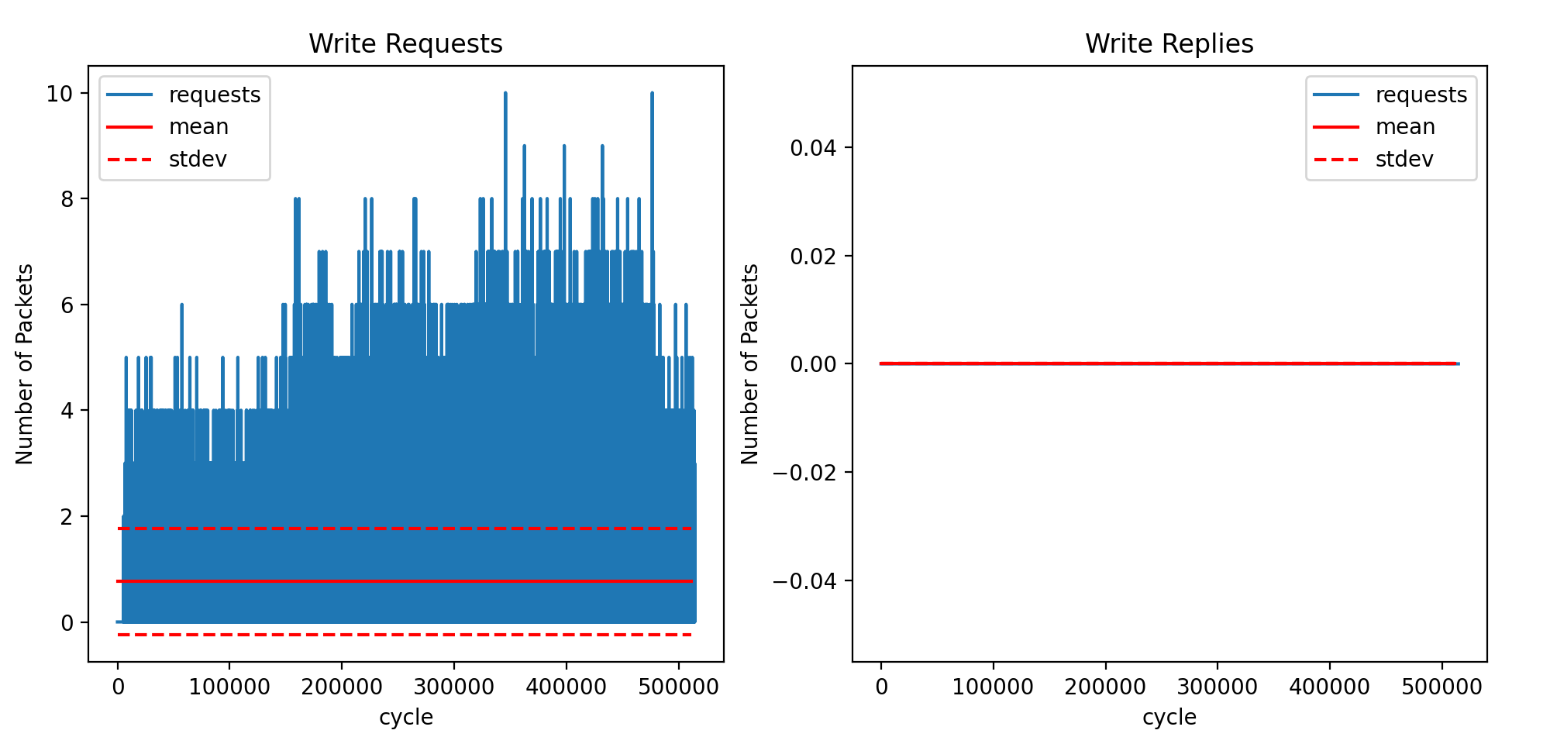
launcher.config_atax.exe

