Slide 1
DECENTRALIZED FUNDING PLATFORM BASED ON BLOCKCHAIN TECHNOLOGY
TEAM MEMBERS: [A10 BATCH]
1. Beneta Getzie M
2. Harini B
3. Deepika T
GUIDE: Mrs.V.Anitha Moses

Slide 2
INTRODUCTION
Crowdfunding is a method of raising funds from a large number of funders to start a new business or for charitable purposes using the internet. Crowdfunding enables us to easily access a vast network of people through crowdfunding website that brings funder and fundraiser together. In this if the funder wishes to donate for any cause he can donate the money. In present day crowdfunding platform, the money donated by the funder is temporarily stored in fundraising platform so the funder will have no control over the money that they have donated. The third-party involvement incurs additional cost. To overcome this issue many decentralized application have been created for peer-to-peer communication between the funder and fundraiser. The advantages of blockchain have created a way to make peer to peer communication more secure, cost efficient and transparent. Hence by using blockchain in crowdfunding we can change the traditional way of crowdfunding.

Slide 3
LITERATURE SURVEY
S.NO | TITLE | YEAR | AUTHOR | INFERENCE | DRAWBACK
1 | Venturing Crowdfunding using Smart Contracts in Blockchain | Third International Conference on Smart Systems and Inventive Technology (ICSSIT 2020)). IEEE Xplore Part Number: CFP20P17-ART; ISBN: 978-1-7281-5821-1, November 2020. | Nikhil Yadav and Sarasvathi V | As there are a lot of transactions involved in crowdfunding the actions should be documented legally. A smart contract which is a transaction protocol is used to automatically control, execute and document the actions automatically according to the agreement created by the project developer. This paper includes two contracts. One contract is used to store the transactions and another contract is used to handle the transactions. There are 3 stages in crowdfunding platform 1. Project creation 2. Sending request 3. Voting system | It can be only used for funding projects. It is based on voting system maximum votes is needed for a project to be approved.

Slide 4
S.NO | TITLE | YEAR | AUTHOR | INFERENCE | DRAWBACK
2 | Smart Contract and Blockchain for Crowdfunding Platform | International Journal of Advanced Trends in Computer Science and Engineering. 9.3036-3041.10.30534/ijatcse/ 2020/83932020, June 2020. | Firmansyah Ashari, Tetuko Catonsukmoro, Wilyu Mahendra Bad, Sfenranto, Gunawan Wang | The dominant schemes in the crowdfunding platform are all or nothing – if the goal is not reached, the funds will be returned to the funders. Keep-it-all – Same as all or nothing but the funds are returned based on the policies of fundraising. Stretched goal scheme – The fundraising goal is expanding and are bound by a statement that can add more values to services and products. | It follows all or nothing scheme so the project is funded only when the goal is reached.
3 | Crowdfunding using Blockchain. | Global Research and Development Journal for Engineering. Volume 4, Issue 4, ISSN: 2455-5703, March 2019. | Ms. S. Benila, V. Ajay, K. Hrishikesh, R. Karthick. | The smart contract is written in solitary language. The campaign factory is used to create new campaigns. A gas fees is specified when a campaign is deployed. The campaign created contains the idea, minimum contribution and detailed description of project. The modules of the project are campaign creation, create request model, request approval model and finalize modules. | During campaign creation minimum fees is specified. The request form must be approved.

Slide 5
S.NO | TITLE | YEAR | AUTHOR | INFERENCE | DRAWBACK
4 | Blockchain-Based Crowdfunding: A ‘Pay-it-Forward’ Model of WHIRL | International Journal of Recent Technology and Engineering (IJRTE) ISSN: 2277-3878, Volume-8 Issue-3, September 2019. | Hasnan Baber | Whirl is a crowdfunding platform developed on pay it forward theory. The owner starts the campaign. The backers is used to back the project by providing cryptocurrencies and in turn they receive karma points. The karma points is used to start their own campaign. | Whirl-app want you to first provide help to others in the community, then the Whirl community will help you in turn.
5 | BitFund : A Blockchain-based Crowd Funding Platform for Future Smart and Connected Nation | Sustainable Cities and Society ·60. 102145. 10.1016/j.scs.2020.102145, May 2020. | Vikas Hassija, Vinay Chamola, and Sherali Zeadally- | A smart contract is established between the investors and the developer. Investors add new project on the decentralized network. A new block contains the timestamp, expected cost, project details, time and developer reputation. The block is delivered to all the nodes in the developer's network, and they start bidding their values for time, cost, support period and votes to win the project. The auctioning algorithm is deployed by the smart contract and it searches for the best developer for the project. | The developer need votes to win the project.

Slide 6
S.NO | TITLE | YEAR | AUTHOR | INFERENCE | DRAWBACK
6 | Crowdsourcing and Crowdfunding Platform using Blockchain and Collective Intelligence. | International Journal of Computer Sciences and Engineering. Vol.7, Issue.2, pp.668-673, February 2019. | Er.Waheeda Dhokley , Saurabh Gupta , Ganesh Pawar , Abrar Shaikh. | Users can create a project or back up an project. It follows all or nothing. The creator posts the project and the funder donates. The creator will post tasks. Workers are selected on the basis of reputation points. The workers should submit their solutions for the project within the specified time and the workers will receive reward points in return. | In crowdfunding it follows all or nothing scheme. In crowdsourcing the workers will earn reputation points only when he submits a solution.
7 | Unchaining Social Businesses – Blockchain as the Basic Technology of a Crowdlending Platform | Proceedings of the 38th International Conference on Information Systems (ICIS), Seoul, South Korea, December 2017. | André Schweizer, Vincent Schlatt, Nils Urbach, Gilbert Fridgen | Crowdfunding allows investors to fund various projects and is usually based on the Internet. In crowdlending, The investors provide loans to the seekers for their projects instead of providing donation or equity. These describes the current funding status and the funding amount. If the payback sum is paid then no more actions is taken by the smart contract and the status of the smart contract is set as closed. The smart contract contains the history and related transactions. | The investors can reclaim their amounts if the minimum funding is not reached within the specified time. The students can withdraw amount only if the fundraising is successful.

Slide 7
S.NO | TITLE | YEAR | AUTHOR | INFERENCE | DRAWBACK
8 | Analysis and outlook of applications of blockchain technology to equity crowdfunding in China | Financial Innovation, Springer, Heidelberg. ISSN 2199-4730, Springer, Heidelberg, Vol. 2, Iss. 29, pp. 1-11, 2016. | Zhu, Huasheng; Zhou, Zach Zhizhong | Equity crowdfunding is a type of crowdfunding in which the fundraiser launches a project with shares of the business as reward. Funders invest in the project in return for equity. This paper examines the problems of equity crowdfunding in china and how to overcome it using blockchain technology. | The problems are underdeveloped credit rating system and lack of qualification management of the investor.
9 | The Applications of Blockchain Technology in Crowdfunding Contract | Article in SSRN Electronic Journal ·10.2139/ssrn.3133176, January 2018. | Zhao Hongjiang, Cephas P.K Coffie | This paper discusses about how the blockchain technology handle the relationship between the fundraiser and the funder. The blockchain helps the platform to record the description of the details provided by the fundraiser and it is visible to the funder. The investors can donate in the platform. Reward based and voting based systems can also be used. Blockchain based crowdfunding is used when there are issues related to security, trust, payment, voting, fund management and communication. | First we have to provide help in turn the community will help us. While using voting system we need to obtain maximum votes then only our project will be approved.

Slide 8
S.NO | TITLE | YEAR | AUTHOR | INFERENCE | DRAWBACK
10 | A Blockchain-Based Approach Towards Overcoming Financial Fraud in Public Sector Services | Business and Information systems Engineering, November 2017. Bus Inf Syst Eng 59, 441–456, 2017. | Hissu Hyvarinen, Marten Risius, Gustav Friis | This paper focuses on overcoming the taxation issues faced by the government related to double spending. When one person applies for the same tax refund without being deducted or if the digital currency is spend twice then it is known as double spending problem. The main reason for double spending is that the activities are not monitored. Blockchain traces the payment activities and prevents double spending problem. | It depends on the trust of the company that offers the tokens and depends on the policies of the bank.
11 | DON’T SLIP ON THE ICO – A TAXONOMY FOR A BLOCKCHAIN-ENABLED FORM OF CROWDFUNDING | Proceedings at AIS Electronic Library (AISeL), 11-28-2018. Research Papers. 83, November 2018. | Fridgen, Gilbert; Regner, Ferdinand; Schweizer, André; and Urbach, Nils | ICO (Initial Coin Offering) is equivalent to IPO (Initial Public Offering). A new business model in which the funders can participate in funding process by using tokens. The project developers first posts a whitepaper which contains the project description. A presale is conducted with limited number of investors. A date is announced in which the public can purchase tokens to participate in project donation or can buy shares of the project. | It depends on the trust of the company that offers the tokens

Slide 9
S.NO | TITLE | YEAR | AUTHOR | INFERENCE | DRAWBACK
12 | ANALYSIS OF FUNDING ALTERNATIVES THROUGH FINANCIAL TECHNOLOGY SERVICES – FINTECH – THE PHENOMENON OF CROWDFUNDING | Review of Financial Studies. Revista de Studii Financiare 3:109-127, November 2017. | Claudia Gabriela Bîzderea | This paper monitors the financial systems. Fintech(“Financial Technology”) introduces a new way in which people can fund, i.e. send money, investments and borrowing. Fintech is an emerging business that uses technology to automate process in finance. Fintech provides more transparency, more efficiency and cost reduction. In multifinacing there are several actors involved. The fundraiser proposes the project that needs amount. The funders who financially support the project. The platform acts as an intermediate between fundraiser and funder. Multifinancing establishes stronger relationship between fundraisers and funders, in which the funder later will become voluntary lawyers of the project. | If the project is launched without generating interest from the public could cause loss. At least a preliminary period of 3-4 months is recommended before launching a new project.

Slide 10
PROBLEM STATEMENT
In Present Crowdfunding system, the fundraiser and the funder will have to log in to the fundraising platform. Here the fundraising platform is monitored by the fundraising agency(third-party). The fundraiser posts the need to raise funds in the fundraising platform. The funders who wish to donate can donate in this platform. After the funder donated the money, the money will be temporarily stored in fundraising organization. The funder will have no idea if the money that he has donated has reached the fundraiser or not. The third-party i.e., the fundraising agency will have complete control over the money and hence they can perform malicious activities. The third-party involvement may also cause additional cost. As this platform is centralized by someone there is a chance to use the money the funders have donated in an illegal way.

Slide 11
TECHNOLOGY STACK
Software:
Backend Language: Java
Technology: Blockchain
Platform(IDE): NetBeans 8.0.2
Database Tool: SQLyog tool
Operating System: Windows 10
Hardware:
Memory of 4 GB RAM.
64 bit distribution capable of running 32 bit application.
1200*800 minimum screen resolution
2 GB of available disk space minimum 4 GB recommended.

Slide 12
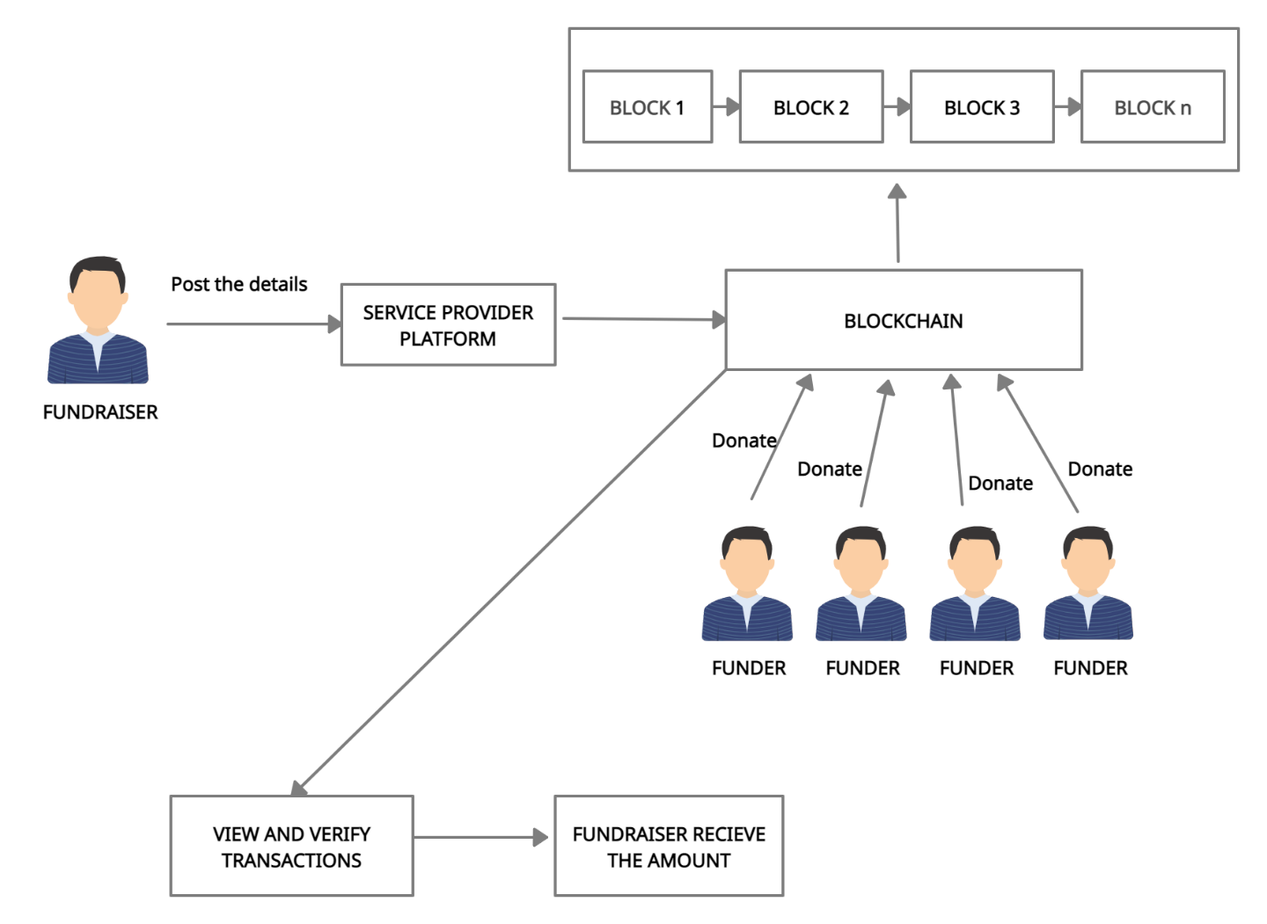
SYSTEM ARCHITECTURE

Slide 13
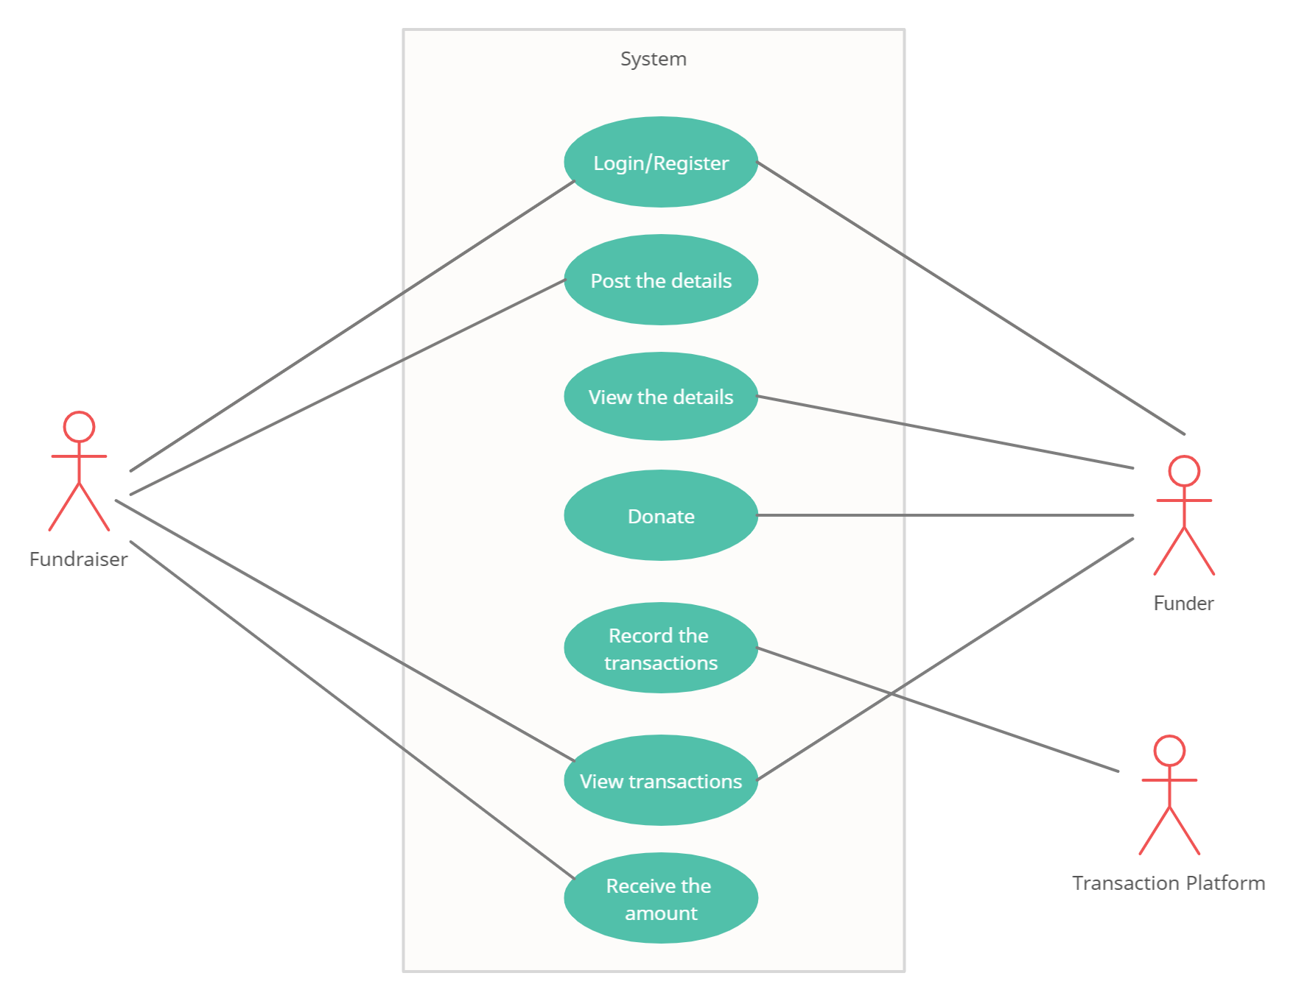
SYSTEM DESIGN – USE CASE DIAGRAM

Slide 14
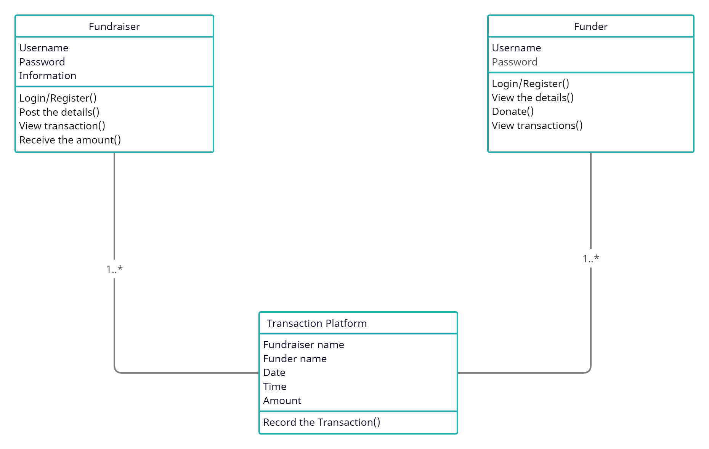
SYSTEM DESIGN – CLASS DIAGRAM

Slide 15
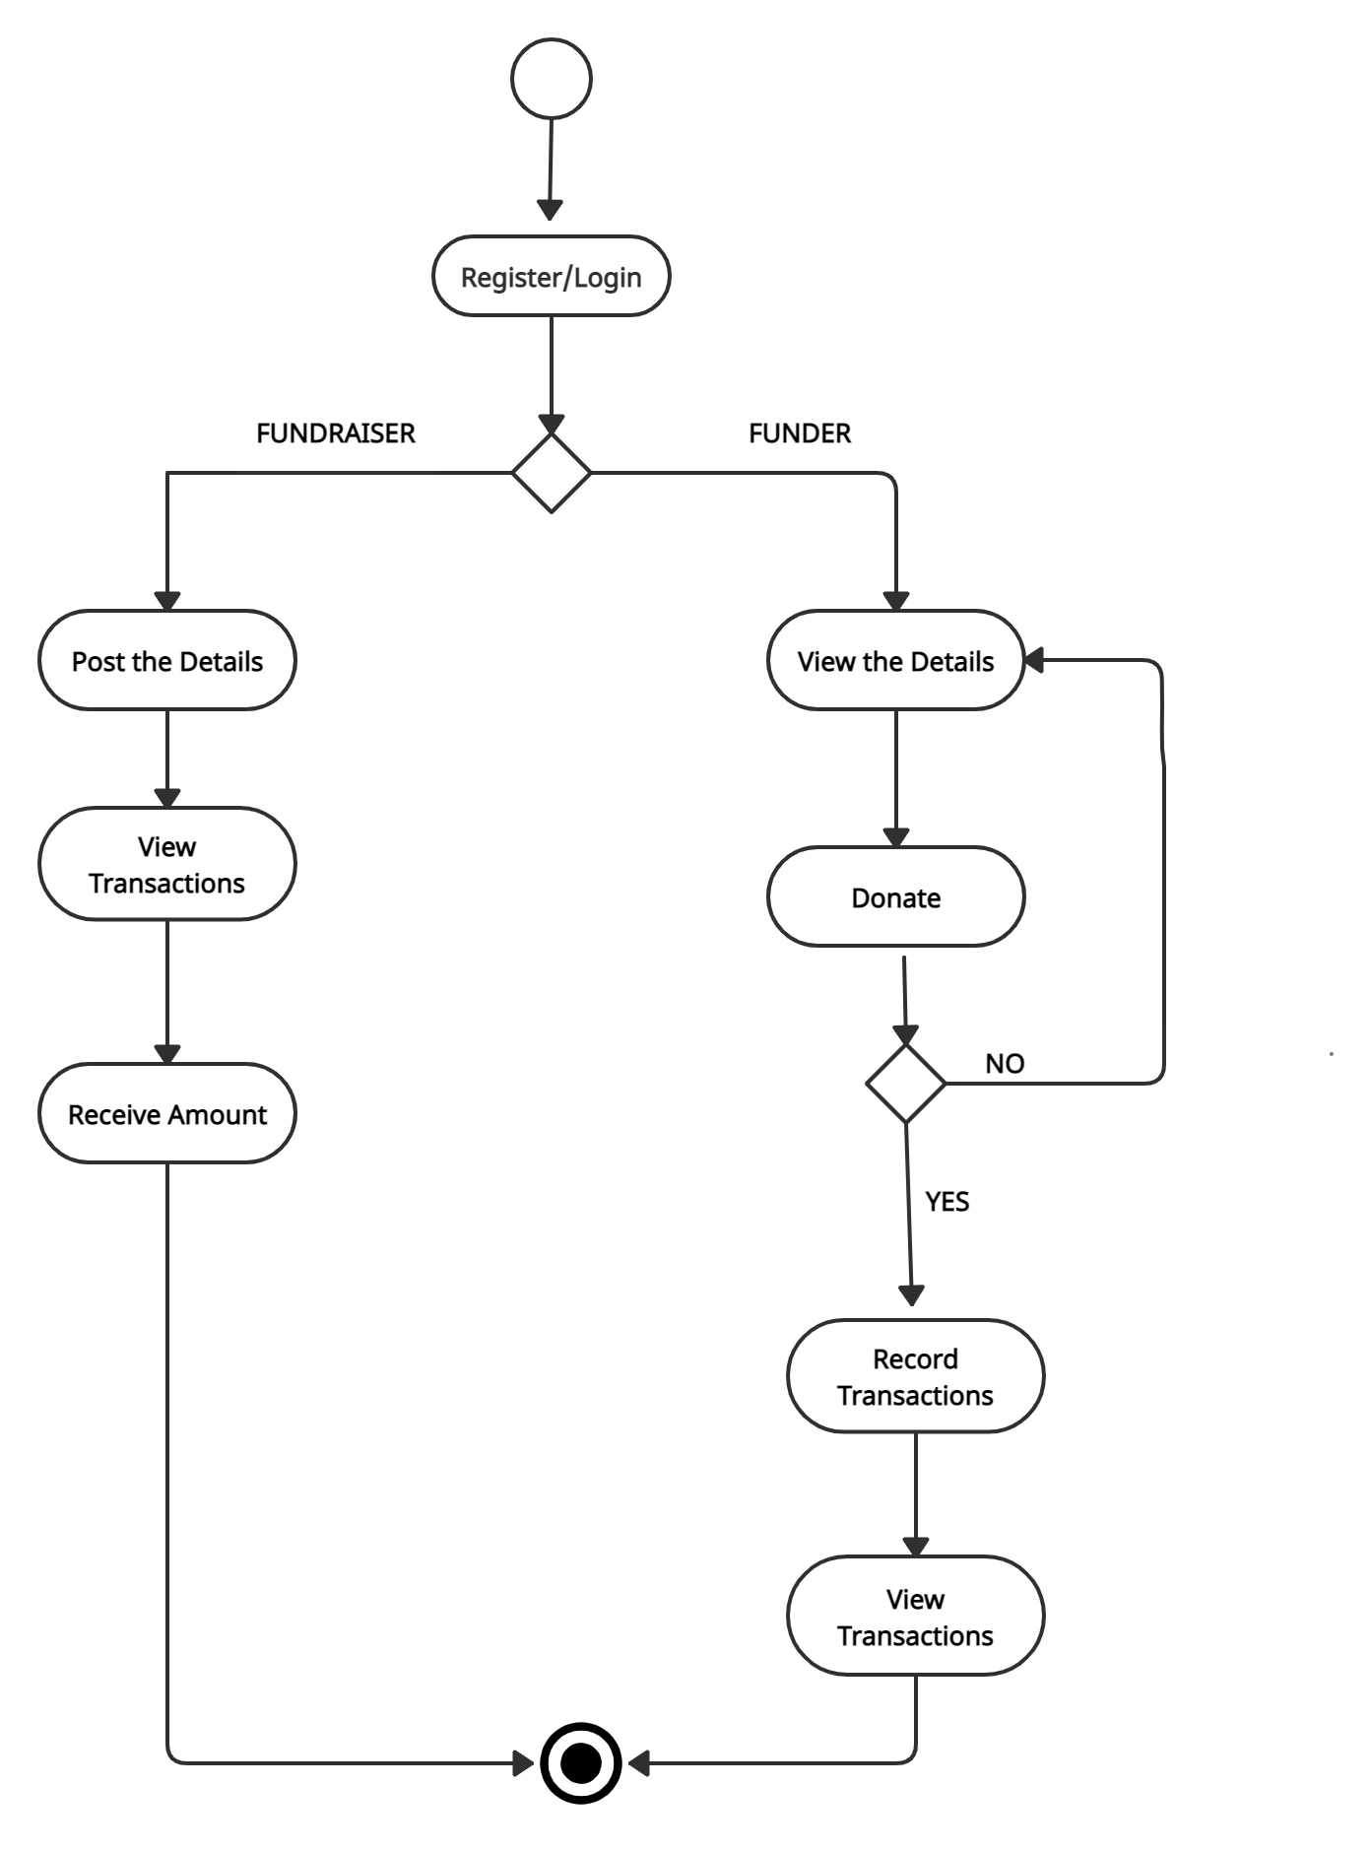
SYSTEM DESIGN – ACTIVITY DIAGRAM

Slide 16
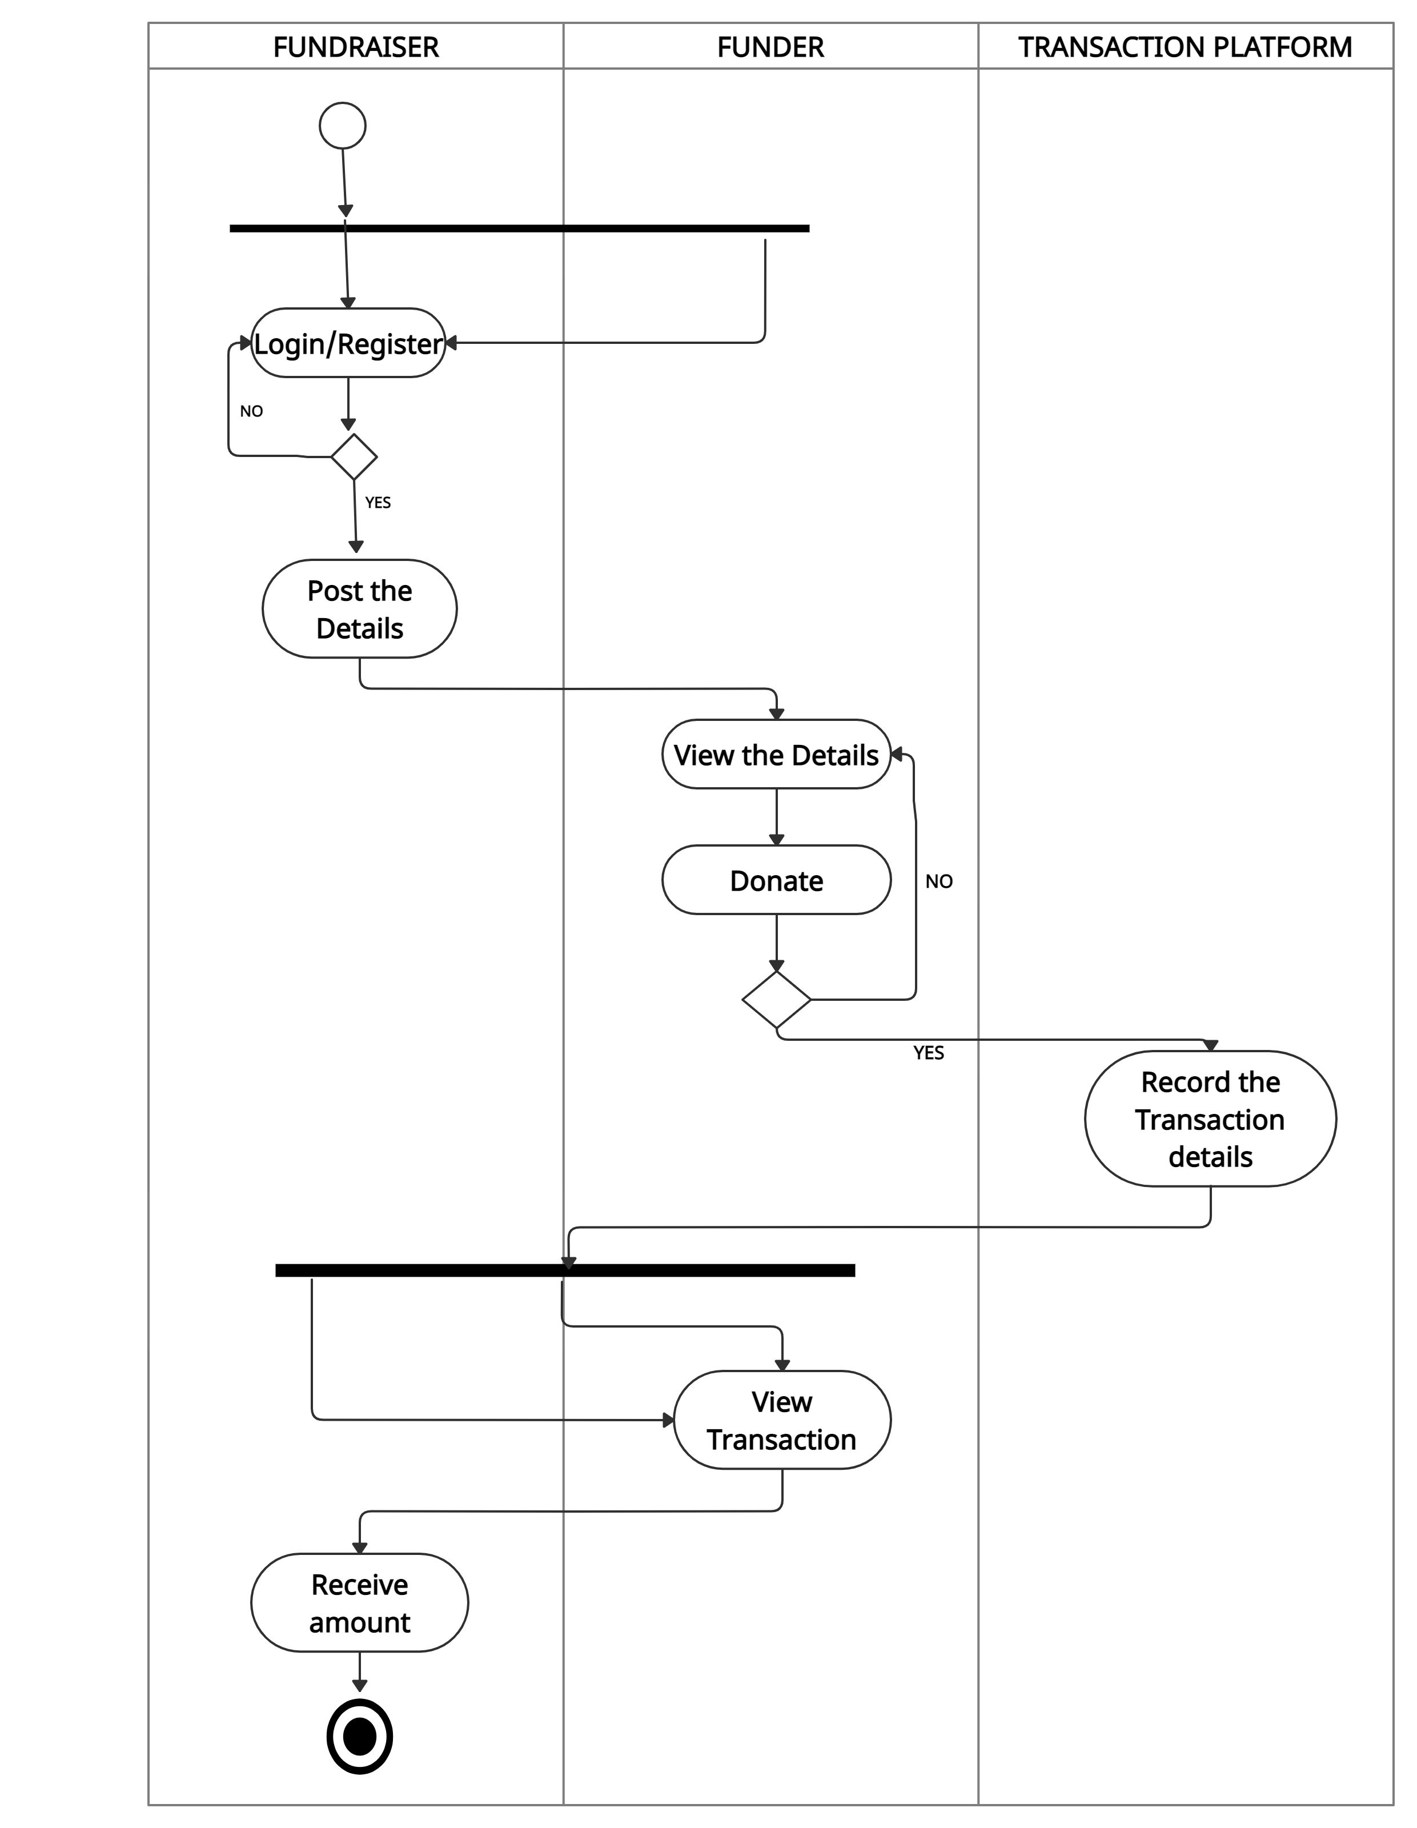
SYSTEM DESIGN – SWIMLANE DIAGRAM

Slide 17
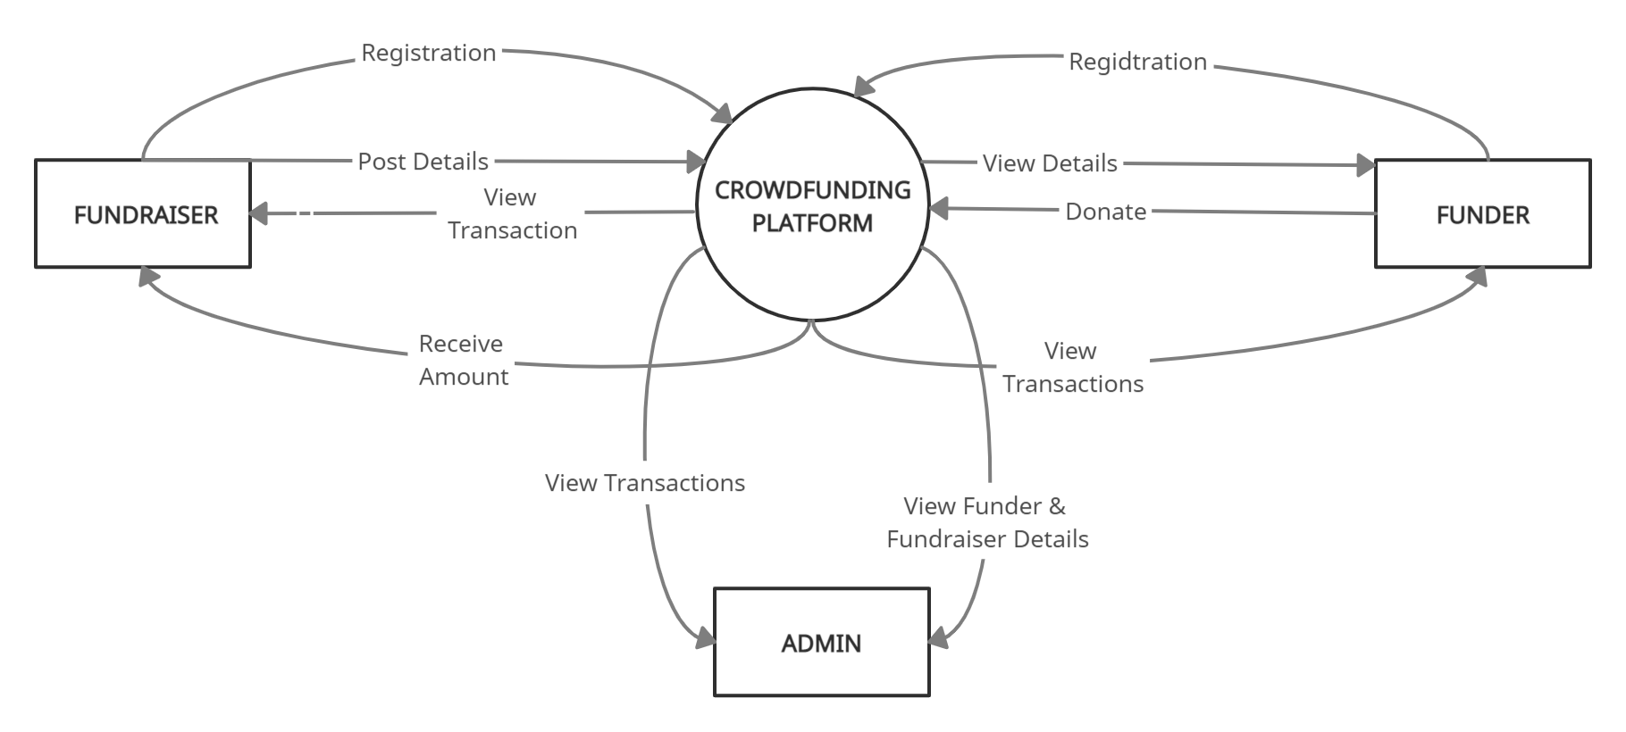
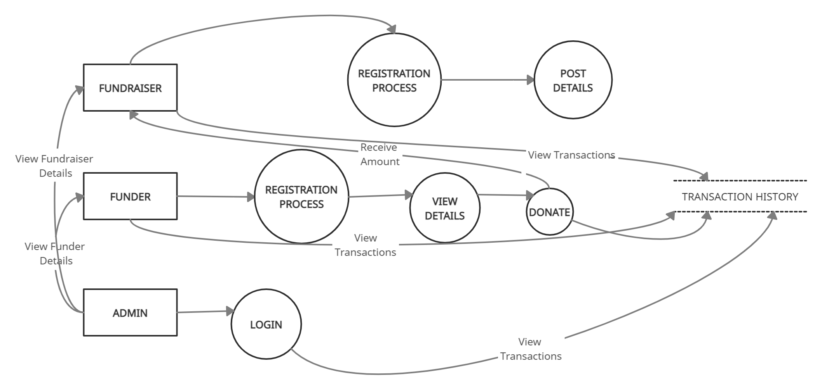
SYSTEM DESIGN – DATAFLOW DIAGRAM
DFD LEVEL 0
DFD LEVEL 1

Slide 18
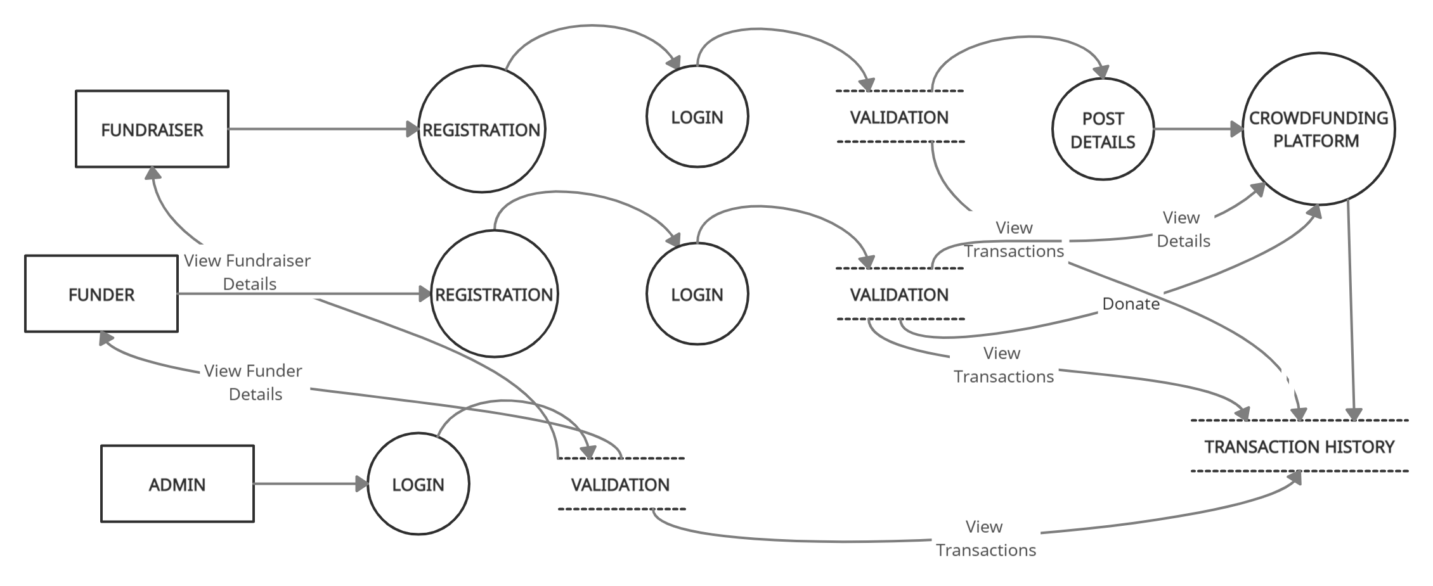
DFD LEVEL 2

Slide 19
SYSTEM DESIGN – DB DESIGN REGISTRATION DB
Field Name | Data Type | Length | Description | Constraints
Username | Varchar | 200 | Name of the user | Primary Key
Password | Varchar | 200 | Password should contains capital letter, small letter, special character and number. | Not Null
Email | Varchar | 200 | Mail id of the user | Primary Key
Mobile | Varchar | 200 | Mobile number of the user | Not Null

Slide 20
SYSTEM DESIGN – DB DESIGN FUNDRAISING DB
Field Name | Data Type | Length | Description | Constraints
Name | Varchar | 200 | Name of the fundraiser | Not Null
Mobile Number | Number | 10 | Mobile number of the fundraiser | Not Null
Account Number | Varchar | 12 | Account number of the fundraiser | Primary Key
Amount | Number | 200 | Amount that they are expecting | Not Null
Description | Varchar | 200 | Reason for their fundraising | Not NUll

Slide 21
MODULES
Registration – Fundraiser
Registration – Funder
Post Creation
Service provider Platform
Payment platform
Transaction history
Admin Platform
Blockchain creating and mining

Slide 22
REGISTRATION - FUNDRAISER
The fundraiser will register in the service provider platform. For storing the meta details about the fundraiser we can use the MySQL data base. Also every time scanned the immutable entry added in the table. In general, the fundraiser registration process only involves two entities, the fundraiser and the service provider of fundraising platform itself. Now the fundraiser can login by using username and password.
REGISTRATION - FUNDER
Similar to the fundraising registration process, donors certainly need to register with a fundraising platform service provider. For storing the meta details about the funder we can use the MySQL data base. Also every time scanned the immutable entry added in the table. This process involves two entities, the funder and the fundraising organization. Now the funder can login by using username and password.

Slide 23
POST CREATION
In this module the fundraiser will raise their funds by providing their Name, Account details, Mobile number, Description, and Amount details. Now these details will be posted on the service provided platform.
SERVICE PROVIDER PLATFORM
The details given during the post creation by the fundraiser will be posted here. Then the funder can view the details posted by the fundraiser and if they wishes to donate then they can proceed with that. If the funder wishes to donate for any cause they can donate the money to the particular fundraiser by clicking on the particular post. Then it asks for CVV number and account number if these numbers matches with number that they have provided during the registration, they can proceed with payment process.

Slide 24
PAYMENT PLATFORM
In the payment process they have to provide Fundraiser name, Funder name, Amount to be transacted, Time, E-mail ID, and Account Number of fundraiser. Now the details of Fundraiser name, Funder Name, Account Number of fundraiser, Amount transacted, E-mail ID, Date and Time of the Transaction are recorded in the blockchain.
TRANSACTION PLATFORM
Now the details of Fundraiser name, Funder Name, Account Number of fundraiser, Amount transacted, E-mail ID, Date and Time with be displayed in the transaction history. This can be viewed by funder, fundraiser and admin. They can keep track of their money through this transaction platform.

Slide 25
ADMIN PLATFORM
Here the admin will login using username and password. Once they login they can view funder details, fundraiser details and transaction history.
BLOCKCHAIN CREATING AND MINING
On startup, create the genesis block then server initiates creation of new block and send the required data Create a new block with the scan data. Mine the block.

Slide 26
TESTING AND PERFORMANCE ANALYSIS UNIT TESTING:
UNIT TESTING is a type of software testing where individual units or components of a software are tested. In this project, In the module of registration each input is denoted with specify constraint and the violation of these constraint will display error message. Thus it verify the unit testing.
Result: All the test cases mentioned above passed successfully. No defects encountered

Slide 27
REGISTRATION FUNDRAISER- REGISTRATION VALIDATION PAGE
s.no | ACTION | INPUT | EXPECTED OUTPUT | ACTUAL OUTPUT | TEST RESULT
1. | Enter the username,password,email,phone number for registration | Username:XXX Password: *** Email id: abc@gmail.com Phone number: 9876543210 | XXX *** abc@gmail.com 9876543210 | XXX *** abc@gmail.com 9876543210 | passed
2. | Compare username and password with registered field | Username:XXX Password: *** | It Redirects to charity home.jsp | It redirects to charity home.jsp | passed
3. | Compare username and password with registered field | Username:XXy Password: *** | Invalid username and password | Invalid username and password | passed

Slide 28
REGISTRATION FUNDER - REGISTRATION VALIDATION PAGE
s.no | ACTION | INPUT | EXPECTED OUTPUT | ACTUAL OUTPUT | TEST RESULT
1. | Funder should provide account number, amount, mail id | Account number: 789012345645 Amount: 10000 Mail id: abc@gmail.com | These details will be stored in fund history. | These details will be stored in fund history. | Passed.
2. | Funder should provide account number, amount, mail id | Account number: 7890123456 Amount: 10000 Mail id: abc@gmail | Please match the requested format for account number | Please match the requested format for account number | passed

Slide 29
SERVICE PROVIDER PLATFORM – FUND TRANSACTION VALIDATION PAGE
s.no | ACTION | INPUT | EXPECTED OUTPUT | ACTUAL OUTPUT | TEST RESULT
1. | Fundraiser should provide Name, mobile number, amount, description, Account number | Name: john Mobile number: 9876543210 Amount: 15000 Description: (reason for the fundraising) Account number: 789012345673 | It will be posted in the service provided platform and it can be viewed by the funder. | It will be posted in the service provided platform and it can be viewed by the funder. | passed
2. | Fundraiser should provide Name, mobile number, amount, description, Account number | Name: john Mobile number: 98765432 Amount: 15000 Description: (reason for the fundraising) Account number: 7890123444 | Please match the requested format for account number and mobile number. | Please match the requested format for account number and mobile number. | passed

Slide 30
INTEGRATION TESTING
INTEGRATION TESTING is a level of software testing where individual units / components are combined and tested as a group. In this project, in the page of charity home when we click fund raise it will redirect to fund raising page(fund raise.jsp) similarly when we click fund history it will redirect to transaction history page(fundhistn.jsp). Thus the integration testing is done successfully and validated.
Result: All the test cases mentioned above passed successfully. No defects encountered

Slide 31
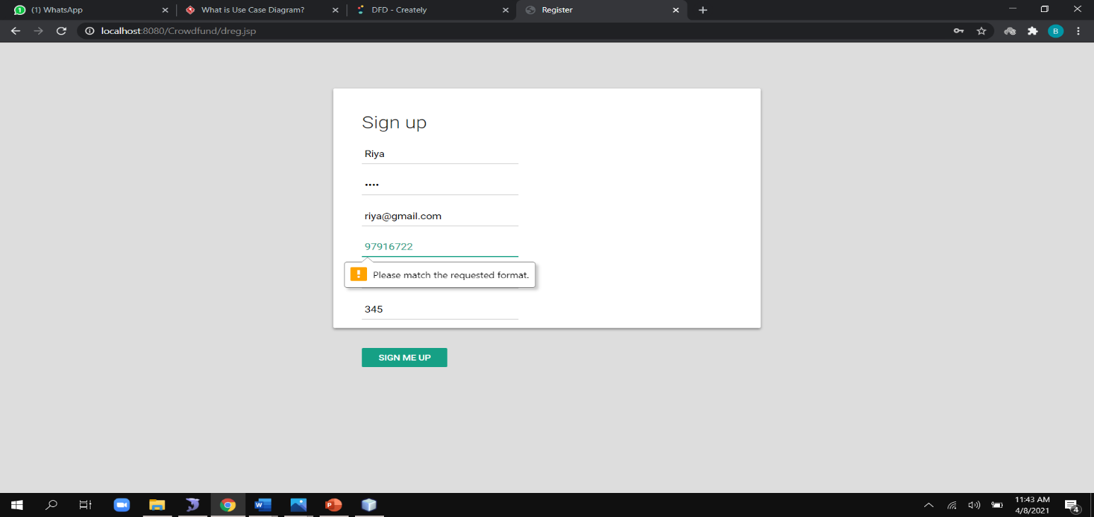
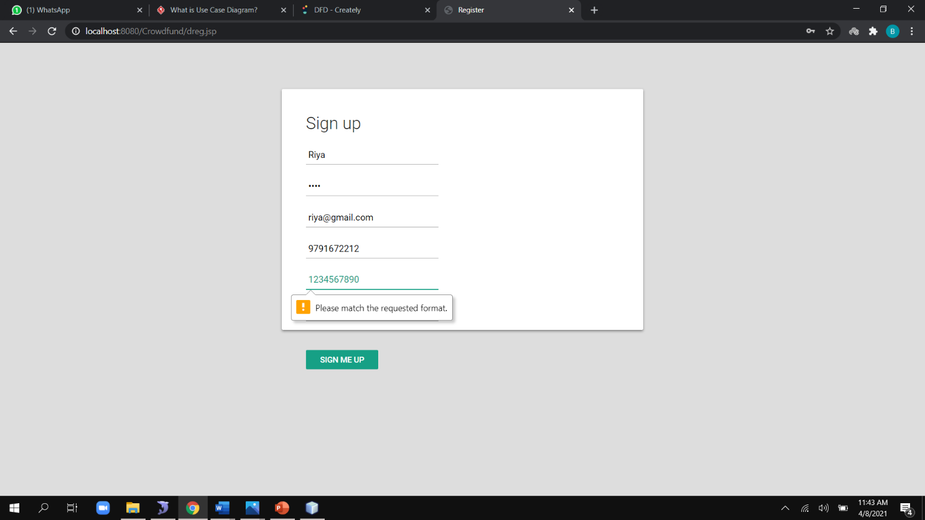
SCREENSHOTS
REGISTRATION VALIDATION PAGE

Slide 32
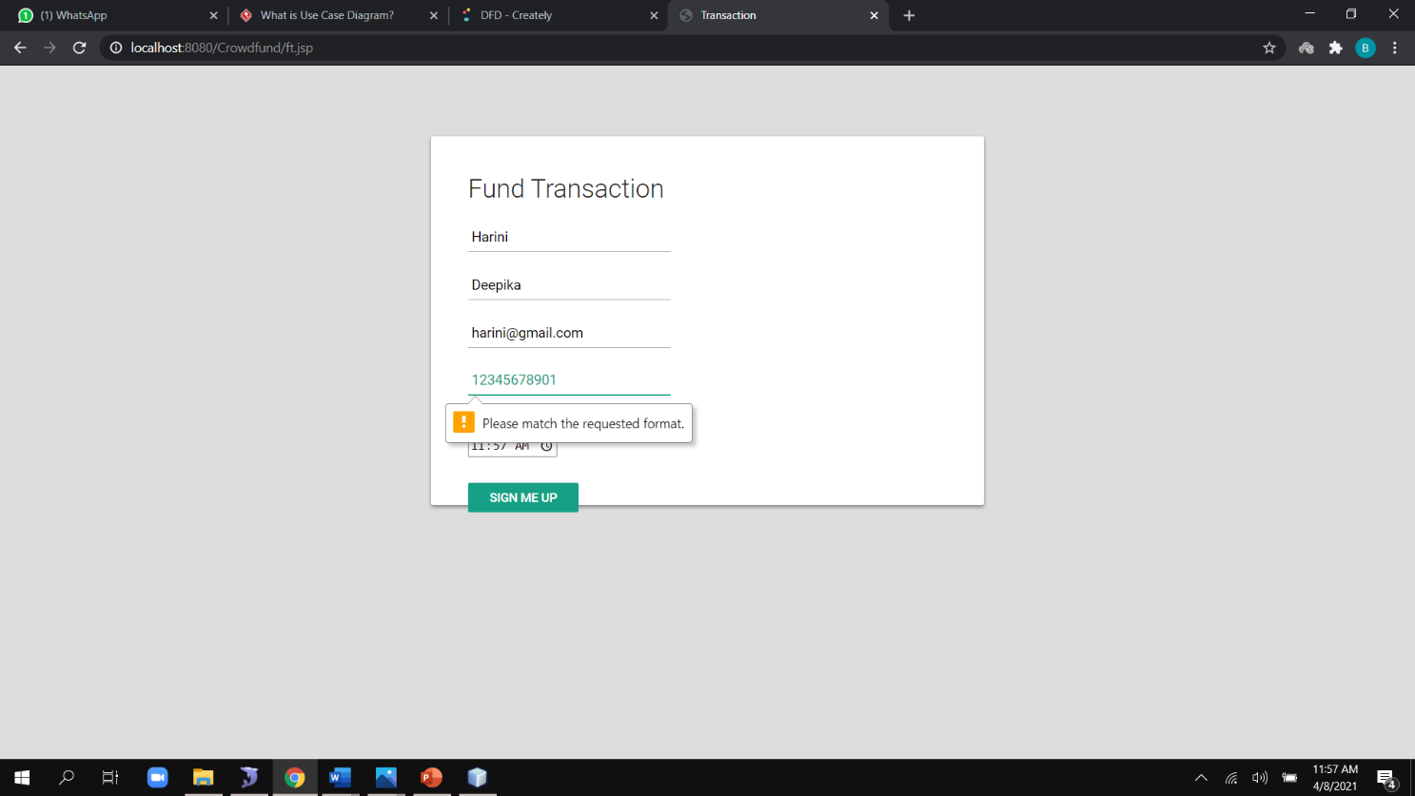
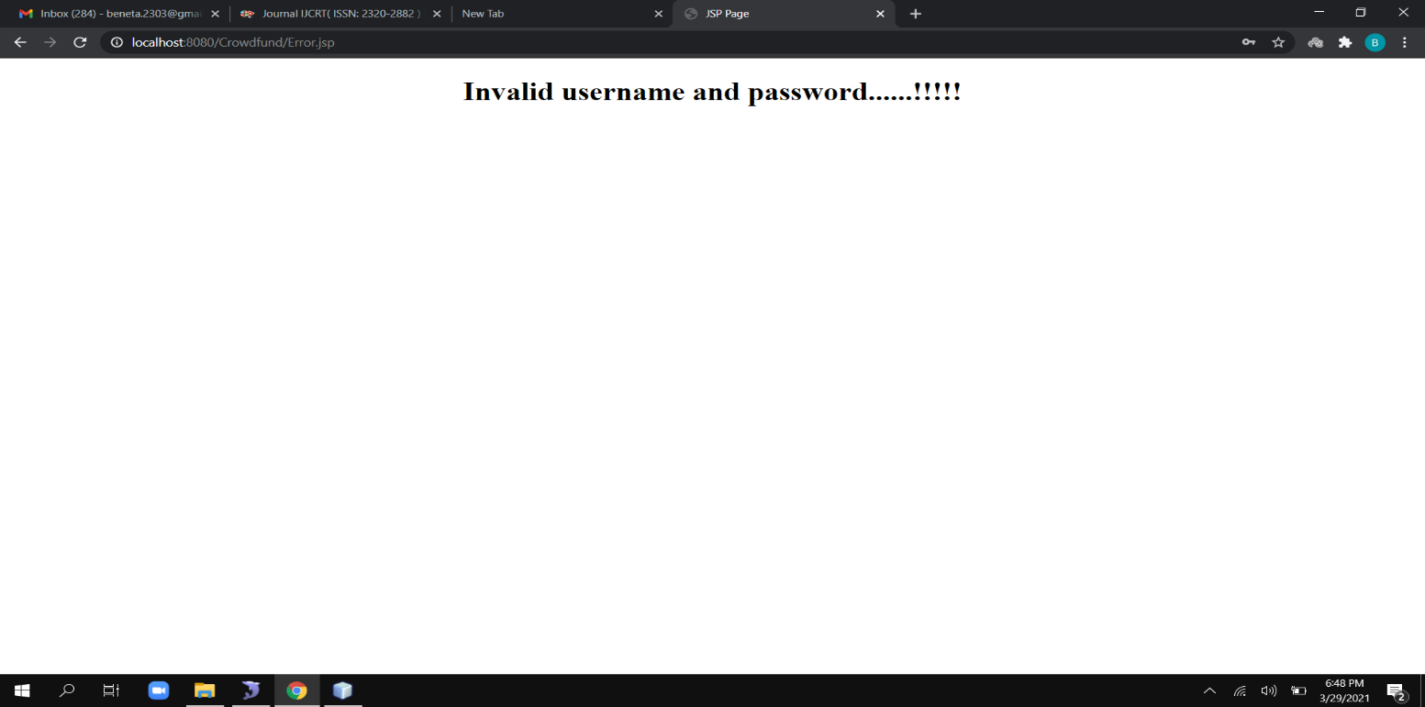
FUND TRANSACTION VALIDATION PAGE
INVALID PAGE

Slide 33
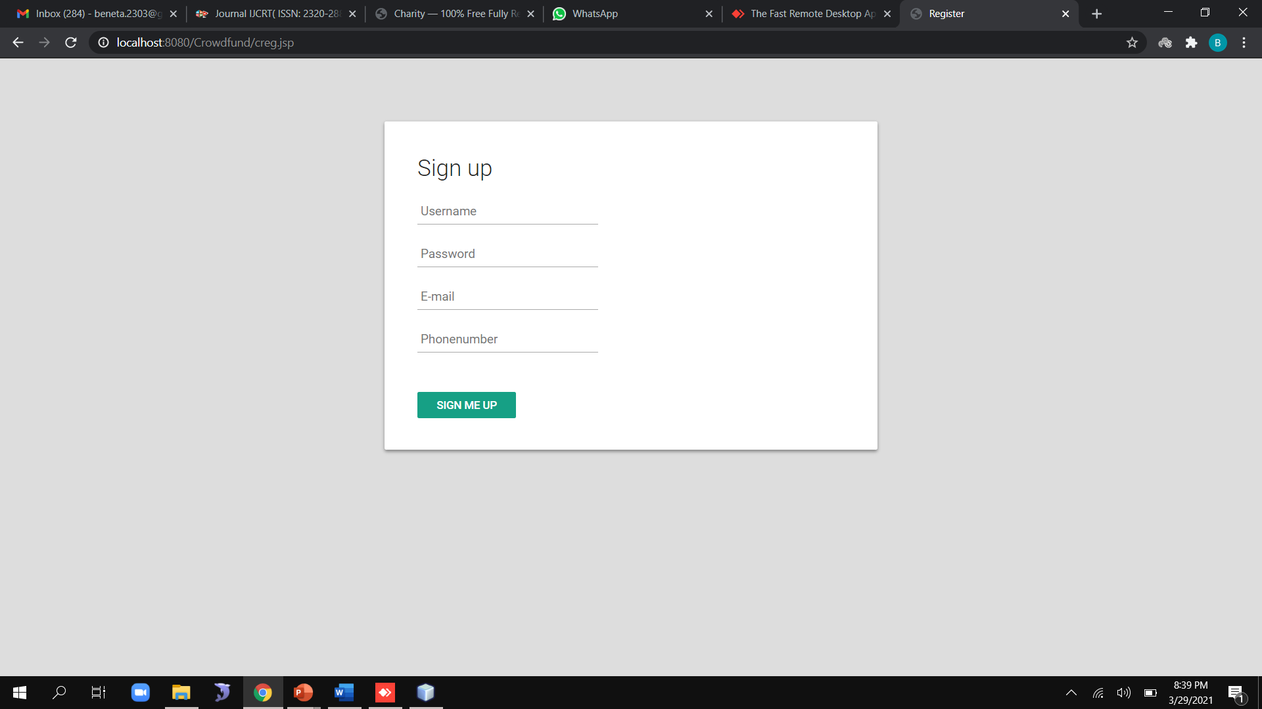
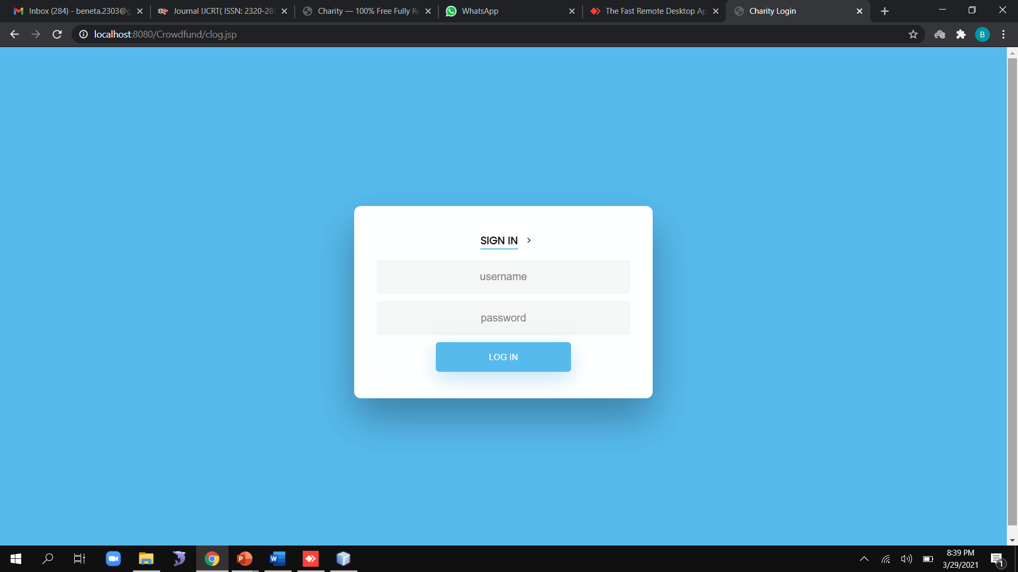
REGISTRATION PAGE
LOGIN PAGE

Slide 34
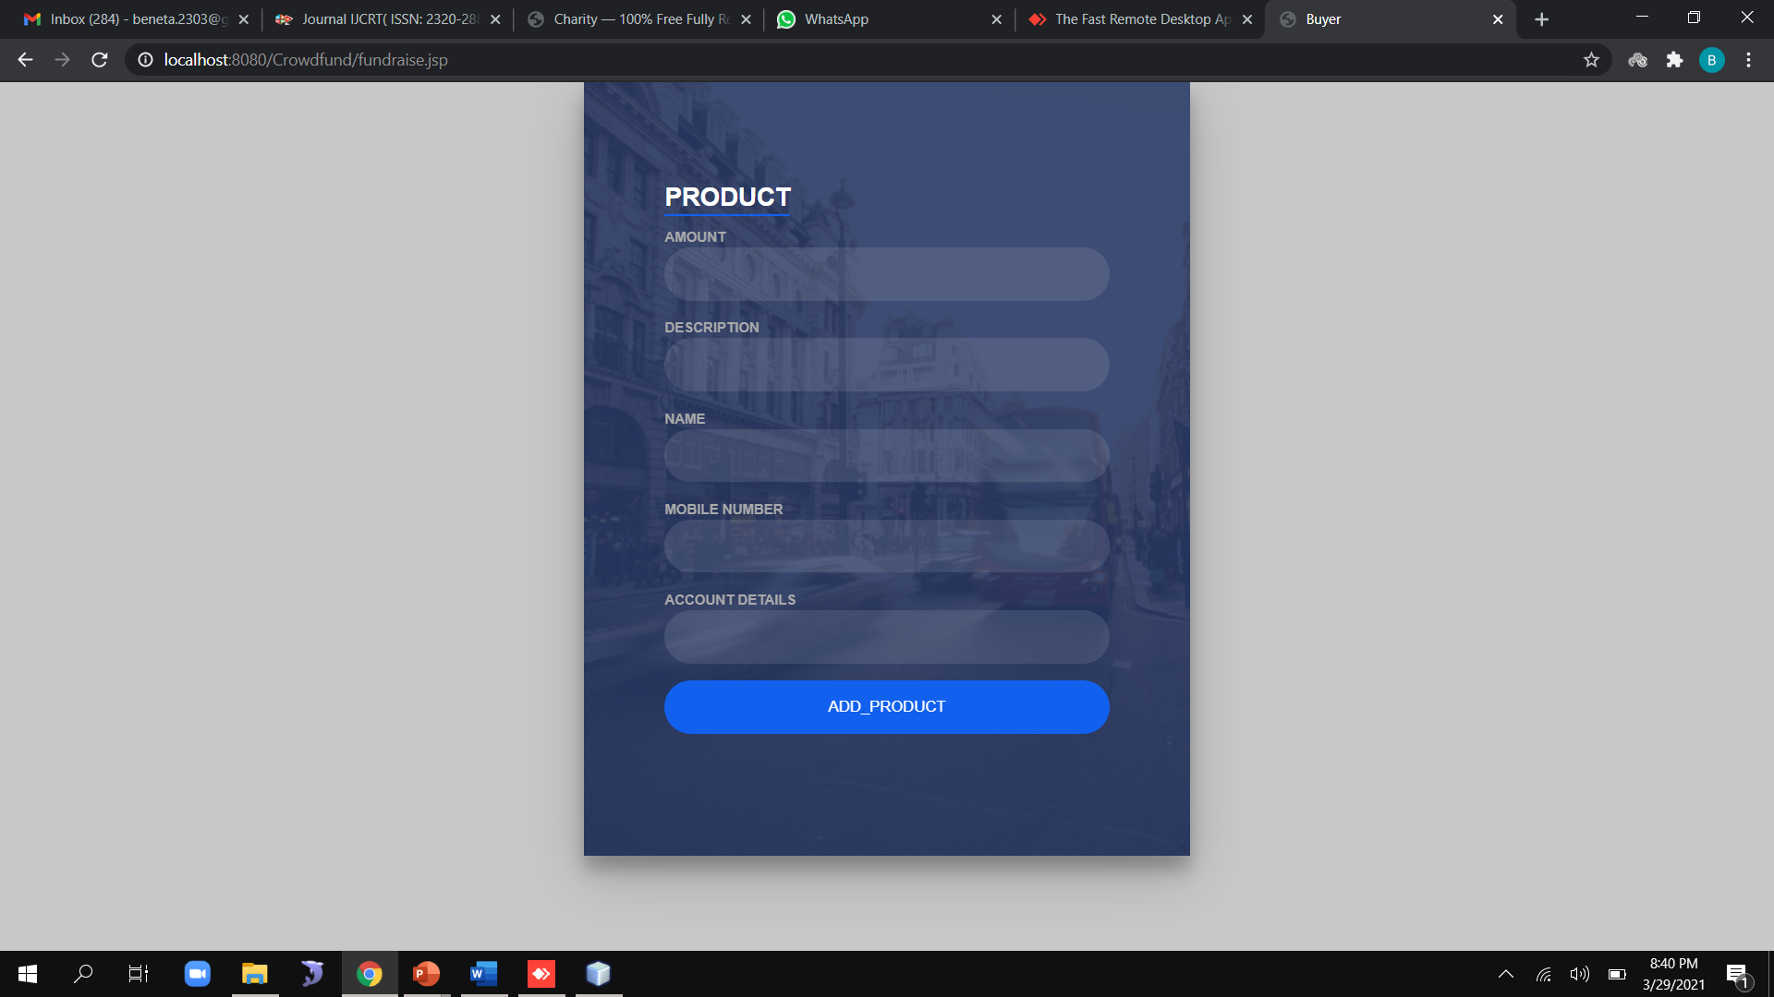
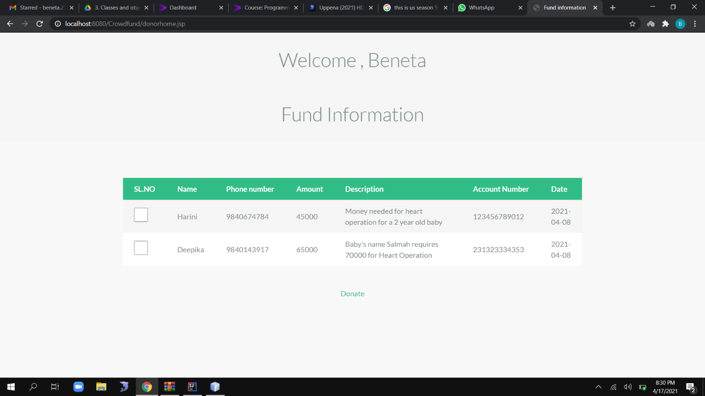
FUND RAISE PAGE
FUND INFORMATION PAGE

Slide 35
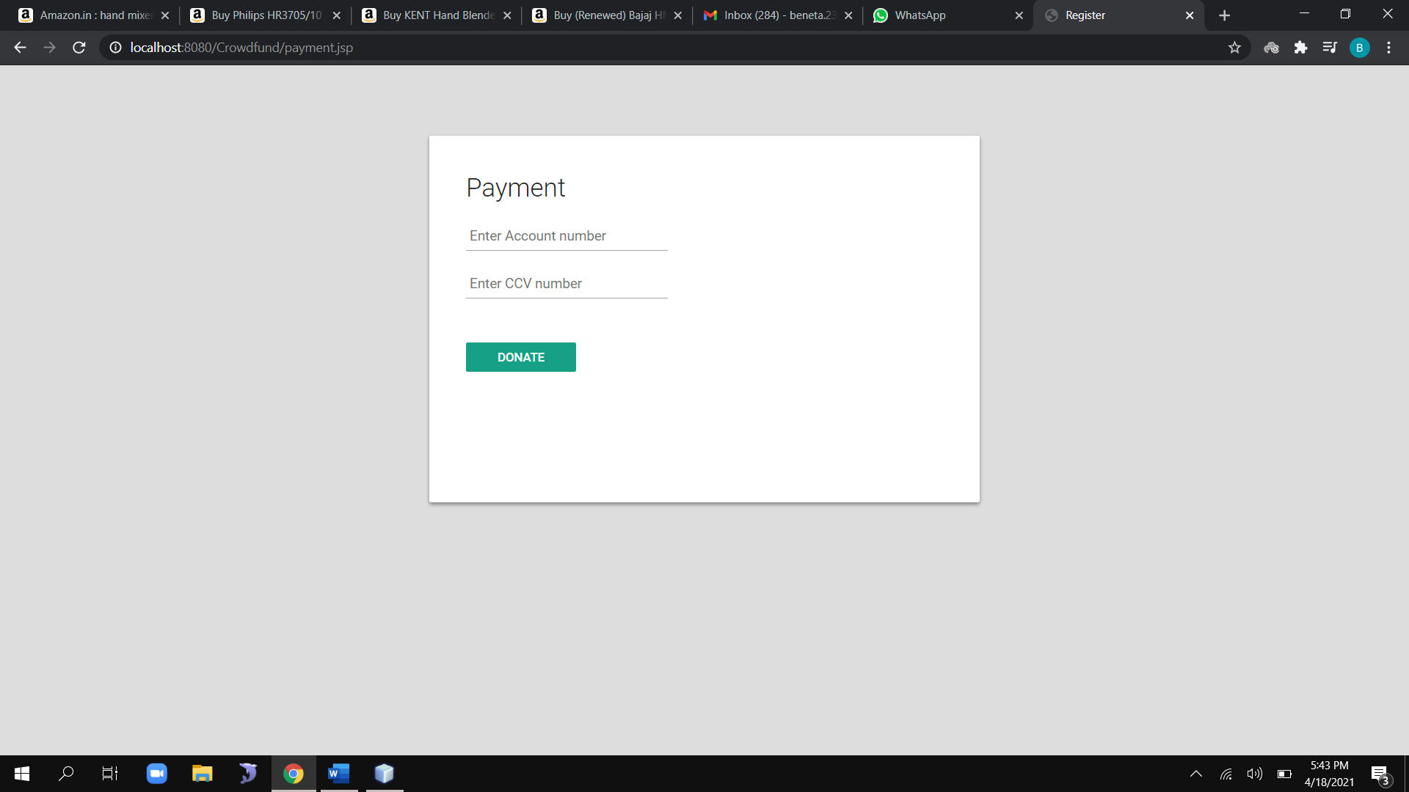
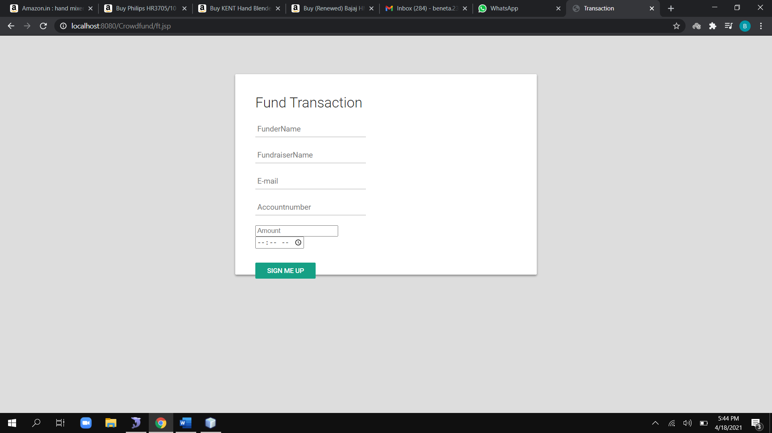
PAYMENT PAGE
FUND TRANSACTION PAGE

Slide 36
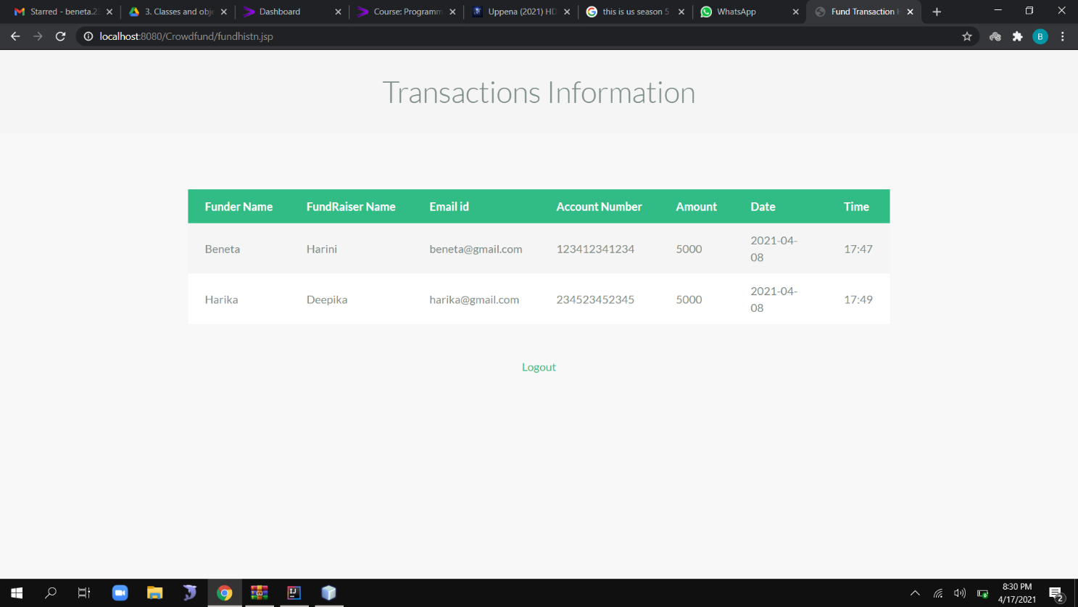

TRANSACTION HISTORY PAGE
BLOCKCHAIN FORMATION PAGE

Slide 37
CONCLUSION AND FUTURE ENHANCEMENT
Finally, the disadvantages faced by the traditional crowdfunding has been overthrown with the help of blockchain technology in crowdfunding. An important factor for the people involved in raising these funds is trust. With the use of the blockchain concept in the crowdfunding, ensures trust of this crowdfunding platform and also reduces the cost of the third party. In future our work can be further enhanced by adding timestamp to the platform i.e., if the funder donates some amount to fundraiser and if the amount doesn’t reach the fundraiser within the timestamp specified then the amount is returned back to the funder. With the help of blockchain technology in the crowdfunding platform the people trust the crowdfunding platform and be a part in this crowdfunding network.

Slide 38
REFERENCES
[1]. Hassija, Vikas, Chamola, Vinay & Zeadally Sherali. (2020). “BitFund: A Blockchain-based Crowd Funding Platform for Future Smart and Connected Nation”. Sustainable Cities and Society. 60. 102145. 10.1016/j.scs.2020.102145, May 2020.
[2]. Nikhil Yadav and Sarasvathi V. “Venturing Crowdfunding using Smart Contracts in Blockchain”. Third International Conference on Smart Systems and Inventive Technology (ICSSIT 2020)), IEEE Xplore Part Number: CFP20P17-ART; ISBN: 978-1-7281-5821-1, November 2020.
[3]. Ms. S. Benila, V. Ajay, K. Hrishikesh, R. Karthick. “Crowdfunding using Blockchain”. Global Research and Development Journal for Engineering, Volume 4, Issue 4, ISSN: 2455-5703, March 2019.
[4]. Hasnan Baber. “Blockchain-Based Crowdfunding: A ‘Pay-it-Forward’ Model of WHIRL”. International Journal of Recent Technology and Engineering (IJRTE), ISSN: 2277-3878, Volume-8 Issue-3, September 2019, September 2019.
[5]. Er. Waheeda Dhokley, Saurabh Gupta, Ganesh Pawar, Abrar Shaikh, “Crowdsourcing and Crowdfunding Platform using Blockchain and Collective Intelligence”. International Journal of Computer Sciences and Engineering, Vol.7, Issue.2, pp.668-673, February 2019.
[6]. Firmansyah Ashari, Tetuko Catonsukmoro, Wilyu Mahendra Bad, Sfenranto, Gunawan Wang (2020). “Smart Contract and Blockchain for Crowdfunding Platform”. International Journal of Advanced Trends in Computer Science and Engineering. 9.3036-3041.10.30534/ijatcse/ 2020/83932020, June 2020.

Slide 39
[7]. André Schweizer, Vincent Schlatt, Nils Urbach, Gilbert Fridgen. “Unchaining Social Businesses - Blockchain as the Basic Technology of a Crowdlending Platform”. Proceedings of the 38th International Conference on Information Systems (ICIS), Seoul, South Korea, December 2017.
[8]. Zhu, Huasheng; Zhou, Zach Zhizhong (2016). “Analysis and outlook of applications of blockchain technology to equity crowdfunding in China”. Financial Innovation, ISSN 2199-4730, Springer, Heidelberg, Vol. 2, Iss. 29, pp. 1-11, 2016.
[9]. Zhao Hongjiang & Coffie Cephas. (2018). The Applications of Blockchain Technology in Crowdfunding Contract. SSRN Electronic Journal. 10.2139/ssrn.3133176, January 2018.
[10].Hissu Hyvärinen, Marten Risius & Gustav Friis. “A Blockchain-Based Approach Towards Overcoming Financial Fraud in Public Sector Services”. Bus Inf Syst Eng 59, 441–456, 2017.
[11]. Claudia Gabriela Bîzderea. "ANALYSIS OF FUNDING ALTERNATIVES THROUGH FINANCIAL TECHNOLOGY SERVICES – FINTECH – THE PHENOMENON OF CROWDFUNDING". Revista de Studii Financiare 3:109-127, November 2017.
[12]. Fridgen, Gilbert; Regner, Ferdinand; Schweizer, André; and Urbach, Nils, "DON’T SLIP ON THE ICO – A TAXONOMY FOR A BLOCKCHAIN-ENABLED FORM OF CROWDFUNDING" (2018). Research Papers. 83, November 2018.

Slide 40
PUBLICATION DETAILS
BenetaGetzie M, Deepika T, Harini B, Anitha Moses V, "DECENTRALIZED FUNDING PLATFORM BASED ON BLOCKCHAIN TECHNOLOGY", International Journal of Creative Research Thoughts (IJCRT), ISSN:2320-2882, Volume.9, Issue 3, pp.4507-4511, March 2021
DOI Details: http://doi.one/10.1729/Journal.26363

