Slide 1
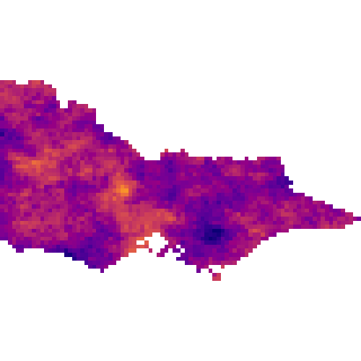
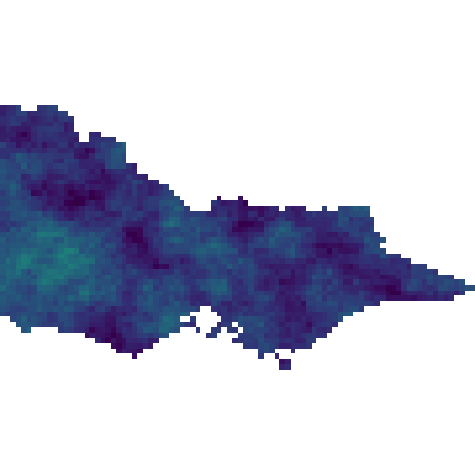
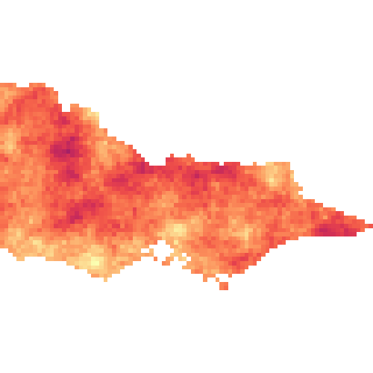
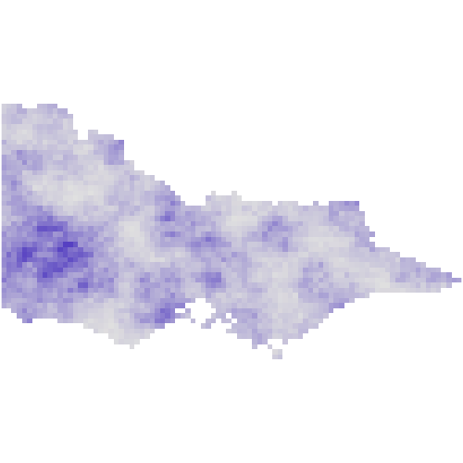
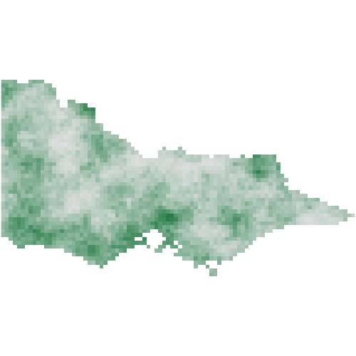
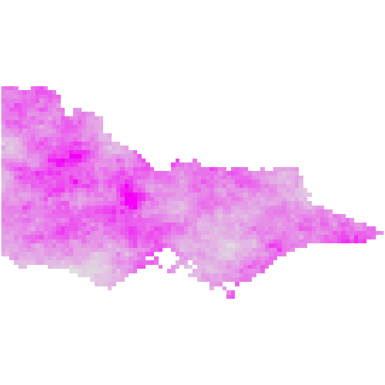
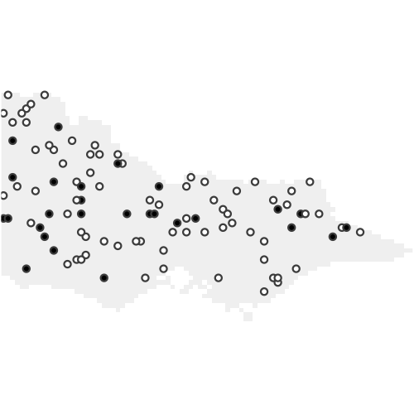
A
B
Correlative SDM
Demographic SDM
covariates
Spatial MPM/IPM
covariates
correlative model
predicted
distribution
MPM/IPM
predicted vital rate
distributions
correlative vital rate models
statistical
inference
observed
distribution
observation model
pop. dynamic model
predicted
distribution
statistical
inference
observed
distribution
observation model

