Slide 1
Python Variables
Programming
Notes:
Last updated: 04-01-21
Resources are updated regularly - the latest version is available at: the-cc.io/curriculum.
This resource is licensed by the Raspberry Pi Foundation under a Creative Commons Attribution-NonCommercial-ShareAlike 4.0 International license. To view a copy of this license, visit, see creativecommons.org/licenses/by-nc-sa/4.0/.

Slide 2
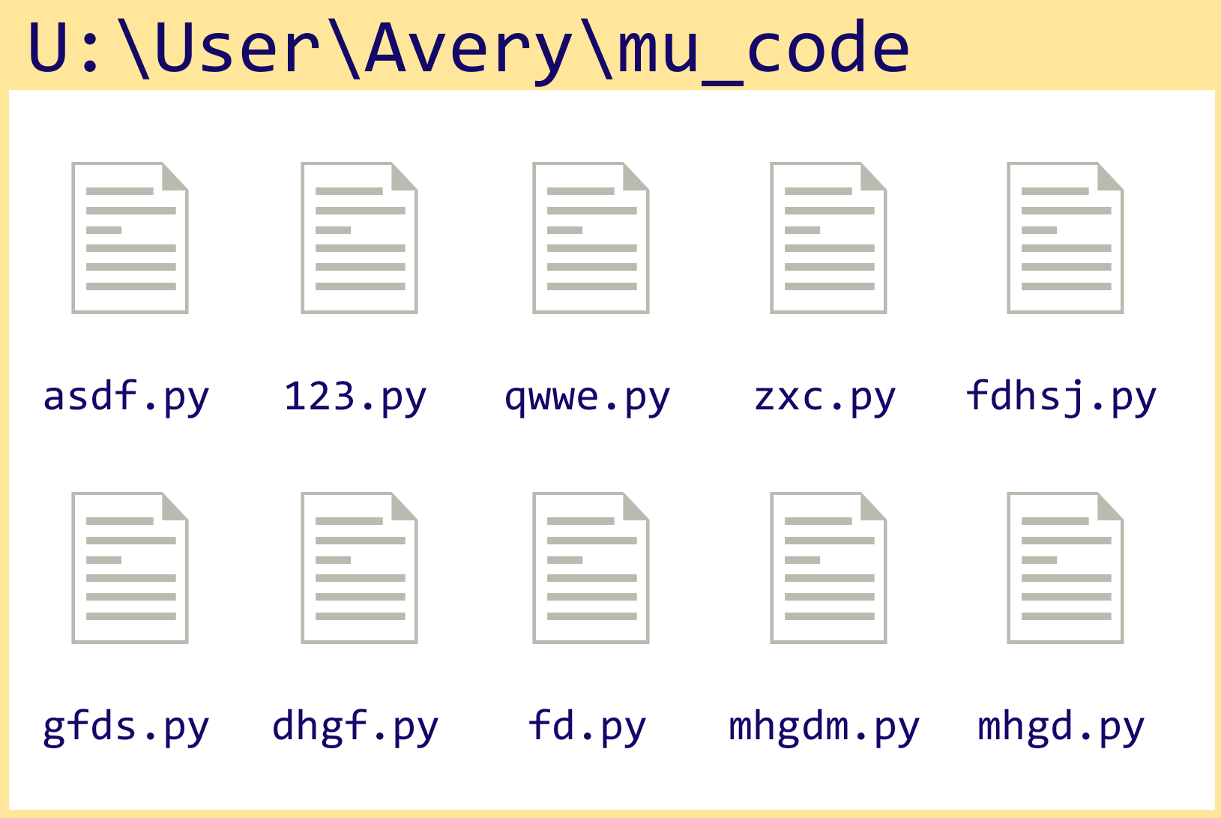
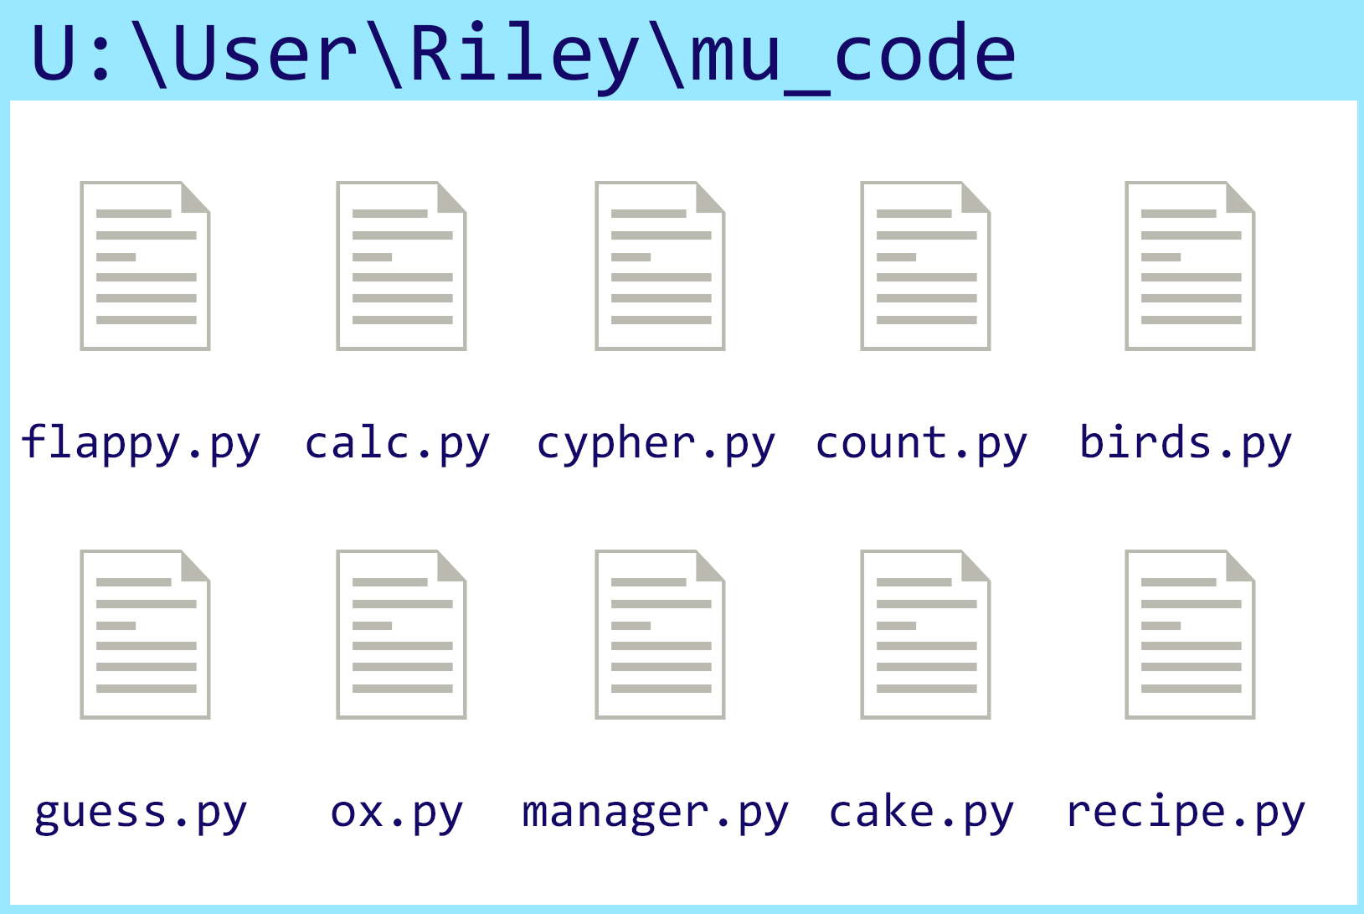
In pairs, compare and contrast these project folders
Starter activity
Who has the better project folder and why?

Slide 3
Why is it important to name files correctly?
Starter activity
Names: ___________________________________ AM PM (Bring this handout up to your teacher when you are finished with the station rotations.)

Slide 4

Python naming conventions
Starter activity
In programming, there are naming conventions that should be followed to make it easier to read and understand your code.
Python has an agreed set of conventions that programmers should follow.
You will explore some of these during this lesson.
age
first_name
num_aliens = 10

Slide 5

Lesson 4: Variables
Objectives
In this lesson, you will:
Use meaningful identifiers
Determine the need for variables
Distinguish between declaration, initialisation, and assignment of variables
Show you know how to name Python variables correctly and according to accepted industry guidelines
Output data (e.g. print (first_name))

Slide 6
What is a variable?
Activity 1
A variable holds a value in a memory location that is needed for the execution of your program.
A variable can hold one value at a time. This value can change throughout the execution of the program.

Slide 7
What is a variable?
Activity 1
You might use a variable to keep track of the score for a game.
At the beginning of a game the score might be 0.
score
0

Slide 8
What is a variable?
Activity 1
You might use a variable to keep track of the score for a game.
At the beginning of a game the score might be 0.
During gameplay, the player might earn a point.
score
0
score = score + 1

Slide 9
What is a variable?
Activity 1
You might use a variable to keep track of the score for a game.
At the beginning of a game the score might be 0.
During gameplay, the player might earn a point.
This would change the value held in score by increasing the value by 1.
score
1
score = score + 1

Slide 10
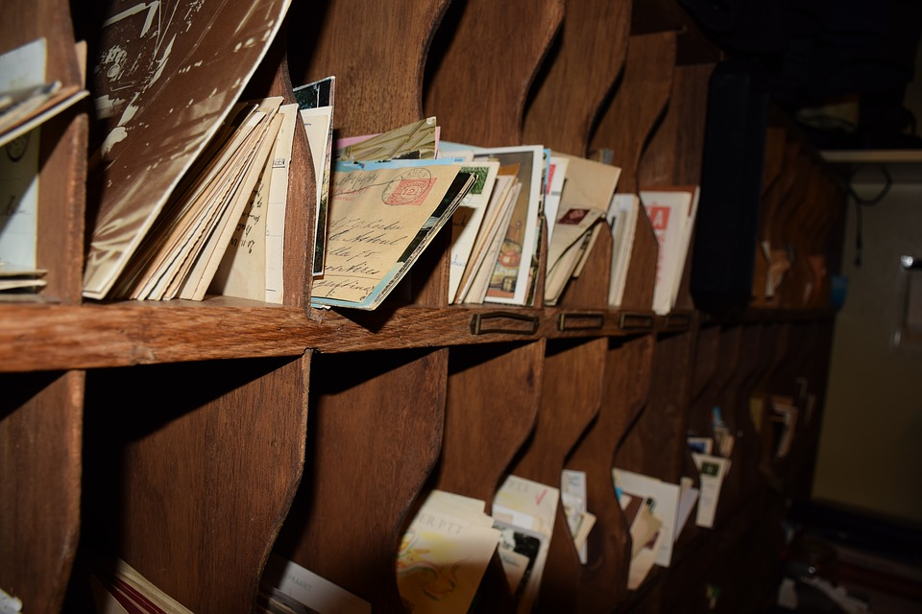
Using a variable
Activity 1
A memory location needs to be allocated for the variable value, before it can be used by the program.
Declaring a variable means stating what data type will be used for the value.
Initialising a variable means setting the initial value.
Notes:
Image source: https://pixabay.com/photos/post-post-office-letter-old-3471110/

Slide 11
Variable declaration in other programming languages
Activity 1
In Python, you don’t have to specify the type of data you want to store in a variable. This is different from other programming languages.
Here are examples of variable declaration in Visual Basic and C.
Integer or int just means whole numbers.
Both of these statements mean declare the variable age as an integer.
Visual Basic
Dim age As Integer
C
int age;

Slide 12
Variable initialisation
Activity 1
Initialisation is when the initial or starting value is assigned to the variable.
Remember that variables only hold one value at a time and this value can change while the script (program) is running.
Here are examples of variable initialisation. This means hold the value 22 under the variable name, age.
Visual Basic
age = 22
C
age = 22;
Python
age = 22

Slide 13
Creating and using our first variable
Activity 1
Line 1 initialises the variable by calling it first_name and assigning the value “Gerry” to a specific memory location.
Activity
Type this code into Python and run it to see what happens.
Switch lines 1 and 2 around and read the error message that is generated.
1
2
3
first_name = "Gerry"
print(name)

Slide 14
Creating and using our first variable
Activity 1
When you try to use a variable before it has been initialised, it will cause/generate an error.
Instructions are executed one after the other.
In this case the error would be:
first_name, ‘first_name’ is not defined
1
2
3
print(first_name)
first_name = "Gerry"
Traceback (most recent call last):
File "c:\users\rebecca\mu_code\name.py", line 1, in <module>
print(name)
NameError: first_name, ‘first_name' is not defined

Slide 15
Creating and using our first variable
Activity 1
Once a variable has been initialised with its first value, it can then be reassigned a new value throughout the execution of the code.
Question .
What do you think will happen when this code is executed (when you run this code)?
1
2
3
first_name = "Gerry"
first_name = "Sam"
print(first_name)

Slide 16
Creating and using our first variable
Activity 1
The program will display Sam on the screen. This is because it was the last value that was assigned to first_name.
1
2
3
first_name = "Gerry"
first_name = "Sam"
print(first_name)
Sam
>>>

Slide 17

Meaningful identifiers and naming conventions
Activity 1
Variables should always be identified in a meaningful way so your code is easier to read and maintain.
a, b, c, x, y are not good names for a variable.
If a variable is going to hold someone’s first name, then call that variable first_name, for example.
x = "Gerry"
first_name = "Gerry"
Notes:
Image source: https://pixabay.com/vectors/check-cross-red-green-attention-158879/

Slide 18
Meaningful identifiers and naming conventions
Activity 1
All programming languages have their own naming conventions.
A considerate, professional programmer will read the documentation for the programming language to find out what the naming conventions are.
In Python, variable names should be written in lowercase, with an underscore separating words that make up the variable if required.

Slide 19

Recap
Activity 1
Declaration means to declare a variable as a certain data type.
Initialisation means to set an initial or starting value for a variable.
Assignment means to change the value stored at the variable location in your computer’s memory.
A variable must be initialised before it can be used.
Meaningful identifiers make your code easier to read and understand.

Slide 20
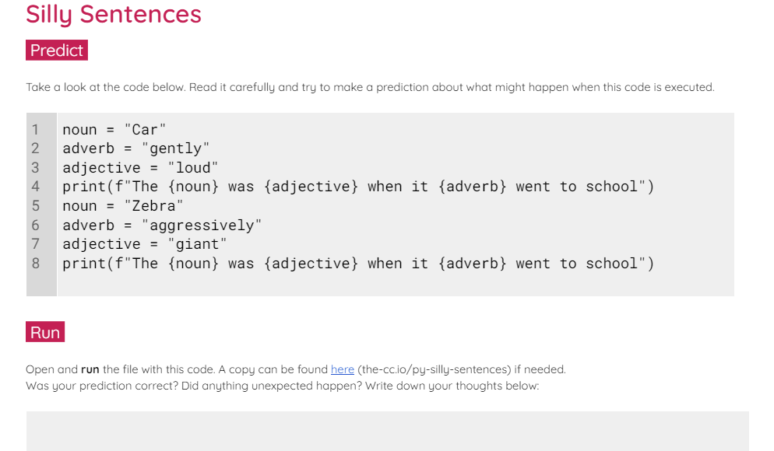
Silly Sentences
Activity 2
In the next station, you’ll predict, run, investigate, and modify a silly sentences script.
Your final task is to create your own silly script.

Slide 21
Peer-review your silly stories
Sit with your assigned partner and peer review your silly stories.
Use the checklist in the markdown (.md) instructions in your starter repo to focus your review.

