Slide 1

STANDARD PROPOSAL -1

Slide 2
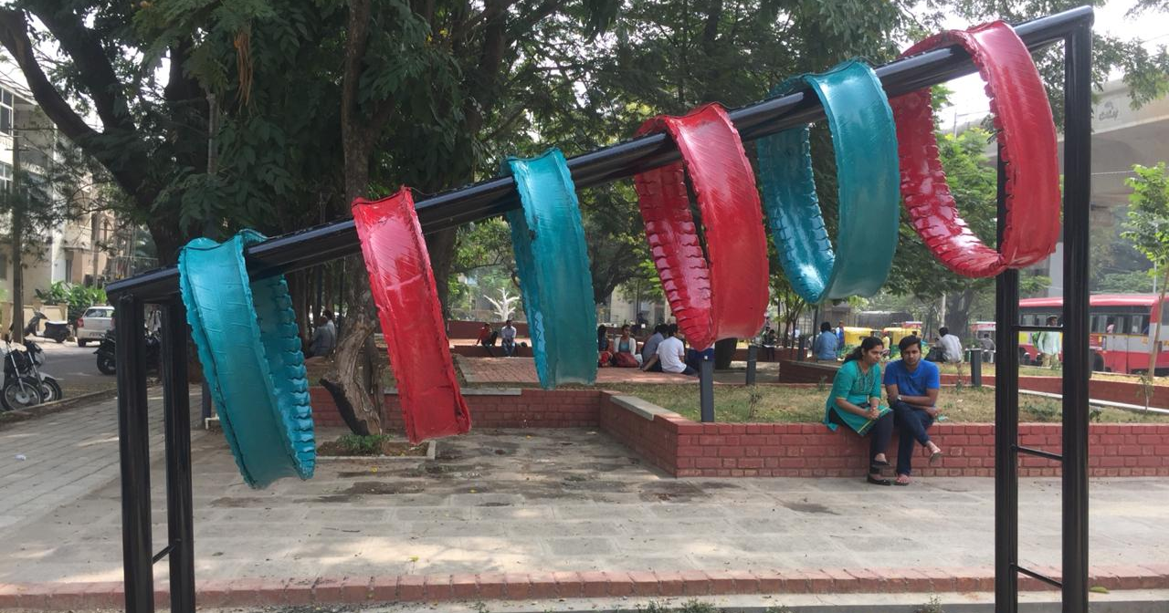
Heaving Hoops

Slide 3
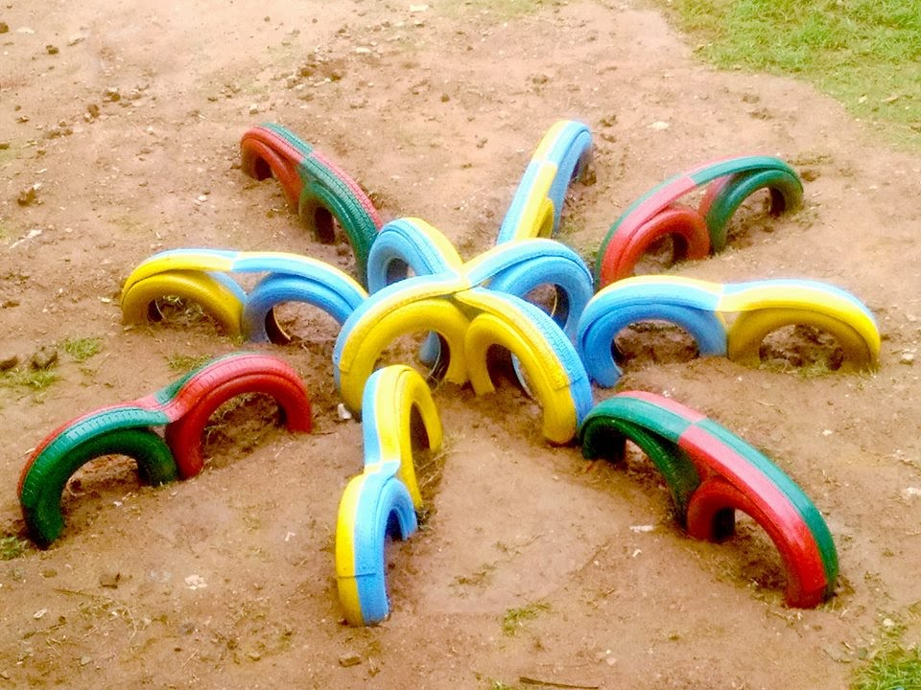
Snowflakes

Slide 4
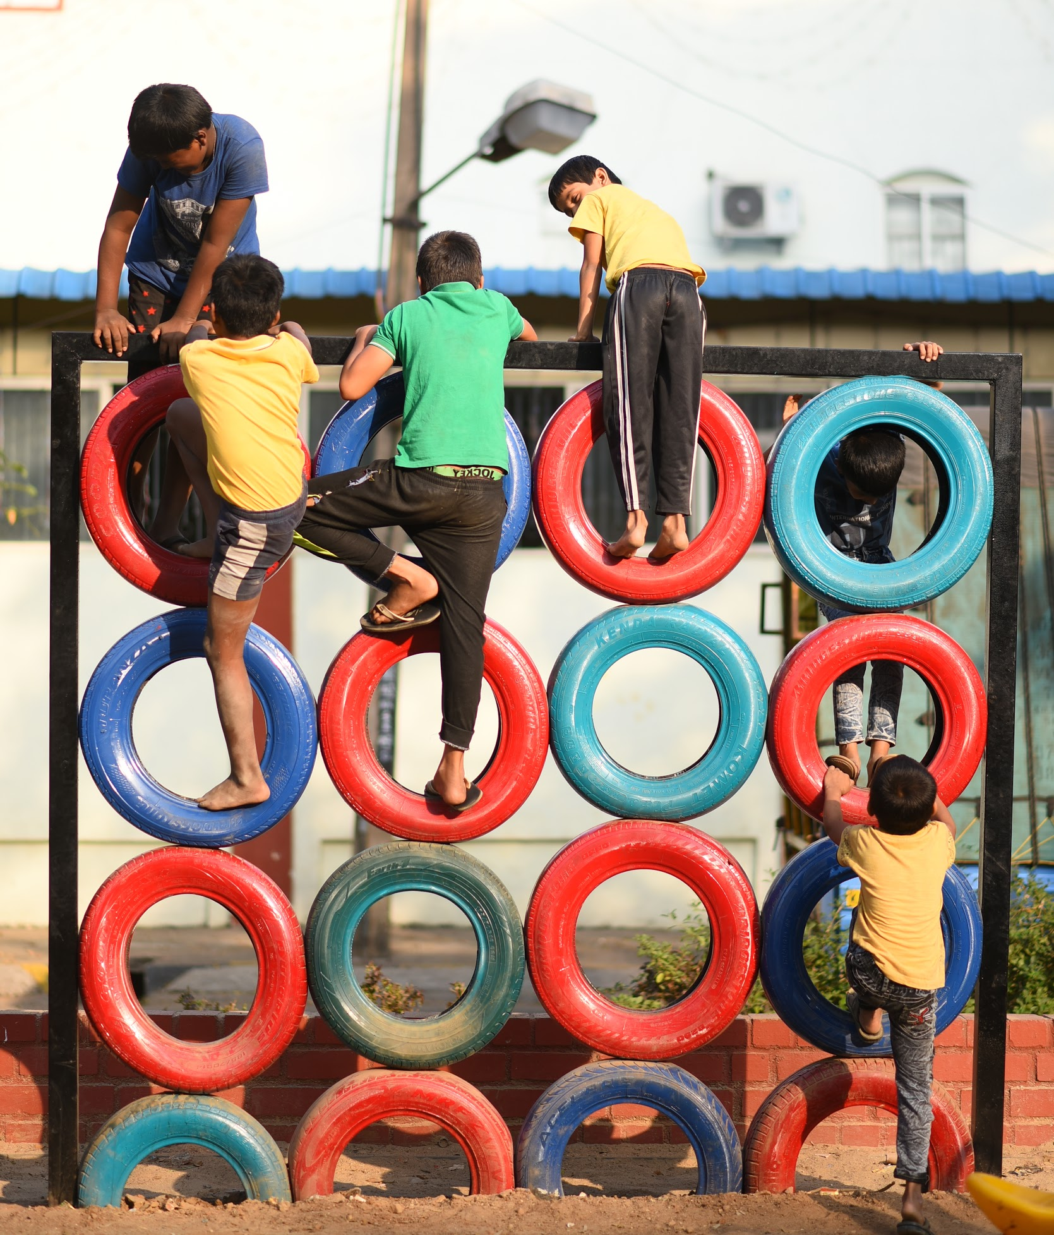
Tyre Climber

Slide 5
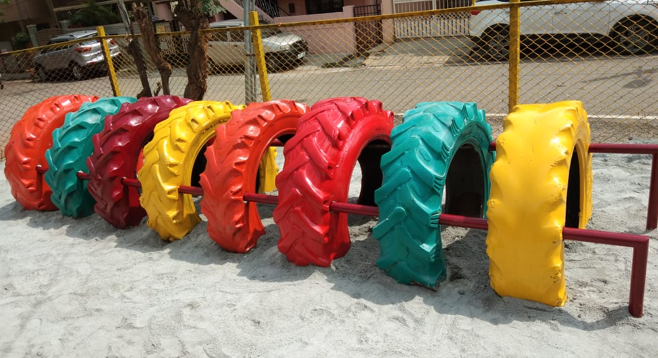
Tyre Tunnel

Slide 6
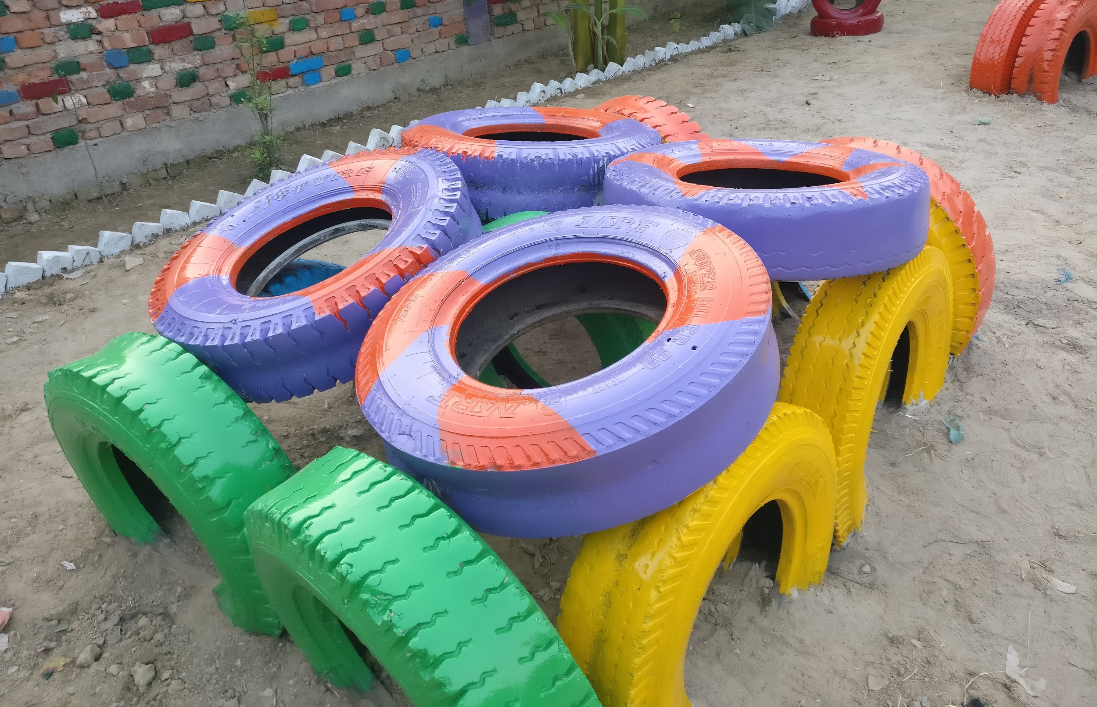
Cube Climber

Slide 7
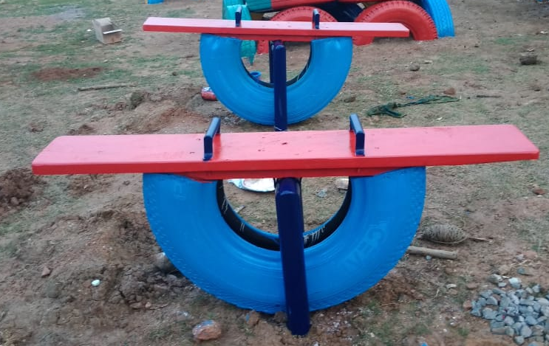
2 Single seesaws

