Slide 1

LEARNING AIDS

Slide 2
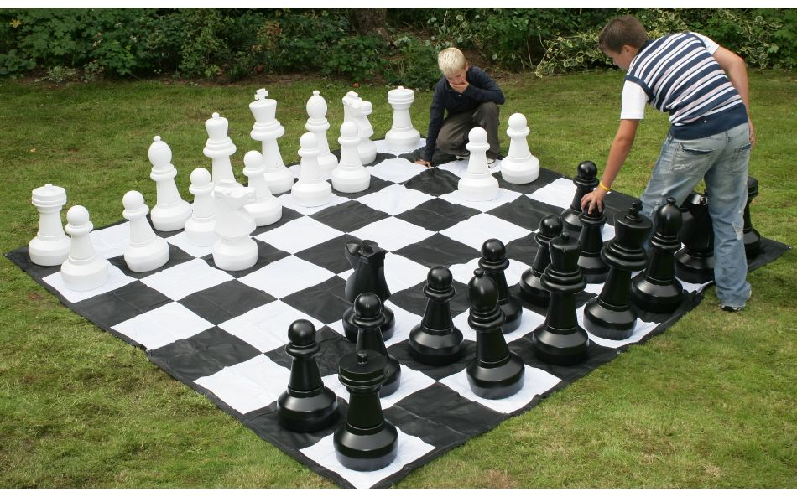
STRUCTURE OF GOVERNMENT
The game can hold the portfolios in hierarchies and they can have the powers vested in the position. The two teams can be ruling and opposition party.
This can be painted on the floor of a classroom.

Slide 3
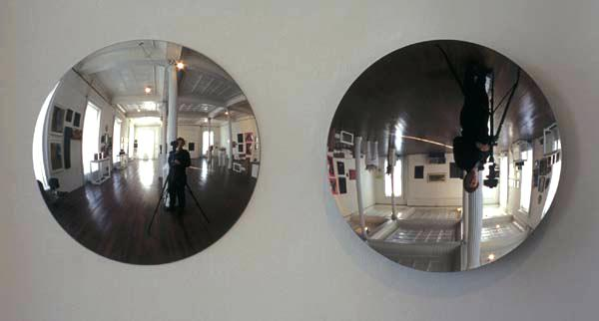
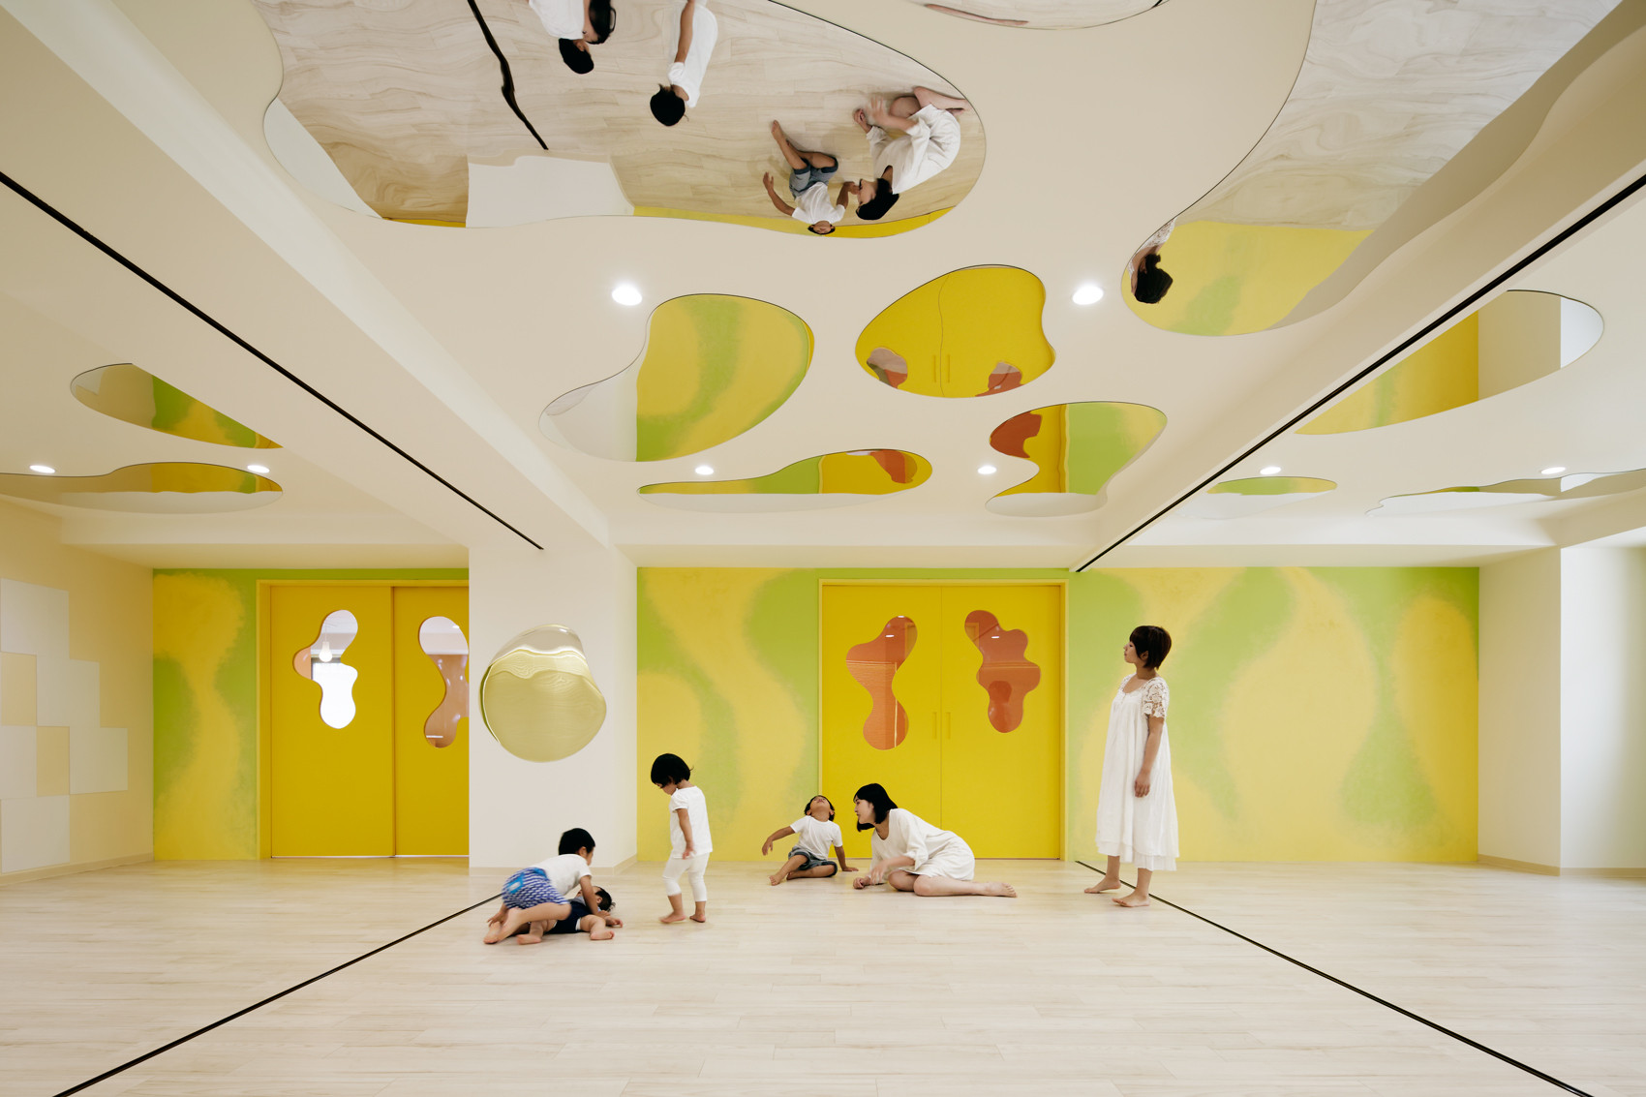
REFLECTIVITIES OF CONCAVE AND CONVEX MIRROR

