Slide 1

PUBLIC PLACE - 2

Slide 2
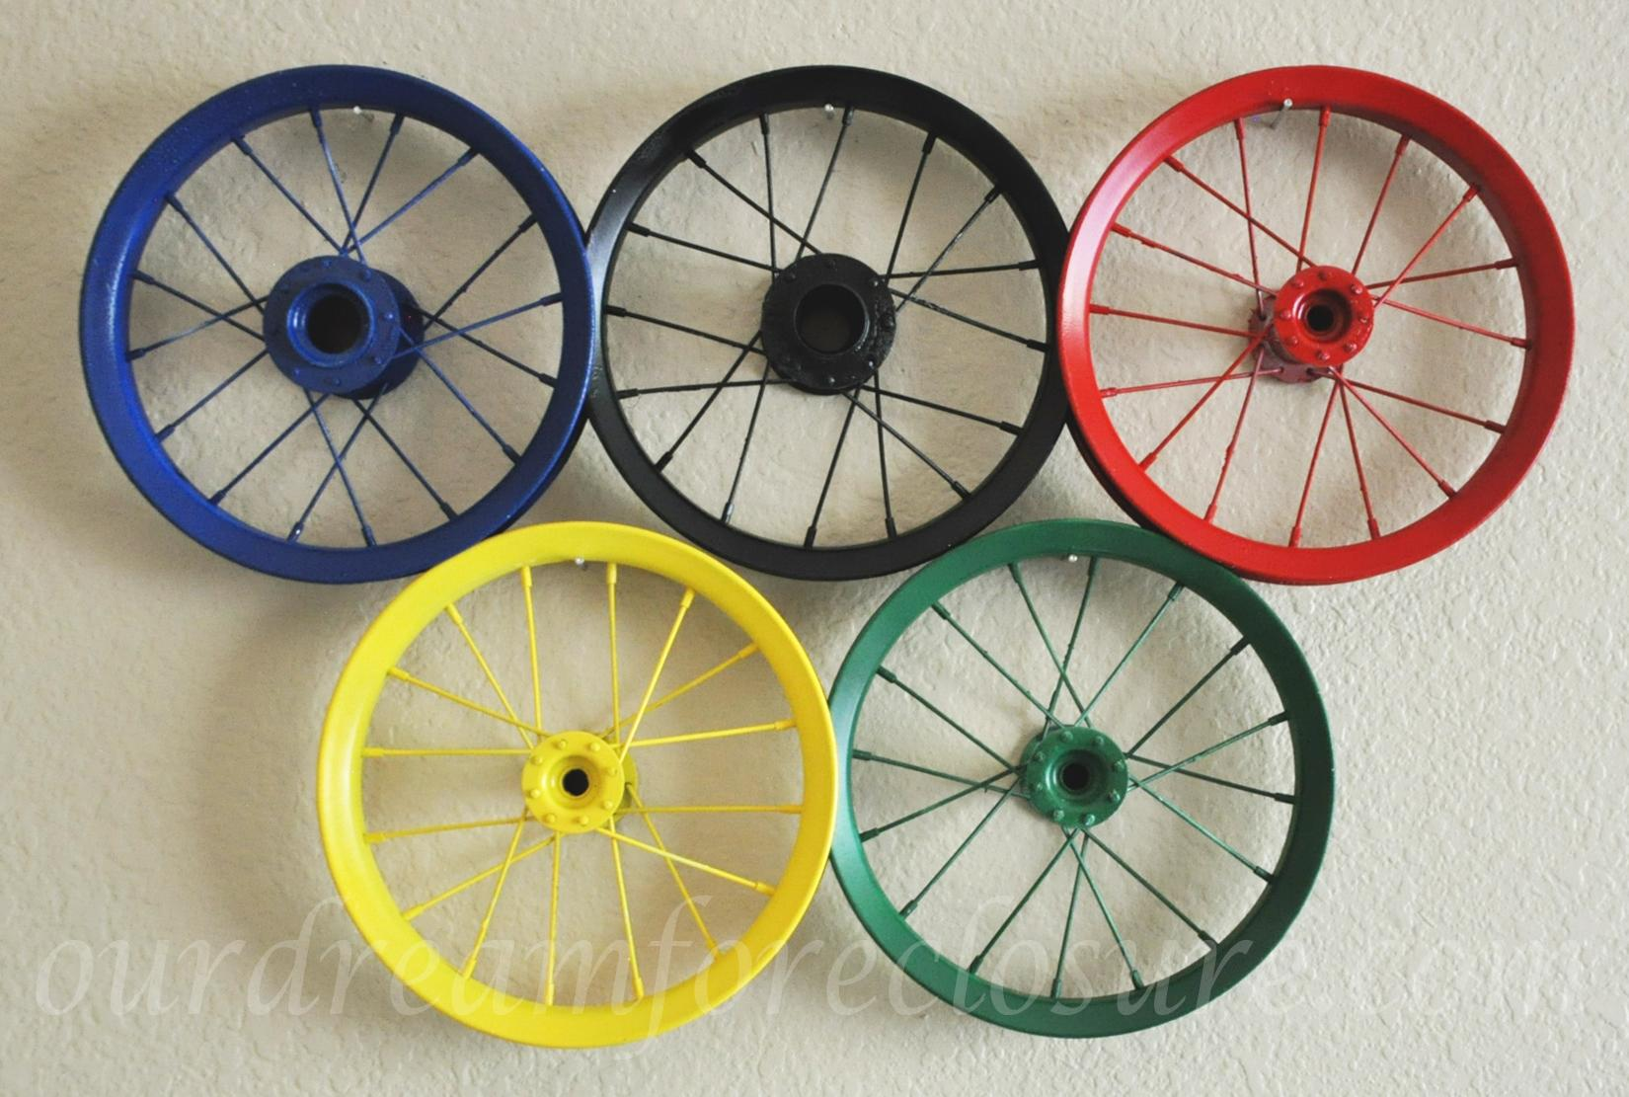
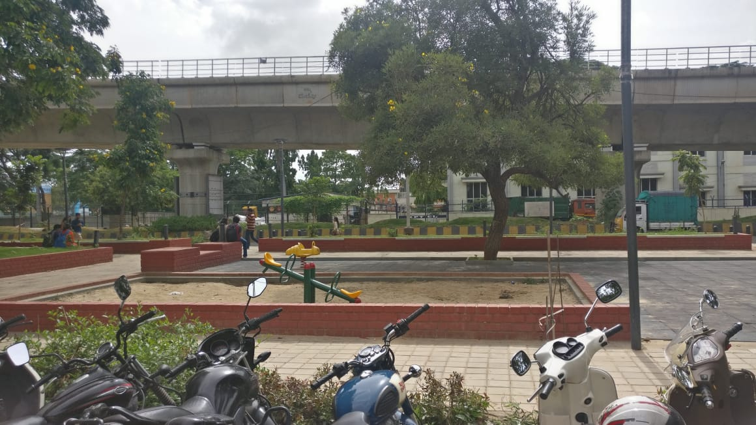
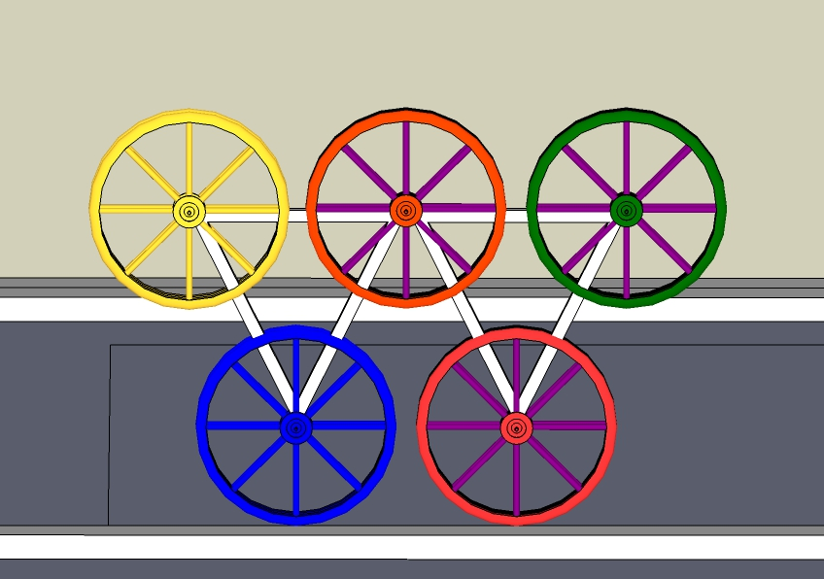
painted cycle rims
An installation of identity to the fun play park. which can be installed on the curb around the sand pit. which kids could rotate and play.
installed
here
will be installed for a length of 15’ on the curb, at varying heights and different colors.
The actual installation

Slide 3
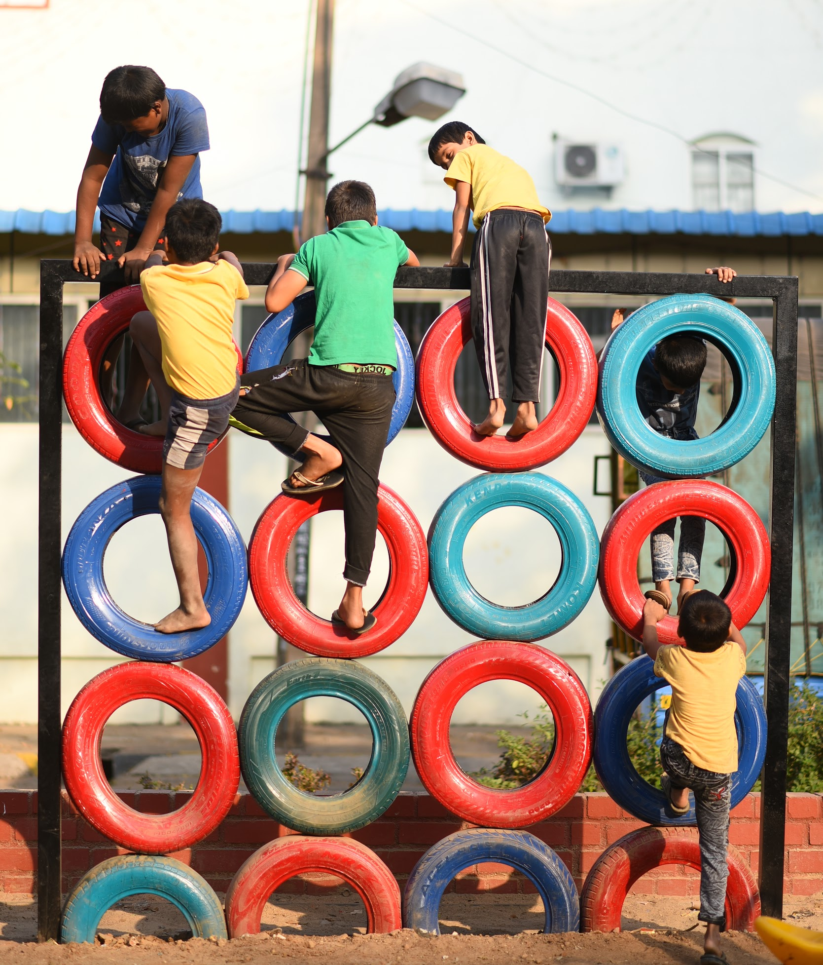
IN THE SAND PIT AREA,
CLIMBER
A structure of tyres, where the kids can climb, jump and move inside out and play, a task which would be fun for elders to climb on too.
would require a metal frame and car tyres and some nuts and bolts.

Slide 4
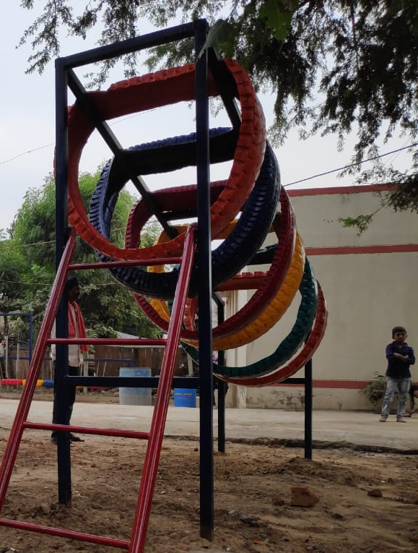
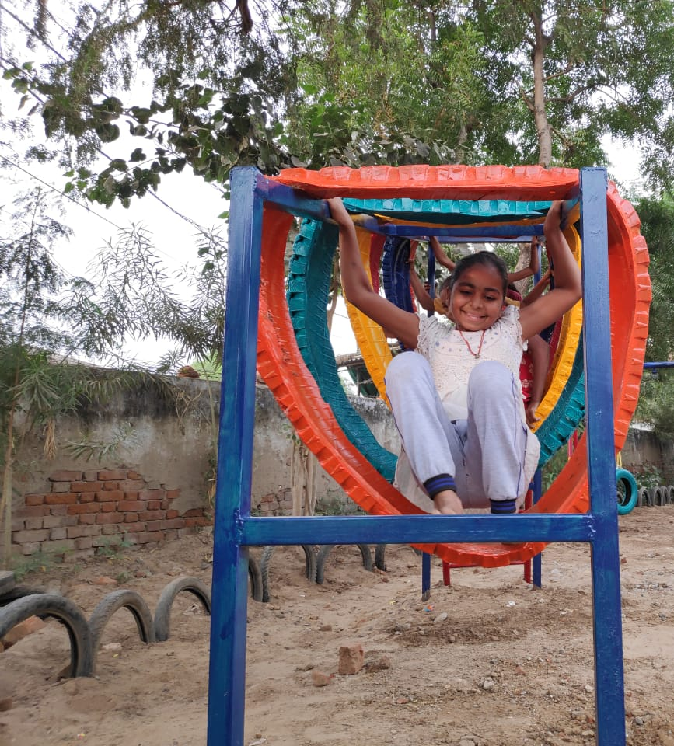
IN THE SAND PIT AREA,
heaving hoops
The kids crawl through the tyres and the challenge is to pass through each loop. This is again a fun element, helping them increase their coordination.
We could install this with layers layers of truck tyres which are strong and are resistant to wear and tear, supported by metal frames anchored to the ground.

Slide 5
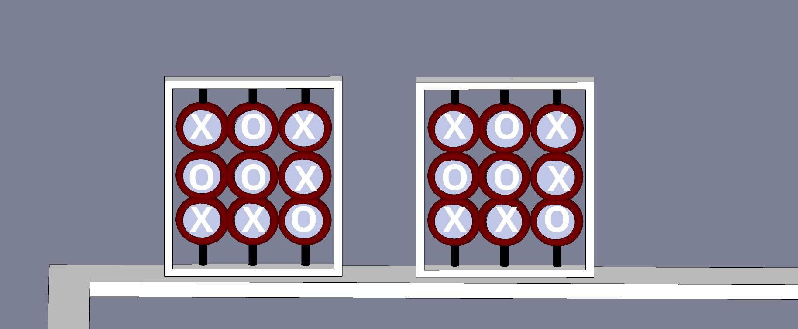
IN THE SAND PIT AREA,
XOX
two players, X and O, who take turns marking the spaces in a 3×3 grid. The player who succeeds in placing three of their marks in a horizontal, vertical, or diagonal row wins the game. It's a strategy game. The life scale tic tac toe would be fun to perceive.

Slide 6
IN THE SAND PIT AREA,
musical drums
Varying heights and sizes of drums with varying color, invokes a vibrance to the space and captures varied sounds. anybody having the interest turn that into some good music are most welcome here.
Thus a public jamming space, it would be also serving as a fun place for kids to jump and play between levels.

Slide 7
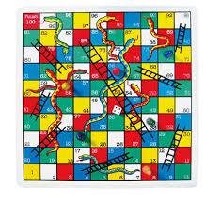
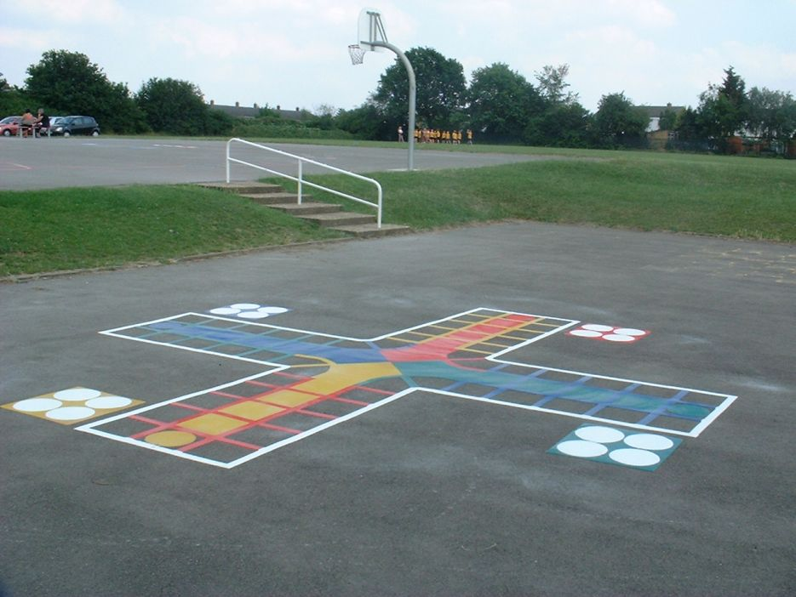
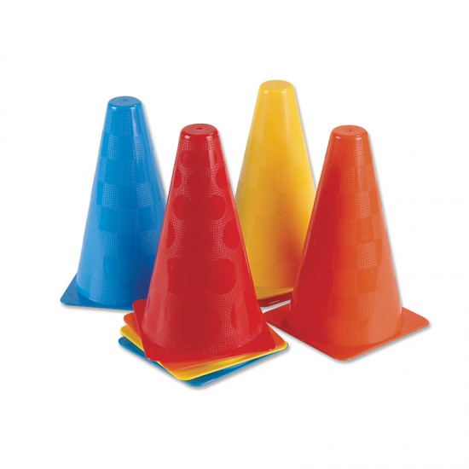

IN THE RUBBER MAT AREA,
THE BOARD GAME
These game could engage large group of people and is also a fun family evening game, the game will be painted on the rubber mats and made colorful. The dice would be a spin wheel, where the player rotates.
would occupy an area of 15’X25’ on the rubber mats.

Slide 8
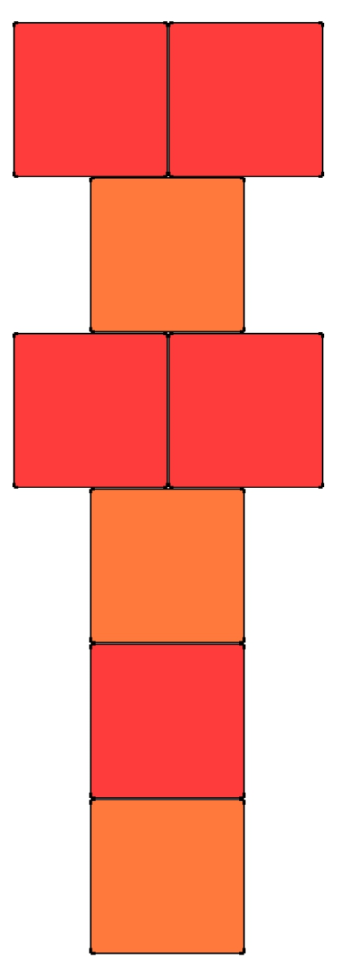
HOPSCOTCH
Hopscotch is an activity where kids would use both their legs and two sides of their brains accordingly, it would also be a fun exercise for adults.
We could use cycle tyre rims and paint them with bright colors to mark the boundaries for them to hop and play the game.

