Slide 1

SNAKE PRONE ZONE - 1

Slide 2
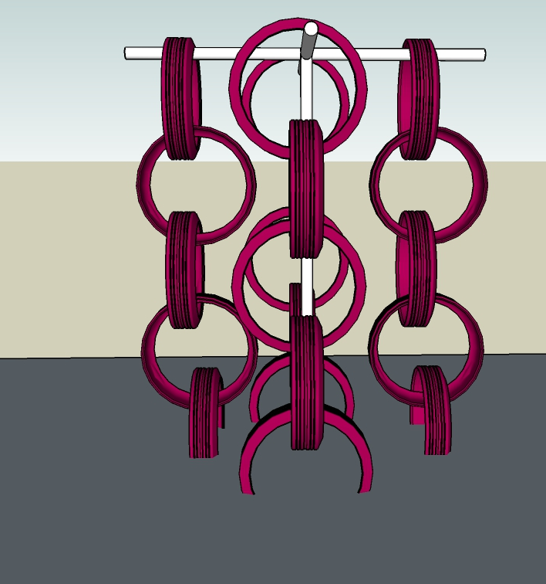
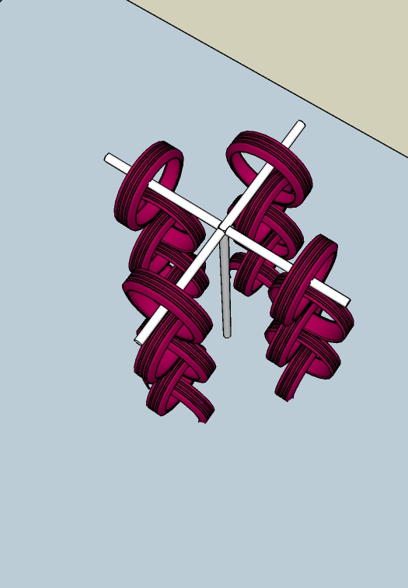
SWAYING CLIMBER
A climber is an element which would help them coordinate better and achieve targets. This would enrich their body and mind coordination.
note : The following image explains the idea of the element and the following element, will be further detailed out to fit site context.

Slide 3
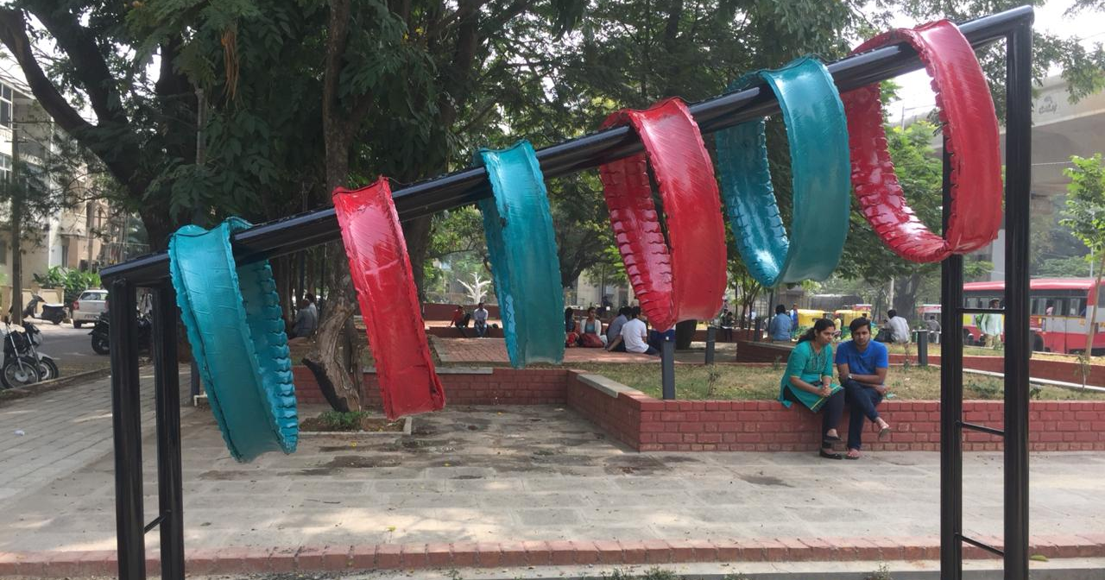
HEAVING HOOPS
The kids crawl through the tyres and the challenge is to pass through each loop. This is again a fun element, helping them increase their coordination.
We could install this with layers layers of truck tyres which are strong and are resistant to wear and tear, supported by metal frames anchored to the ground.
note : The following image explains the idea of the element and the following element, will be further detailed out to fit site context.

Slide 4
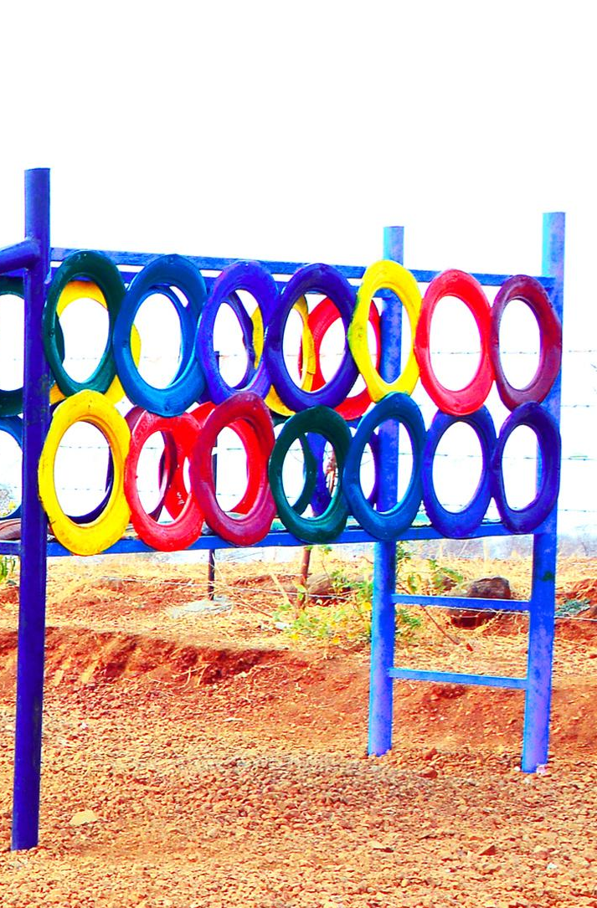
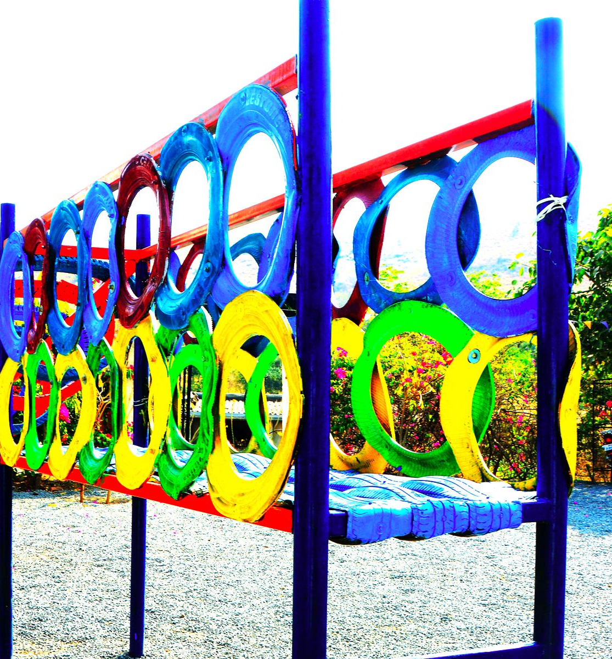
TYRE PLATFORM
A balance walk, which will require coordination for them to walk over the knit tyres.
note : The following image explains the idea of the element and the following element, will be further detailed out to fit site context.

Slide 5
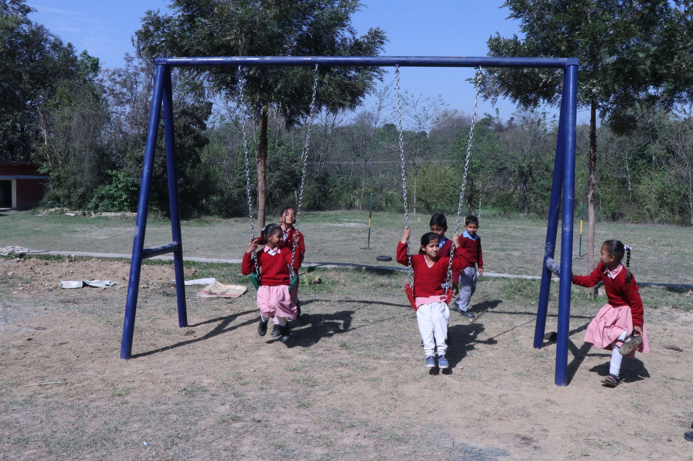
TYRE SWINGS
Swings are relaxing and a fun game for children and adults. This would explain to the children the idea of oscillatory motion. The metal bars especially the ones on the sides can be used to create fun puzzles for them to solve.
note : The following image explains the idea of the element and the following element, will be further detailed out to fit site context.

Slide 6
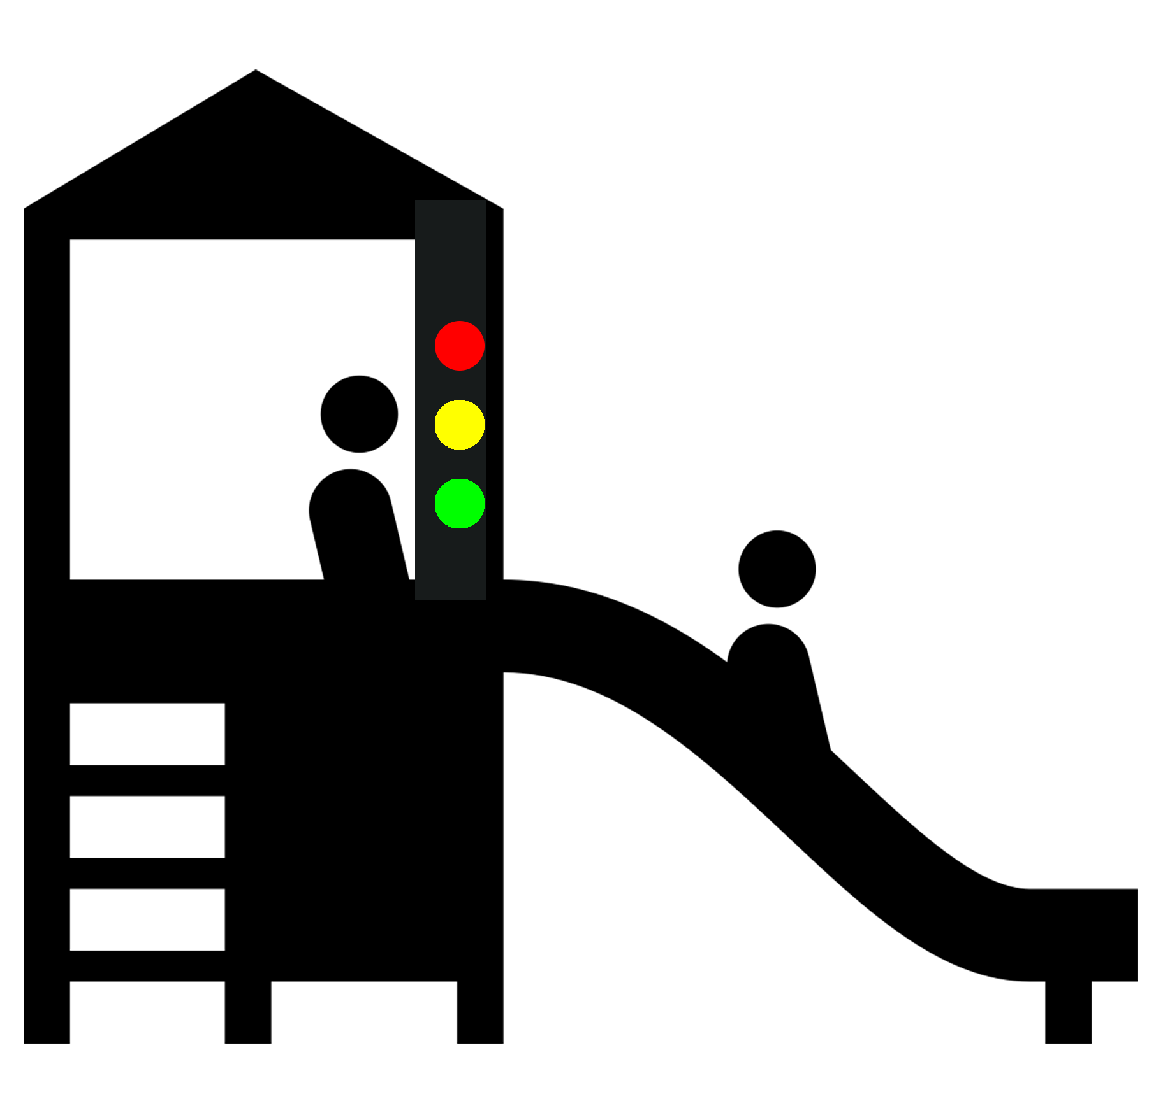
A slide with traffic lights
Context:
Green means to “GO”, Red means to “STOP” and Yellow means to “SLOW DOWN”
Play:
The traffic lights and road safety can be integrated in games like Slide. Only when one child is off the slide and the light turns green, can the other child slide.
Also teaches standing in queue for the turn to come without pushing each other.

Slide 7
TYRE SWINGS
Swings are relaxing and a fun game for children and adults. This would explain to the children the idea of oscillatory motion. The metal bars especially the ones on the sides can be used to create fun puzzles for them to solve.
note : The following image explains the idea of the element and the following element, will be further detailed out to fit site context.

Slide 8
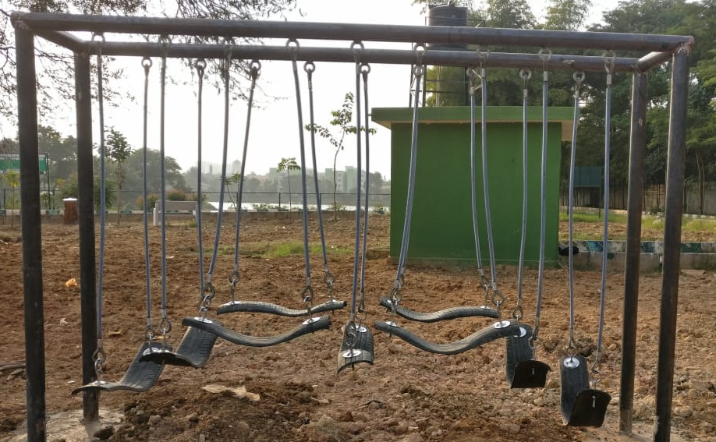
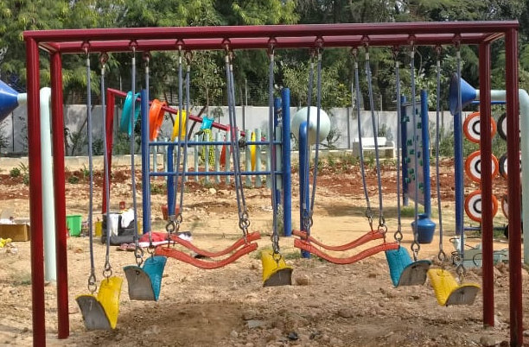
ADVENTURE CONNECT
The Adventure Connect would be a fun element for all age groups, this element is designed to infuse balance and stability, and would be challenging and fun for all age groups.
note : The following image explains the idea of the element and the following element, will be further detailed out to fit site context.

Slide 9
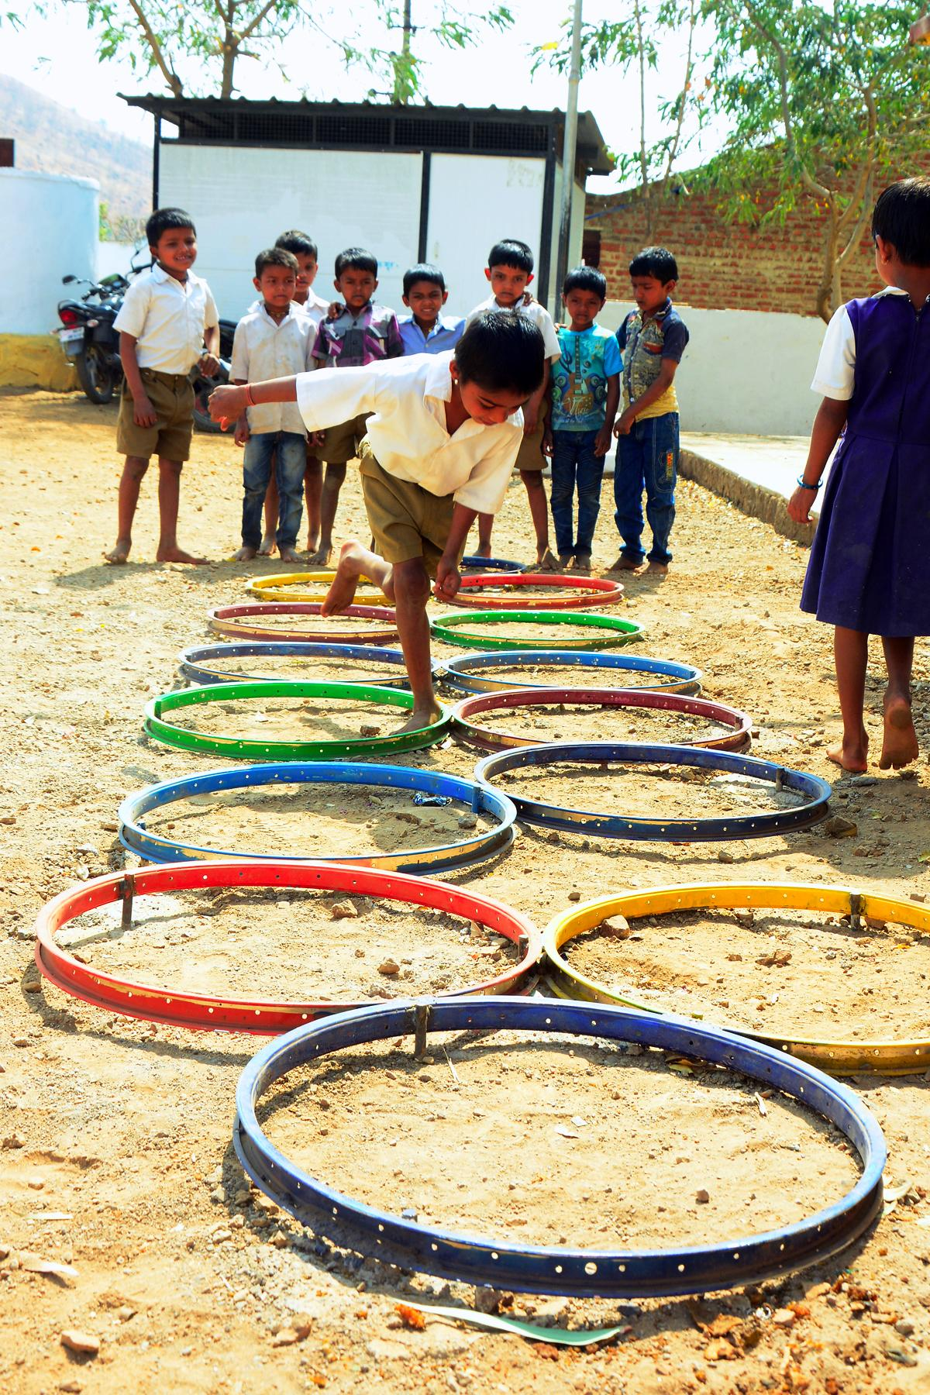
cycle rim HOPSCOTCH
Hopscotch is an activity where kids would use both their legs and two sides of their brains accordingly.
note : The following image explains the idea of the element and the following element, will be further detailed out to fit site context.

Slide 10
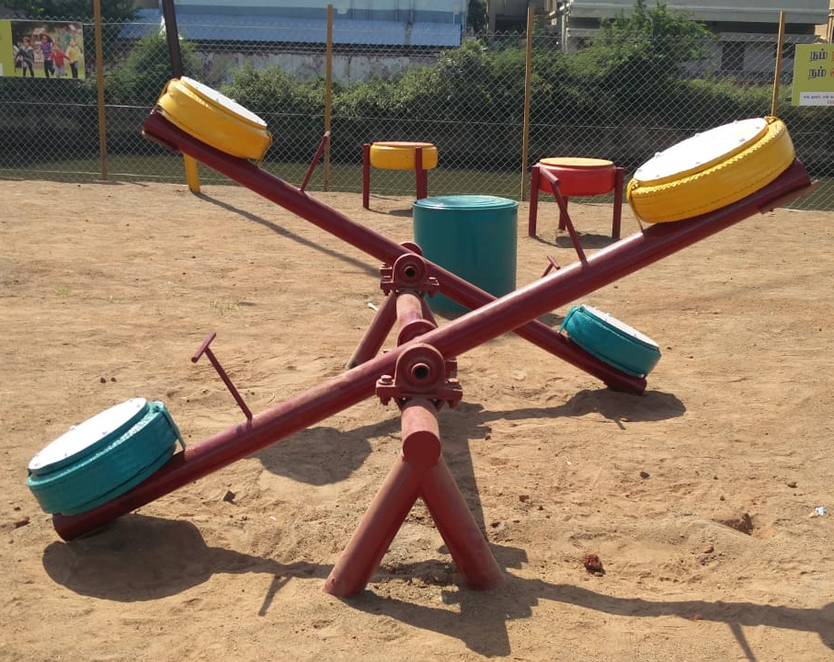
SEE SAW
A seesaw is a lever, which is found in most of children's parks. A couple of seesaws would explain some science and the idea of balance.
note : The following image explains the idea of the element and the following element, will be detailed out such that, there would be no settling corners for snakes.

