Slide 1

STANDARD PROPOSAL - 2

Slide 2
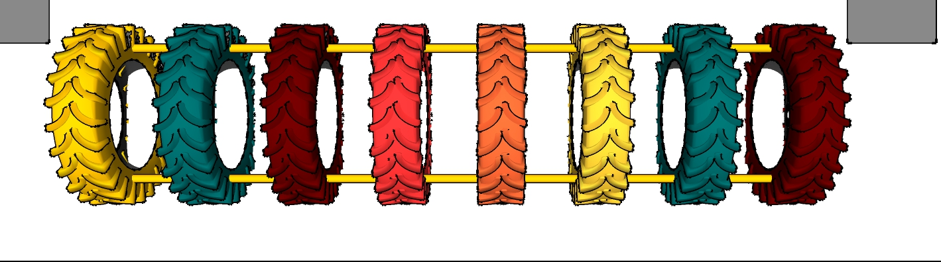
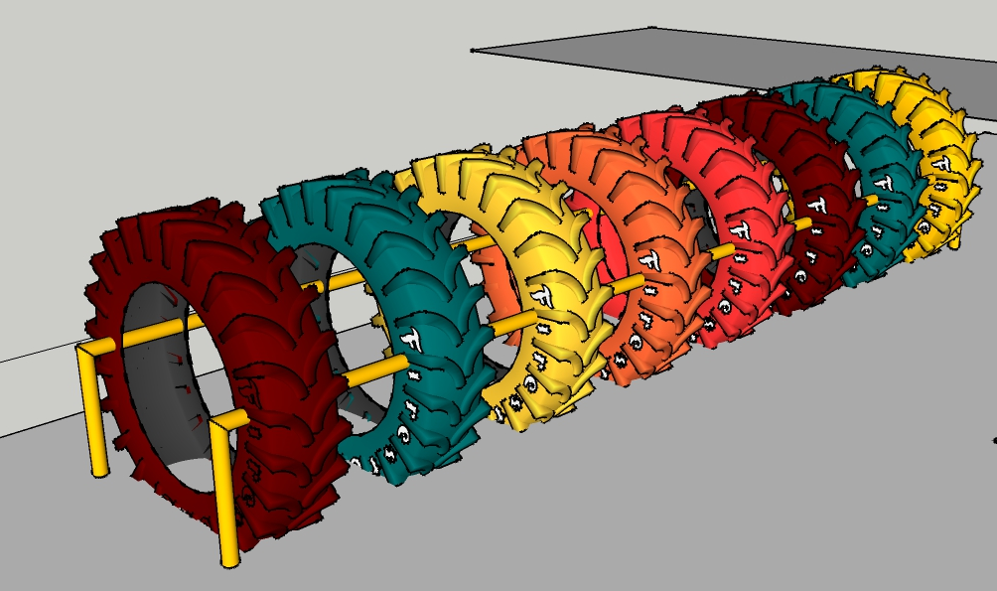
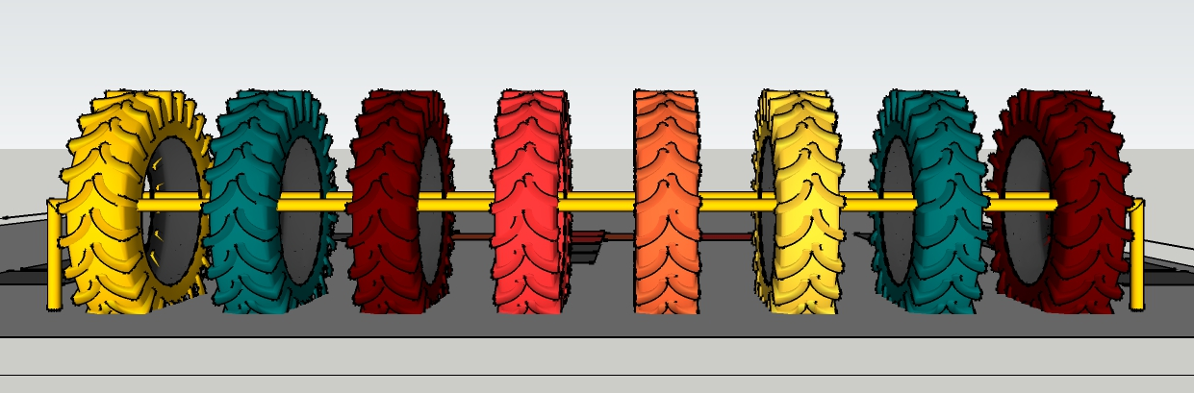

metal required:2” pipe
length of element : 15’ 6”
number of tyres required: 8
TYRE TUNNEL
1’
1’6”
metal pipe below the ground 2’ in concrete.
15’6”
Tyres required: 1020 sized tyres 8 nos. (exactly same dimensions of tyres preferred).
if not available, we need 8 tractor tyres and the frames will not be required.

Slide 3
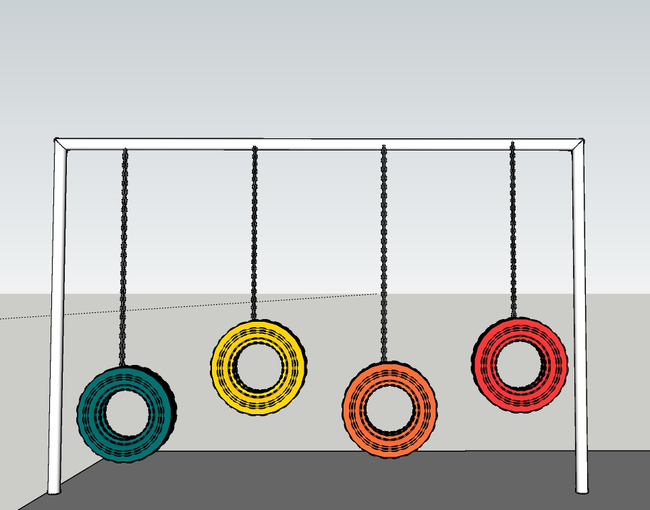
Metal required: box section 3”X3”
vertical members : 2nos
horizontal members : 1 nos
length of vertical member : 7’ above the ground + 2’ below the ground.
length of horizontal member : 8’
metal pipe below the ground 2’ in concrete.
12’
TYRE SWINGS
8’
5’
4’
5’
4’
Tyres required : 16 car tyres (exactly same dimensions of tyres preferred).

Slide 4
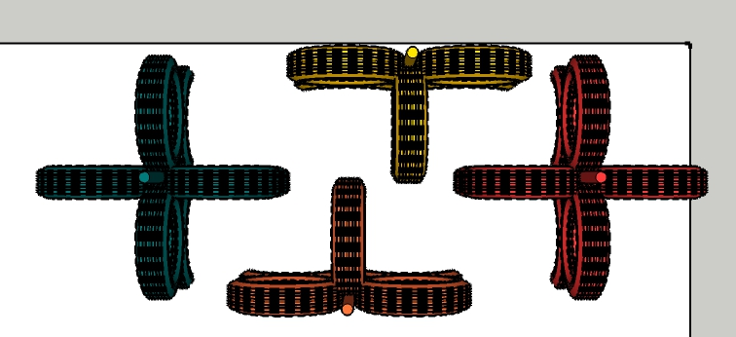
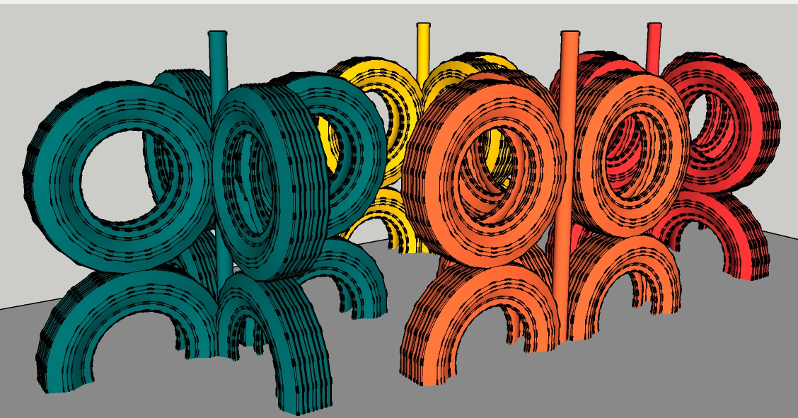
Metal required: box section 3”X3”
number of poles : 4
length of each pole : 5’ above the ground+2’ below the ground.
MAZE MINI
5’
Tyres required: 28 SUV tyres required, all 870 size. (exactly same dimensions of tyres preferred).

Slide 5
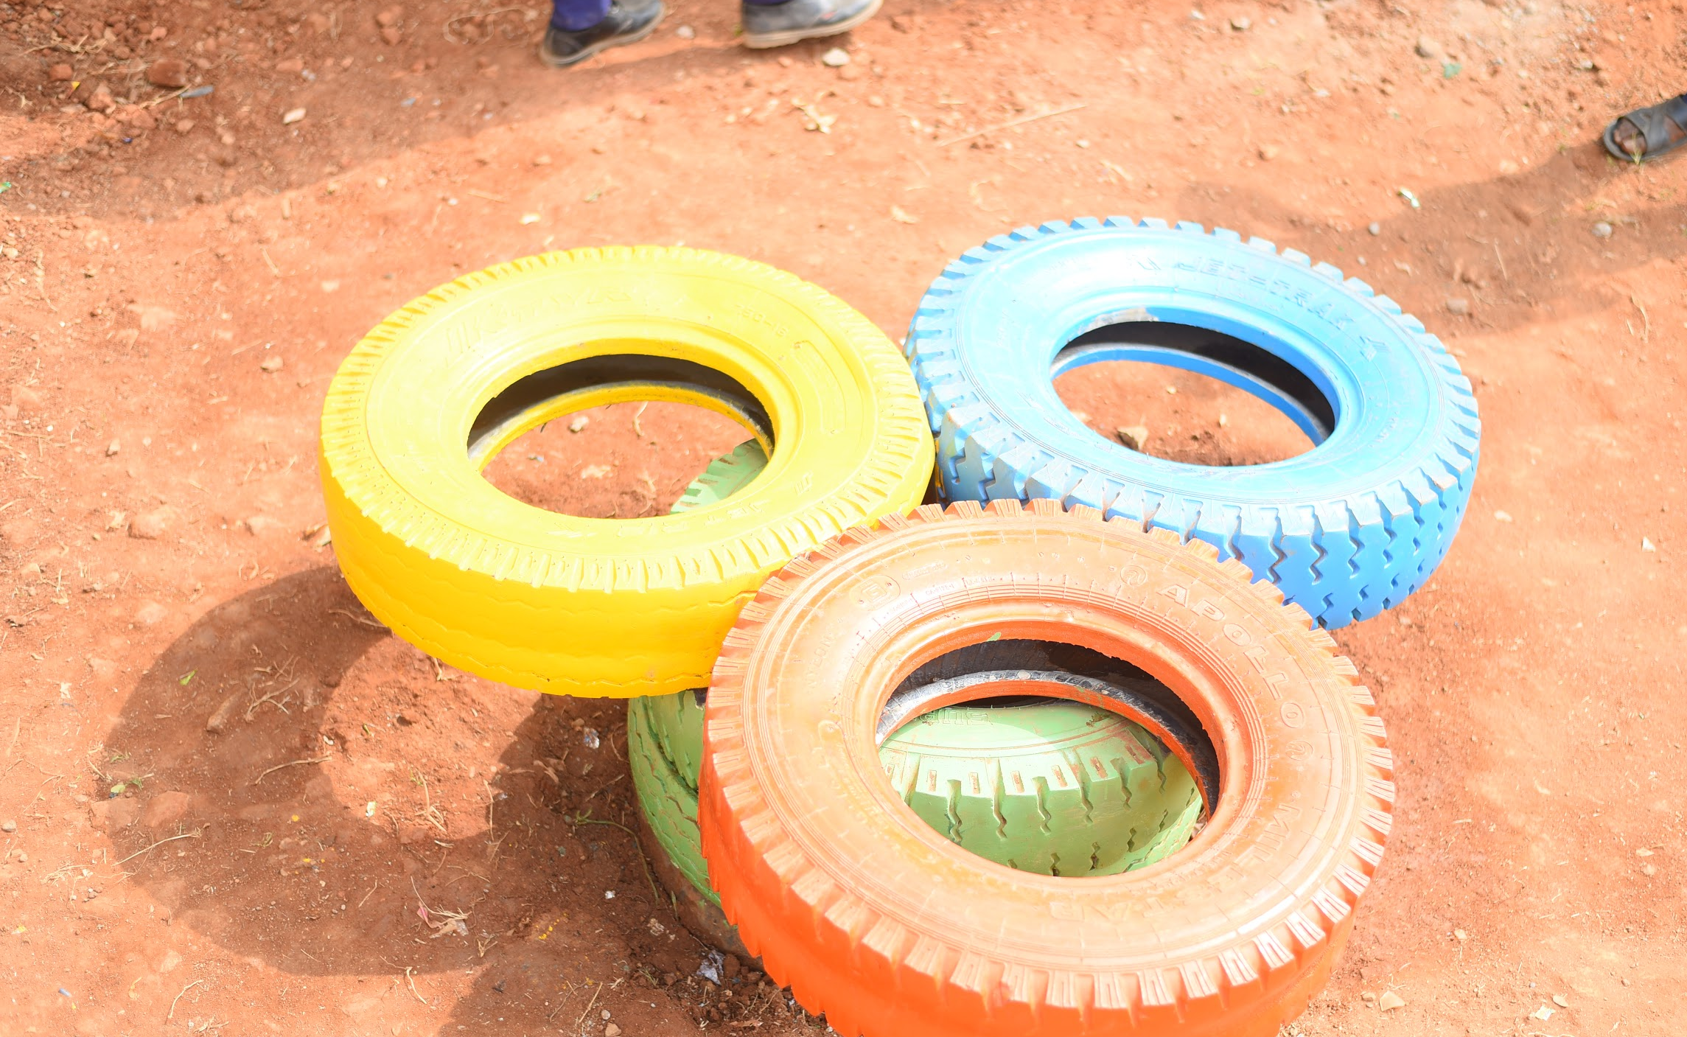
How do we perceive a See Saw
ELEMENT G: See Saw
Material: 8 Truck Tyre
Procedure:
Step 1 - Marking
Step 2 - Digging
Step 3 - Drilling
Step 4 - Bolting
Step 5 - Painting

Slide 6
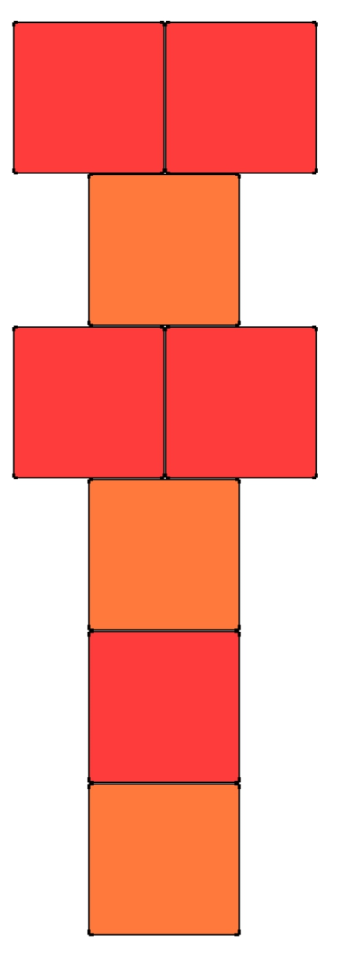
TILE Hopscotch
Hopscotch is an activity where kids would use both their legs and two sides of their brains accordingly, it would also be a fun exercise for adults.
We could use cycle tyre rims and paint them with bright colors to mark the boundaries for them to hop and play the game.
material : 8 tiles of 2’X2’

