Slide 1

NEXT TO A WATER BODY

Slide 2
TYRE SWINGS
Swings are relaxing and a fun game for children and adults. This would explain to the children the idea of oscillatory motion. The metal bars especially the ones on the sides can be used to create fun puzzles for them to solve.
note : The following image explains the idea of the element and the following element, will be further detailed out to fit site context.

Slide 3
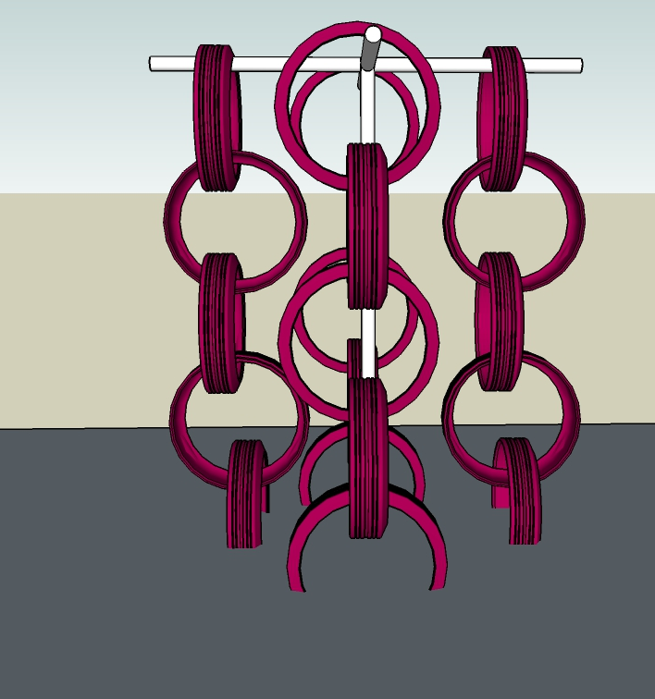
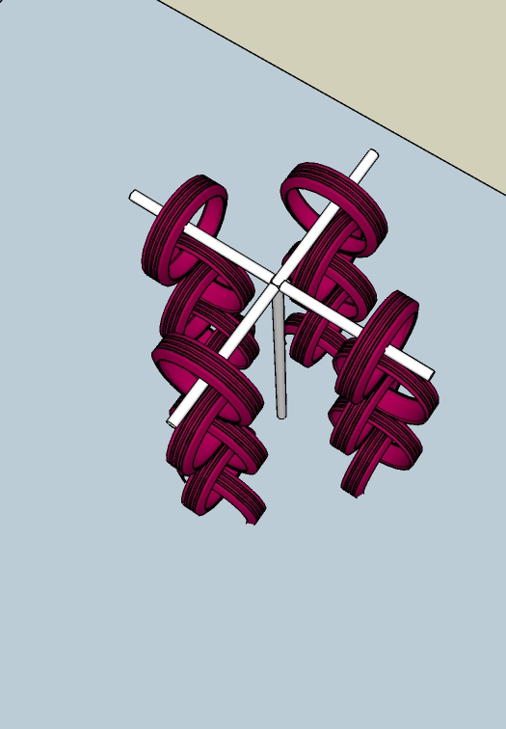
SWAYING CLIMBER
A climber is an element which would help them coordinate better and achieve targets. This would enrich their body and mind coordination.
note : The following image explains the idea of the element and the following element, will be further detailed out to fit site context.

Slide 4
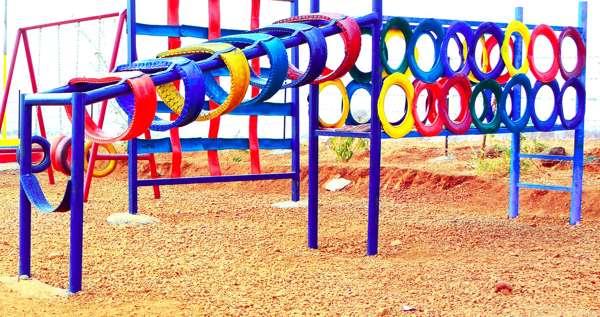
PLAYSTATION - 01 BALANCE BRIDGE AND HEAVING HOOPS
note : The following image explains the idea of the element and the following element, will be detailed out such that, there would be no settling corners for snakes.

Slide 5
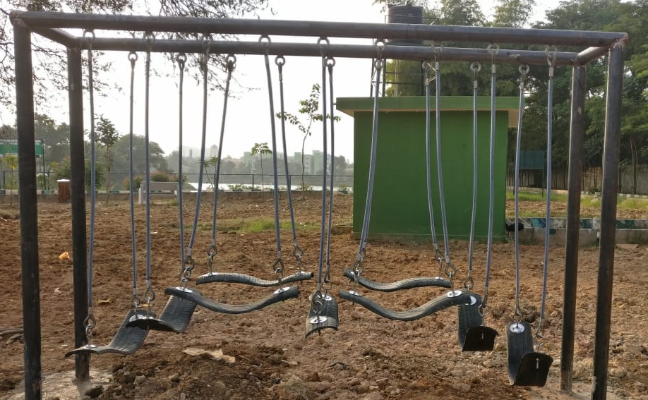
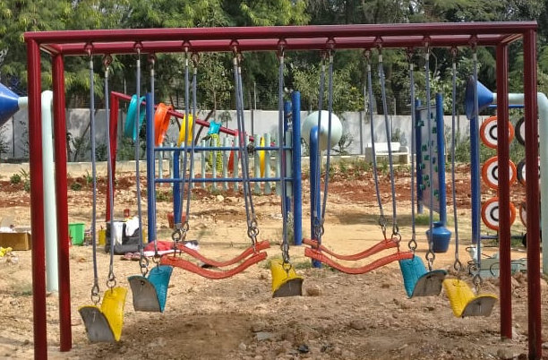
ADVENTURE CONNECT
The Adventure Connect would be a fun element for all age groups, this element is designed to infuse balance and stability, and would be challenging and fun for all age groups.
note : The following image explains the idea of the element and the following element, will be further detailed out to fit site context.

Slide 6
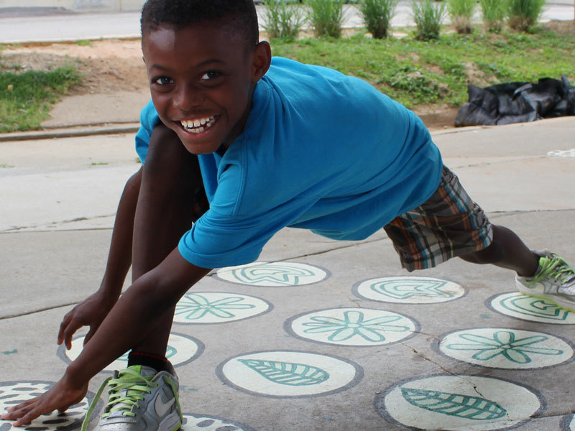
LET’S STRETCH
note : The following image explains the idea of the element and the following element, will be detailed out such that, there would be no settling corners for snakes.

Slide 7
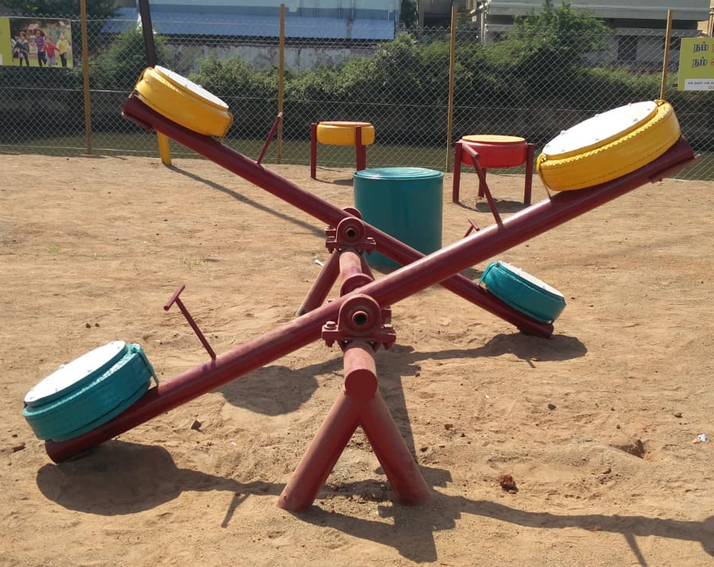
SEE SAW
A seesaw is a lever, which is found in most of children's parks. A couple of seesaws would explain some science and the idea of balance.
note : The following image explains the idea of the element and the following element, will be detailed out such that, there would be no settling corners for snakes.

