Slide 1

Anthill Creations

Slide 2
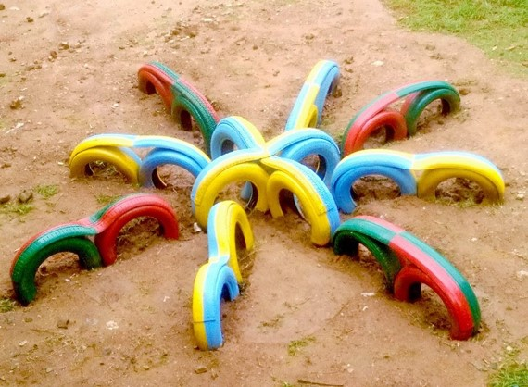
snowflakes

