Slide 1
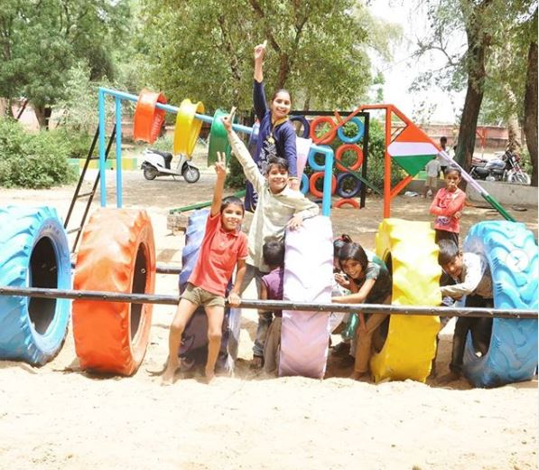
TEAM 04 PITCH DECK

Slide 2

Hello!
We are Team 04

Slide 3
1.
Problem

Slide 4
Problem Statement
The amount of time spent on manually writing emails and crafting designs based on client requirements is an important concern for Anthill Creations
No easy way exists for the team at Anthill Creations to quicken this process

Slide 5

PROBLEM DEFINITION: Situation – Gap – Question
Gap
A lack of technical support to help automate the current process.
Situation – Current State
Desired Future State
Anthill Creations is an organization that builds playscapes for their clients in various communities.
Current process involves manual intervention at each stage. More time is spent on manually writing
Excel sheets are used for maintaining client information. Google forms are being used to build and collect survey results.
Outcome: Anthill Creations has reduced the man-hours involved in the onboarding stage of their clients.
Behavior: Anthill Creations are using our technology that automates the process.
Insight: Survey is taken on a customizable webpage. Client registration information and survey responses are being maintained in a MySQL DB. Emails are auto-generated using Python APIs.
Key Question
How can we build a simple website that is budget friendly and easily maintainable?

Slide 6
Inspection of the problem reveals the following focus areas..
Automation of the following:
Sending a welcome email to the clients containing the link to site survey
Design selection
Sending an email containing the selected design

Slide 7
2.
Our Product

Slide 8
Our Proposed Solution
A web platform for your clients that helps you
SAVE TIME
SAVE EFFORT
SAVE MONEY

Slide 9
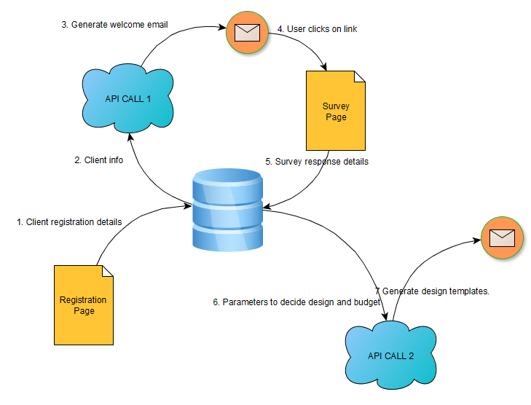
ARCHITECTURE

Slide 10
For the client:
A registration page
A survey page
For you:
A database on MySQL
A webpage for the designer to upload her/his ideas
Auto-generation of emails
A model that predicts design templates for the user

Slide 11




You can be confident that your messages are getting delivered to your clients.
1
2
Build long term relationships with clients with little effort.
3
Follow-up flawlessly without missing a single client.
4
Turn website visitors into clients.

Slide 12
5.
Why us?

Slide 13


INTENT
SIMPLE & EFFECTIVE
NO TECHIE?
NO PROBLEM

Slide 14
6.
Future Roadmap

Slide 15
Scaling up
The auto-response email has been created for one purpose already. You can now duplicate this for different groups of clients, products services
Enable continuous marketing
An autoresponder can be made to send marketing messages out to your prospects and customers on a regular basis + you won’t need to hire more people to do this!
More clients
Redirect clients to your blog/website/articles/videos all of which will help them make the buying decision.

