Slide 1
A Toolkit for High Performance Event Driven Systems
Ben Gangl-Lipson

Slide 2
Table of Contents
Schema Validation
Provenance
Fact Events
Hashing
Compaction
Batching and Timeouts
Deduplication
Fresh Filtering
Draining
Caching
Concurrency
Compression

Slide 3
Schema Validation
Introduce strict typing into Kafka
Typically uses an external schema registry
Serialization and deserialization via schema ID
Key and value are separate validations
Broker schema validation vs producer schema validation

Slide 4
Schema Validation
Benefits
Strong typing and contracts
Safe version control
Better observability
Strong documentation
Drawbacks
Operational complexity running a registry
Slower prototyping
Conventions must be agreed upon

Slide 5
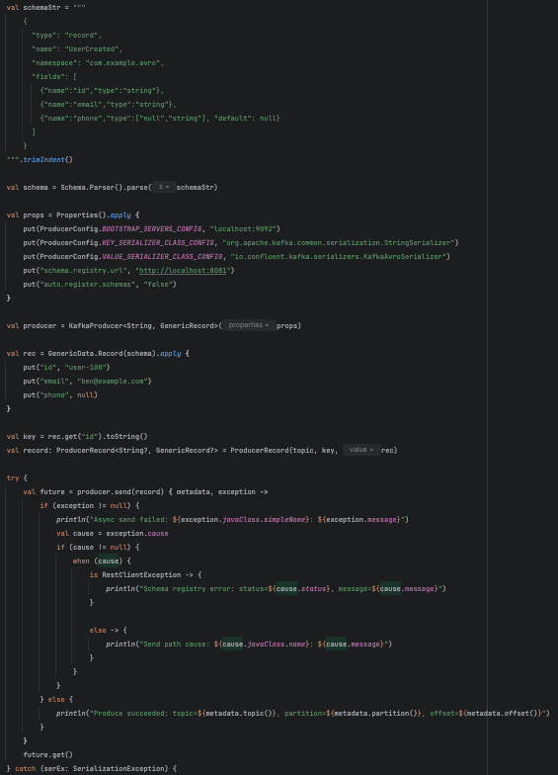
Schema Validation
When and how can I use it? When?
Almost always
Topics are consumed publicly across the enterprise
How?
Schema registry like Confluent Schema Registry
Serialization format like Avro, Protobuf, or JSON
key.serializer and value.serializer config values
schema.registry.url for producer validation and confluent.value.schema.validation for broker validation

Slide 6
Provenance
Metadata attached to an event to identify it across systems
Troubleshooting and explaining data
Typically set in the headers
All inputs get set on the output
Very few drawbacks if any

Slide 7
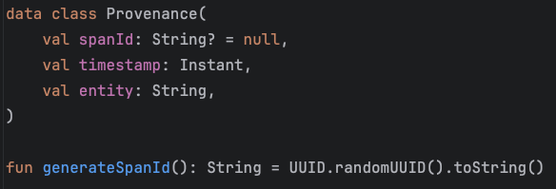
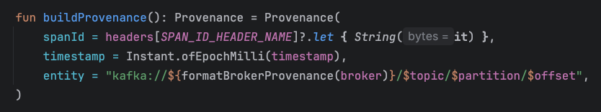
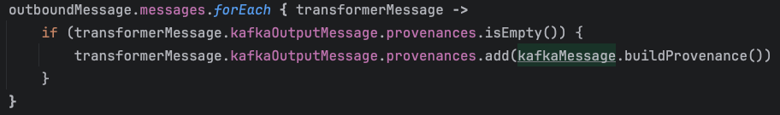
Provenance
When and how can I use it? When?
Always set a unique ID to events
Forward those same IDs when filtering data
Add those unique IDs to the body when transforming an input topic or aggregating multiple input topics
How?
Kafka headers
Random UUIDs with timestamps and source topic names

Slide 8
Fact Events
Alternative to deltas
Includes the entire scope of the domain model on every message
Benefits
No state management required
Fewer bugs
Easy for consumers to publish fewer events via batching changes into one fact
Observability
Drawbacks
Individual event size is larger
Slower publishing if batching, more large events if not
Loss of intent

Slide 9
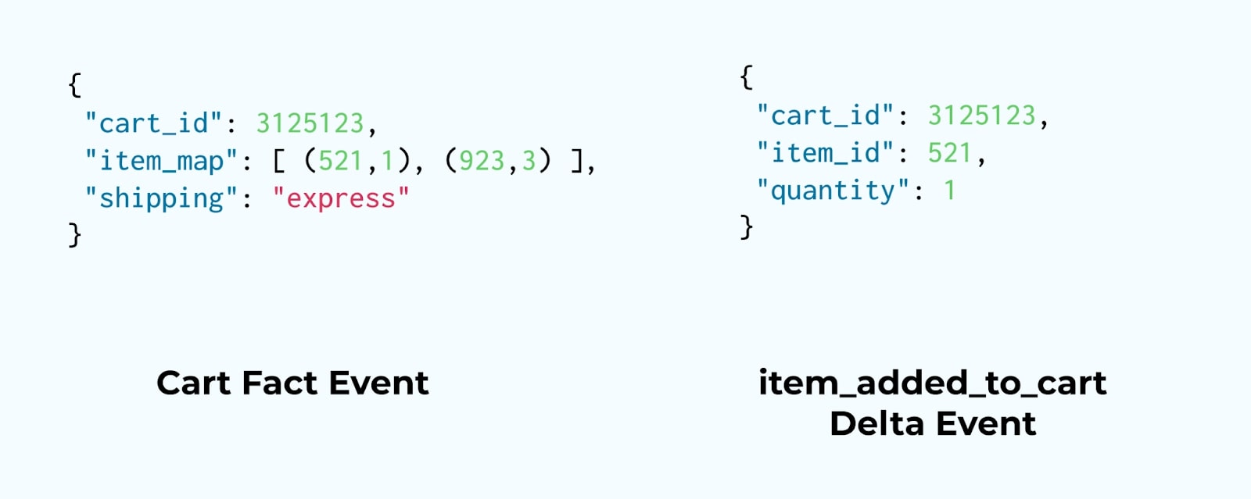
Fact Events
When and how can I use it? When?
Any time you want to know the current state of a domain
Almost always, exception is when you only want to notify consumers of very specific events (e.g. “low inventory alert”)
How?
Publish the entire state of your domain instead of deltas

Slide 10
Hashing
Define which partition a message goes to via hash function and modulo
Default is to use the key
Can define a custom partitioning strategy by hashing on whatever values you want

Slide 11
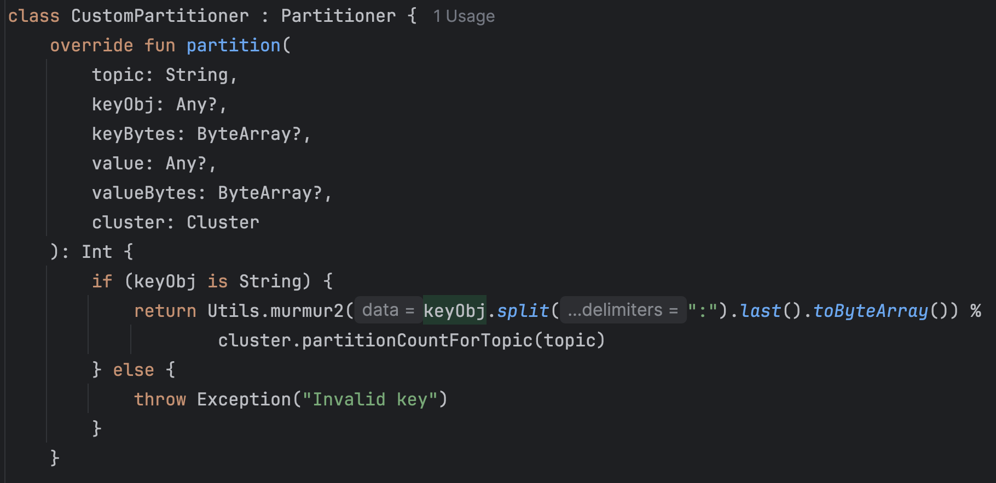
Hashing
When and how can I use it? When?
Rarely
Grouping for deduping or fresh filtering by something other than the key, like a subset of a composite key
How?
Class that implements Partitioner and overrides the partition() method
ProducerConfig.PARTITIONER_CLASS_CONFIG= YourCustomPartitioner

Slide 12
Compaction
A type of cleanup policy
Alternative to typical “delete” retention
Can be combined with “delete” retention

Slide 13
Compaction
Benefits
Latest state
Fast consumption and recovery
Reduced storage
Drawbacks
Eventually consistent
No historical audit trail or replay ability
More CPU and memory usage on the broker
Careful key design
Offline consumers can miss tombstones

Slide 14
Compaction
When and how can I use it? When?
When consumers only care about the latest value for a key (e.g. fact topics)
Finite unique keys (10s to 100s of millions limit)
Compact + delete if values are time-sensitive and can expire
You can set up a periodic repopulation if needed
How?
cleanup.policy = compact config value
Tweak max.compaction.lag.ms and segment.ms to run often but not too often (24 hours and 12 hours respectively)
Don’t tweak min.cleanable.dirty.ratio because it causes compaction to run too often
Send tombstones (null value) to delete messages

Slide 15
Batching and Timeouts
Batching while consuming
Consume data within a bounded timeframe or size
List<Message> instead of a single Message
Batching while producing
Publish data within a bounded timeframe or size
Publish a List<Message> instead of a single Message
Timeouts
Client waits for the broker to respond
Broker waits for the consumer to respond
Max amount of time a consumer has to process a message/batch

Slide 16
Batching and Timeouts
Benefits
Reduce number of network requests
Increase throughput
Minimize load on the broker
Compression efficiency
Drawbacks
Introduces a small latency
Doesn’t inherently improve the performance of individual message processing
Increases rebalancing

Slide 17
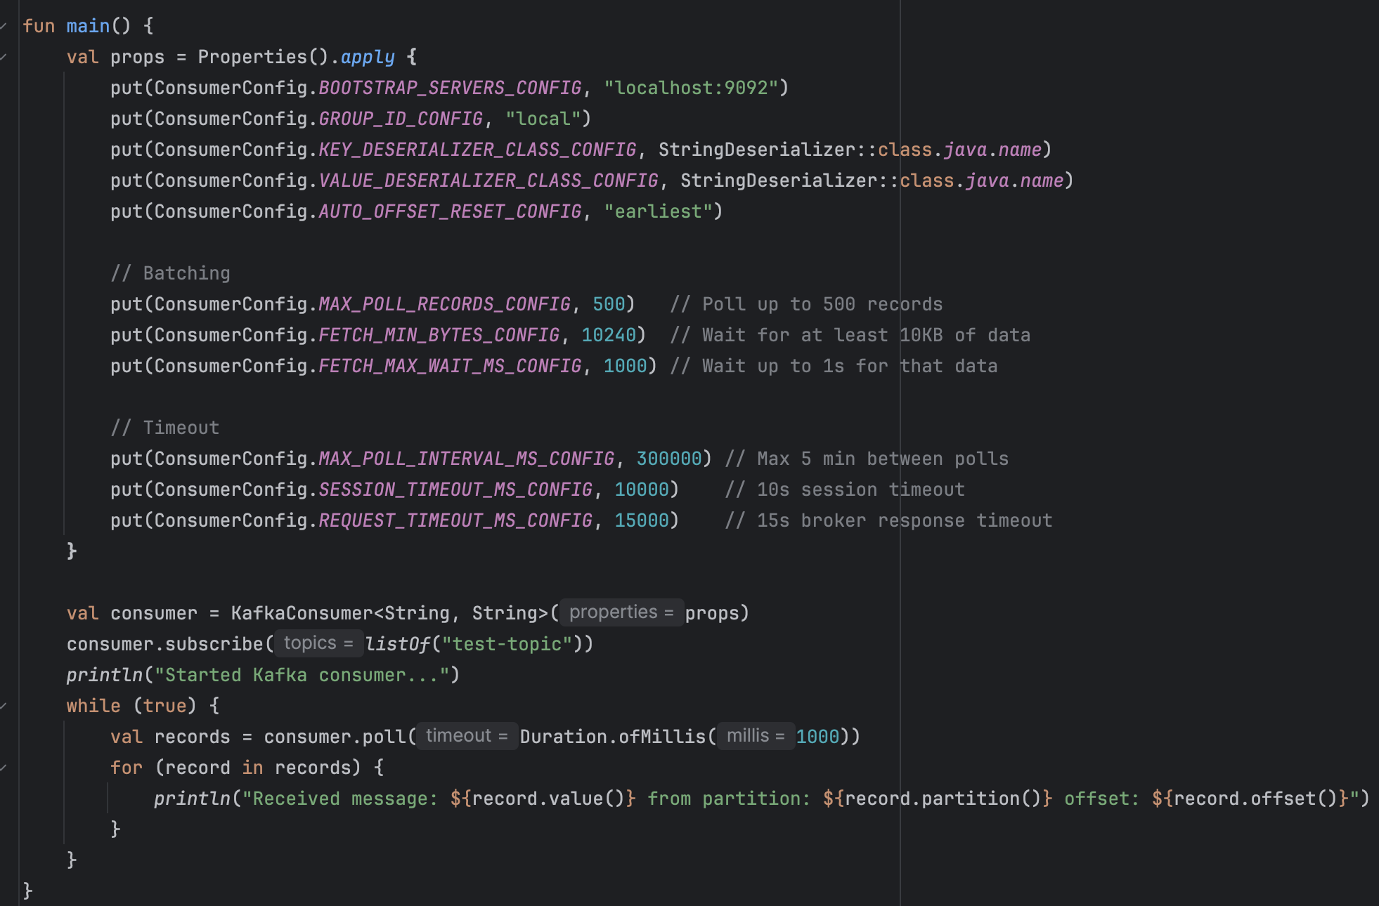
Batching and Timeouts
When and how can I use it?
When?
Almost always
Exception is extremely low latency requirements where messages must be published or processed immediately
How?
Producer
batch.size
linger.ms
request.timeout.ms
delivery.timeout.ms
Consumer
max.poll.records
max.poll.interval.ms
fetch.min.bytes
fetch.max.wait.ms
request.timeout.ms
session.timeout.ms

Slide 18
Deduplication
Exact duplicate messages
Caused by network interruptions, rebalancing, etc…
Idempotence in producer and consumer
Multiple different messages in a batch with the same key
Happens even with log compaction enabled
Process the latest message only and skip any others
Much harder when you mix partitions (don’t mix partitions)
Don’t dedupe tombstones

Slide 19
Deduplication
Benefits
Simple optimization strategy
Reduce number of network requests
Increase throughput
Minimize load on the broker
Preserves ordering
Drawbacks
Only works within a single poll
Not durable across application restarts or crashes
Requires carefully constructed data (compaction, fact topic, no side effects, sensible keys)
Tombstone edge cases, they must be ignored if they aren’t the last update

Slide 20
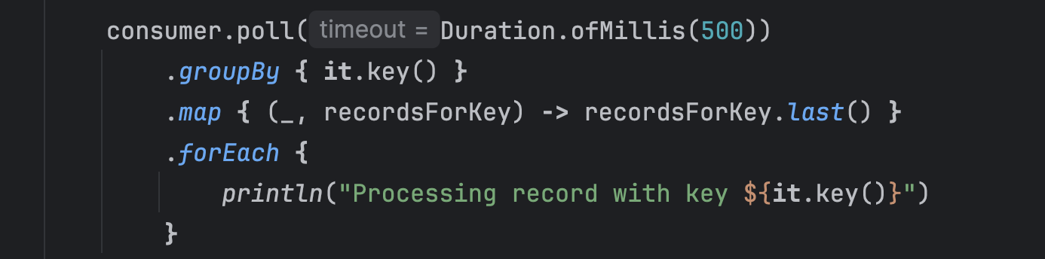
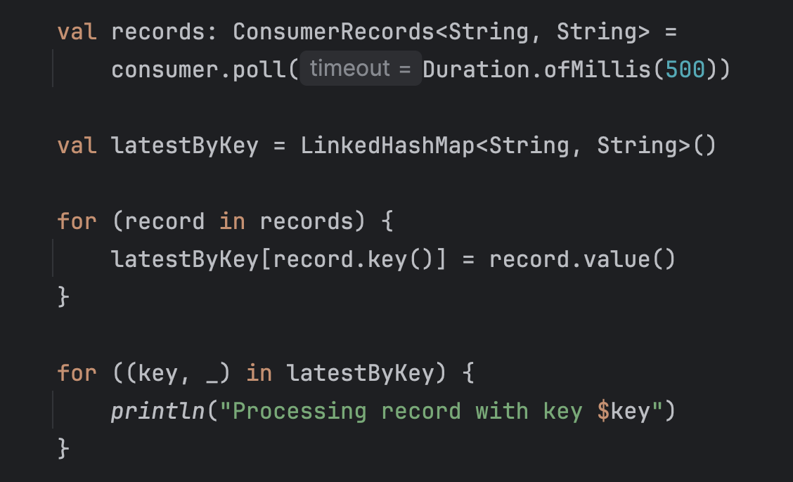
Deduplication
When and how can I use it?
When?
Only when reading from fact topics
Ideally when reading from log compacted topics
Referentially transparent processing
Processing incurs heavy cost (network calls, DB queries, etc…)
Downstream systems aren’t idempotent
How?
Group by the last event for each key
Linked hash map for a more performant mutable option

Slide 21
Fresh Filtering
Like deduplication, but based on something in the value instead of the key
Ignore messages where the field(s) inside the value that you care about aren’t changed
Can be done in memory inside a single batch, but is typically done across multiple polls and partitions via state management

Slide 22
Fresh Filtering
Benefits
Correctness across restarts or crashes
Works across polls, instances, and partitions
Easy to implement a retention policy
Drawbacks
Requires some kind of durable state
Latency and throughput cost for state lookup
Storage overhead
Ordering matters and must be accounted for

Slide 23
Fresh Filtering
When and how can I use it?
When?
Frequent updates to fields you don’t care about or infrequent updates to fields you do
You are the source of truth for the data, or want to guarantee correctness
How?
Topic filtering (loader), a service with a consumer/producer pair that only publishes the data you care about to an internal topic
Durable DB or cache like Postgres, MongoDB, or Redis. Only upsert when incoming data you care about has changed
Embedded DB like RocksDB (via Kafka streams or otherwise)
In memory with hash maps or other data structures

Slide 24
Draining
Consume all the messages on the entire topic faster than anything can produce to it
Result is guaranteed 0 lag
Kafka as a persistent store
Requires compaction or no retention
Send messages into state management
External DB or cache (often too slow)
Embedded DB
In memory

Slide 25
Draining
Benefits
Low latency
Plays nice with parallelism for high throughput
Lightweight and cheap
Resolves backpressure
Drawbacks
Requires state management and rebuilding on startup
Must be careful about always sending related events to the same partition / instance to maintain ordering

Slide 26
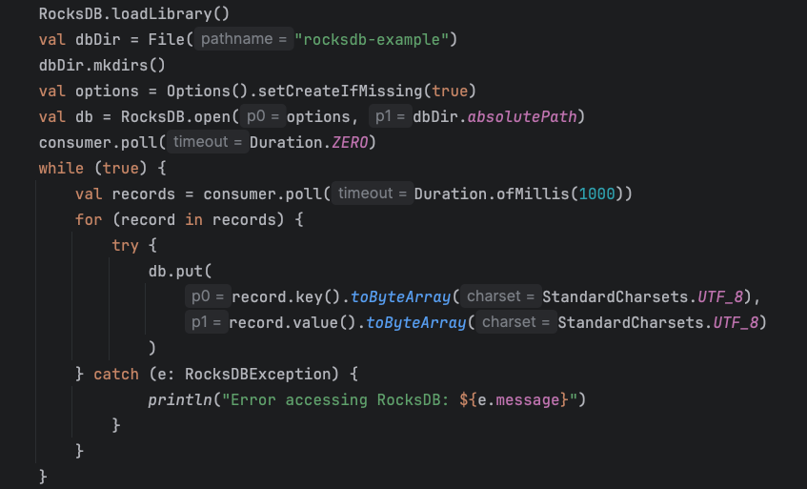
Draining
When and how can I use it? When?
Low latency required
Reading from compacted fact topics makes it a lot easier
The application is not the source of truth, eventually consistent data is okay
Data set is not too large (big data)
How?
Class that implements Partitioner and overrides the partition() method
ProducerConfig.PARTITIONER_CLASS_CONFIG= YourCustomPartitioner

Slide 27
Caching
External caching
For kafka-backed embedded or in-memory caching see “Draining”
Real-time data access and state management
Cache prefetching
Data synchronization

Slide 28
Caching
Benefits
Low latency external read access across systems
High QPS
Easy state management with idempotency
Persistent
Independent scaling
Drawbacks
Memory cost
Eventually consistent
More complexity

Slide 29
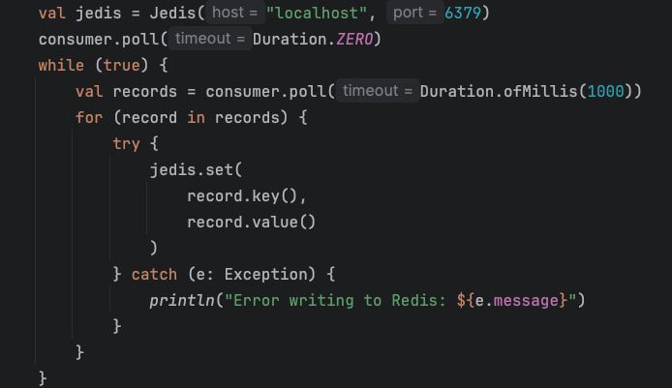
Caching
When and how can I use it? When?
Multiple services need fast access to the same data
Specialized data structures (sorted sets, pub/sub, etc…)
Small enough state to fit in memory
How?
Publish the entire state of your domain instead of deltas

Slide 30
Concurrency
Kafka guarantees order within a partition
Max concurrency = # of partitions
Not thread safe
Frameworks to handle async I/O calls, data transformations, and backpressure (LMAX Disruptor, Kotlin Flows)
Simple parallelism (thread pools) breaks ordering
Allows for custom configurations after single threaded Kafka polling is run (e.g. “step A must finish before step B, but all other steps can be run in parallel”)

Slide 31
Concurrency
Benefits
High throughput
Low latency
Mechanical sympathy and resource utilization
Clear, composable pipelines
Backpressure awareness
Drawbacks
More complexity
Operational tuning and configuration
Extra work to enable observability

Slide 32
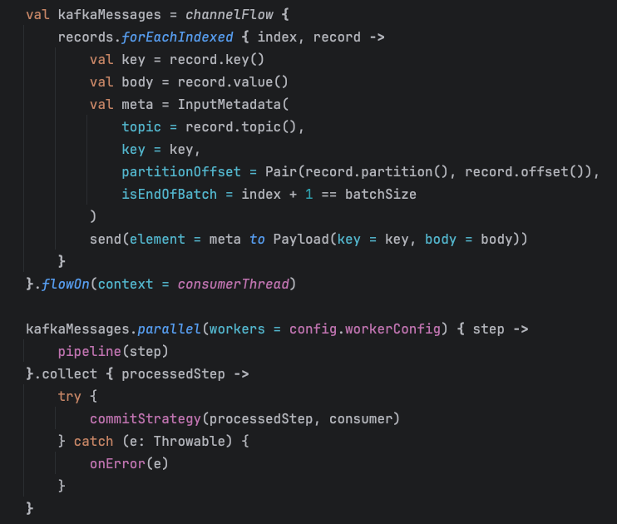
Concurrency
When and how can I use it? When?
Heavy async I/O operations (HTTP API calls, DB queries, etc…)
Very strict latency SLAs
High volume and frequency of events
How?
Publish the entire state of your domain instead of deltas

Slide 33
Compression
Reduces the size of messages
Producer’s responsibility to compression batches per partition
Broker periodically runs decompression to do things like compaction and validation
Consumer’s responsibility to decompress messages

Slide 34
Compression
Benefits
Better disk utilization
Reduced network bandwidth
Higher throughput
Faster replication and compaction
Drawbacks
More CPU usage as broker processes
Extra work for consumers to decompress
Harder to work with encrypted data
Can add latency
Diminishing returns

Slide 35
Compression
When and how can I use it? When?
Most of the time, exception is extremely low latency systems with small messages
Large messages
High volume and frequency of events
Large batch sizes
How?
compression.type config value
Typically use lz4, tweak if needed
Almost never use gzip

Slide 36
Sources
Batching and Timeouts
Deduplication
Fresh Filtering
Hashing
https://www.confluent.io/learn/kafka-partition-key/
https://www.naleid.com/2021/05/02/kafka-topic-partitioning-replication.html
Draining
https://www.confluent.io/blog/okay-store-data-apache-kafka/
Fact Events
https://developer.confluent.io/courses/event-design/fact-vs-delta-events/
Caching
https://redis.io/compare/redis-enterprise-and-kafka/
Concurrency
https://github.com/bengangllipson/pulse
https://medium.com/@chetanshingare2991/kotlin-flows-a-complete-guide-to-asynchronous-streams-in-android-e790a6a9e116
https://lmax-exchange.github.io/disruptor/
Compression
https://www.confluent.io/blog/apache-kafka-message-compression/
https://www.naleid.com/2021/05/02/kafka-topic-partitioning-replication.html
Schema Validation
https://docs.confluent.io/platform/current/schema-registry/schema-validation.html#enabling-sv-on-a-topic-from-the-confluent-cli
Provenance
https://www.ibm.com/think/topics/data-provenance
Compaction
https://www.naleid.com/2023/07/30/understanding-kafka-compaction.html

